Slide 1

ONCE UPON A TIME….
ALLIE CARLILE, BREVIN OWENS, & ANDREW SWIGART

Slide 2
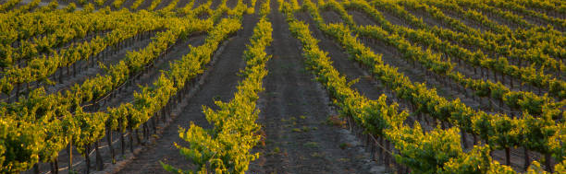
there was a family vineyard & winery…
The parents:
The apprentice:
The children: Michel-Laurent, Clara, & Nathan (take the hint)

Slide 3
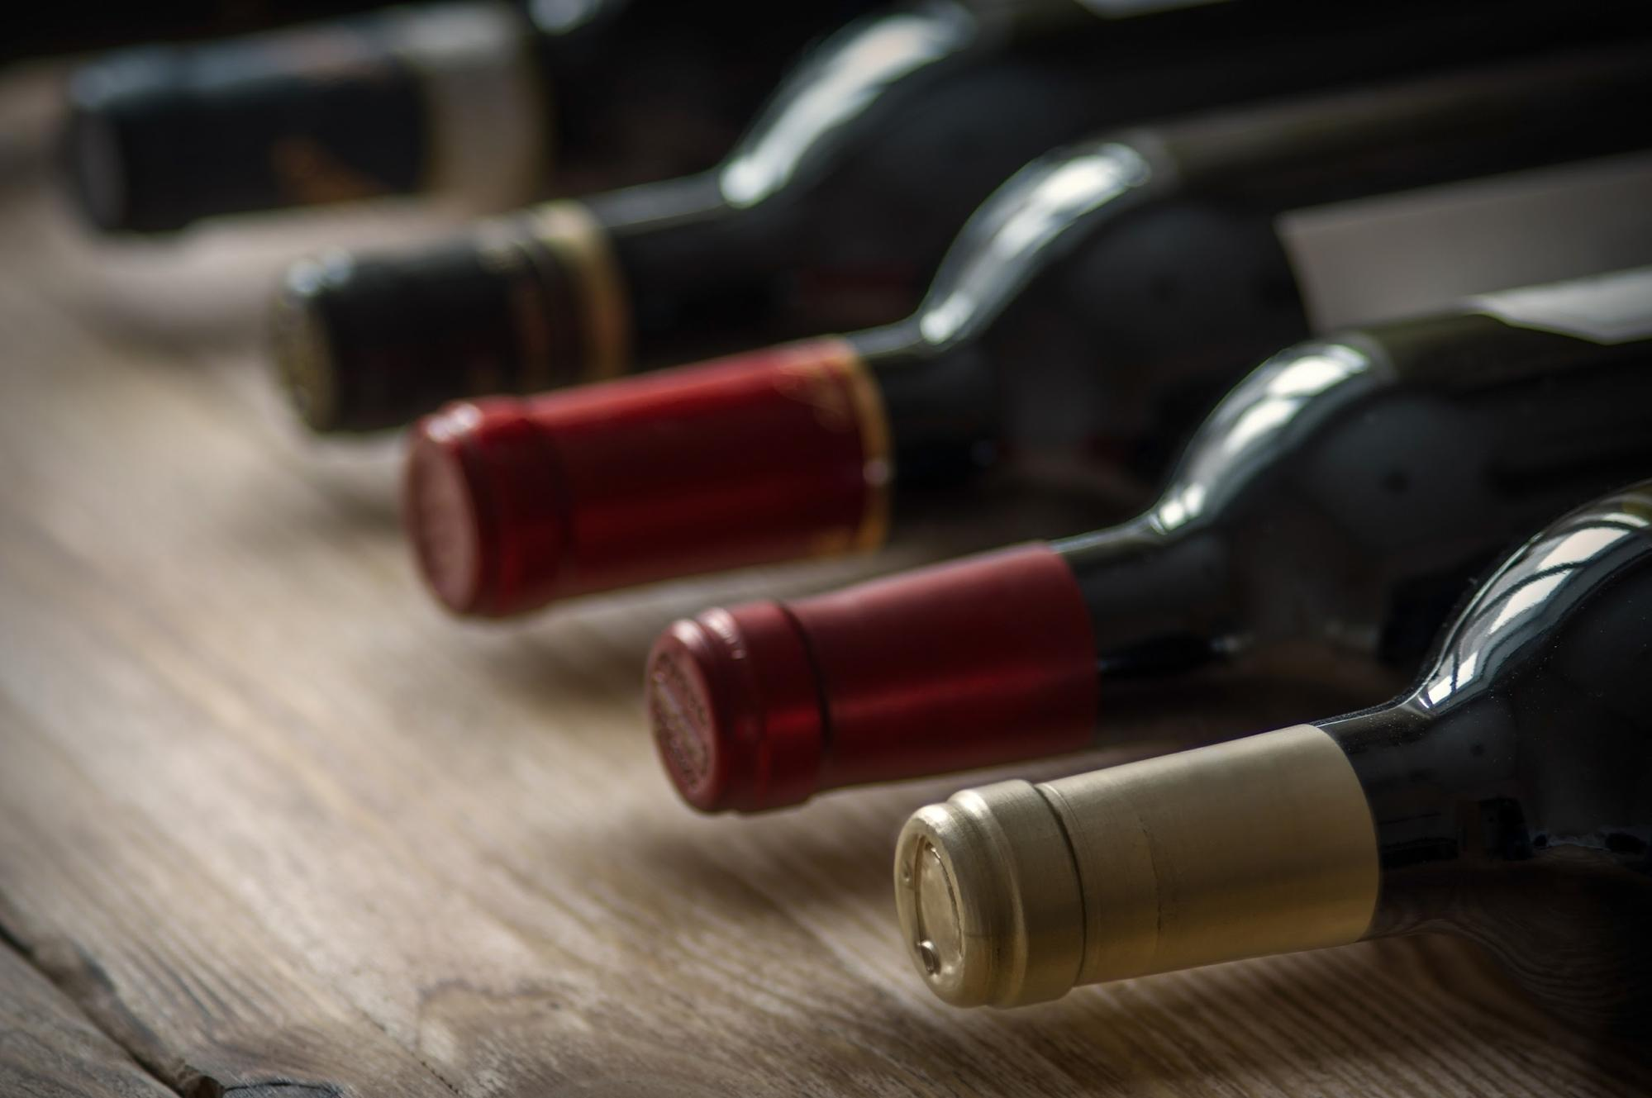
“…The greatest wine? Blech, you’ve ruined me!...”

Slide 4
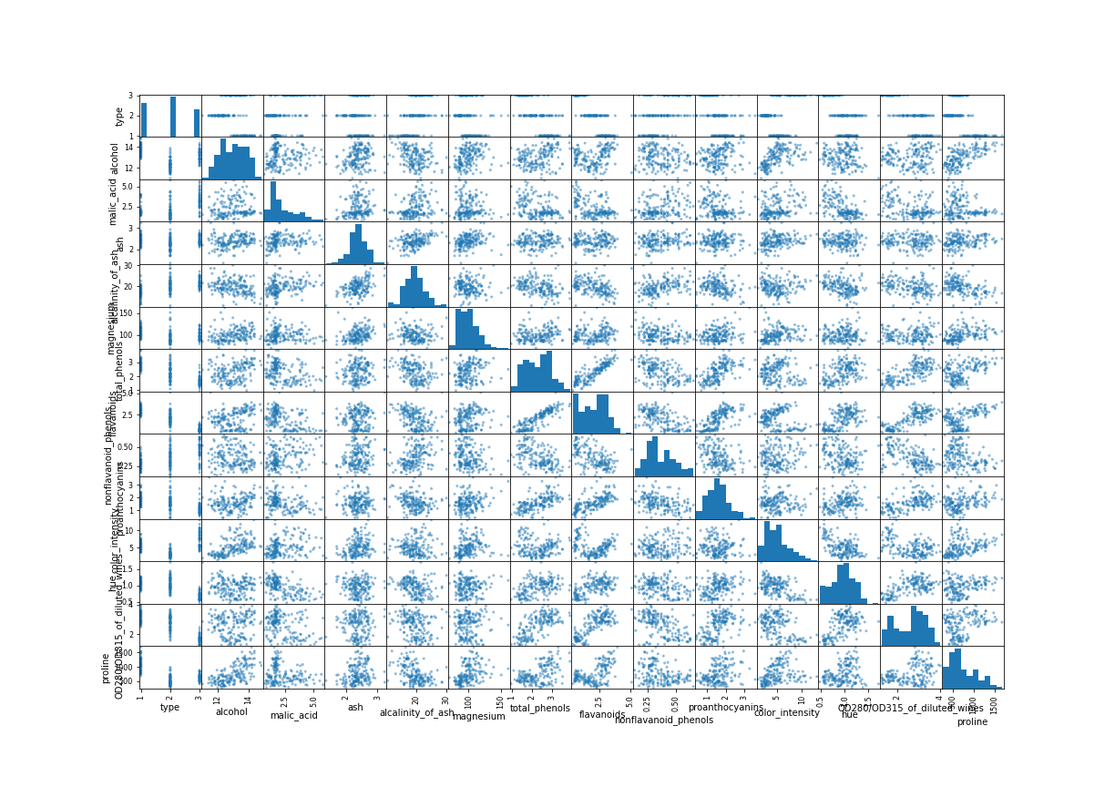
The Dataset,

