Slide 1
the US Refugee crisis in 3 visualizations
By Allie Carlile,
Kirsten Larson,
& Andrew Swigart

Slide 2
Project Framework:
This project examines U.S. immigration from 1990-2021, focusing on affirmative and defensive asylum seekers. Using a line graph, a grouped bar chart, and complex line chart, we can see that the numbers of people entering the U.S. seeking asylum are unexpectedly low.

Slide 3
Refugees: 5 protected grounds
RACE
RELIGION
NATIONALITY
POLITICAL OPINION
MEMBERSHIP IN A PARTICULAR SOCIAL GROUP

Slide 4
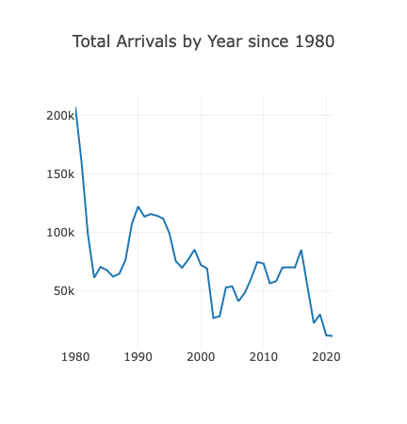
Path 1: Refugee Program since The refugee Act of 1980 passed
Insert table of refugee arrivals

Slide 5
Asylum Seekers, individuals, and refugees
Refugees- In a third country, seeking migration, qualifies under 5 protected grounds. | Individuals – Not within US borders, not seeking migration, not seeking to change visa status.
Asylum Seeker-Defensive- Within the US border, in deportation, seeking asylum as defense against deportation. | Asylum Seeker: Affirmative – Within the US border, fits within 5 protected grounds, seeks to change status.

Slide 6
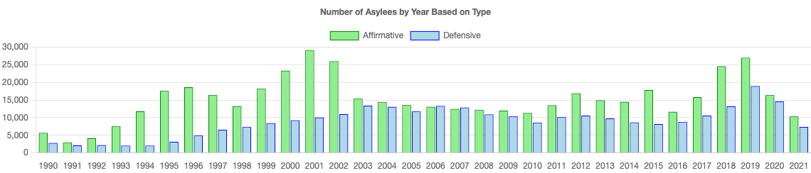
Path 2: Individuals seeking asylum

Slide 7
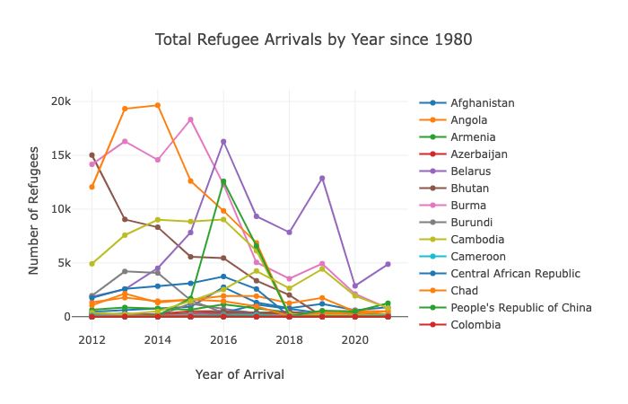
Where do the current refugees come from?

Slide 8
Coding project remarks
SQLite Database
Into Flask-CORS
D3.JS

Slide 9
Summary & questions
Data Citation:
https://usafacts.org/data/topics/people-society/immigration/
https://www.dhs.gov/immigration-statistics/refugees-asylees
https://www.cfr.org/timeline/us-postwar-immigration-policy
https://www.cfr.org/backgrounder/how-does-us-refugee-system-work-trump-biden-afghanistan?gclid=Cj0KCQjwkOqZBhDNARIsAACsbfKrKsvXmamp2Fe6quIkaAjem-jj9iEUJzhlOR_MhvuWwD5mFHAjrPYaAqFuEALw_wcB

