Slide 1

Notes:
- Name, course, one-sentence goal
- Two systems: fine-tuned MatCha vs OpenCV + OCR
- Every choice made on validation; test run once
Hi Dr. Cruz. My project takes an image of a vertical bar chart and turns it into a table, with one row per bar: the bar's label and its value. That's the Benetech task from Kaggle. I fine-tuned MatCha, a vision-language model that looks at the chart image and writes the table out as text. I compared it with a classic computer-vision pipeline I built with OpenCV and Tesseract OCR, which doesn't learn anything from our charts. I made every choice using the validation set, and I ran the test set only once, at the very end.
Q: Why only vertical bar charts?
A: That was the scope I set in the proposal. Vertical bars are the largest chart type in the Benetech data, and limiting it to one type kept the baseline buildable in one semester.

Slide 2
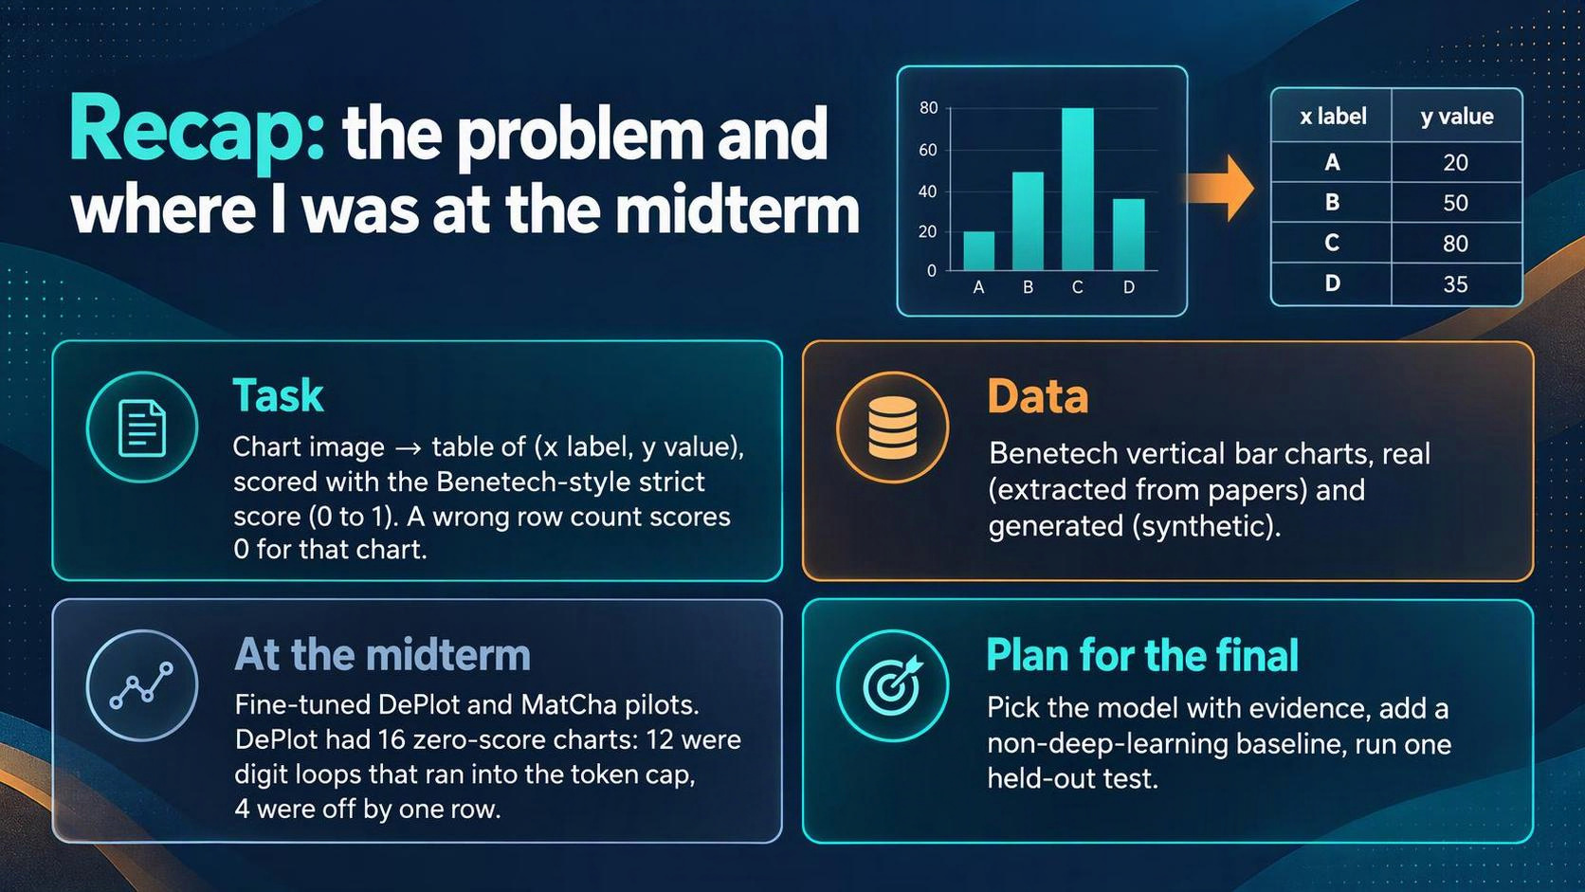
Notes:
- Input: image; output: label/value rows
- Strict score: wrong row count = 0
- Midterm problem: digit loops, 12 of DePlot's 16 zeros
Quick recap. The input is a chart image, and the output is a small table. I score it with the strict score from the competition. It compares the predicted labels with the true labels as text, and the predicted values with the true values as numbers, and gives a score from 0 to 1. If the model writes the wrong number of rows, that chart gets a 0, so getting the row count right matters a lot.
At the midterm I had fine-tuned DePlot and MatCha on a small pilot set, and the main problem was what I called digit loops. The model would start a number like 0.3333 and keep writing threes until it ran out of tokens, so the table never finished. Twelve of DePlot's 16 zero-score charts were loops, and the other four were off by one row. So the plan for the final was to fix the loops and show that the fix worked, add a baseline that doesn't use deep learning, and run the test set once at the end.
Q: What exactly does the strict score measure?
A: For the labels, it counts how many characters you'd have to change to turn the predicted labels into the true ones. For the values, it measures how far off they are compared with just guessing the average. It averages the two. If the row count is wrong, the chart gets 0. Backup slide B1 has the formula.
Q: Why not a softer metric?
A: The strict one is the competition's metric, and it punishes the mistake I care most about, which is getting the number of bars wrong.

Slide 3
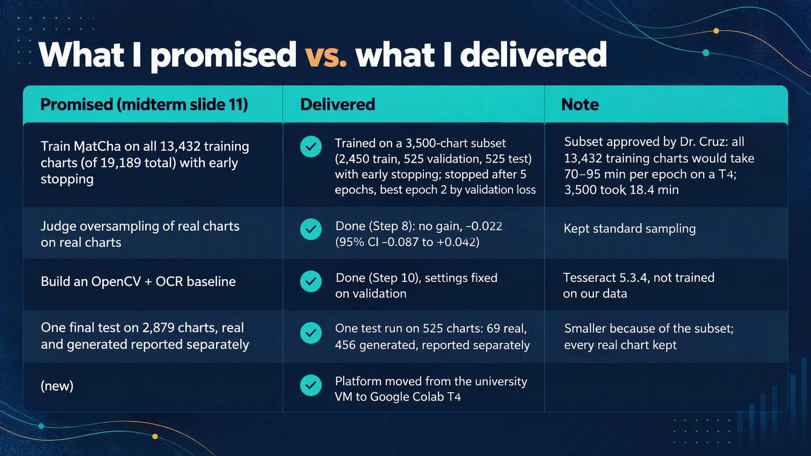
Notes:
- 4 promises, all delivered, 2 changed in size
- 3,500 subset: approved; 70-95 min/epoch vs 18 min
- Test: 525 charts, run once
Here's what I said I'd do at the midterm, and what I actually did. I said I'd train MatCha on all 13,432 training charts, out of 19,189 charts in total. On a T4 GPU that would have taken 70 to 95 minutes per epoch, so with your approval I used a 3,500-chart subset instead. That brought an epoch down to about 18 minutes and left time for early stopping. It's 2,450 charts for training, 525 for validation and 525 for test. I said I'd test oversampling the real charts, and I did: it didn't help, so I kept normal sampling. I built the OpenCV and OCR baseline. And I ran the final test once, on 525 charts instead of 2,879, because of the subset. I kept every real chart, which gives 69 real test charts, and I report real and generated charts separately, like I said I would. One other change: I moved from the university VM to Google Colab with a T4 GPU.
Q: Doesn't a smaller test set weaken the result?
A: It makes the interval wider, so I report the interval. On all 525 charts MatCha beats the baseline by 0.44, with a 95% interval of 0.40 to 0.48. On the 69 real charts the interval is wider, 0.48 to 0.69, but even its low end is far above zero.
Q: How did you build the subset?
A: I started from the frozen splits and removed every chart the leakage check flagged. I kept every real chart that was left, because they're scarce and they're the evidence that decides things. Then I filled the rest with generated charts picked at random with seed 42. Each chart stayed in the split it was already in, so nothing could move from test into training.

Slide 4
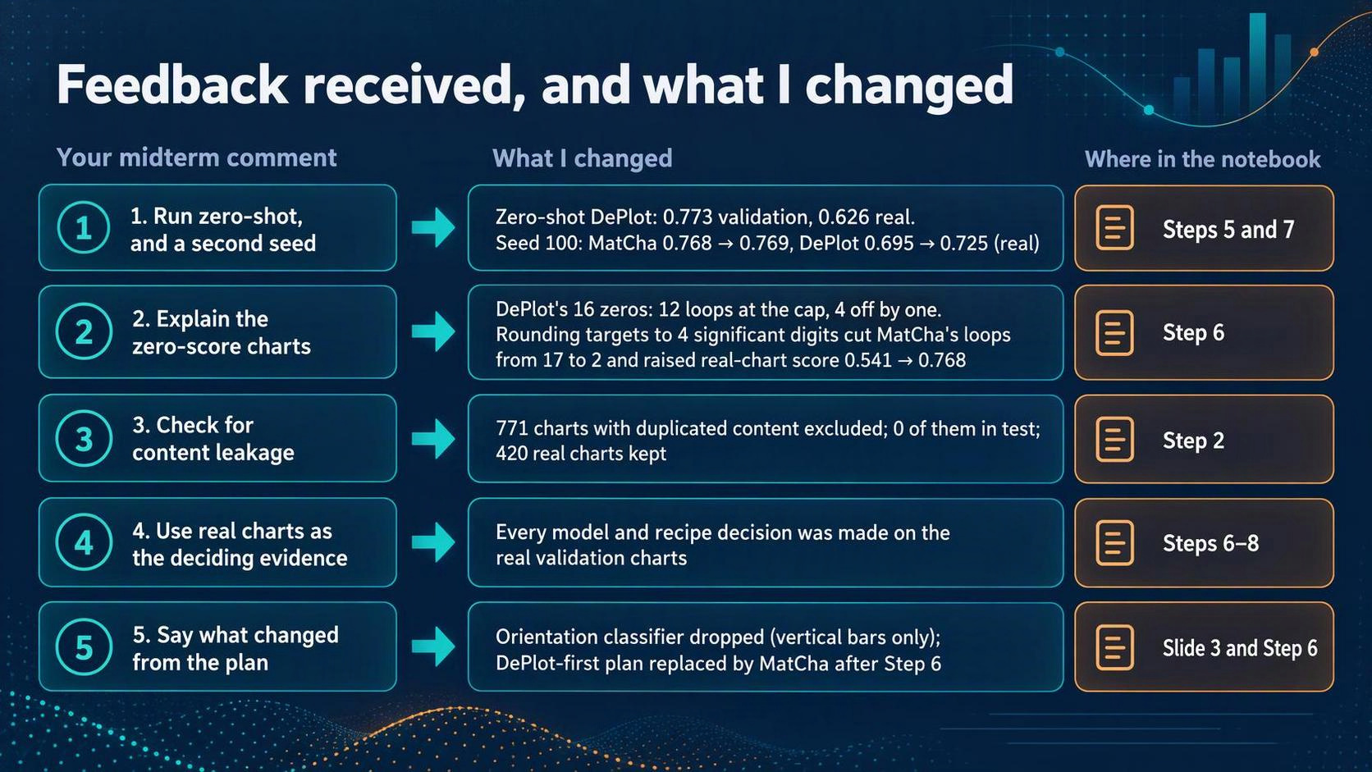
Notes:
- 5 comments → 5 changes, each with a notebook step
- Biggest one: zeros were loops → rounding fixed them
- Then: let me show you in the code
You gave me five comments at the midterm, and each one became a step in the notebook. First, you asked for a zero-shot run and a second seed. Zero-shot DePlot, with no training at all, scored 0.773 on validation but only 0.626 on real charts. With a second seed, MatCha's real-chart score moved from 0.768 to 0.769, so the result holds up. Second, you asked me to explain the zero-score charts. Twelve of DePlot's 16 zeros were digit loops, so I rounded the training targets to four significant digits. On the real pilot charts, MatCha went from 0.541 to 0.768, and loops dropped from 17 to 2. Third, you asked about content leakage. I found 771 charts that duplicated charts in another split and removed them, and none of them came from the test set. Fourth, you asked me to let the real charts decide, so every choice was made on the real validation charts. And fifth, you asked me to say what changed from the plan: I dropped the orientation classifier and switched from DePlot to MatCha. Let me show you this in the code.
Q: How did you detect content leakage?
A: I compared every chart with every chart in the other splits in four ways: the same chart ID, the same data table, nearly the same image using a perceptual hash, and, for real charts, the same source, like the same title or the same labels. If two matching charts were in different splits, I removed the one in the earlier split, so the test set stayed whole. I also looked at the 59 flagged real charts by eye before removing any.
Q: Why round to 4 significant digits and not fewer?
A: Four digits keeps almost all the information. Even if the model wrote the rounded values perfectly, the best possible score on the real charts would still be 0.992. And it gets rid of the long decimals that caused the loops. Whole numbers aren't changed.
Q: Doesn't rounding the targets hurt accuracy, since you score against full precision?
A: In theory a little, because I still score against the full-precision tables. In practice the best possible score with rounding is 0.992, far above what the model actually reaches.

Slide 5

Notes:
- One notebook, steps in order
- Everything before Step 12 = train + validation only
- Test scored once
This is the whole notebook in one line. Each step answers one question, in the order I did the work. Everything up to Step 11 uses only the training and validation charts. The test set is scored once, in Step 12, with settings I froze before it ran. Step 13 then looks at where each system went wrong on that test run.
Live Code Walkthrough then continue from slide 21
Live code walkthrough: speaker notes (slide 5)
Notebook top to bottom, about 6:30
Ctrl+F the search word to jump to each cell
Point at the output, not just the code
[0:00 - top of notebook]
This is the notebook, top to bottom, in the order I did the work. Each step has a markdown cell that says why it’s there and what output to expect, followed by the code. I’ll go through the most important parts.
[0:20 - 2b leakage checks]
Step 2 answers your leakage comment. This cell fingerprints every chart three ways: its data table, its text, and a perceptual hash of the image. The hamming function counts how many bits two image hashes differ by; four or fewer means near-duplicate. cross_split_groups then keeps only matches that fall in two different splits, because a duplicate inside the training set isn’t leakage.
[0:50 - 2f final exclusions]
After I reviewed the flagged real charts by eye, 2f builds the final exclusion list and runs the checks again on what’s left. This line shows the result: identical tables left across splits, zero.
[1:10 - Step 3]
Step 3 draws the subset from the charts that are left: every real chart is kept, generated charts are picked at random with seed 42, and no chart changes split. That gives 2,450, 525 and 525.
[1:30 - 6c-i rounded targets]
This is the fix for the zero-score charts. round4_policy is the rule: whole numbers stay as they are, and everything else is rounded to four significant digits. In the examples, 92.3333 repeating becomes 92.33. This only changes the training targets. Scoring is still against the original full-precision tables.
[1:55 - 6e comparison]
And here’s the result. Approach A is the old setup, B adds a repetition penalty, C rounds the targets, and D does both. On the 66 real charts, MatCha goes from 0.541 to 0.768 with rounding, and loops drop from 17 to 2. D scores the same as C, so the penalty isn’t needed. That’s why the final recipe is C.
[2:40 - Step 8 result]
Step 8 tested showing the real charts three times as often. The difference is minus 0.022, and the interval includes zero, so there’s no evidence it helps. The final training uses normal sampling.
[3:00 - 9b Phase B training]
Step 9 is the full training run. For early stopping I wrote this callback, EarlyStopFromHistory. At the end of each epoch it reads the validation loss from the trainer’s history, saves the best model to Drive, and stops after three epochs without improvement. Because it reads the saved history, it gives the same answer if Colab disconnects and the run resumes. In the EarlyStop lines you can see the best epoch was 2, followed by three epochs without improvement, then the stop.
[3:20 - 9d loss curves]
The graph shows the same thing: training loss keeps falling, but validation loss is lowest at epoch 2. That’s overfitting, and epoch 2 is the checkpoint I used on test.
[3:40 - 10a OpenCV + OCR baseline]
This is the baseline. find_bars only uses OpenCV. It marks the pixels that differ from the background color, removes long thin lines like axes and gridlines with a morphological opening, and keeps shapes that look like solid rectangles of about the same width. y_calibration uses Tesseract to read the axis numbers and fits a straight line from pixel height to value. It uses a robust fit, so one misread number doesn’t throw it off. x_labels reads the text under each bar at three angles and keeps the angle that reads the most text. Down here it’s run on four validation charts, and the red boxes are the bars it found. This one works well. These two produce no table because it never found the bars, and that’s the most common way it fails across the whole set.
[4:40 - 11a token audit]
Before the test run, I checked the token limits again using only training and validation charts. The longest rounded target is 647 tokens, under the 864 limit, and both validation charts that hit the limit were loops. So the limit stayed at 864.
[5:00 - 12a freeze manifest]
12a protects the test run. It writes a manifest with everything that could change the result: a hash of the model file, the decoding settings, the baseline settings, the scorer version and the list of 525 test IDs. Then it runs the exact test code on eight validation charts. All ten checks pass, and the outputs match the earlier validation run exactly. The test cells after this refuse to run if anything in the manifest changes.
[5:40 - 12d score the test set]
12d scores both systems with the same function and the same strict score, against the full-precision test tables. In the table, MatCha scores 0.936 on real charts and the baseline 0.349. Below that is the paired bootstrap: ten thousand resamples of the per-chart differences, giving a lead of 0.44 overall with an interval of 0.40 to 0.48.
[6:10 - 13a failure categories]
Step 13 only reads the saved test files. The category function puts each chart into one group per system: no usable table, too few rows, too many rows, high-scoring, or right row count with weaker labels or weaker values. MatCha’s mistakes are mostly row-count errors, and the baseline’s are mostly charts where it never found the bars. I’ll go back to the slides for the details.
Q: Can you show me where the strict score is computed?
A: It’s in chart_eval.py, benetech_strict_score. It averages a label score and a value score, and each is zero if the row count doesn’t match. 12d calls it through tp.score_predictions.
Q: Why a robust fit for the y-axis?
A: OCR sometimes misreads one tick number, like 50 as 5. A plain least-squares line would be pulled off by that one point; the robust fit ignores a single outlier.
Q: What would happen if you re-ran 12b now?
A: It would see that the predictions exist with the same manifest and do nothing. If the settings were different, it would stop with an error. That’s the write-once rule.
Q: Why greedy decoding?
A: It’s deterministic, so the same checkpoint gives the same table, which makes the comparisons fair. The loops were the risk with greedy, and rounding fixed them.
Q: Was the test set touched at all before Step 12?
A: Only by the Step 2 leakage check, which compared test charts with the other splits to find duplicates. Nothing was scored on test before Step 12.

Slide 6


Slide 7
Why the models scored zero: loops, and the rounding fix (Steps 4–7)
Approach | Strict | Zero-score charts | Loops
A: full precision, greedy | 0.541 | 27 | 17
B: full precision + repetition penalty 1.05 | 0.608 | 22 | 10
C: rounded to 4 significant digits, greedy | 0.768 | 10 | 2
D: rounded + penalty 1.05 | 0.768 | 10 | 2
• Second seed (Step 7): MatCha C 0.768 → 0.769 on real charts.
• Zero-shot DePlot (Step 5): 0.626 on real charts; fine-tuned DePlot C: 0.695.
[Screenshot to add: output of cell "6e comparison of A, B, C and D" and one looping prediction (for example 92.3333333…) from the 4c or 6d output.]
Notes:
- Loop = endless digits until the 864 cap
- Rounding the targets fixed it; penalty didn't add anything
- Second seed: same answer
This step is where the biggest improvement came from. A loop is when the model writes something like 92.3333 and keeps writing threes until it hits the 864-token limit. The table never finishes, so the chart scores zero. I tried two fixes. A repetition penalty, which discourages the model from repeating itself, helped a little. Rounding the training targets to four significant digits helped a lot: MatCha went from 0.541 to 0.768 on the real charts, and loops went from 17 to 2. Once the targets were rounded, adding the penalty made no difference, so I left it out. With a second seed I got 0.769, basically the same.
Q: Why did long decimals cause loops?
A: My guess, which I haven't proven, is that the model learns that digits in long decimals tend to repeat, and with greedy decoding a small difference can push it into repeating forever. What I did see is that removing the long decimals removed almost all the loops.
Q: Why MatCha over DePlot?
A: With rounded targets, MatCha scored 0.768 on real charts against DePlot's best of 0.710, and it stayed ahead with the second seed.

Slide 8
Oversampling real charts did not help (Step 8)
• Only 287 of 2,450 training charts (12%) are real. Oversampled run: real charts drawn 3× as often (about 28.5% real).
• Same number of updates, same everything else; only the sampling changed.
64 real validation charts | Standard | Oversampled 3× | Difference (95% interval)
Strict score | 0.8693 | 0.8476 | −0.022 (−0.087 to +0.042)
• Decision: keep standard sampling. Fair wording: no evidence it helps (not "it hurts").
[Screenshot to add: the "Step 8 result" markdown table, or the output of cell "8c score and compare".]
Notes:
- Real charts are 12% of training
- 3x oversampling, everything else equal
- Interval includes 0 -> no evidence it helps
Only 12% of the training charts are real, so I tested whether showing the real charts three times as often would help. Both runs had the same number of training updates and the same settings; the only difference was how the charts were sampled. On the 64 real validation charts, the oversampled run scored 0.022 lower, but the 95% interval goes from minus 0.087 to plus 0.042, so it includes zero. That means I have no evidence it helps, and I can't say it hurts either. So I kept normal sampling.
Q: Is one seed and 2 epochs enough?
A: It's a limitation. It's one seed and two epochs, and the decision rests on 64 real charts, which is why the interval is so wide.

Slide 9
Full MatCha training and the checkpoint choice (Step 9)
• 2,450 charts, seed 42, learning rate 2e-5, batch 2 × accumulation 2, fp16, 18.4 min per epoch.
• Early stopping: stop when validation loss hasn't improved by 0.001 for 3 epochs.
• Validation loss by epoch: 0.4204, 0.4084, 0.4092, 0.4104, 0.4226 → stopped after epoch 5, kept epoch 2.
• Validation strict score of epoch 2: real 0.8602, generated 0.9651.
• Limitation: chosen by loss, not by strict score; I don't claim epoch 2 has the best strict score.
[Screenshot to add: phaseB_loss_curves.png (the 9d output; also on Drive in V3_4_7_work/).]
Notes:
- Rule set before training: lowest validation loss
- Epoch 2 lowest, then rises 3 times -> stop
- Limitation: loss is not the strict score
I set the rule before training: keep the checkpoint with the lowest validation loss on all 525 validation charts, and stop once the loss hasn't improved for three epochs in a row. Training loss kept going down, but validation loss was lowest at epoch 2 and then went up three times in a row. That's overfitting, so training stopped after epoch 5 and I kept epoch 2. One limit: validation loss is measured while the model is given the correct previous tokens at each step, but the strict score grades the whole table the model writes on its own. I only scored epoch 2 with the strict score, so I can't say it's the best epoch by that measure.
Q: Why didn't you score every epoch with the strict metric?
A: Time. I set the rule in advance, and epochs 3 and 4 were within 0.002 of epoch 2 on loss. Scoring every epoch is the next thing I'd do.
Q: What's teacher forcing?
A: When the loss is calculated, the model is given the true previous tokens at every step instead of its own output. So the loss measures next-token prediction, not the full table the model would write by itself.

Slide 10
The OpenCV + OCR baseline (Step 10)
• Find the bars (OpenCV: colour mask, remove lines, keep solid rectangles of typical width) → read the y-axis numbers (Tesseract), fit pixel height to value → read the x labels (Tesseract at 0°, 45°, 90°) → write rows.
• Nothing trained on our data; Tesseract is a pretrained OCR engine used as is.
• Four settings tuned on 128 validation charts with a rule fixed in advance: background tolerance 35, minimum fill 0.6, width tolerance 0.4, grey bars off.
• Validation: real 0.2884, generated 0.5948. Most zeros: no bars found, no value scale, or the wrong number of bars.
• When it gets past finding the bars, it is accurate: 0.839 (real) and 0.865 (generated) on the charts it scored above zero.
[Screenshot to add: one of the annotated charts from cell "10a OpenCV + OCR baseline" (bars outlined in red), plus step10_scores_and_failures.png from Drive V3_4_7_work/ocr_baseline/.]
Notes:
- Classic pipeline: find bars, read axis, read labels
- Tuned on validation only, rule fixed first
- Fails at step one: finding the bars
The baseline is the classic way to do this, with no learning on our charts. OpenCV finds the bars by looking for solid colored rectangles that are all about the same width. Tesseract reads the numbers on the y-axis, and I fit a straight line from pixel height to value, so each bar's value comes from where its top sits on that line. Then Tesseract reads the label under each bar. I tuned four settings on validation charts only, and I wrote down how I'd pick the winner before running it. It scored 0.29 on real charts and 0.59 on generated ones. Most of its zeros come from the first step: it didn't find the bars, or it couldn't read the scale. On the charts where it got past that, it scored about 0.84 on real and 0.87 on generated.
Q: How did you come up with these numbers?
A: I started with values I picked by hand while building the baseline on a few validation charts. Then, before running anything, I chose two values for each of four settings: background tolerance 20 or 35, fill 0.6 or 0.8, width tolerance 0.25 or 0.40, and grey bars on or off. That's 16 combinations. I ran all 16 on 128 validation charts, 64 real and 64 generated, and I had already written down how I'd pick the winner: the highest average of the real score and the generated score, with ties going to whichever did better on real. The winner was 35, 0.6, 0.4 and grey off. It scored 0.288 on those 64 real charts and 0.654 on the 64 generated ones. The test set wasn't used at all for tuning.
Q: What units are 35, 0.6 and 0.4 in?
A: None of them are pixels or any physical unit. 35 is a color difference on the usual 0 to 255 scale for each color channel, so a pixel has to be at least that far from the background color to count as part of a bar. 0.6 is a fraction: a shape has to fill at least 60 percent of its bounding box to count as a solid bar, which screens out text and thin lines. 0.4 is also a fraction: a bar's width has to be within 40 percent of the median bar width on that chart. Because the last two are fractions, the same setting works on a small chart or a large one.
Q: How does the 35 actually work? What does 0 to 255 mean?
A: Each pixel has three numbers, red, green and blue, and each runs from 0 to 255. 0 means none of that color and 255 means all of it, so (0, 0, 0) is black and (255, 255, 255) is white. That's brightness, not saturation. The three numbers are only equal for black, white and greys. Any actual color has different numbers: pure red is (255, 0, 0), and a typical blue bar might be something like (31, 119, 180). So the code checks each of the three separately against the background color and uses the biggest gap. For that blue bar on a white background, the gaps are 224 for red, 136 for green and 75 for blue. The biggest is 224, which is well over 35, so the pixel counts as part of a possible bar. A light grey pixel at (230, 230, 230) on white is only 25 away, so it's treated as background. And the background isn't always white. The code uses the median color of the image, so a chart with a light grey or tinted background works the same way.
Q: Does Tesseract always rotate to 0, 45 and 90 degrees?
A: No, Tesseract doesn't do that on its own. That part is my code. X-axis labels are usually flat, slanted or vertical, and while I was building the baseline the slanted and vertical ones weren't getting read. So the code cuts out the strip under the x-axis, rotates it by 0, 45 and 90 degrees, runs Tesseract on each version, and keeps the one that reads the most text with the highest confidence. I didn't tune those angles. They're just the three common label orientations.
Q: Why did you leave grey bars off?
A: Because the grey setting is a swap, not an add-on. With it off, the baseline keeps colored bars and dark fills, so it misses light grey bars. With it on, it keeps light and mid grey instead, but then dark and black bars get treated like text and thrown out. If you allow both, it starts picking up text, axis lines and gridlines as fake bars. In the tuning run, grey on raised the best real score to 0.329, but the generated score dropped to somewhere between 0.18 and 0.42, so the rule picked grey off.
Q: Is this a fair baseline when Tesseract is pretrained?
A: Yes, as long as I'm clear about it. Tesseract is pretrained, but nothing in the baseline was trained on our charts.

Slide 11
Token audit and the test-run safeguards (Steps 11–12a)
• Token audit (training and validation only): longest rounded training target 502 tokens, validation 647; nothing over the 864 generation cap. Both validation cap hits were loops, so the cap stayed at 864.
• Freeze manifest written before the test run: checkpoint hash, decoding, baseline settings, scorer version, the 525 test IDs.
• Preflight on 8 validation charts: 10 of 10 checks passed, identical to the earlier validation outputs.
• Write-once: the test cells refuse to run if any setting changed.
[Screenshot to add: step11b_token_lengths.png and the preflight output of cell "12a freeze manifest and preflight" (the PASS lines).]
Notes:
- Midterm limits came from an audit that included test lengths
- Re-audited on train + val only: 864 fits
- Then froze everything and ran a preflight
At the midterm I mentioned that my token limits came from looking at the whole dataset, including the test set. So before the test run, I redid that check using only training and validation charts. With rounded targets, the longest table is 647 tokens, well under the 864 limit. The two validation charts that hit the limit were both loops, not real long tables, so I kept 864. Then I wrote a freeze file with every setting that could change the result, including a hash of the model file and the list of test chart IDs, and ran a preflight on eight validation charts. All ten checks passed, and only then did I start the test run.
Q: Why does it matter that the old audit saw test lengths?
A: Picking a setting from test data is a mild form of leakage. Redoing it with training and validation only means nothing from the test set shaped that setting.

Slide 12
Held-out test results (Step 12)
Test charts | MatCha (fine-tuned) | OpenCV + OCR baseline | Difference, MatCha − baseline (95% bootstrap interval)
Real (69) | 0.936 (2 zero-score charts) | 0.349 (41 zero-score) | +0.587 (+0.481 to +0.693)
Generated (456) | 0.969 (4 zero-score) | 0.550 (171 zero-score) | +0.420 (+0.380 to +0.460)
All (525) | 0.965 (6 zero-score) | 0.523 (212 zero-score) | +0.442 (+0.405 to +0.480)
• Per chart: MatCha better on 498, baseline better on 23, tied on 4.
• Row count right: MatCha 98.9%, baseline 59.6%. MatCha hit the 864-token cap 0 times.
• Validation → test: MatCha real 0.860 → 0.936, generated 0.965 → 0.969. The result held.
[Screenshot to add: the output tables of cell "12d score the test set" (the scores table and the bootstrap table), or rebuild the table above in Slides.]
Notes:
- One run, frozen settings
- MatCha 0.94 real / 0.97 generated vs baseline 0.35 / 0.55
- Paired difference + bootstrap: real, generated, all; all far from zero
- Held from validation
This is the only test run, with every setting frozen beforehand. On the 69 real charts, MatCha scores 0.936 and the baseline 0.349. On the 456 generated charts, it's 0.969 against 0.550.
The main comparison is the paired difference. For each test chart I take MatCha's score minus the baseline's score on that same chart, and then I bootstrap those per-chart differences ten thousand times to get a 95% interval.
I did that separately for real and generated charts, like everywhere else in the project. On the real charts, MatCha is ahead by 0.59, with an interval of 0.48 to 0.69. On the generated charts it's ahead by 0.42, with an interval of 0.38 to 0.46. On all 525 together it's 0.44, from 0.40 to 0.48. Even the low end of each interval is well above zero, so MatCha's lead doesn't depend on which charts happened to land in the test set. Chart by chart, MatCha did better on 498, worse on 23, and tied on 4. The validation results also held up on test. The real-chart score actually went up, from 0.86 to 0.94.
Q: Why did the real-chart score go up on test?
A: I don't know for sure. Both systems went up on the real test charts, the baseline too, from 0.29 to 0.35. My guess is that the real test charts happen to be a bit easier, but I haven't tested that.
Q: Why a paired bootstrap?
A: Both systems are scored on the same charts, so pairing removes the difference in difficulty from one chart to the next. Resampling the per-chart differences gives an interval without assuming they follow a normal distribution.
Q: Why is the real-chart interval wider?
A: There are only 69 real charts, so each resample can swing more. With 456 generated charts, the average is much more stable.
Q: Did you run the test more than once?
A: No. The test cells are write-once: they refuse to run if predictions already exist with different settings, and they can only resume a run that was interrupted.

Slide 13
Error analysis: where each system fails (Step 13)
• Each test chart sorted into one category per system. "High-scoring" means strict score ≥ 0.8 (other cut-offs: ≥ 0.7 and ≥ 0.9 give the same picture).
Category (real / generated) | MatCha | Baseline | Out of (real / generated)
High-scoring (≥ 0.8) | 65 / 443 (94% / 97%) | 20 / 229 (29% / 50%) | 69 / 456
No usable table | 1 / 0 (1% / 0%) | 26 / 104 (38% / 23%) | 69 / 456
Too few rows | 1 / 3 (1% / 1%) | 12 / 64 (17% / 14%) | 69 / 456
Too many rows | 0 / 1 (0% / <1%) | 3 / 3 (4% / 1%) | 69 / 456
Right rows, labels weaker | 0 / 0 (0% / 0%) | 5 / 45 (7% / 10%) | 69 / 456
Right rows, values weaker | 2 / 9 (3% / 2%) | 3 / 11 (4% / 2%) | 69 / 456
• MatCha's 6 zero-score charts: 5 are one row off (two skipped the year 1977, one wrote a label twice), 1 real chart with text-heavy labels produced no table.
• Baseline's zeros: mostly it never found the bars (15 real, 99 generated) or the wrong number of bars.
• Where the baseline won: e.g. a chart where MatCha skipped one row (MatCha 0, baseline 0.981).
[Screenshot to add: the category table from cell "13a failure categories", and optionally one chart from the 13b gallery (for example a chart that skipped 1977).]
Notes:
- MatCha's misses = row counting, not reading
- Baseline's misses = finding the bars
- Where the baseline wins: MatCha skips a row
For the error analysis, I put every test chart into one category for each system. MatCha scored 0.8 or higher on 65 of the 69 real charts and 443 of the 456 generated ones. Five of its six zero scores were off by exactly one row. On two charts with a long run of years along the bottom, it skipped 1977, and on another it wrote the same label twice. When MatCha gets the row count right, its labels are almost always correct, and its values are a little less accurate. The baseline fails in a different way: most of the time it doesn't find the bars, or it finds the wrong number of them, so it never gets to reading the values. The baseline did better than MatCha on 23 charts. Its two biggest wins were charts where MatCha was one row off and the baseline counted the bars correctly.
Q: Why 0.8 for high-scoring?
A: It's just a cut-off for describing the results, not something I tuned. I also show 0.7 and 0.9. At 0.7 MatCha has 65 real and 446 generated high-scoring charts, and at 0.9 it has 60 and 435, so the picture is the same.
Q: Why would MatCha skip 1977?
A: I don't know for sure. It's a long run of years in a row, and the model may lose its place. The output shows the skip; the reason is my guess.
Q: Anything else unusual in MatCha's mistakes?
A: On one real histogram, MatCha wrote every % sign as the digits 96, so 0.25% became 0.2596, and it also left out one bin. I think it confuses the % symbol with 96, but I haven't tested that.

Slide 14
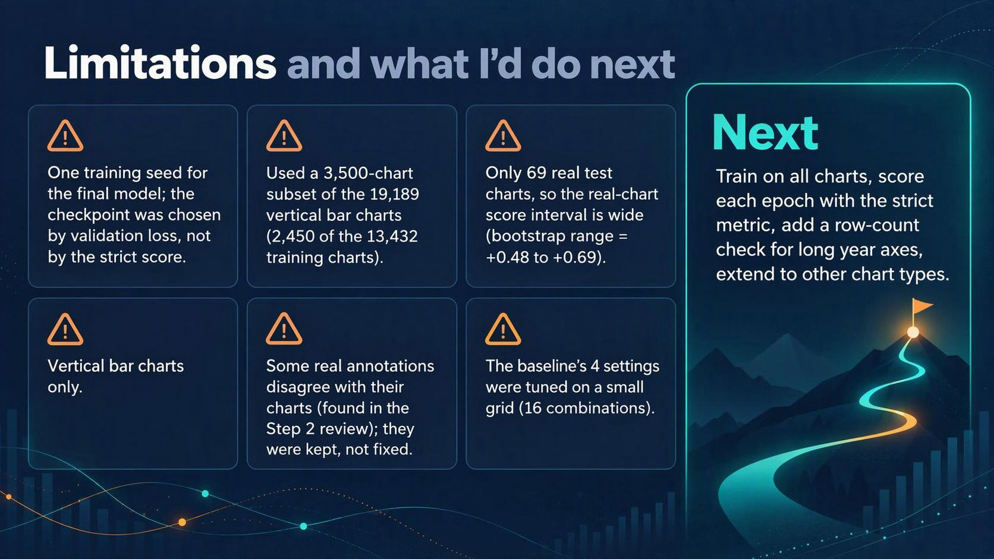
Notes:
- Seed, subset, small real test set
- Checkpoint by loss
- Next: full data, per-epoch strict scoring, row-count fix
There are a few limits I want to point out. I trained the final model with one seed, and I picked the epoch by validation loss, not by the strict score. I also trained on 3,500 charts, not the full set of 19,189. Also, I only had 69 real test charts. On those, MatCha beat the baseline by 0.59 on average, and the bootstrap puts the true gap somewhere between 0.48 and 0.69. That's a wide range, but even 0.48 is a big lead, so MatCha clearly wins on real charts. With more time, I'd train on all the charts, score every epoch with the strict metric instead of only the loss, and look into why MatCha sometimes writes one row too many or too few. Five of its six zero scores came from that, and two of them were charts with a long run of years along the bottom, where it skipped the year 1977.
Q: Would more data fix the row-count errors?
A: I can't say from what I ran. That would be the first experiment: the same recipe on all 13,432 training charts, then check whether the off-by-one cases drop.

Slide 15

Notes:
- Big win on real charts
- Rounding was the key fix
- AI-use line, then questions
To sum up: the fine-tuned model is far ahead of the classic pipeline, especially on real charts. The biggest improvement came from fixing the training data, by rounding the targets, not from changing the model. I made every choice on validation and ran the test once. On AI use: I used Claude to help write and debug code and draft the slide text, and ChatGPT to review each step's plan before I ran it. I made the decisions and ran everything myself. Thank you, I'm happy to take questions.
Q: What part of the code did you write yourself?
A: [Answer in your own words: which parts you wrote, which you adapted, and how you checked AI-written code, for example with the self-tests in Step 1 and the preflight in 12a.]

Slide 16
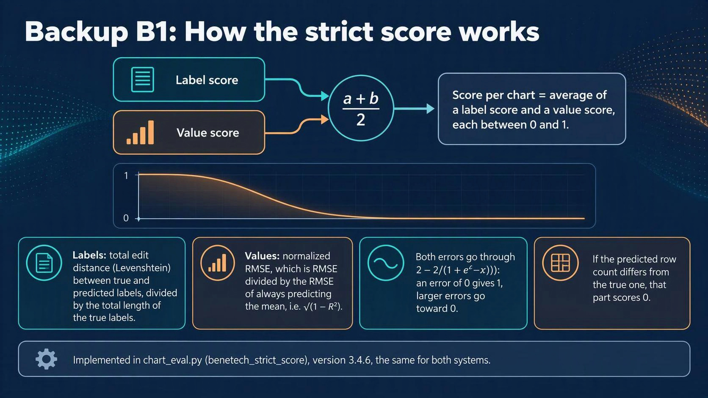
Notes:
- Labels: edit distance; values: normalized RMSE
- Both converted to 0-1
- Wrong row count = 0
- RMSE= root mean squared values
- R^2 = 1 - (Model's squared errors / Squared errors from predicting the mean)
The score is the competition's formula. For the labels, it's the edit distance, meaning the number of characters you'd have to change, divided by the total length of the true labels. For the values, it's the RMSE divided by the RMSE you'd get by always guessing the average. Both errors are converted to a score from 0 to 1, where a perfect answer gets 1, and the chart's score is the average of the two. If the number of rows is wrong, that part is 0, because the bars can't be lined up one to one.
Q: Isn't a zero for one missing row harsh?
A: Yes, and that's why five of MatCha's six zeros are one row off. I report row-count accuracy separately so you can see how often it happens: MatCha got the row count right on 98.9% of test charts.

Slide 17
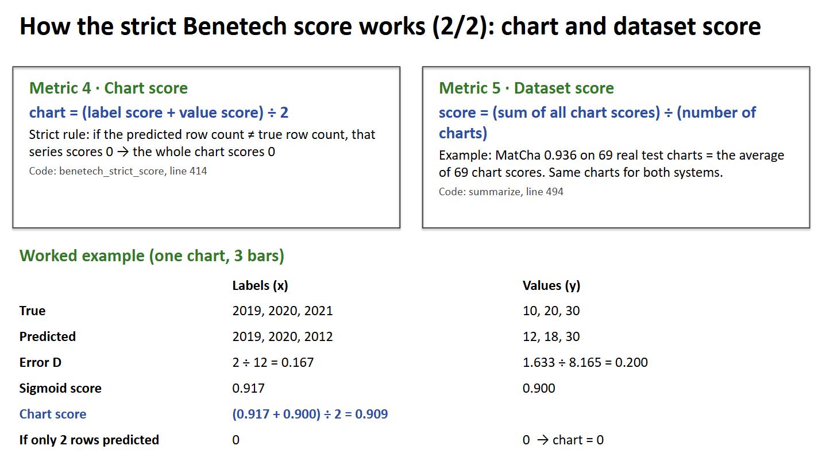
Notes:
The chart's score is the average of the label score and the value score. The strict part is the row count: if the model writes a different number of rows than the truth, the chart gets zero, because the bars can't be matched one to one. For the whole test set, I average the chart scores. Here's one chart worked through: one label off by two characters out of twelve gives an error of 0.167 and a score of 0.917. The values give an error of 0.200 and a score of 0.900. The chart scores 0.909. If the model had written only two rows, it would score zero.

Slide 18
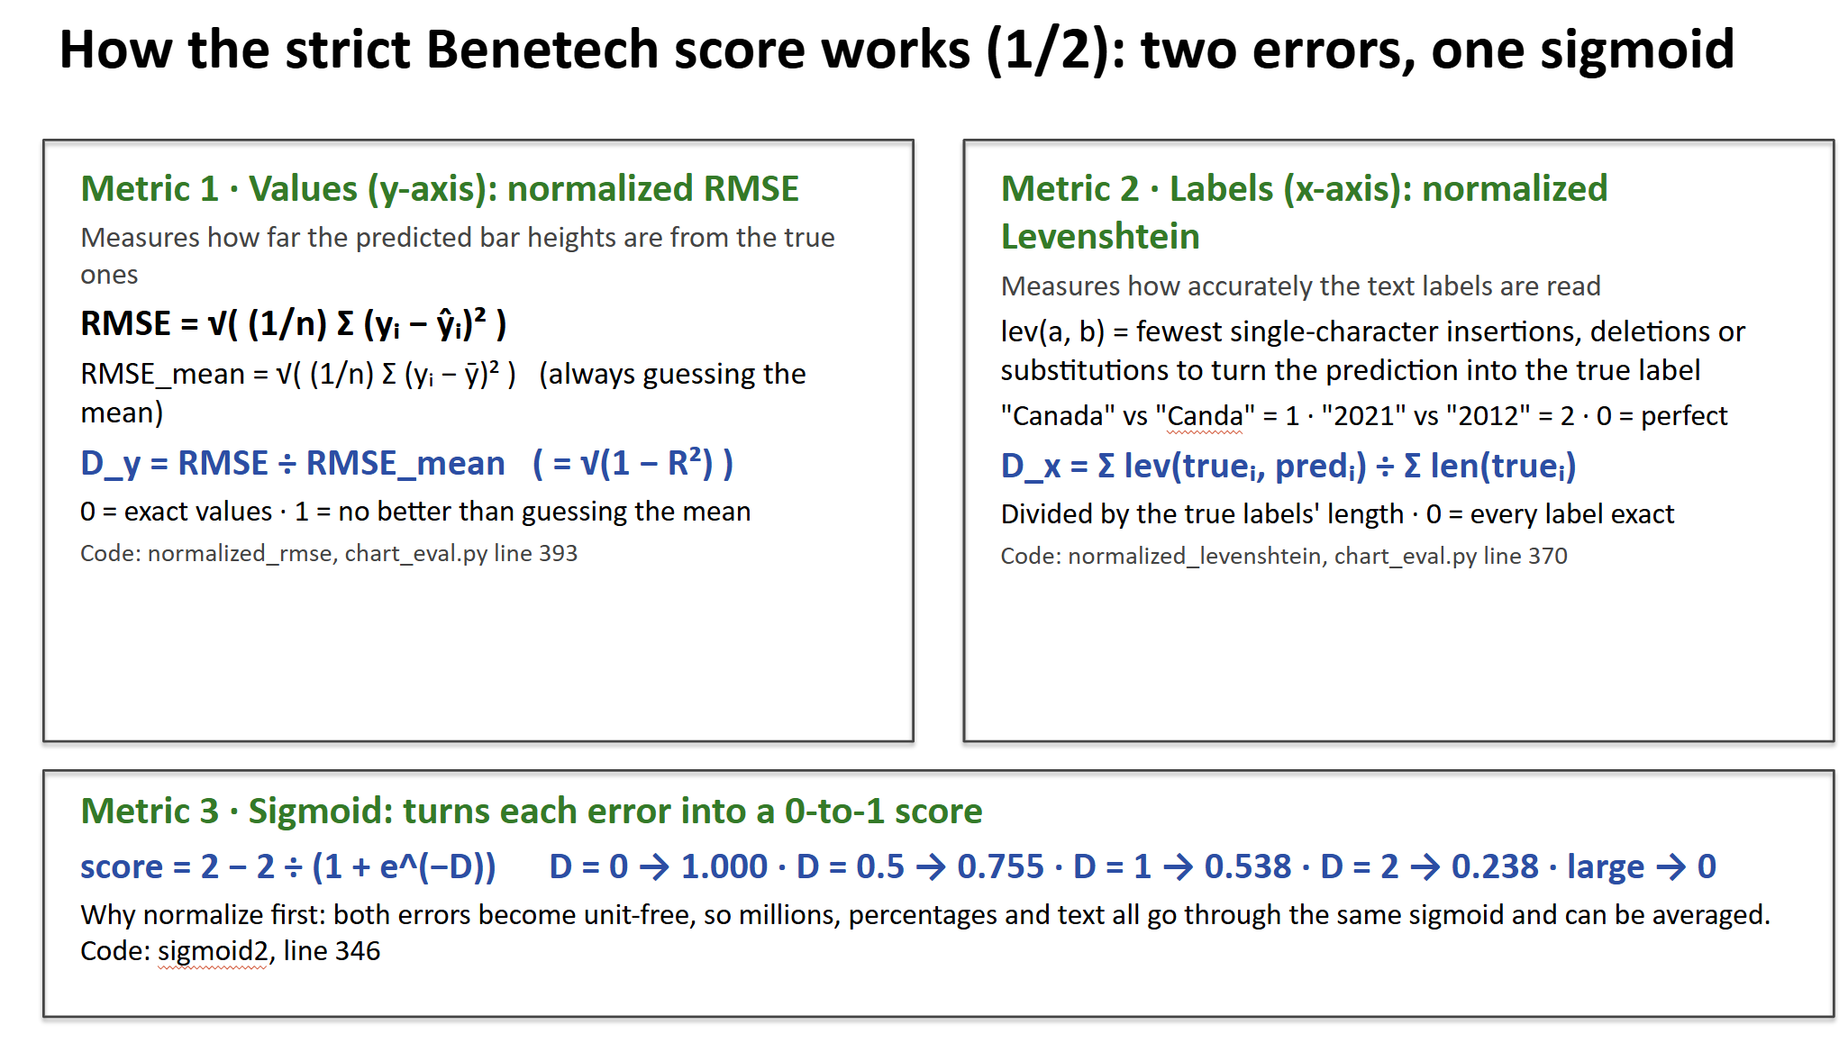
Notes:
The score handles the numbers and the text separately. For the bar values, I take the RMSE of my predictions and divide it by the RMSE I'd get by always guessing the average. Zero means exact, one means no better than guessing the mean. For the labels, I use Levenshtein distance, the fewest single-character edits to turn my label into the true one, summed over all labels and divided by the total length of the true labels. Both errors are unit-free, so both go through the same sigmoid, two minus two over one plus e to the minus D. An error of zero gives a score of one, and bigger errors push it toward zero.

Slide 19
Backup B2: Validation vs. test, both systems
 | Validation real (64) | Test real (69) | Validation generated (461) | Test generated (456)
MatCha | 0.860 | 0.936 | 0.965 | 0.969
Baseline | 0.288 | 0.349 | 0.595 | 0.550
[Screenshot to add: the validation-vs-test table in the 12d output, or the "Validation vs test" table in the Step 12 result cell.]

Slide 20
Backup B3: Zero-shot and second seed (Steps 5 and 7)
Real pilot charts (66) | Seed 42 | Seed 100
MatCha, rounded targets | 0.768 | 0.769
DePlot, rounded targets | 0.695 | 0.725
Zero-shot DePlot (no training) | 0.626 | —

