Slide 1


Slide 2
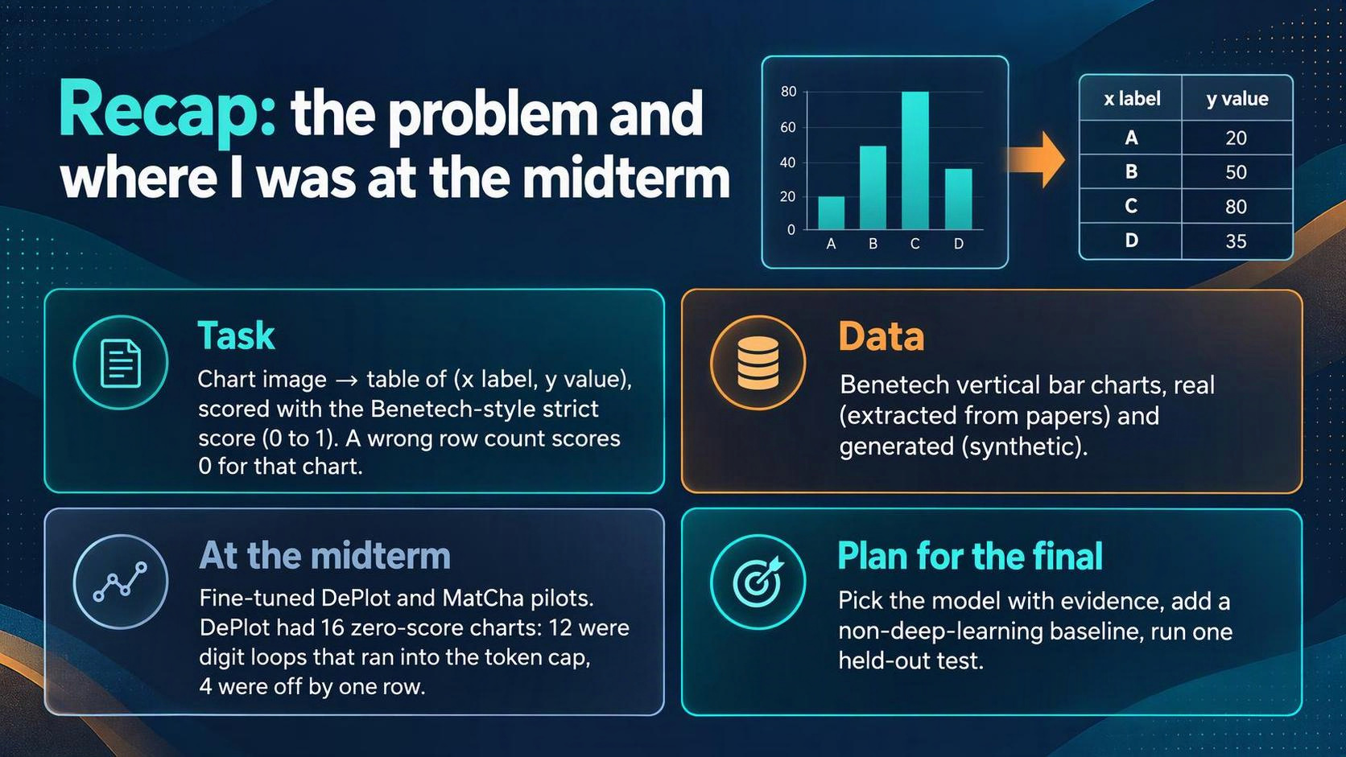

Slide 3
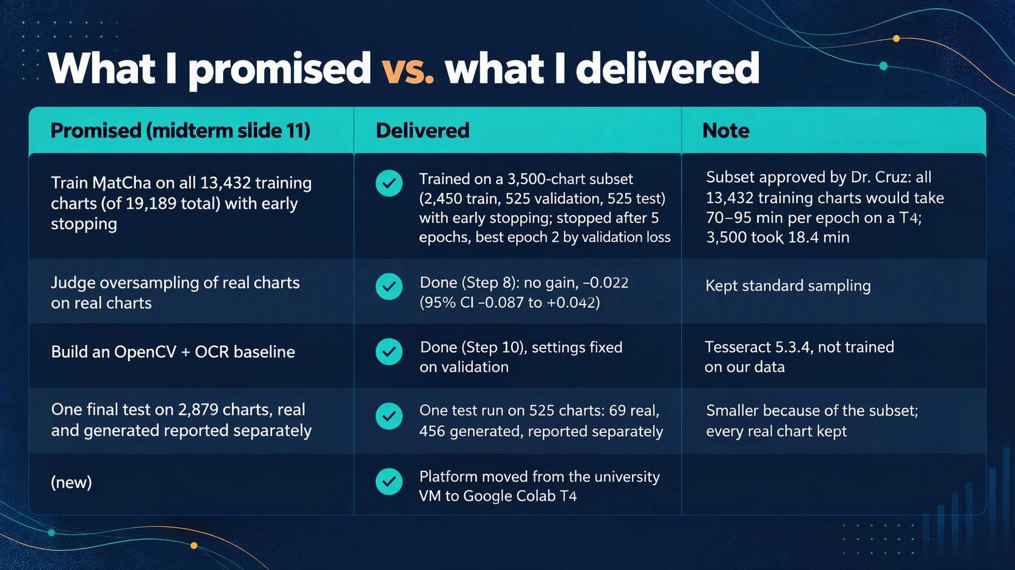

Slide 4
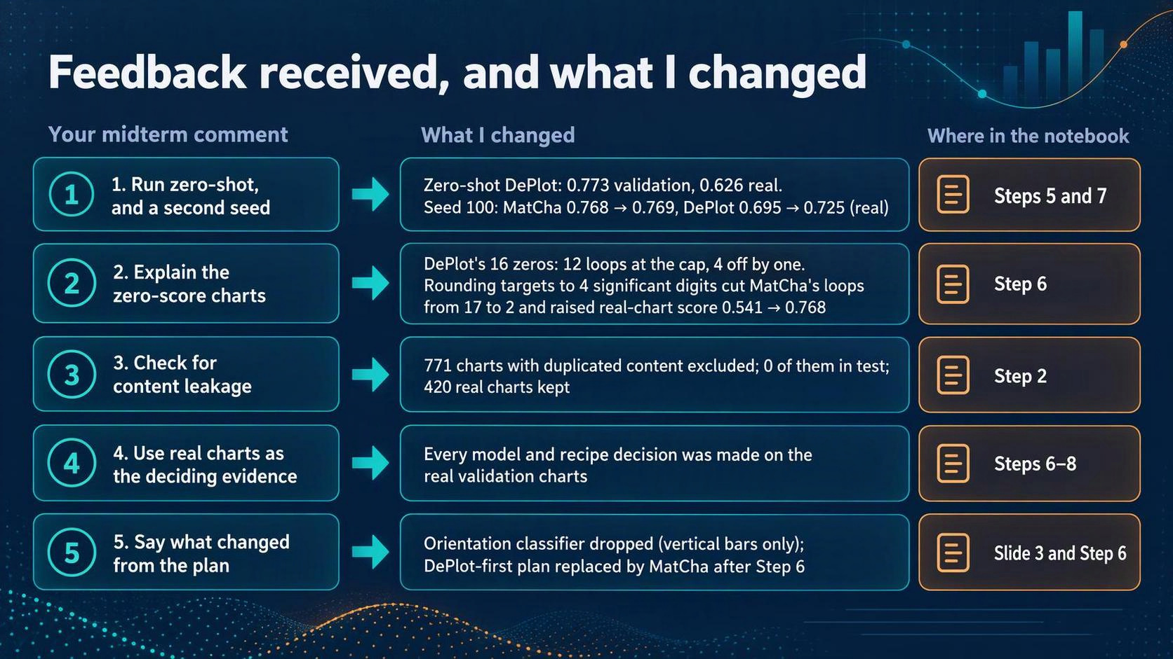

Slide 5


Slide 6


Slide 7
Why some charts scored zero: loops and the rounding fix (Steps 4–7)
Approach | Strict | Zero-score charts | Loops
A: full precision, greedy | 0.541 | 27 | 17
B: full precision + repetition penalty 1.05 | 0.608 | 22 | 10
C: rounded to 4 significant digits, greedy | 0.768 | 10 | 2
D: rounded + penalty 1.05 | 0.768 | 10 | 2
• Second seed (Step 7): MatCha C 0.768 → 0.769 on real charts.
• Zero-shot DePlot (Step 5): 0.626 on real charts; fine-tuned DePlot C: 0.695.
• Loop: the model keeps repeating digits or rows until it hits the token limit, so the table is
unusable and scores 0.
• Greedy: at each step, the model picks the single most likely next token.
• Takeaway: Rounding the training targets fixed most loops: 17 → 2 loops and 0.541 → 0.768 strict. The penalty helped only without rounding.
Walkthrough reference: Steps 4–7

Slide 8
Separate oversampling experiment: real charts did not help (Step 8)
• Only 287 of 2,450 training charts (12%) are real. Oversampled run: real charts drawn 3× as often (about 28.5% real).
• Same number of updates, same everything else; only the sampling changed.
64 real validation charts | Standard | Oversampled 3× | Difference (95% interval)
Strict score | 0.8693 | 0.8476 | −0.022 (−0.087 to +0.042)
• The interval includes 0, so the difference isn’t significant
•Decision: keep standard sampling. Fair wording: no evidence it helps (not "it hurts").
Walkthrough reference: Step 8

Slide 9
Full MatCha training and the checkpoint choice (Step 9)
• 2,450 charts, seed 42, learning rate 2e-5, batch 2 × accumulation 2(effective batch 4), fp16, 18.4 min per epoch.
• Early stopping: stop when validation loss hasn't improved by 0.001 for 3 epochs.
• Validation loss by epoch: 0.4204, 0.4084, 0.4092, 0.4104, 0.4226 → stopped after epoch 5, kept epoch 2.
• Validation strict score of epoch run 2: real 0.8602, generated 0.9651.
• Limitation: chosen by loss, not by strict score; I don't claim epoch 2 has the best strict score.
Walkthrough reference: Steps 9

Slide 10
The OpenCV + OCR baseline (Step 10)
• Find the bars (OpenCV: color mask, remove lines, keep solid rectangles of typical width) → read the y-axis numbers (Tesseract), fit pixel height to value → read the x labels (Tesseract at 0°, 45°, 90°) → write rows.
• Nothing trained on our data; Tesseract is a pretrained OCR engine used as is.
• Four settings tuned on 128 validation charts with a rule fixed in advance: background tolerance 35, minimum fill 0.6, width tolerance 0.4, grey bars off.
• Validation: real 0.2884, generated 0.5948. Most zeros: no bars found, no value scale, or the wrong number of bars.
• When it gets past finding the bars, it is accurate: 0.839 (real) and 0.865 (generated) on the charts it scored above zero.
Walkthrough reference: Steps 10

Slide 11
Token audit and the test-run safeguards (Steps 11–12a)
• Token audit (training and validation only): longest rounded training target 502 tokens, validation 647; nothing over the 864-token generation cap. Both validation cap hits were loops, so the cap stayed at 864.
• Freeze manifest written before the test run: checkpoint hash, decoding, baseline settings, scorer version, the 525 test IDs.
• Preflight on 8 validation charts: 10 of 10 checks passed, identical to the earlier validation outputs.
• Write-once: the test cells refuse to run if any setting changed.
Walkthrough reference: Steps 11-12a

Slide 12
Held-out test results (Step 12)
Test charts | MatCha (fine-tuned) | OpenCV + OCR baseline | Difference, MatCha − baseline (95% bootstrap interval)
Real (69) | 0.936 (2 zero-score charts) | 0.349 (41 zero-score) | +0.587 (+0.481 to +0.693)
Generated (456) | 0.969 (4 zero-score) | 0.550 (171 zero-score) | +0.420 (+0.380 to +0.460)
All (525) | 0.965 (6 zero-score) | 0.523 (212 zero-score) | +0.442 (+0.405 to +0.480)
• Per chart: MatCha better on 498, baseline better on 23, tied on 4.
• Row count right: MatCha 98.9%, baseline 59.6%. MatCha hit the 864-token cap 0 times.
• Validation → test: MatCha real 0.860 → 0.936, generated 0.965 → 0.969. The result held.
Walkthrough reference: Step 12

Slide 13
Error analysis: where each system fails (Step 13)
• Each test chart sorted into one category per system. "High-scoring" means strict score ≥ 0.8 (other cut-offs: ≥ 0.7 and ≥ 0.9 give the same picture).
Category (real / generated) | MatCha | Baseline | Out of (real / generated)
High-scoring (≥ 0.8) | 65 / 443 (94% / 97%) | 20 / 229 (29% / 50%) | 69 / 456
No usable table | 1 / 0 (1% / 0%) | 26 / 104 (38% / 23%) | 69 / 456
Too few rows | 1 / 3 (1% / 1%) | 12 / 64 (17% / 14%) | 69 / 456
Too many rows | 0 / 1 (0% / <1%) | 3 / 3 (4% / 1%) | 69 / 456
Right rows, labels weaker | 0 / 0 (0% / 0%) | 5 / 45 (7% / 10%) | 69 / 456
Right rows, values weaker | 2 / 9 (3% / 2%) | 3 / 11 (4% / 2%) | 69 / 456
• MatCha's 6 zero-score charts: 5 are one row off (two skipped the year 1977, one wrote a label twice), 1 real chart with text-heavy labels produced no table.
• Baseline's zeros: mostly it never found the bars (15 real, 99 generated) or the wrong number of bars.
• Where the baseline won: e.g. a chart where MatCha skipped one row (MatCha 0, baseline 0.981).
Walkthrough reference: Step 13

Slide 14
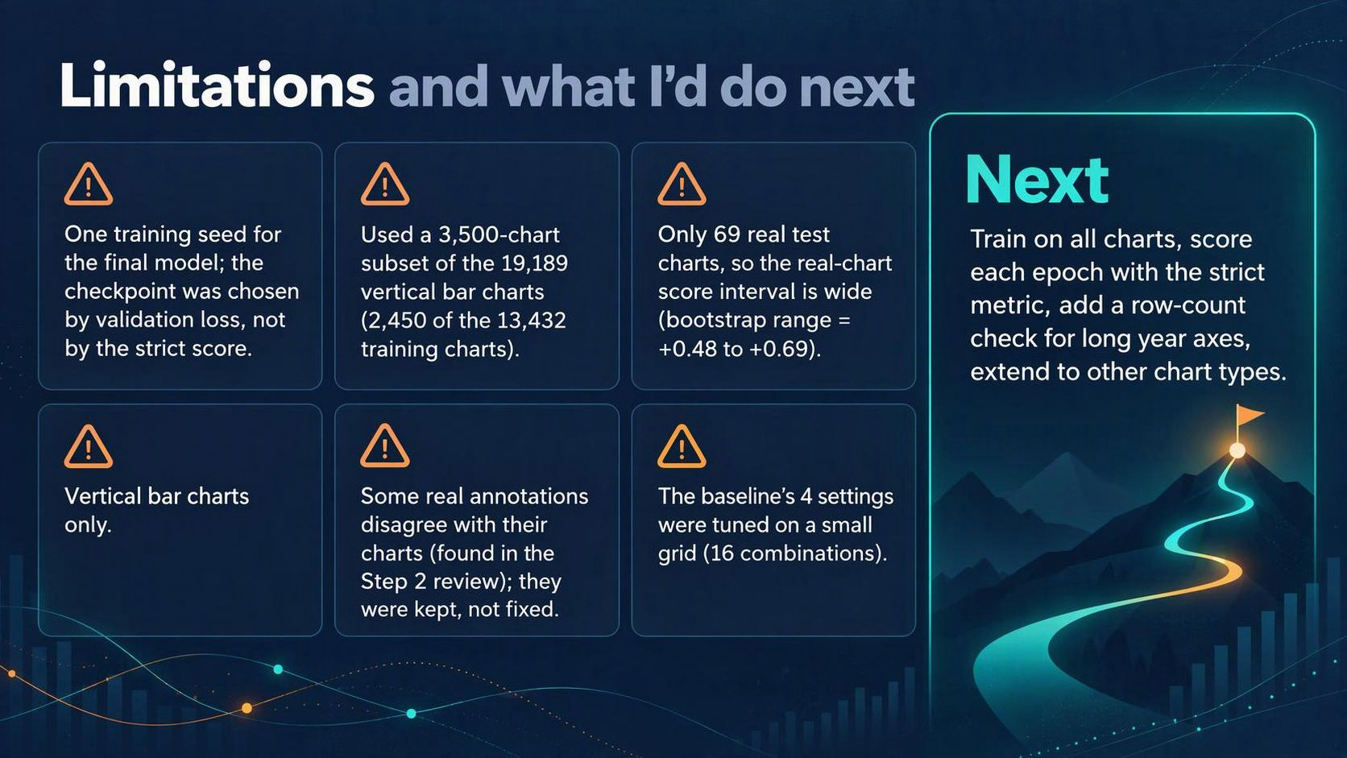

Slide 15


Slide 16
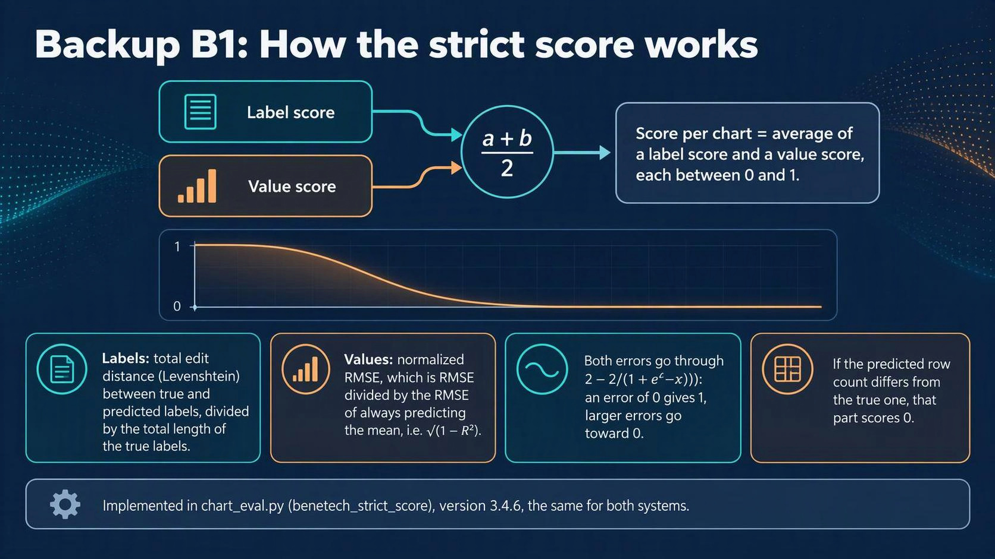

Slide 17
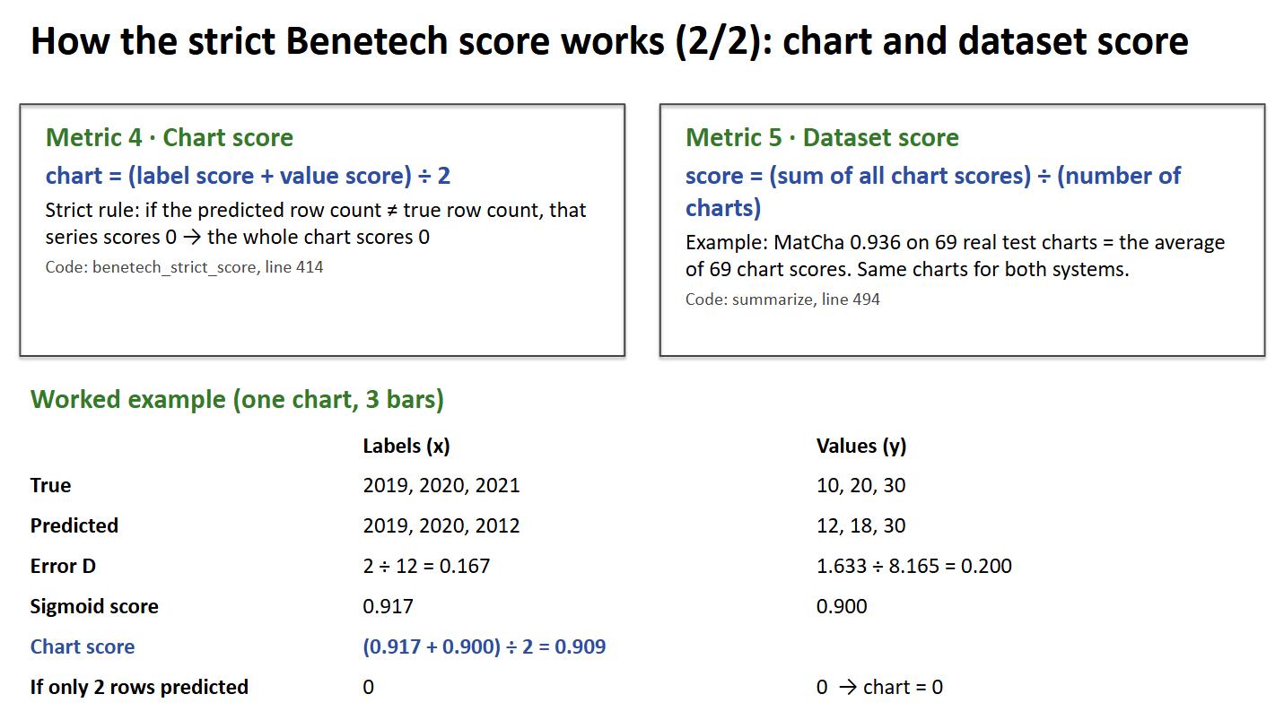

Slide 18
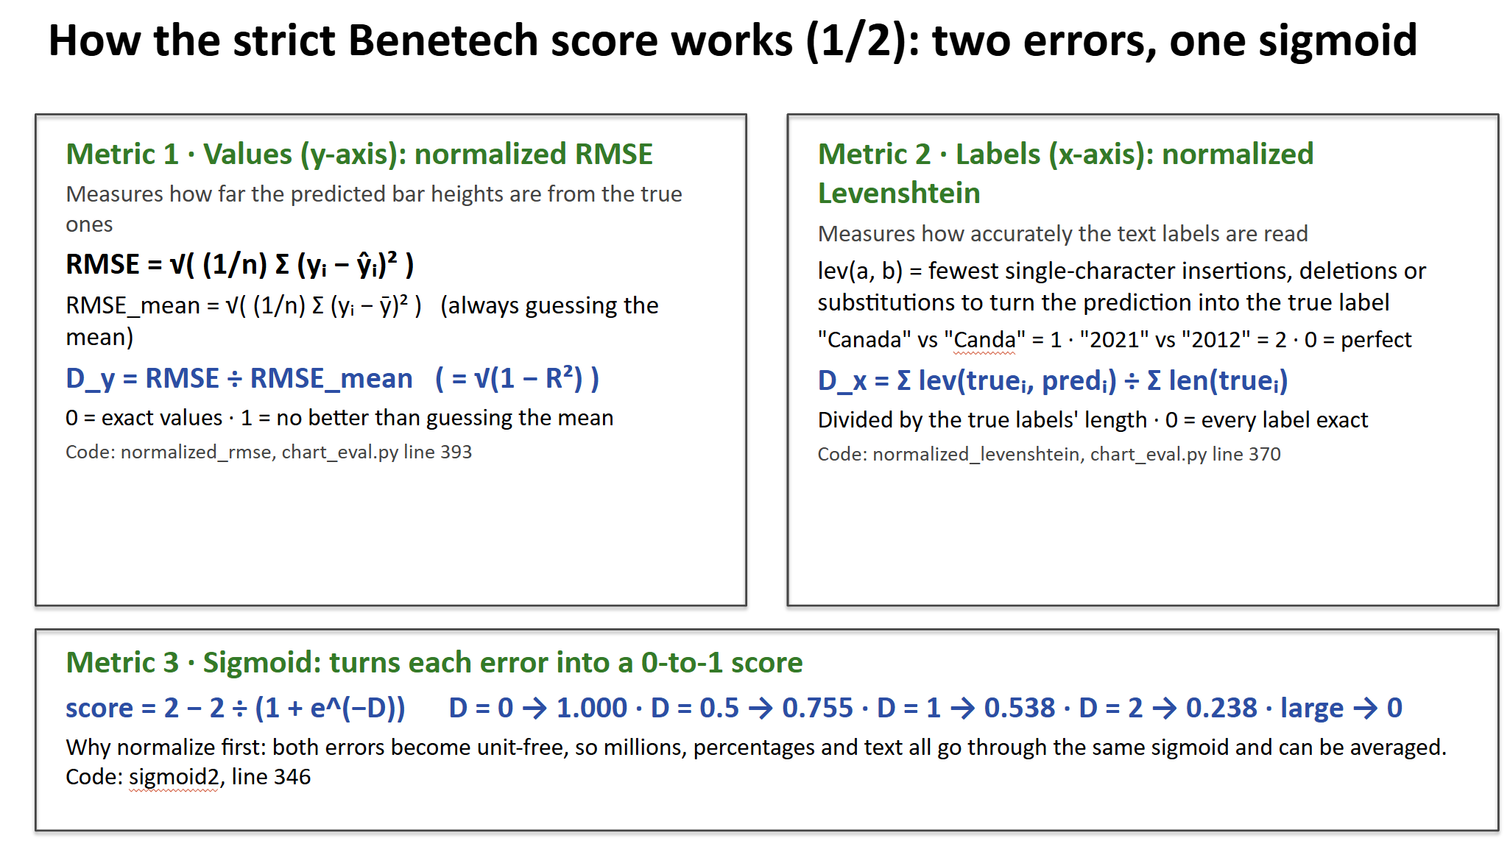

Slide 19
Backup B2: Validation vs. test, both systems
 | Validation real (64) | Test real (69) | Validation generated (461) | Test generated (456)
MatCha | 0.860 | 0.936 | 0.965 | 0.969
Baseline | 0.288 | 0.349 | 0.595 | 0.550
• MatCha’s test scores held up or improved over validation, so it didn’t overfit the validation set. Real sets are small (64 and 69), so a swing of a few points is expected.

Slide 20
Backup B3: Zero-shot and second seed (Steps 5 and 7)
Real pilot charts (66, from the Step 4-7) | Seed 42 | Seed 100
MatCha, rounded targets | 0.768 | 0.769
DePlot, rounded targets | 0.695 | 0.725
Zero-shot DePlot (no training) | 0.626 | —
• MatCha was stable across seeds (0.768 vs. 0.769), while DePlot varied more. Fine-tuning beat zero-shot DePlot, which is why we kept MatCha.

