Slide 1

ZERO TRUST
ARCHITECTURE
SIMULATION
Design and Simulation of a Zero Trust Architecture for Secure Enterprise Networking
Autenia Murray
CSCI 7536: Network and Computer Security
Spring 2025
Click here to hear slide narration
Main claim
A controlled Azure + Python lab can demonstrate core Zero Trust behavior: verify every request, enforce least privilege, and generate auditable monitoring evidence.
Notes:
Key points:
• Project goal: demonstrate Zero Trust with a real cloud lab plus reproducible simulation.
• Evidence includes Azure configuration, packet capture, Python results, and CSV outputs.
• Keep this title slide brief and confident.
Detailed speaker script:
I will present my Zero Trust Architecture implementation project for CSCI 7536.
The goal of this project was not only to describe Zero Trust in theory, but to build a small working model that demonstrates the idea through configuration evidence, packet-capture evidence, and simulation results.
I used an Azure Ubuntu virtual machine as the cloud lab environment, then implemented a Python-based policy engine to evaluate access requests.
The main security idea behind the project is that access should not be trusted just because it comes from inside a network.
Each request needs to be checked using identity, role, device posture, source segment, resource sensitivity, and monitoring behavior.
I will walk through the problem, the design, the implementation, the testing evidence, and the results.

Slide 2
01 | PROBLEM AND OBJECTIVE
Perimeter trust breaks down when attackers get inside
Zero Trust changes the security question from “inside or outside?” to “should this exact request be allowed?”
Traditional model
Zero Trust objective
Strong boundary controls access at entry
Internal network often receives broad trust
Compromised credentials can enable lateral movement
Flat network design increases blast radius
Verify identity and account status
Check device compliance and risk
Enforce role and source-segment rules
Generate logs and alerts for every denial
Risk created
13
3
10
One successful login or endpoint compromise may expose HR records, finance data, or administrative systems.
policy test cases
allowed requests
denied requests
Design goal: show core Zero Trust behavior using real ​
cloud configuration evidence and reproducible simulation output.​
Design goal: show core Zero Trust behavior using real cloud configuration evidence and reproducible simulation output.
Notes:
Key points:
• Start with the security challenge, not the technology.
• Explain why a perimeter-only model is not enough.
• Then state the project objective in one sentence.
Detailed speaker script:
The security challenge I addressed is the weakness of perimeter-based trust.
Traditional network security often focuses on keeping outsiders out.
That still matters, but it does not solve the full problem.
If a user account is compromised, or if a device inside the network becomes risky, the system may still treat that activity as trusted simply because it appears to come from inside.
That is dangerous for sensitive systems like HR records, finance databases, and administrative consoles. In this project, I modeled the opposite approach.
The objective was to evaluate every request based on the specific user, device, source segment, target resource, and monitoring context.
The simulation included 13 policy test cases.
Three were valid access requests and were allowed.
Ten were risky or unauthorized and were denied.
This gave me a measurable way to show that the Zero Trust rules were actually being applied.

Slide 3
02 | ZERO TRUST DESIGN LOGIC
The access decision combines identity, device posture, segment, and monitoring
Identity
Device
Segment
Resource
Monitor
active account
role + MFA
managed
compliant
risk score
source path
micro-segment
sensitivity
allowed roles
log + alert
repeat failure
Core rule implemented in Python
ALLOW only when no policy condition fails; otherwise DENY and record the reason.
Least privilege: role/resource match • Micro-segmentation: allowed source path • Monitoring: denials generate alerts
Notes:
Detailed speaker script:
This slide shows the logic behind the simulation.
The decision is not based on one factor.
It combines identity, device posture, network segment, protected resource, and monitoring behavior.
The identity check asks whether the user exists, whether the account is active, whether the role is allowed, and whether MFA is required.
The device check asks whether the device is managed, compliant, encrypted when needed, and below the risk threshold.
The segment check represents micro-segmentation.
A request from the wrong segment is denied even if the user role looks valid.
The resource check considers sensitivity and allowed roles.
Finally, the monitoring engine logs denials and creates alerts, especially for repeated denied attempts.
The important design idea is that access is only allowed when none of the policy conditions fail.
If one condition fails, the request is denied and the reason is recorded.

Slide 4
03 | SYSTEM ARCHITECTURE
The prototype separates enforcement, policy decisions, resources, and monitoring
Protected Resources
User + Device
Policy Engine
Enforcement
HR records
Finance database
Admin console
Public portal
role, MFA, account status
device compliance and risk
evaluate request
return ALLOW or DENY
record decision reason
block or allow
least privilege access
Access Logs
Monitoring Alerts
access_log.csv
test_summary.csv
alerts.csv
policy denials
repeated failures
Micro-segments modeled in simulation
HR
Finance
IT Admin
Guest/Public
Architecture is a small-scale prototype: policy logic + cloud lab evidence, not a production Zero Trust platform.
Notes:
Key points:
• Walk left to right: request, decision, enforcement, resource, logs/alerts.
• Explain how micro-segmentation appears in the Python policy rules.
• Mention this is a prototype, not a full enterprise ZTA product.
Detailed speaker script:
This is the architecture of the prototype.
A request starts with a user and device.
The policy engine evaluates the request using identity, role, account status, device compliance, device risk, source segment, and resource sensitivity
f the request passes all required checks, the enforcement step allows access.
If any check fails, the request is denied.
The protected resources are modeled as HR records, the Finance database, the administrative console, and a public portal.
The lower part of the diagram shows the evidence outputs.
The access log records each decision and its reason.
The test summary shows expected versus actual results.
The monitoring alerts file records policy denials and repeated denied access attempts.
The micro-segments in this project are HR, Finance, IT Admin, and Guest/Public.
This is not a full production Zero Trust deployment, but it is a clear prototype of the key access-control and monitoring concepts.

Slide 5
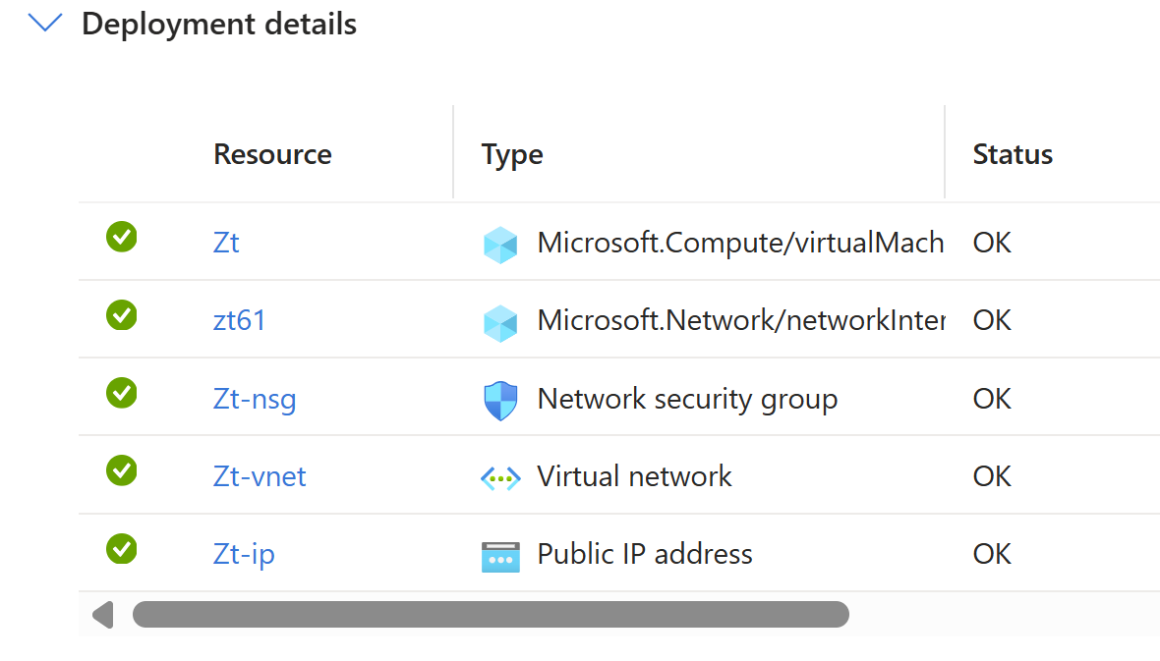
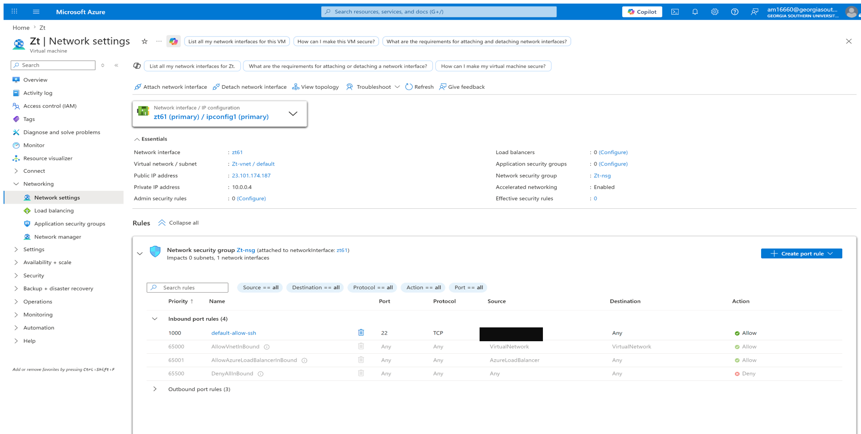
04 | CLOUD LAB CONFIGURATION
The Azure VM provided a real Linux environment for secure testing
1
Cloud resources created
2
SSH restricted
3
Security purpose
VM, NIC, NSG, VNet, and public IP were created as a controlled Azure lab.
Port 22 stayed available for administration, but the source was limited to a trusted /32 public IP.
The lab demonstrates secure remote access before moving into packet capture and simulation.
Notes:
Key points:
• Point out that this was not just a paper design.
• Explain the Azure resources and SSH rule in plain terms.
• Stress that “restricted” is more accurate than “closed” for port 22.
Detailed speaker script:
This slide shows the cloud lab setup.
The project used Azure because the original class security lab resources were not available anymore.
The Azure deployment created the virtual machine, network interface, network security group, virtual network, and public IP.
That gave the project a real Linux environment instead of only a local simulation.
The most important security configuration here is the Network Security Group rule.
SSH on port 22 was not closed, because I still needed it for administration.
Instead, the source was restricted from Any to one trusted public IP address using slash-32 notation.
That means only that specific public IP should be able to initiate SSH access.
This is a small but important secure administration control.
It supports the Zero Trust idea that access should be specific and limited instead of broadly trusted.

Slide 6
05 | IMPLEMENTATION WORKFLOW
Implementation connected cloud setup, traffic generation, and policy simulation
1
2
3
4
5
Azure setup
Tool verification
Protected resource
Traffic evidence
Policy simulation
Ubuntu 24.04 VM
NSG + SSH restriction
Python 3
nmap
tcpdump
local HTTP server
port 8080
curl + nmap
tcpdump .pcap
13 access requests
CSV logs + alerts
Selected command evidence
python3 src/zero_trust_simulation.py → access_log.csv + alerts.csv + test_summary.csv
The workflow keeps testing controlled: all scans and packet captures target the VM/localhost resource, not external systems.
Notes:
Key points:
• Use this slide to walk through what you actually built.
• Mention that tests were controlled and did not target outside systems.
• Highlight that source code and output files are reproducible.
Detailed speaker script:
This slide summarizes the implementation workflow.
First, I created the Azure Ubuntu VM and configured the supporting network resources.
Second, I verified the tools needed for the lab, including Python, nmap, and tcpdump.
Third, I created a small protected HTTP resource using Python’s built-in HTTP server on port 8080.
Fourth, I generated controlled traffic against that local resource using curl and nmap, then captured that traffic with tcpdump.
Finally, I ran the Python Zero Trust simulation.
The simulation generated three CSV files: the access log, the alerts file, and the test summary file.
I want to be clear that this was controlled testing.
I did not scan external systems or perform offensive testing against anything outside the lab.
The traffic stayed inside the Azure Ubuntu VM environment and targeted localhost on port 8080.

Slide 7
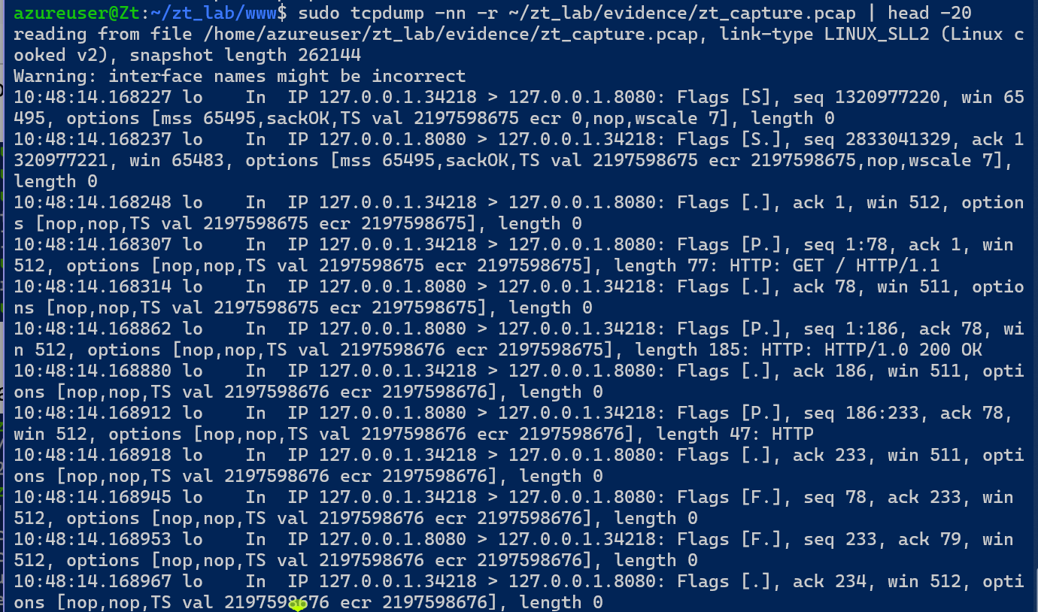
06 | TRAFFIC MONITORING EVIDENCE
Packet capture confirmed real HTTP traffic was generated and inspected
WHAT THE CAPTURE SHOWS
TCP handshake to port 8080
HTTP GET request to local resource
HTTP/1.0 200 OK response
Saved .pcap file read back with tcpdump
Why it matters
This validates the monitoring layer with real packet evidence, not only simulated logs.
Traffic was generated only against the local protected resource on 127.0.0.1:8080.
Notes:
Key points:
• Explain this as the hands-on network evidence slide.
• Point out the HTTP GET and 200 OK response.
• Connect this to continuous monitoring.
Detailed speaker script:
This slide is the main network evidence.
I used tcpdump to capture traffic generated against the local protected resource on port 8080.
The readable capture shows TCP traffic between localhost and port 8080.
It also shows an HTTP GET request and a successful HTTP 200 OK response.
This matters because it demonstrates that the lab was not just theoretical.
I generated real traffic, captured it into a packet-capture file, and read the capture back to verify what happened.
In a production environment, continuous monitoring might use tools such as an IDS, SIEM, or packet sensor.
In this project, tcpdump served as the network monitoring evidence.
It supports the broader Zero Trust principle that access decisions should be observable and auditable, not invisible.

Slide 8
07 | PYTHON ZERO TRUST ENGINE
The simulation denies access unless every policy condition passes
1
Identity
Simplified policy logic
User exists, account is active, role is allowed, MFA requirement is satisfied.
if user.role not in resource.allowed_roles:
reasons.append("role not authorized")
if resource.requires_managed_device and not device.managed:
reasons.append("managed device required")
if request.source_segment not in allowed_sources:
reasons.append("blocked by segmentation")
decision = "ALLOW" if not reasons else "DENY"
2
Device posture
Managed, compliant, encrypted when sensitive, and below risk threshold.
3
Micro-segmentation
The source segment must be authorized for the requested resource.
4
Monitoring
Denied requests generate alerts; repeated denials escalate severity.
Decision = ALLOW only when the reasons list stays empty.
Notes:
Key points:
• Keep the code explanation clear and short.
• The code builds a list of denial reasons; an empty list means allow.
• This is the core simulation logic.
Detailed speaker script:
This slide explains the core code logic.
The simulation uses structured data for users, devices, resources, and access requests.
For each request, the policy engine checks several conditions.
If the user role is not allowed for the resource, it adds a denial reason.
If a managed device is required and the device is unmanaged, it adds another reason.
If the source segment is not allowed, it adds another reason.
At the end, the decision is simple: if there are no reasons, access is allowed.
If there is at least one reason, access is denied.
That structure is useful because it does not only say yes or no.
It also records why the decision happened.
That makes the simulation auditable and easier to explain.
The monitoring engine then reads the decision and creates alerts when access is denied.

Slide 9
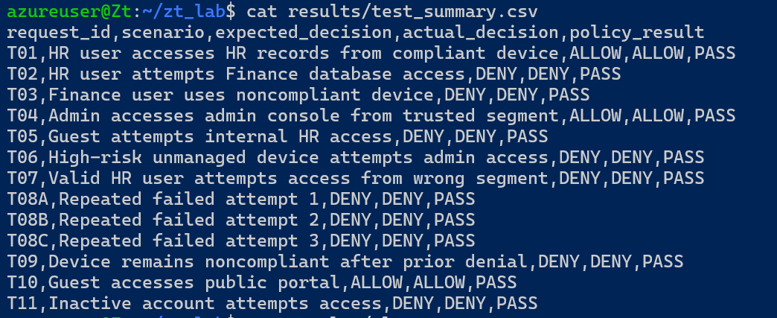
08 | TESTING RESULTS
All 13 policy tests passed, with risky requests denied by design
Result counts
Allowed
3
Denied
10
Alerts
13
13/13
10
3
policy tests passed
denied by policy
allowed by policy
Test categories included cross-segment access, noncompliant devices, high-risk devices, public access, and inactive accounts.
Notes:
Key points:
• Start with the headline: 13 out of 13 tests passed.
• Explain allowed versus denied results.
• Use the CSV screenshot as proof that expected and actual decisions matched.
Detailed speaker script:
This slide summarizes the simulation results.
The simulation evaluated 13 access requests, and all 13 policy tests passed.
Three requests were allowed and ten were denied.
The allowed cases were valid requests, such as an HR user accessing HR records from a compliant device, an admin accessing the admin console from the trusted IT Admin segment, and a guest accessing the public portal.
The denied cases tested the security boundaries.
The simulation denied cross-segment access, noncompliant device access, high-risk unmanaged device access, guest access to internal records, and inactive account access.
The screenshot on the right shows the test summary CSV.
Each row compares the expected decision to the actual decision.
The policy result column shows PASS, meaning the decision engine behaved as expected for each test case.

Slide 10
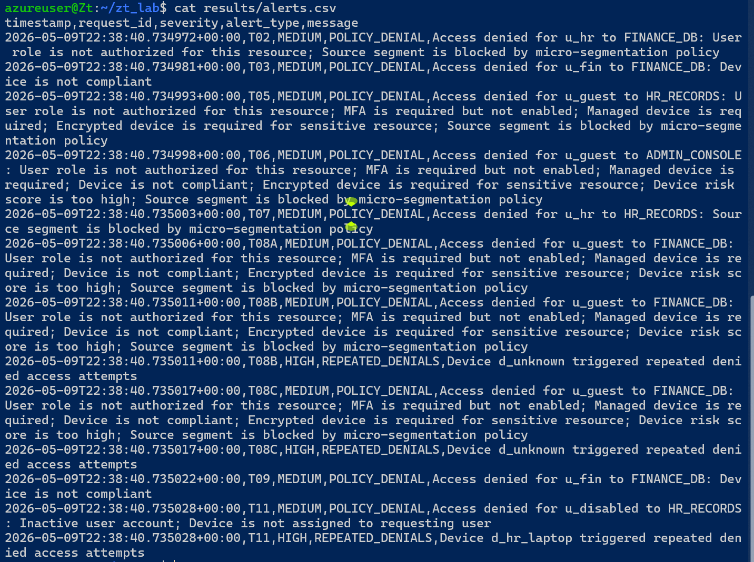
09 | MONITORING AND INCIDENT RESPONSE
The monitoring engine turns denied access into auditable alerts
SIMULATED RESPONSE WORKFLOW
Evaluate request
Deny if policy fails
Log reason
Generate alert
Escalate repeated denials
Alert types produced
POLICY_DENIAL + REPEATED_DENIALS
Notes:
Key points:
• This slide connects the project to detection and response.
• Explain the difference between a denial and an alert.
• Mention repeated denials create high-severity alerts.
Detailed speaker script:
This slide focuses on the monitoring part of the project.
A Zero Trust system should not only make access decisions.
It should also create evidence that security staff can review.
In this simulation, every denied request generated a medium-severity policy denial alert.
When the same device produced repeated denied access attempts, the monitoring engine generated a high-severity repeated-denials alert.
This is a simplified model of incident detection and escalation.
The screenshot shows the alerts CSV that was produced by the simulation.
The message field includes the denied user, target resource, and policy reasons.
For example, a request can be denied because the role is not authorized, MFA is missing, the device is unmanaged or noncompliant, encryption is missing, the risk score is too high, or the source segment is blocked.
This makes the system auditable, which is an important part of Zero Trust.

Slide 11
10 | DISCUSSION AND FUTURE WORK
The prototype met the project objective, with clear paths to scale
What worked
Limitations
Future scale-up
Azure lab gave real Linux evidence
SSH restriction reduced exposure
Packet capture validated monitoring
Simulation produced 13/13 passing tests
Single VM prototype
No real identity provider
No production SIEM integration
No Snort/Suricata IDS deployment
Multi-VM segmented lab
Microsoft Entra / Okta integration
SIEM dashboard and alert correlation
IDS-based detection with Snort or Suricata
Bottom line: the project demonstrated core Zero Trust behavior in a controlled, reproducible environment, while leaving room to expand into a larger enterprise-style security lab.
Notes:
Key points:
• Be honest about what the project does and does not do.
• Limitations make the project more credible.
• Future work shows how it can scale.
Detailed speaker script:
This slide is the discussion slide.
The project met its objective because it built a working cloud lab, generated real network evidence, and ran a reproducible Zero Trust simulation.
The strongest parts are the Azure Linux environment, the restricted SSH configuration, the packet-capture evidence, and the 13 out of 13 passing policy tests.
The limitations are also important to state honestly.
This is a single-VM academic prototype.
It does not replace a real enterprise Zero Trust platform.
It does not integrate with a real identity provider, endpoint management system, SIEM, or IDS.
However, those limitations are also the clearest future-work path.
The project could be expanded into multiple Azure VMs or subnets for HR, Finance, IT Admin, and Guest segments.
It could connect to Microsoft Entra ID or Okta.
Alerts could be sent to a SIEM dashboard, and Snort or Suricata could provide intrusion detection.

Slide 12
Final takeaway
Zero Trust is strongest when policy, evidence, and monitoring work together.
Submission artifacts
Final report
Screenshot evidence packet
Source code zip
Live demo recording
uploaded with project requirements
Presentation deck
Recorded demo shows the simulation run, result files, policy summary, alerts, and access log.
Q&A
Thank you
Notes:
Key points:
• End with confidence, not a rushed apology.
• Remind the audience what the project demonstrated.
• Then invite questions.
Detailed speaker script:
To close, the main takeaway is that Zero Trust is not only a slogan.
It can be represented as a set of specific access checks, secure configuration choices, monitoring outputs, and repeatable test results.
In this project, I demonstrated that through the Azure Ubuntu VM, the restricted SSH rule, the protected local resource, packet capture, the Python policy engine, and the generated CSV logs.
The live demonstration recording is uploaded with the project requirements and shows the simulation running, the CSV result files being generated, the policy summary, alerts, and access log output.
Thank you, and I am ready for questions.

