Slide 1
Statistics (II)
Slides by:
Jiannan Wang
https://www.cs.sfu.ca/~jnwang/

Slide 2
Outline
Correlation Analysis
Big Picture
How to do correlation analysis
Causal analysis
Hypothesis Testing
Big Picture
A/B Testing

Slide 3
Outline
Correlation Analysis
Big Picture
How to do correlation analysis
Hypothesis Testing
Big Picture
A/B Testing

Slide 4
Correlation Analysis
Correlation
It is a measure of relationship between two variables
Why is correlation analysis useful?
For understanding data better
For making predictions better

Slide 5
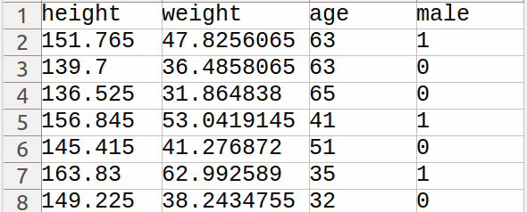
Case Study: How to do correlation analysis
Height and weight are correlated
Source: Think Stats -- Exploratory Data Analysis in Python

Slide 6
Idea 1. Visualization

Slide 7
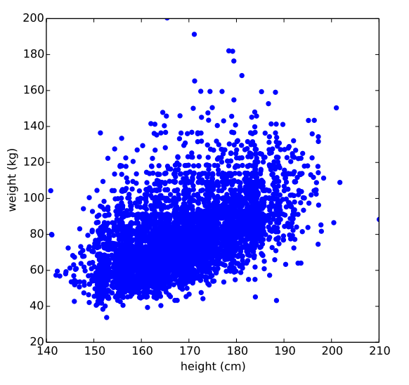
Scatter Plot

Slide 8
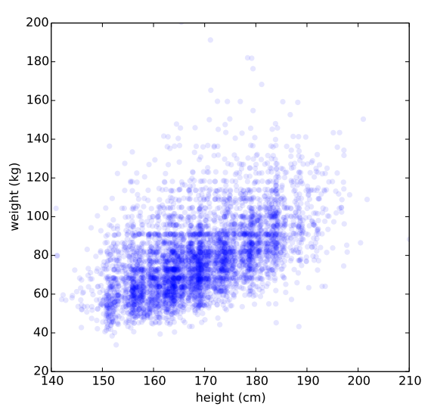
Scatter Plot (with transparency)

Slide 9
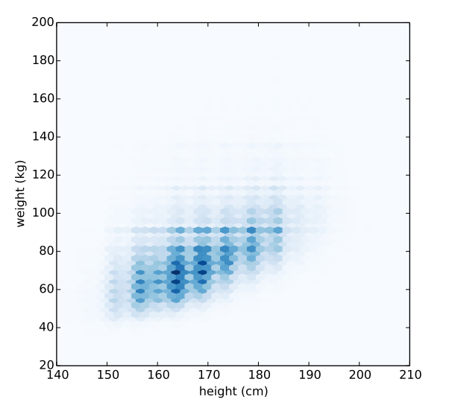
Hexbin Plot

Slide 10
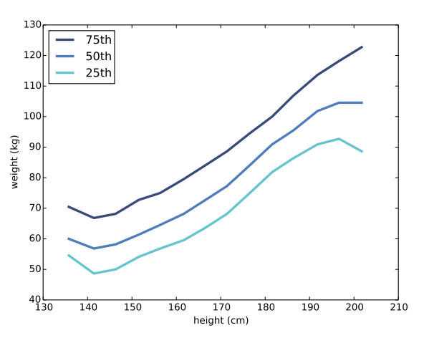
Characterizing relationships

Slide 11
Idea 2. Correlation Coefficient

Slide 12


Covariance
Covariance is a measure of the tendency of two variables to vary together.
Hard to interpret
113 kilogram-centimeters

Slide 13
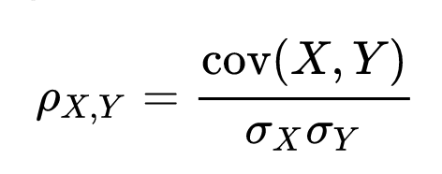
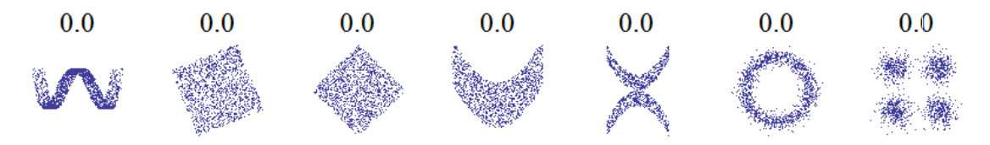
Pearson’s correlation
Pearson’s correlation is a measure of the linear relationship between two variables
Easy to Interpret
[-1, 0) → Negative Correlated
(0,+1] → Positive Correlated
-1 or +1 → Perfectly Correlated
What about non-linear relationship?

Slide 14
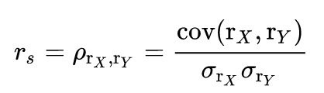
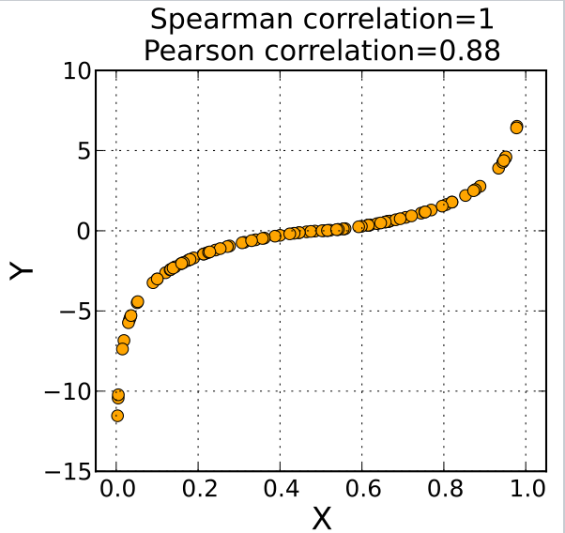
Spearman’s rank correlation
Spearman’s rank correlation is a measure of monotonic relationship between two variables
Advantages
Mitigate the effect of outliers
Mitigate the effect of skewed distributions

Slide 15
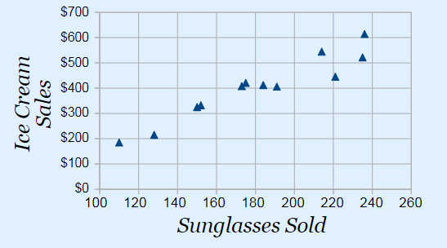


Causal Analysis
Correlation ≠ Causation

Slide 16
Causal Analysis
If A and B are correlated, then
A causes B,
B causes A, or
C causes both A and B
How to tell which case it is?
Use time (If A comes before B, then A can cause B but not the other way around)
Use Randomness (randomized controlled trial)

Slide 17
Outline
Correlation Analysis
Big Picture
How to do correlation analysis
Causal analysis
Hypothesis Testing
Big Picture
A/B Testing

Slide 18
Why Hypothesis Testing?
We want to make a claim from our data
But, data is just a sample
How to prove our claim in this situation?
Example
Claim: A data scientist earns more money than a data engineer
Data: A sample of 50 data scientists and 50 data engineers
Result: 100K vs. 70k
Using Hypothesis Testing
Can we use this result to prove that our claim is correct?

Slide 19
Hypothesis Testing
Equivalent Terms
Hypothesis == Claim
Hypothesis Testing == Claim Proving
Key Idea
Prove by contradiction
Analogy
How to prove: There is no smallest rational number greater than zero.
Hint: a rational number is any number that can be expressed as the fraction a/b of two integers

Slide 20
Alternative and Null Hypotheses
Alternative Hypothesis (H_{a})
This is the claim that you want to prove it’s correct
Null Hypothesis (H₀)
The opposite side of H_{a}
Possible Outcomes
Reject H₀ (a contradiction is found)
Fail to reject H₀ (no contradiction is found)
→ Accept H_{a}

Slide 21
Example
Alternative Hypothesis (H_{a})
A data scientist earns more money than a data engineer
NULL Hypothesis (H₀)
A data scientist earns less (or equal) money than a data engineer
If H₀ is true, what’s the probability of seeing:
Data Scientist (100 K) vs. Data Engineer (70 K)
Salary(Data Scientist) – Salary(Data Engineer) >= 30 K
This is called P-value

Slide 22
Make a decision based on p-value
We hope that
p-value is as low as possible so that we can reject H₀ (i.e., accept H_{a})
Level of Significance (e.g., α = 0.01)
How low do we want p-value to be?
Level of Confidence (e.g., c = 1- α = 99%)
How confident are we in our decision?

Slide 23
P-Hacking (Cheating on a P-Value)
Common Mistakes
Collect data until the hypothesis testing is passed
Keep doing analysis on the same data until you find something significant
Solution
You should know what you‘re looking for (H₀ and H_{a}) before you start
Decrease the level of significance (e.g., α/2 for two hypothesis tests on the same data)

Slide 24
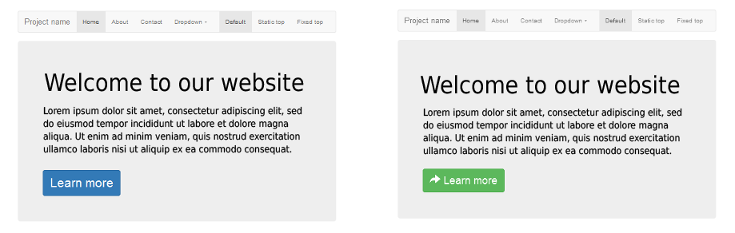
A/B Testing
What UI is better?

Slide 25
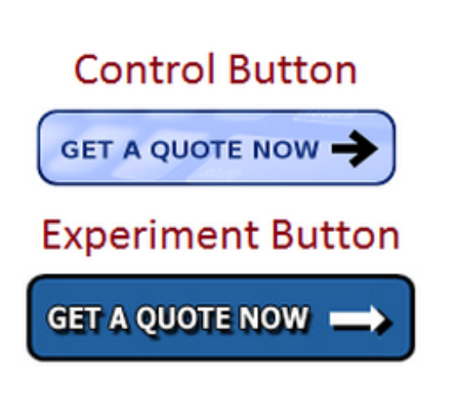

Surprising A/B Tests
https://www.wordstream.com/blog/ws/2012/09/25/a-b-testing

Slide 26
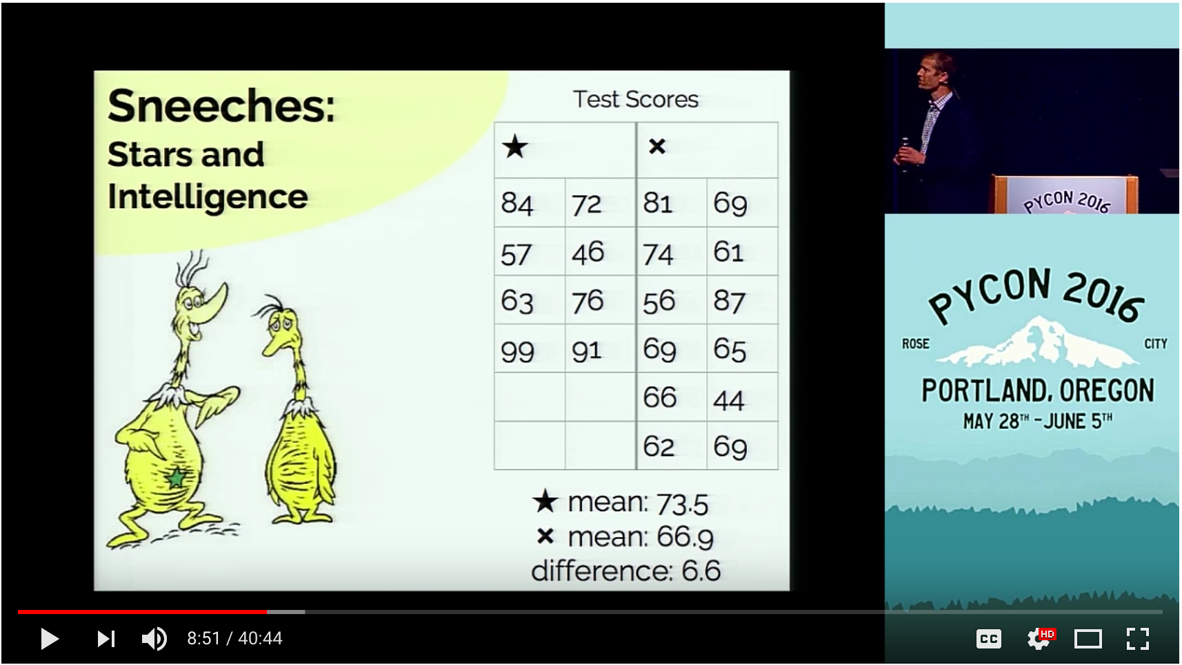
Permutation Test
https://youtu.be/Iq9DzN6mvYA?t=8m9s

Slide 27
Conclusion
Correlation Analysis
Using visualizations (scatter plot, hexbin plot)
Using correlation coefficients (Pearson, Spearman’s rank)
Hypothesis Testing
Null Hypothesis (H₀) and Alternative Hypothesis (H_{a})
P-value and P-hacking
A/B Testing
Notes:
Prove by contradiction

