Slide 1
Cluster Computing
For
High Performance Computing
Harsh Kataria
Ambuje Gupta
Souvik Mishra
E17CSE(071,120,127)
Rushil Goomer
Alarsh Tiwari
Sonali Mehta
E17CSE(113,132,169)

Slide 2
Project description
Problems/Obstacles
Huge amounts of data produced everyday
Single processing systems fail to process this data
Need for parallel systems
Energy efficiency in parallel systems
Our study
We explored multiple Cluster computing applications that were high processing in natural or based on cost and energy efficient clusters.
Our implementation based on these studies include
Image processing algorithms for wheat count using canny edge and watershed
Finding total number of primes in a range
EEG signal processing
It was successfully inferred that a cluster performs a task in a much efficient manner than a single processor system. The cluster used was also cheap and power efficient. It proved to be viable solution for the problem,
Future HPC computers will be limited to about 20 MW of power consumption in the coming decade. We expect to conclude this paper on a high note with hopes that the research on the same would be continued and we will exercise maximum exploitation from the capabilities of today’s hardware's on the lane of High Performance Computing.

Slide 3
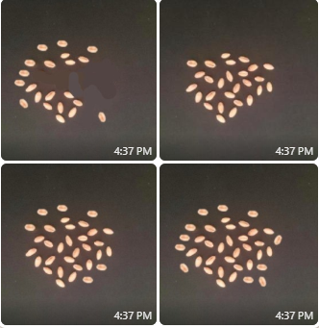
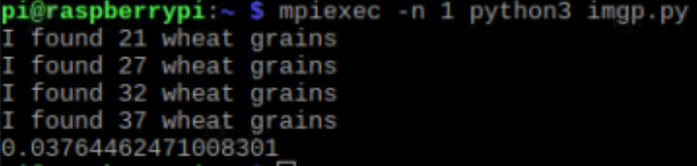
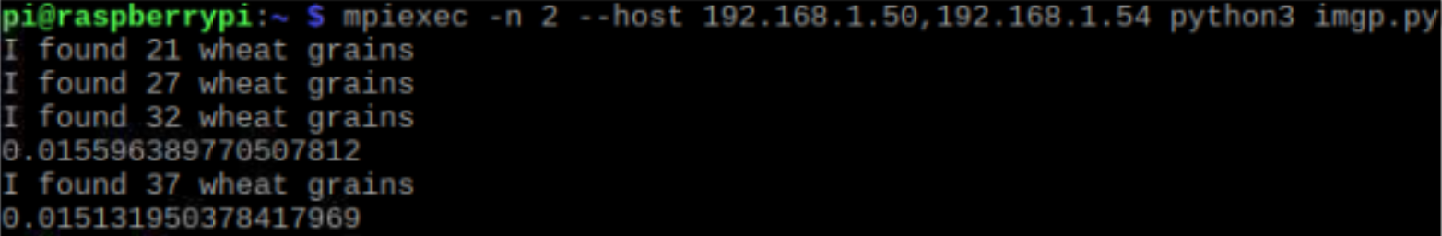
Image processing
Canny edge detection for counting wheat grain
We are using low pass filter (gaussian filter) to remove the noise.
Then we are using canny edge detection to detect the edges.
We now find contours and then count the number of wheat grains
Code:
for i,task in enumerate(task_list):
#This is how we split up the jobs.
#The % sign is a modulus, and the "continue" means
#"skip the rest of this bit and go to the next time
#through the loop"
# If we had e.g. 4 processors, this would mean
# that proc zero did tasks 0, 4, 8, 12, 16, ...
# and proc one did tasks 1, 5, 9, 13, 17, ...
# and do on.
if i%size!=rank: continue
print "Task number %d (%d) being done by processor %d of %d" % (i, task, rank, size)
f(task)
Single node using canny edge detection
Cluster using canny edge detection

Slide 4
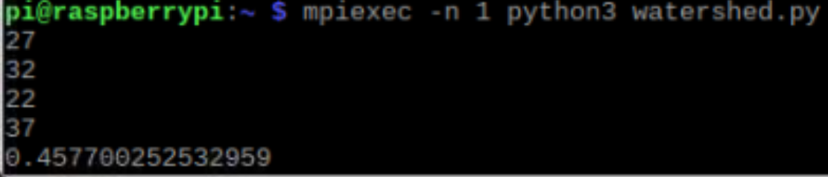
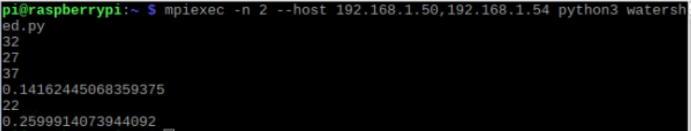
Image processing
Watershed algorithm for counting wheat grain
Threshold the image to a specific value
Apply morphological opening to remove noise.
To remove boundary pixels we apply erosion
As objects are very close we find distance transform
To find area which are the objects we dilate the image
We subtract the foreground area from background area
Then we create marker and apply watershed algo to find the count
Code:
import numpy as np
import cv2
import matplotlib.pyplot as plt
l=['wheat_grain21.jpeg','wheat_grain27.jpeg','wheat_grain32.jpeg','wheat_grain37.jpeg']
for i in range(0,len(l)):
img = cv2.imread(l[i],1)
gray = cv2.cvtColor(img,cv2.COLOR_BGR2GRAY)
ret, thresh = cv2.threshold(gray,0,255,cv2.THRESH_BINARY_INV+cv2.THRESH_OTSU)
kernel = np.ones((3,3),np.uint8)
opening = cv2.morphologyEx(thresh,cv2.MORPH_OPEN,kernel, iterations = 2)
sure_bg = cv2.dilate(opening,kernel,iterations=3)
dist_transform = cv2.distanceTransform(opening,cv2.DIST_L2,5)
ret, sure_fg = cv2.threshold(dist_transform,0.1*dist_transform.max(),255,0)
sure_fg = np.uint8(sure_fg)
unknown = cv2.subtract(sure_bg,sure_fg)
ret, markers = cv2.connectedComponents(sure_fg)
markers = markers+1
markers[unknown==255] = 0
markers = cv2.watershed(img,markers)
img[markers == -1] = [255,0,0]
…..
Single node using watershed algo
Cluster using watershed algo

Slide 5
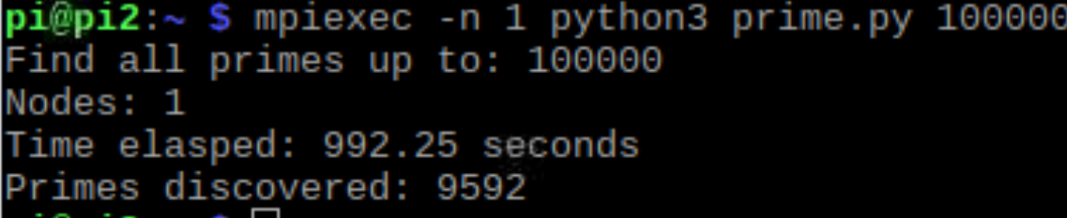
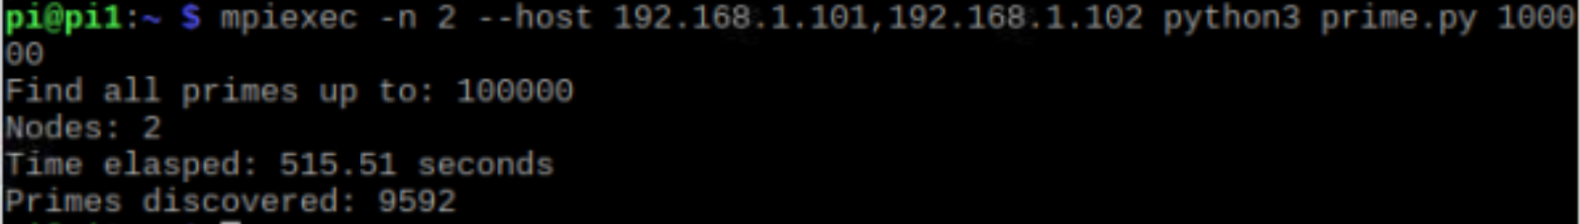
Finding prime numbers
Python code and its working in comments
# If I am the governing node, show the results
if my_rank == 0:
# How long did it take?
end = round(time.time() - start, 2)
print('Find all primes up to: ' + str(end_number))
print('Nodes: ' + str(cluster_size))
print('Time elasped: ' + str(end) + ' seconds')
# Each process returned an array, so lets merge them
merged_primes = [item for sublist in results for item in sublist]
merged_primes.sort()
print('Primes discovered: ' + str(len(merged_primes)))
# Uncomment the next line to see all the prime numbers
# print(merged_primes)
# Go through all previous numbers and see if any divide without remainder
for div_number in range(2, candidate_number):
if candidate_number % div_number == 0:
found_prime = False
break
# If we get here, nothing divided, so it's a prime number
if found_prime:
# Uncomment the next line to see the primes as they are found (slower)
# print('Node ' + str(my_rank) + ' found ' + str(candidate_number))
primes.append(candidate_number)
# Once complete, send results to the governing node
results = comm.gather(primes, root=0)
from mpi4py import MPI
import time
import sys
# Attach to the cluster and find out who I am and how big it is
comm = MPI.COMM_WORLD
my_rank = comm.Get_rank()
cluster_size = comm.Get_size()
# Number to start on, based on the node's rank
start_number = (my_rank * 2) + 1
# When to stop. Play around with this value!
end_number = int(sys.argv[1])
# Make a note of the start time
start = time.time()
# List of discovered primes for this node
primes = []
# Loop through the numbers using rank number to divide the work
for candidate_number in range(start_number, end_number, cluster_size * 2):
# Log progress in steps
# print(candidate_number)
# Assume this number is prime
found_prime = True
Single node
Cluster

Slide 6
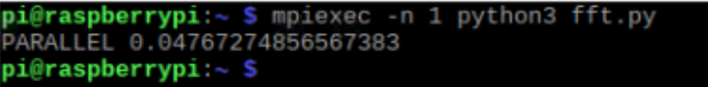
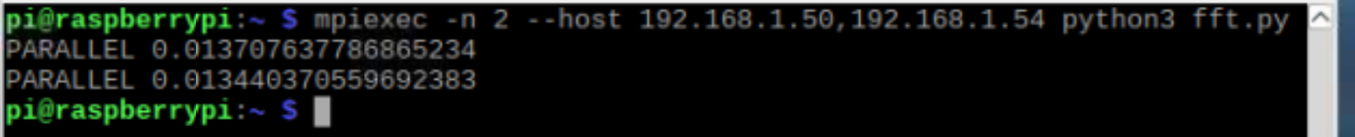
EEG signal processing
Applying FFT on EEG signals
Threshold the image to a specific value
Apply morphological opening to remove noise.
To remove boundary pixels we apply erosion
As objects are very close we find distance transform
To find area which are the objects we dilate the image
We subtract the foreground area from background area
Then we create marker and apply watershed algo to find the count
Code:
x = np.asarray(x, dtype=float)
N = x.shape[0]
if N % 2 > 0:
raise ValueError("must be a power of 2")
elif N <= 2:
return dft(x)
else:
X_even = fft(x[::2])
X_odd = fft(x[1::2])
terms = np.exp(-2j * np.pi * np.arange(N) / N)
return np.concatenate([X_even + terms[:int(N/2)] * X_odd,
X_even + terms[int(N/2):] * X_odd])
Single node
Cluster

Slide 7
Results
For the implementation, a cluster of 2 Raspberry Pi's was taken and its performance was evaluated. The setup consisted of a Raspberry Pi 3b with a quad core 1.2GHz CPU and 1GB RAM and another Raspberry Pi 3b+ model with Cortex A53 @1.4GHz and 1GB RAM, both had Gigabit Ethernet ports which were used to connect to a spare router converted into a switch, all of this made up the cluster.
The software consisted of a custom python code which was used to find prime numbers, count the number of wheat grains from different images, the other used to apply FFT to EEG signal and Watershed algorithm , all were written in python3 and used the Numpy, MPI4PY, Pandas libraries. Here the MPI4PY was the most important as it facilitated most of the intra-cluster communication and processes. MPI was the backbone of these codes.
The processing completion times were calculated and analysed to find out that the 2 node cluster would perform about 50 % better and even 70 % in some cases depending on the heating of the boards and headless conditions
Table: Total seconds taken to perform respective tasks on nodes and cluster
 | Node1 | Node2 | Cluster
Watershed | 0.30 | 0.45 | 0.25
Canny | 0.28 | 0.37 | 0.015
FFT | 0.29 | 0.47 | 0.013
Prime | 992 | 962 | 515

Slide 8
Thanks!
References
https://github.com/mrpjevans/cluster-prime?files=1
https://gist.github.com/joezuntz/7c590a8652a1da6dc4c9
Duˇsan Markovi ́c, Dejan Vujiˇci ́c, Dragana Mitrovi ́c, and Siniˇsa Rani ́c. 2018. Image processing on raspberry picluster.International Journal of Electrical Engineering and Computing, 2(2):83–90
https://towardsdatascience.com/fast-fourier-transform-937926e591cb
https://lucasvr.gobolinux.org/publications/2014-HiPC-IFM.pdf
https://www.researchgate.net/publication/323734475_Parallel_Computing_for_Artificial_Neural_Network_Training_using_Java_Native_Socket_Programming

