Slide 1
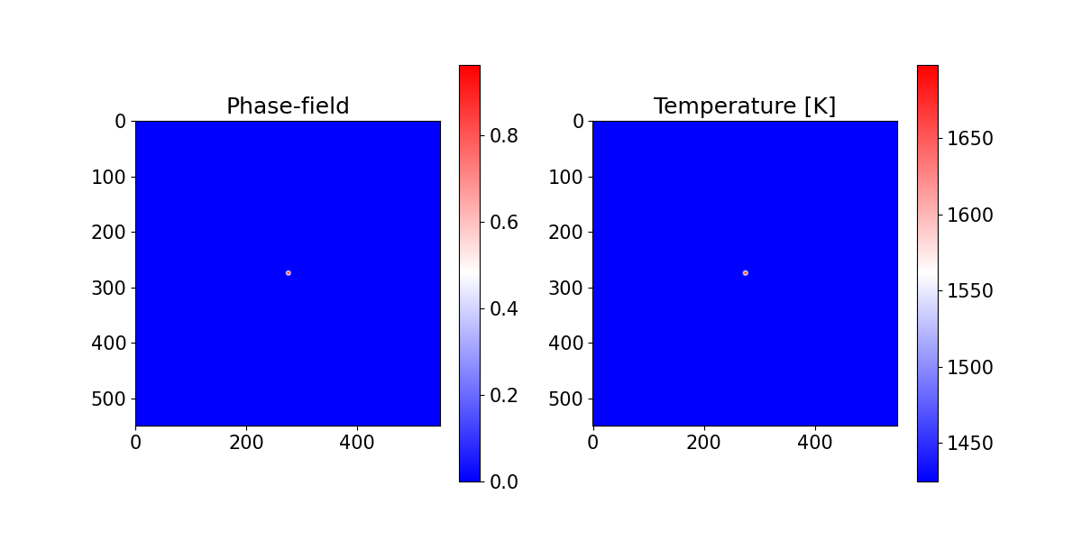
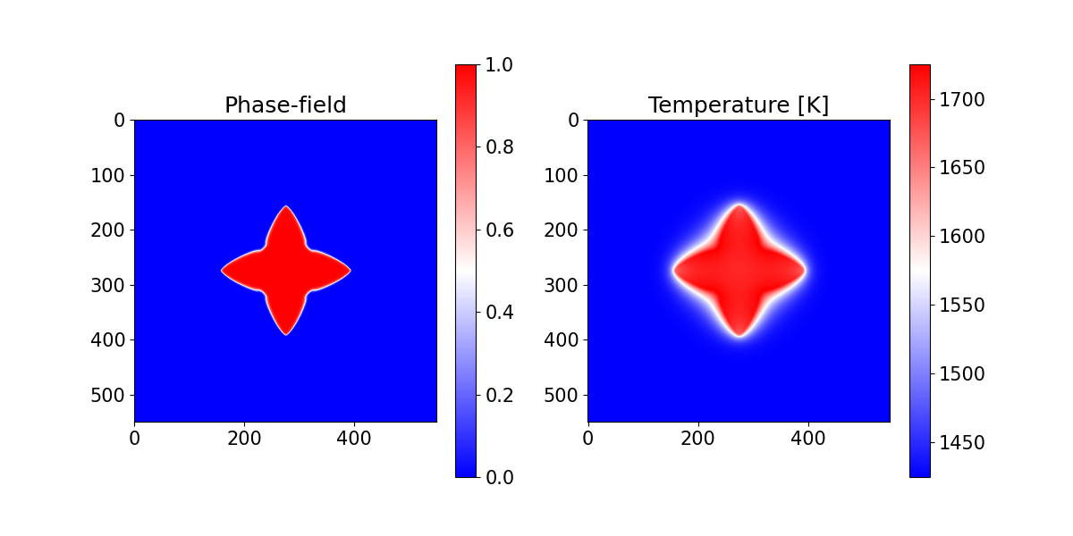
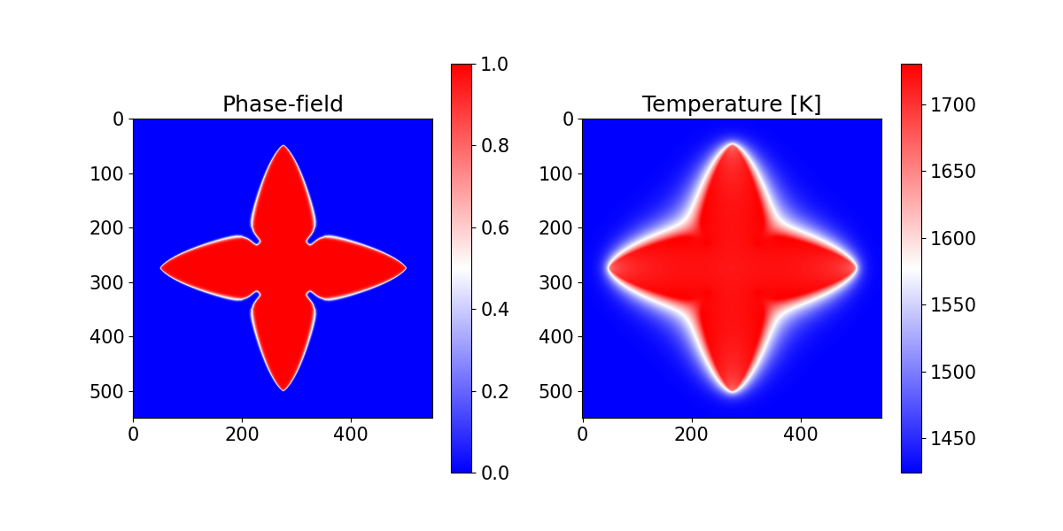


0s
$2.25×{10}^{−8}$ s
$4.5×{10}^{−8}$ s

Slide 2
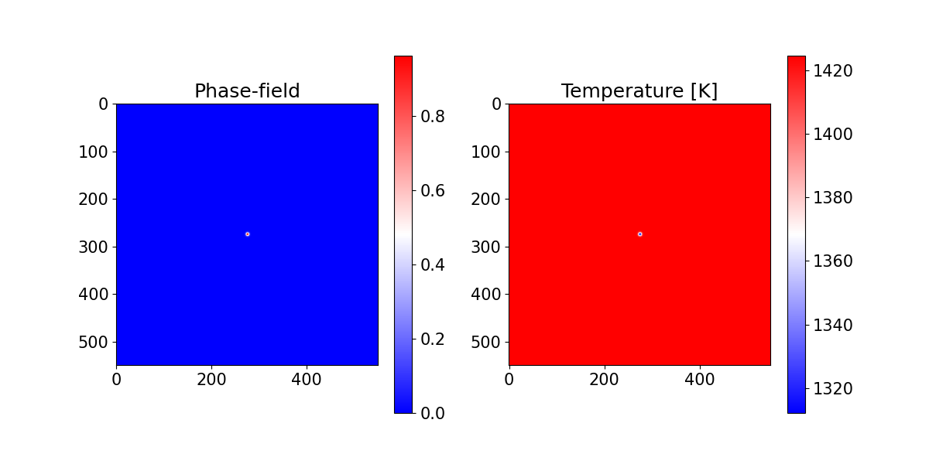
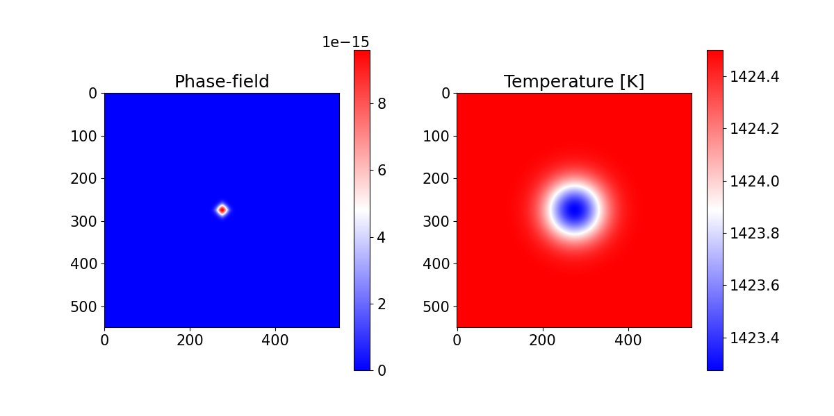
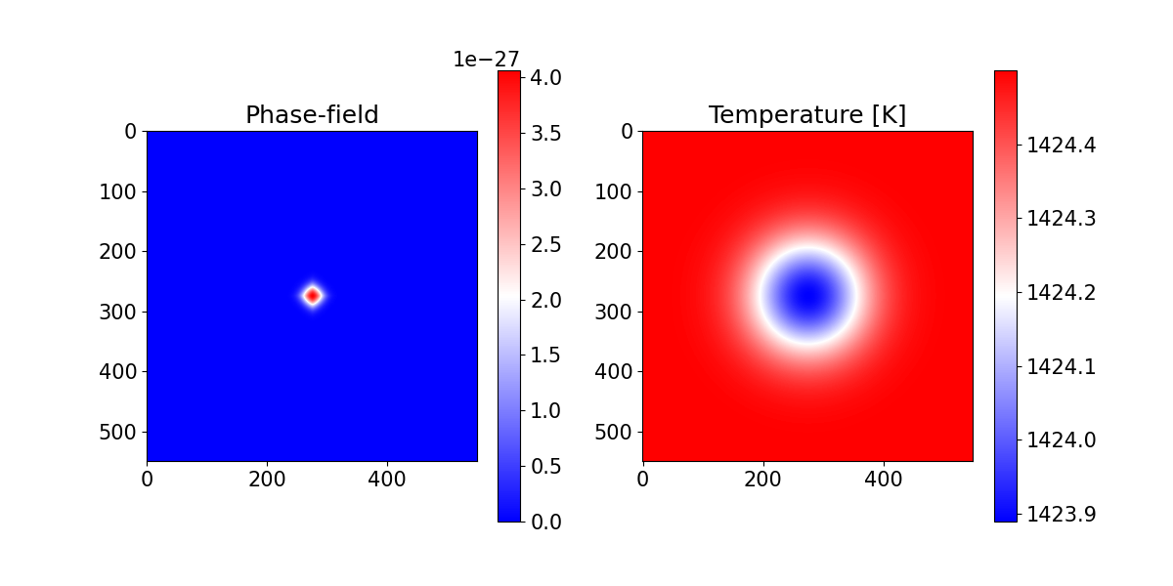


0s
$2.25×{10}^{−8}$ s
$4.5×{10}^{−8}$ s

Slide 3
