Slide 1
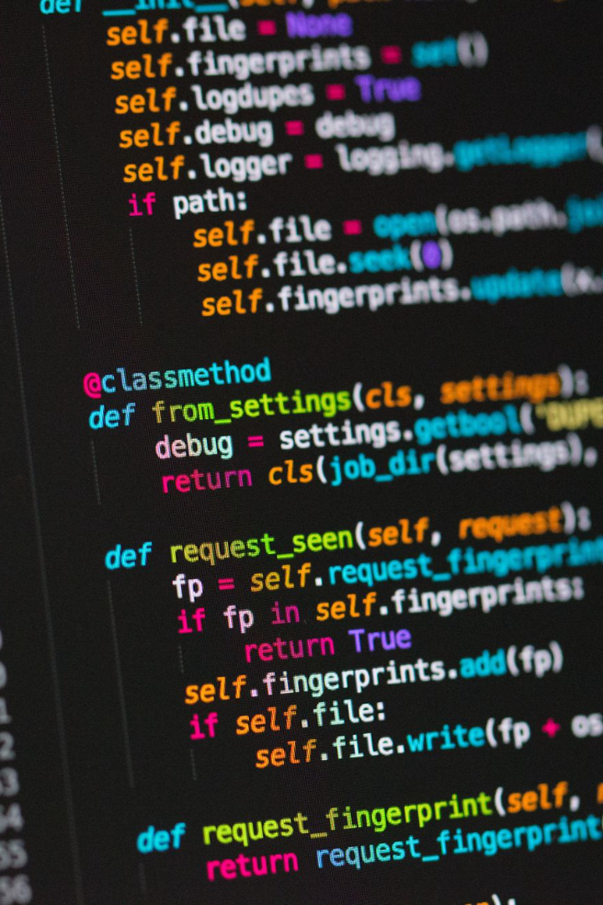
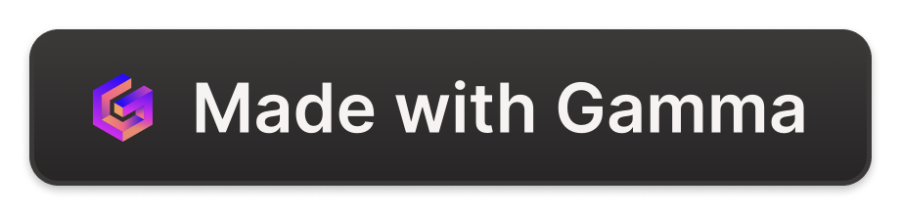
All Details About Python
Python is a powerful and versatile programming language that has become increasingly popular over the years. In this presentation, we'll explore the history, applications, features, libraries, and resources of this language.
AT
by Abhay Tiwari

Slide 2

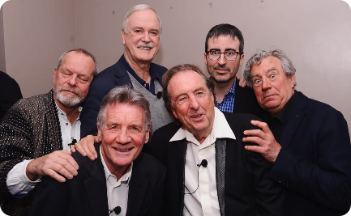
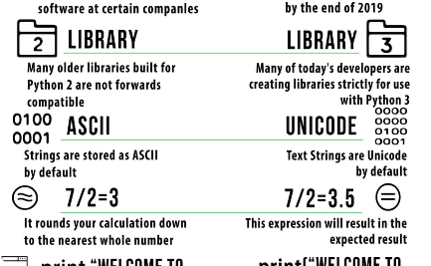
The History of Python
Creation
Name
Versioning
Python was created by Guido van Rossum in the late 1980s and first released in 1991.
The language was named after the TV show Monty Python's Flying Circus, as a nod to the creator's love for the comedy group.
Python 2 was the most widely used version until 2020, when Python 3 finally surpassed it in adoption.

Slide 3
Python Applications and Use Cases
Data Science 📊
Web Development 🌐
Python is widely used in data analysis, machine learning, and artificial intelligence.
Python frameworks like Django and Flask have made web development faster and easier than ever before.
Automation 🤖
Scientific Computing 🔬
Python can automate a wide range of tasks, from file management to testing to web scraping.
Python's simplicity, ease of use, and vast collection of libraries make it a popular choice among scientists and researchers.

Slide 4
Python Features and Syntax
1
Readability
Python's syntax is designed to be easy to read and understand, making it an ideal language for beginners and experts alike.
Dynamic Typing
2
Python is a dynamically typed language, meaning variables are not bound to a specific data type and can be changed on the fly.
3
Object-Oriented
Python supports object-oriented programming, which allows for efficient and reusable code.

Slide 5
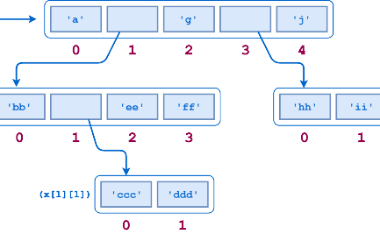

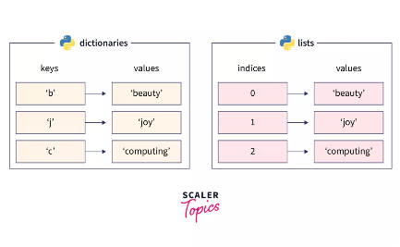
Python Data Types and Structures
Lists
Tuples
Dictionaries
A collection of ordered and changeable elements.
An ordered sequence of elements that cannot be changed.
A collection of unordered, changeable, and indexed key-value pairs.

Slide 6
Python Libraries and Frameworks
NumPy
Pandas
Matplotlib
A library for working with arrays and matrices.
A library for data manipulation and analysis.
A library for creating data visualizations.

Slide 7

Resources for Learning Python
1
Python.org
2
Codecademy
3
Stack Overflow
The official website for Python offers documentation, tutorials, and downloads.
A website that offers a free interactive Python course for beginners.
A community-driven Q&A website where users can ask and answer Python-related questions.

Slide 8

Conclusion
Python is an incredibly versatile language with applications across a wide range of industries. Its simplicity, ease of use, and large community make it an ideal choice for both beginners and experts. With a vast collection of libraries, resources, and frameworks, the possibilities of what you can achieve with Python are endless.

