Slide 1
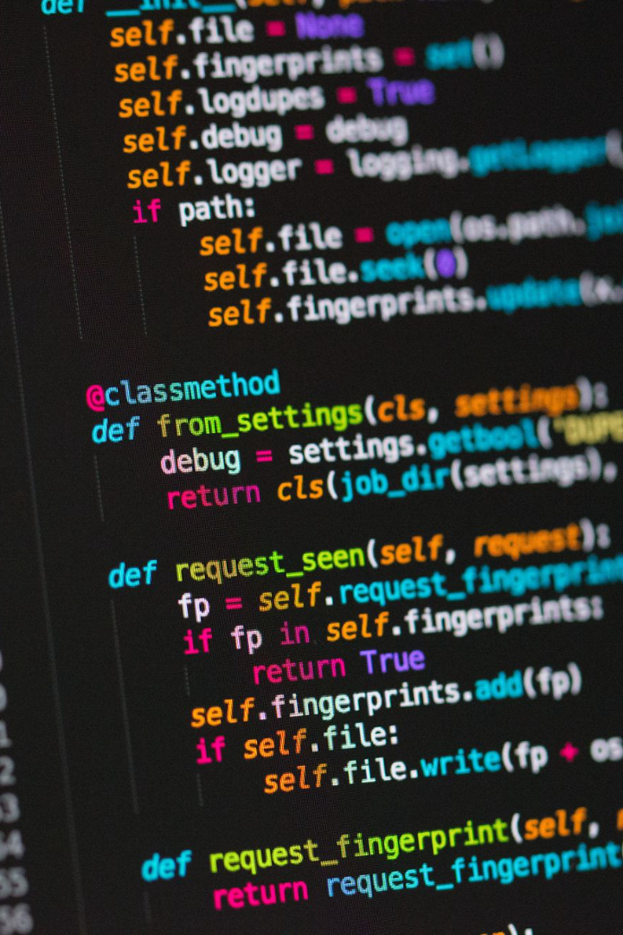
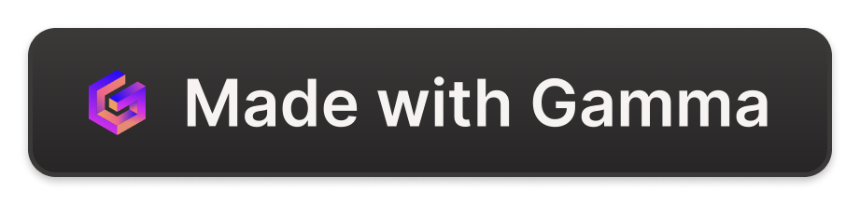
Discover the Power and Beauty of Python
Welcome to the world of Python - the robust, easy-to-learn, and easy-to-use programming language that can help you bring your ideas to life.

Slide 2

History and Background of Python
1
Created by Guido van Rossum 🇳🇱
2
Named after Monty Python's Flying Circus 🐍🎭
3
Open-source and constantly evolving 💻
Python was developed in the late 1980s by Guido van Rossum, a Dutch programmer who wanted to create an easy-to-use language for developers.
The name of the language was inspired by Monty Python's Flying Circus - a British sketch comedy series - showing that Python doesn't take itself too seriously.
Python is open-source and has a large community of developers who are constantly working to improve it and create new libraries and frameworks.

Slide 3
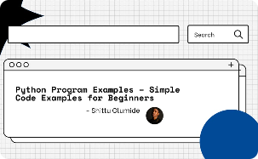

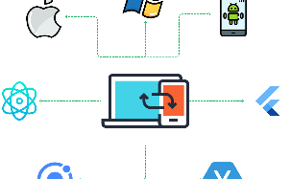
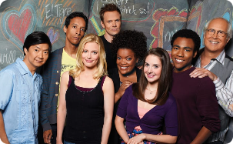
Features and Advantages of Python
Easy to Learn
Powerful Libraries
Cross-Platform and Compatible
Python has a syntax that is easy to read and understand, making it perfect for beginners.
Python has numerous libraries for data analytics and machine learning, making it the go-to language for these fields.
Python runs on all major operating systems and is compatible with many other languages like C and Java, making it versatile and flexible.
Large Community and Support
Python has a vast and active community of developers who offer support and share knowledge and resources.

Slide 4
Basic Syntax and Data Types in Python
Operators and Expressions
Python has a variety of operators, including arithmetic, comparison, and logical operators, and supports a range of expressions like slicing and indexing.
Loops
Python supports both for and while loops for repetitive execution of code.
1
2
3
4
Variables and Data Types
Conditional Statements
Python supports several data types, including numbers, strings, and lists, and supports dynamic variable declaration and assignment.
Python uses if-elif-else statements to control program flow according to logical conditions.

Slide 5
Control Statements in Python
Break and Continue Statements
Pass Statement
Try and Except Statements
The pass statement is used as a null operation to indicate an empty block of code.
Python's break and continue statements are used to control the flow of execution in loops.
The try and except statements are used for error handling and to gracefully handle exceptional conditions in code.

Slide 6
Functions and Modules in Python
Modules
Modules are files containing Python definitions and statements that can be imported and used in other scripts, making code modular and reusable.
1
2
3
Functions
Libraries
Functions are a way of encapsulating code for reuse and easier maintenance. Python has various built-in functions and supports user-defined functions.
Python has a wealth of libraries and frameworks to extend functionality and accelerate development.

Slide 7
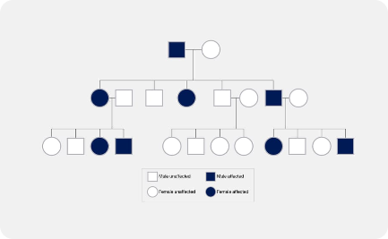
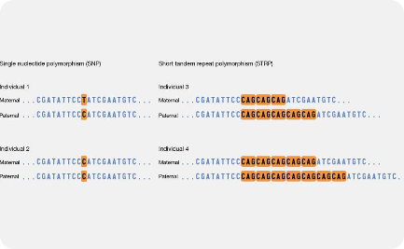
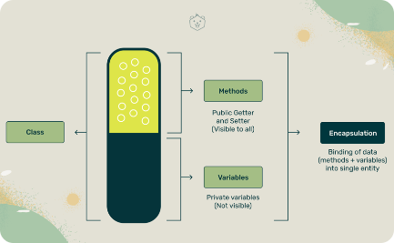
Object-Oriented Programming (OOP) in Python
Inheritance
Polymorphism
Encapsulation
Python supports inheritance, allowing classes to inherit attributes and methods from parent classes.
Polymorphism is supported in Python, allowing objects to take different forms depending on the context in which they are used.
Python supports encapsulation, the process of hiding functionality and data inside objects, promoting code modularity and security.

Slide 8
Applications of Python in Different Fields
Data Science 🧪
Web Development 🕸️
Artificial Intelligence 🤖
Python is a popular language for data science and has libraries like NumPy, pandas, and scikit-learn for data analysis and machine learning.
Python has several web frameworks like Django and Flask that make web development easy and straightforward.
Python is the go-to language for artificial intelligence and has numerous libraries and frameworks for tasks like natural language processing and computer vision.
Python is used in various industries like finance, healthcare, and government for data analysis and decision making.
Python's simplicity and readability make it an excellent choice for creating scalable and robust server-side applications.
Python is used for developing AI systems like chatbots, recommendation engines, and autonomous vehicles.

