Slide 1
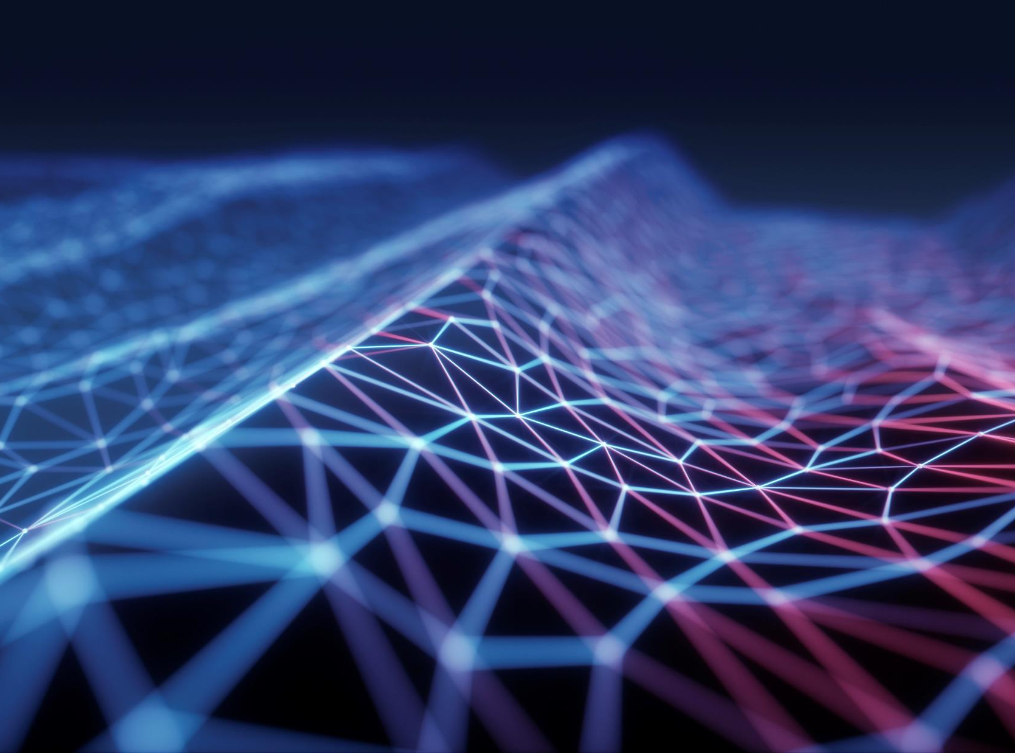
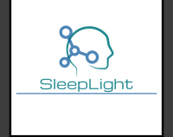
SleepLight
SleepWell with personalized dusk and dawn

Slide 2
problem
Our modern lifestyle often prevents us from receiving natural cues that aid in a healthy sleep cycle.
It is difficult to manage circadian rhythms and many times we are forced to sleep in unfamiliar environments or faced with negative stimuli.

Slide 3
Solution
SleepLight is a comfortable and lightweight smart sleep mask that blocks out unwanted light and provides its own-colored hues to trigger your body’s natural responses (serum melatonin). Blue hues are used to wake you gently and effectively in the morning before your chosen alarm time, and red-toned light helps you fall asleep at night. These are the same light cues used by NASA to regulate sleep on the space station and customize your body’s circadian rhythm.

Slide 4
Potential market
In 2019, the Market Size for Smart Sleep Devices was $15.590 Billion
Compounded Annual Growth Rate (CAGR) is expected a rate of 18.5%
By the end of 2026, the market size is expected to reach $43.470 Billion
Most of the market share is in North America with over 55% of the market
According to research by MarketWatch and Nester Research

Slide 5
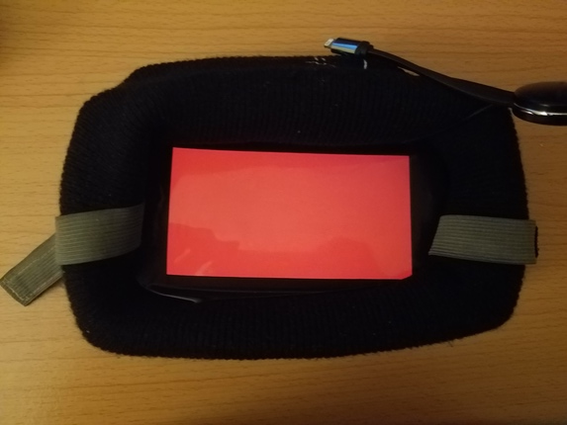

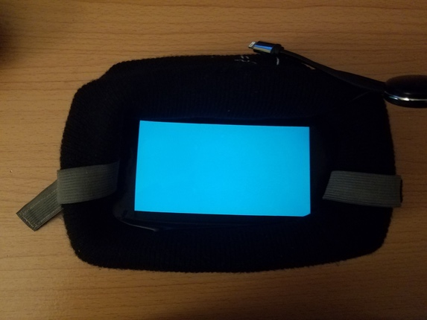
Traction
SleepLight was formed during HackGT HealthTech Hackathon and Won Best Inpatient.
The prototype has been created and successfully tested, we also have published a demo and are working on a marketable prototype with lowered costs.
https://devpost.com/software/sleeplight
https://www.youtube.com/watch?v=Ha7YMirltc4

Slide 6
Team
Aditya Singhal: GT CS Student with drive and motivation, Many Hackathon Victories and Strong Code and Product Development Skills. Internship Experience at High Growth Tech Companies and Incoming at FAANG.
Laith Qushair: Auburn EE Student, Many Hackathon Victories and Hardware Engineering background in Product Development. Has Professional experience with building tangible electronics with hardware and software.

Slide 7
Competition
Our competitors in this Category have small market share and primarily pursue smart glass-based/non-customizable products for one size fits all solution wear and lack brand awareness.
SleepLight is customizable solution that uses software to allow users to customize their sleep schedules and/or load pre-written patterns to their liking. In addition, the design is modular in nature allowing for addition of custom noises and integrations with other IoT devices – a competitive edge that is not available in the marketplace.
Pegasi | Active Performance Sleep Glasses | Product is not suitable for average use ($$$) and is not wearable while sleeping
Manta | Sleep Mask | Focused on temperature adjustment and no software compatibility to regulate sleep
Award Winning Sleep Mask | Red Light Sleep Mask | Only uses red LEDs and has no ability to customize sleep schedule or interact with software.

Slide 8
Product https://devpost.com/software/sleeplight
Hardware Based Product with Software Packaged In Form of Web and Mobile App interface.
Potential for Software Based licensing Model
Potential for Recurring Revenue with Software as a Service (SaaS) Model
Potential for SleepLight Marketplace to provide custom SleepLight Patterns
This Gives Our Product A Competitive Edge as we can Provide Cloud Updates and Tailor to specific sleep patterns instead of a One-Size-Fits all approach of competitors
Modular Build Allowing for Easy supplemental audio and sensory sleep aids
IOT Landscape Connection Possible
Cost Effective Build at Scale = Large Sales Margins for Hardware
A baseline product with ESP32 Chips and IoT Wi-Fi capabilities will cost 7.50 at scale and 11.50 for lower volume.
Software Margins at 95%+ for SaaS Model
Based on Market Research subscription revenue will be priced at $1.99-3.99 monthly or discounted $19.99-39.99 for 1-year.
Software only has upfront development costs and will continue to generate revenue.

Slide 9
SleepWell with personalized dusk and dawn

Slide 10
SleepLight

