Slide 1
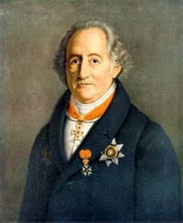
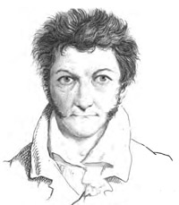
Year categorization
of German literature

Slide 2
Motivation
Style of classical literature changed drastically in time
Usage of words
Sentence structure
Is the publishing year detectable by text alone?

Slide 3
Overview
Collection of data: Web Scraping
Data filtering / processing: Tokenization tools from NLTK
Results and Discussion
Ideas for improvement

Slide 4

Data Collection
Wikipedia
Authors who published books in the from the in 18th - 20th century
Periods covered: Enlightment (Aufklärung), Sensibility (Empfindsamkeit), Sturm und Drang, Classicism, Romanticism, Realism, Naturalism
Year of birth / death
projekt-gutenberg.org
Collection of books / chapters that are free of copyright
Year of first publication (if stated)
about 25,000 chapters collected

Slide 5
Data filtering / Processing
Publication year:
No publication year mentioned
Year does not fit birth / death year of author
Chapters:
Collections of books / poems
Additional sites containing information about projekt-gutenberg.org
Tokenization:
Chapters too short to contain useful information
~ 11,000 chapters left by 41 different authors

Slide 6
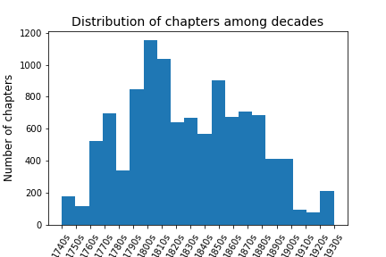
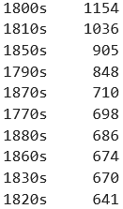
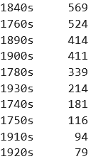
Decade count Decade count

Slide 7
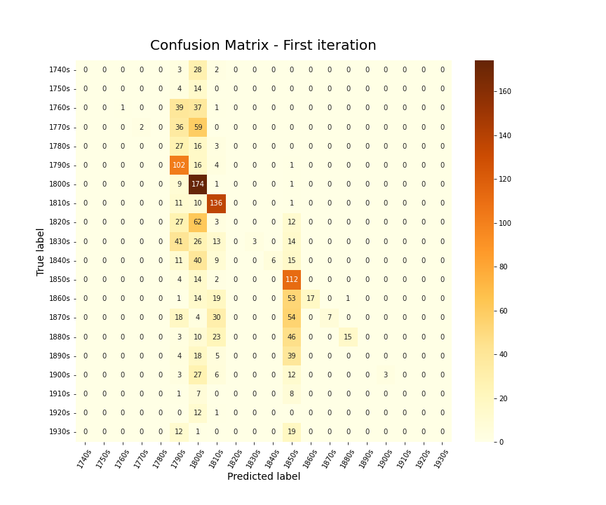
First iteration:
Only kept tokens that consist solely of alpha-character.
Max: 500 tokens per chapter
Results:
Biased predictions due to unbalanced data
every prediction for the decades 1760s, 1770s, 1830s, 1840s, 1860s, 1870s, 1900s is correct!
Accuracy: ~35%

Slide 8
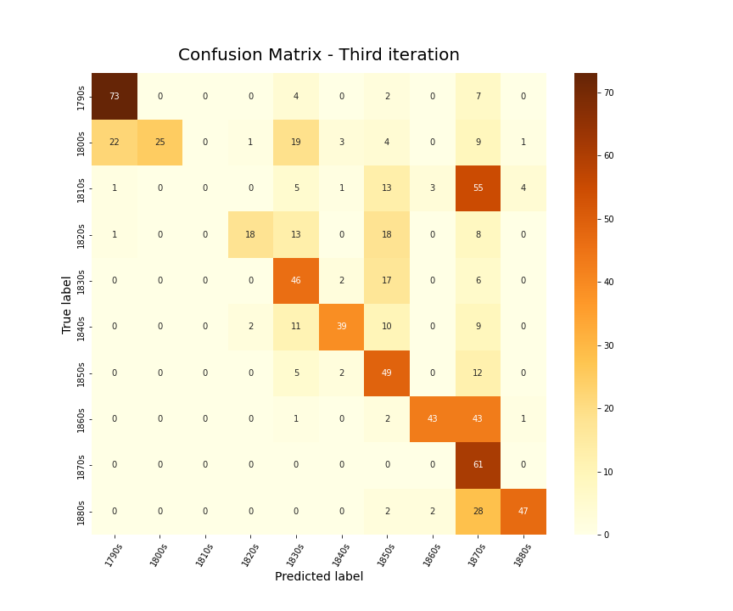
Third iteration (Downsampling):
Restriction to “popular” decades
500 chapters for each decade
no token restriction
Results:
Mostly predictions along the main diagonal
1810s and 1870s stand out
Accuracy: ~53%

Slide 9
Improvement Ideas
Predict training data to check for overfitting
Error analysis
Collect more data
from decades that are underrepresented
from more authors to have more diversity per decade
Other Classification models / Deep Learning techniques
Preprocessing:
stop-word removal
Remove Character names and names of places
Predict literature period instead of publication decade

Slide 10


Slide 11
Goethe, 8. Juni 1821

