Slide 1
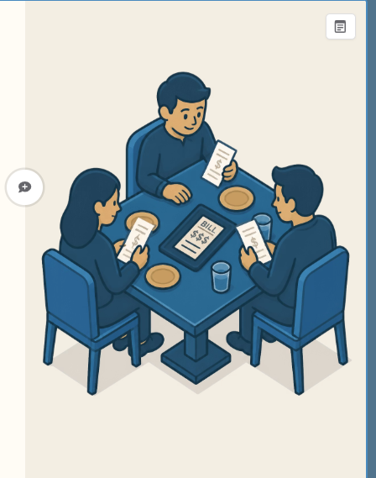
SplitSmart
Modern Expense Sharing Application
M. Atchaya
B . Tech Information Technology
IV Year
NIET

Slide 2


Problem Statement & Objectives
Problem
Objectives
Difficult to manage shared expenses
Manual calculations are error-prone
Hard to track balances
Simplify expense sharing
Secure user authentication
Automatic balance calculation

Slide 3






Technology Stack
React.js
Spring Boot
Spring Security
Interactive UI
Backend APIs
Secure Access
JWT
H2 Database
Postman
Token Authentication
Data Storage
API Testing

Slide 4

System Architecture
User
End user on browser
React.js Frontend
Interactive UI layer
Spring Boot Backend
REST API over HTTP
Spring Security (JWT)
Authentication & authorization
Spring Data JPA
Persistence layer
H2 Database
Data storage

Slide 5





Key Features
User Registration
User Login
JWT Authentication
Quick and simple sign-up
Fast, secure sign-in
Token-based session security
Group Management
Expense Management
Balance Calculation
Create and manage groups
Add and organize expenses
Automatic, accurate settle-ups

Slide 6
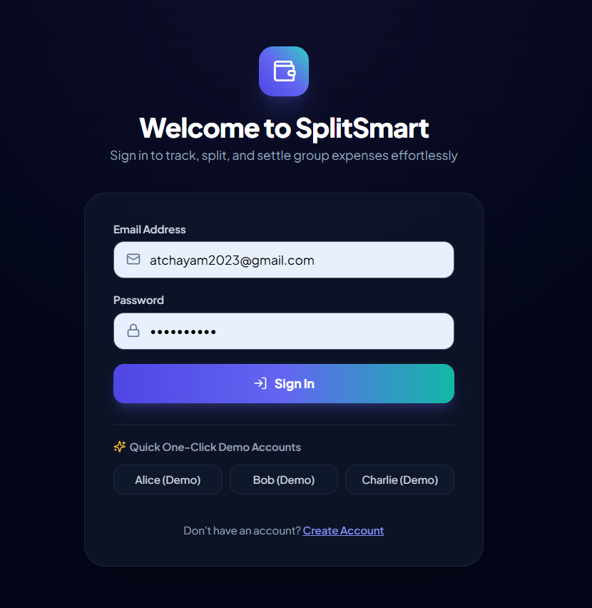
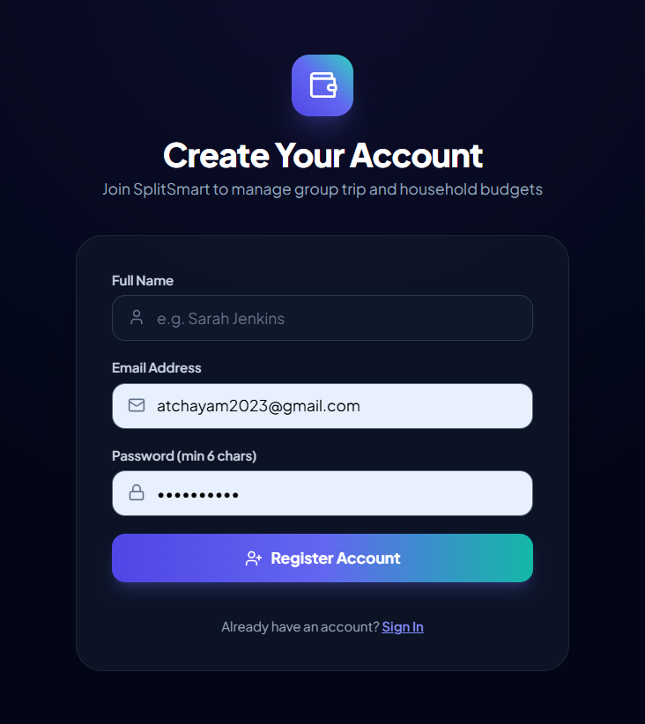
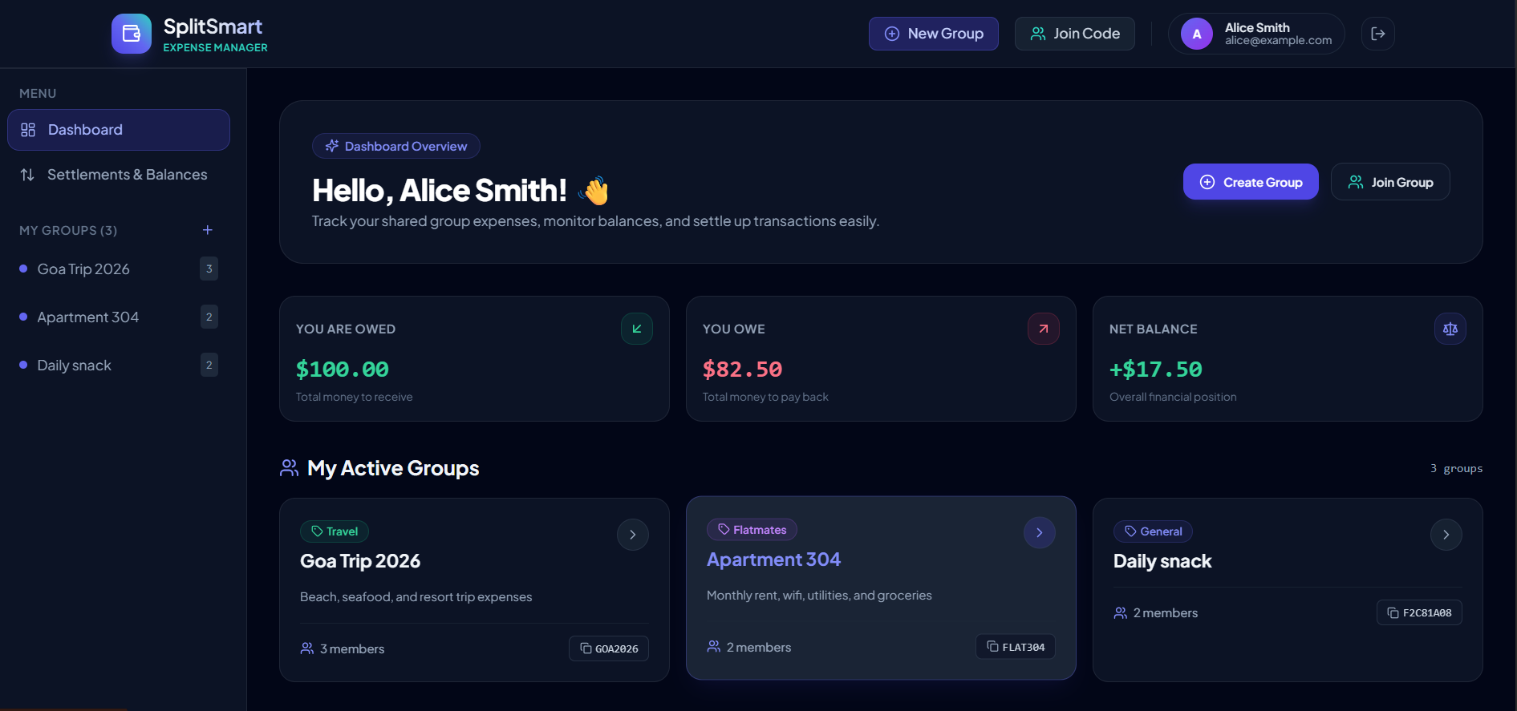
Application Screenshots
A look at the SplitSmart user interface
Sign In
Create Account
Dashboard
Quick access with demo accounts
Simple onboarding in seconds
Track balances at a glance

Slide 7


Conclusion
Highlights
Future Scope
Secure and easy expense-sharing application
Reduces manual calculations
Improves expense tracking
MySQL
UPI Payments
Mobile App
Expense Reports

