Slide 1



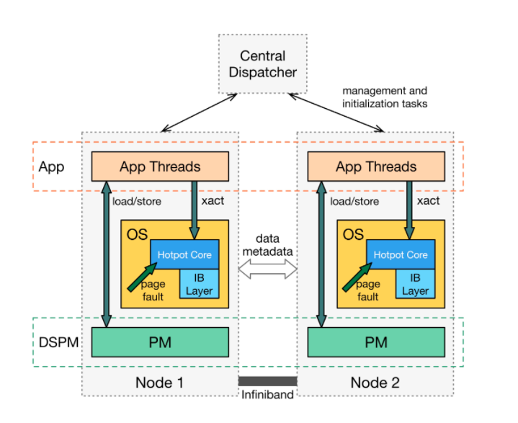
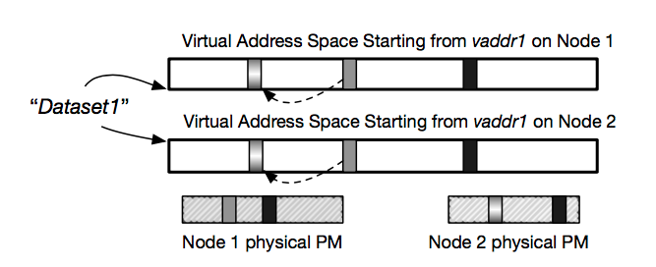
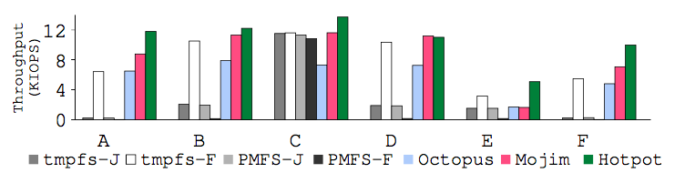
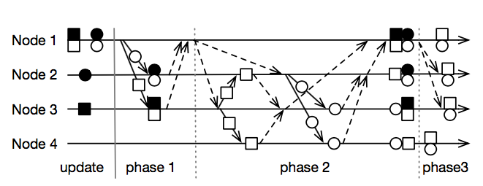
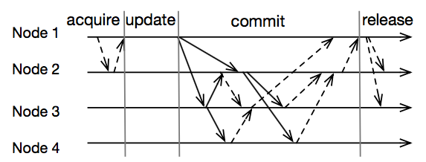
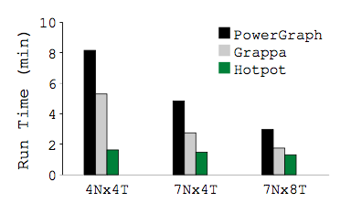
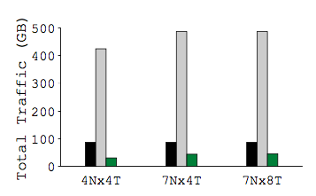
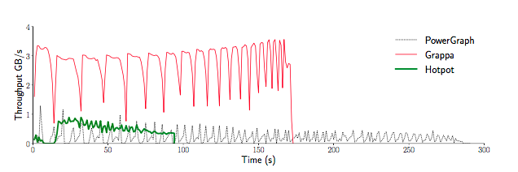
Distributed Shared
Persistent Memory
Yizhou Shan, Shin-Yeh Tsai, Yiying Zhang
Distributed Shared Persistent Memory (DSPM)
Motivation
A New Framework for Persistent Memories (PM)
Persist data by using load/store
Using distributed PM in data centers
Integrate Memory Caching and Replication
One layer approach
No data marshaling/unmarshalling
Global, shared, and persistent memory space
Accesses to Distributed PM
Utilize distributed PM
Transparent remote access
Scale-out datacenter applications
Emerging PM
3DX-point
PCM, STTM
Applications
TensorFlow
PowerGraph
Lack of Distributed PM
Storage system target block devices
Memory system designed for DRAM
Fast Network
InfiniBand NIC
Remote Direct Memory Access
Our Solution: Hotpot
Hotpot Architecture
A kernel-level DSPM system
Flexible data consistency levels
Direct load/store access to distributed PM
High reliability and availability
Hotpot Node
Direct load/store to PM
Efficient transaction APIs
Efficient network stack
Central Dispatcher
Manage hotpot nodes
Initialize tasks
Lightweight
Benefits
Low latency
High throughput
One layer approach
Persistent Naming and Addressing
Dataset
Similar to file concept
No directories in Hotpot
Flat naming is easy and efficient
Global Consistent and Persistent Pointers
Pointers can sustain power failures
Always valid across multiple run
Evaluation
Environment
Xeon E5-2620 v3, 128 GB DRAM
40Gbps Mellanox ConnectX-3 IB card
Centos 7.1 distribution and 3.11.1 linux kernel
Data Durability and Reliability
MongoDB and YCSB throughput
Modified MongoDB v2.7.0 storage engine for Hotpot
3 nodes running MongoDB
10K ops on a database with 100K 1 KB records
Multiple Readers Multiple Writers
MRMW
Distributed atomic commit protocol
Concurrent versions of dirty data
Lazy synchronized
Multiple Readers Single Writer
MRSW
Trade parallelism for consistency
One writer to a PM page at a time
Eager synchronized
MRMW Commit Example
MRSW Commit Example
Distributed (Persistent) Graph
In-house graph engine based on Hotpot
PageRank with Twitter (41 M vertices, 1 B directed edges)
Hotpot APIs
API | Explanation | Backward
open (close) | Open or create (close) a DSPM dataset | Same as current
mmap (munmap) | Map (munmap) a DSPM region in a dataset to application address space | Same as current
commit | Commit a set of data and make N persistent replicas | Similar to msync
acquire | Acquire single writer permission
thread-barrier | Helper function to synchronize threads on different nodes | Similar to pthread barrier
Notes:
1

