Slide 1
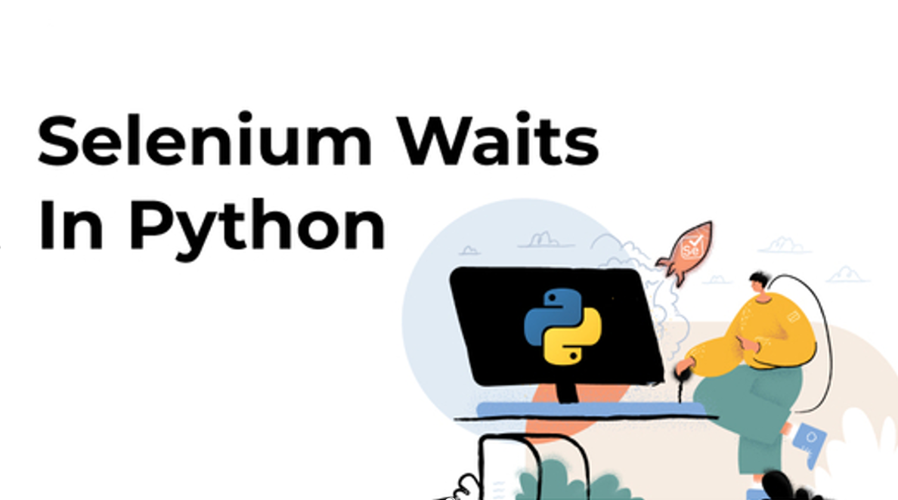



Slide 2
AGENDA
Introduction
Sleep
Why Waits and Uses
Various Waits
Difference b/w Waits and Sleep

Slide 3

INTRODUCTION
When a page is loaded by the browser, the elements which we want to interact with may load at different time intervals. On that time Exception occurs.
An exception is an event, which occurs during the execution of a program that disrupts the normal flow of the program's instructions.
While interacting with Web Elements, Exception occurs. why?
a)It ‘ll occur when the Element is not found in the DOM.
Reasons,
Element is present in DOM but not visible.
Element is present in DOM but not interactable(Enabled).
How to Handle?
Either by using Sleep or Waits Concept.

Slide 4
Sleep
The Sleep function will pause the execution of a current Thread for a specified number of seconds.
Python has a module named “time” which provides this function “Sleep”.
Time consumption is more while use Sleep concept.
SYNTAX:
time.sleep(s)
DEMO.....

Slide 5
Waits
Wait commands direct a test script to pause for a certain time before throwing an Exception.
During automated testing of websites, issues may occur due to variations in time lag for loading web elements. Wait commands help observe and troubleshoot these issues.
Uses of Waits:
Case 1: Uploading files
when you try to upload files using Selenium test automation scripts, you will need to implement Selenium Wait in Python for realizing the successful uploading of the file.
Case 2: Conditional load of Page Elements
Certain websites have some components or elements hidden, or not visible at an initial stage. They can be interacted with only after some preset conditions are met.
For example – On a movie ticketing website, the button for booking a seat becomes available only after some preset time.

Slide 6
Various Waits
Implicit Wait
Explicit Wait
Fluent Wait
Implicit Wait:
Implicit Wait is Generic.
It ‘ll wait till the Element present in DOM, but it won't look up for the interaction and visiblity.
It ‘ll poll DOM for eacy & every 0.5 seconds of time interval by default.
SYNTAX:
driver.implicitly_wait(s)
DEMO.....

Slide 7
Explicit Wait:
Explicit wait allows to command the webdriver to wait until several conditions are met.
How to use:
create WebDriverWait instance(Object).
wait until conditions to be met.
SYNTAX:
WebDriverWait wait = new WebDriverWait(driver,s);
wait.until(ExpectedConditions.element_to_be_clickable(By.xpath(“xpath”));
Conditions such as,
element_to_be_clickable()
element_to_be_selected()
presence_of_element_located()
text_to_be_present_in_element()
visibility_of_element_located()
invisibility_of_element() and so on... DEMO.....

Slide 8
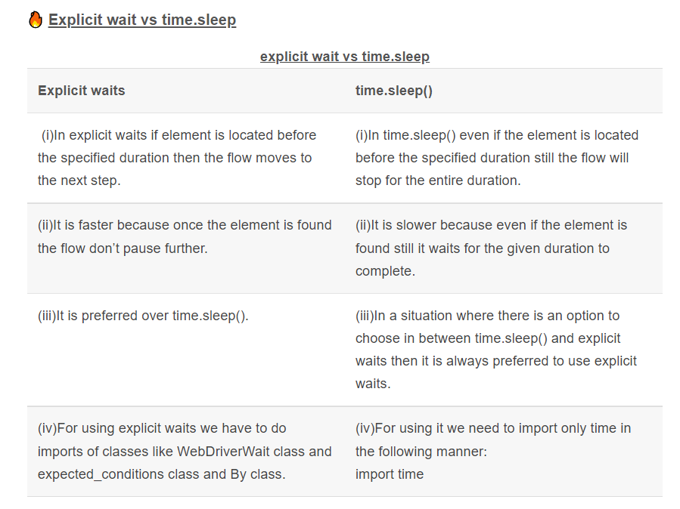
Difference b/w Sleep & Explicit wait

Slide 9
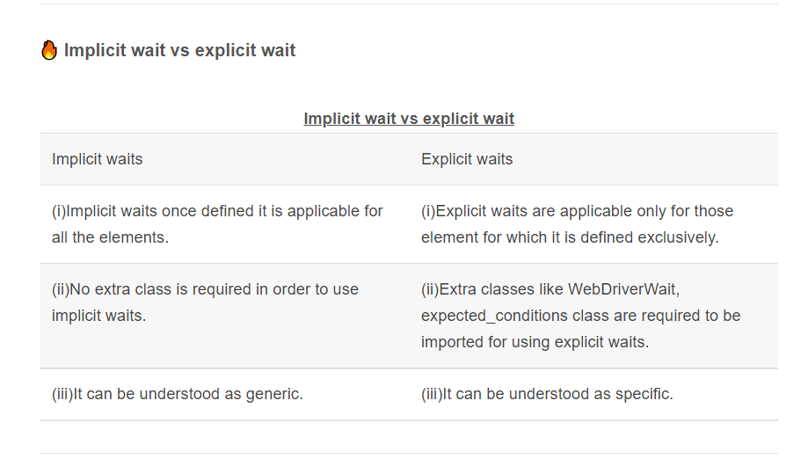
Diff b/w Implicit & Explicit wait

