Slide 1
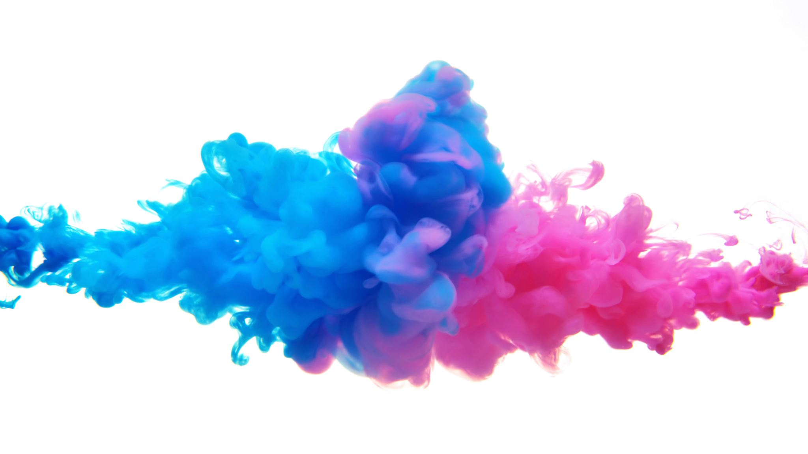
StylizeMe Controllable High-Resolution Artistic Style Transfer
Atesam 2021114
Huzaifa 2021234

Slide 2

Problem Statement
Problem Statement: Preserving Content While Transferring Artistic Style in Images
The ability to transfer the artistic style of one image (style image) to another image (content image) while preserving the content of the latter is a challenging task in computer vision.

Slide 3
Introduction
StyleGAN: Generative Adversarial Networks (GANs) are a type of artificial intelligence that can create incredibly realistic images. StyleGAN, a powerful GAN architecture, excels at generating faces and allows for manipulation of features like eye color and hair style through a special code.

Slide 4
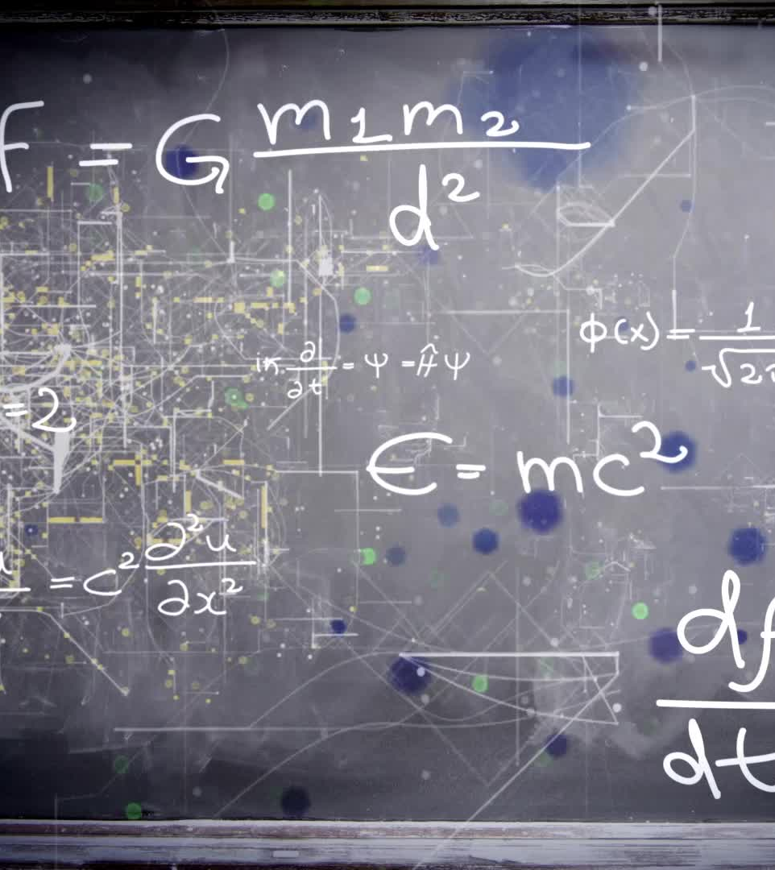
StyleGAN
Generator vs. Discriminator in adversarial training
Latent space: Controls image features
StyleGAN: Controls facial features with latent vectors

Slide 5
Dataset
Flickr Faces High-Quality (FFHQ) is a large dataset of human faces specifically designed for training and evaluating deep learning models related to facial images. Here's a closer look at its key aspects:
Source: FFHQ was created by NVIDIA in 2019 by scraping Flickr photos.
Data Selection: The dataset includes 70,000 high-resolution PNG images (1024x1024 pixels) containing faces of people from diverse ages, ethnicities, and backgrounds.

Slide 6
methodology
We Used AnimeGAN.
AnimeGAN is a Generative Adversarial Network (GAN) designed specifically to create high-quality anime-styled images.
The generator, typically a convolutional neural network (CNN), takes a random noise vector as in
The discriminator, another CNN, tries to differentiate between real anime images and those generated by the generator.put and aims to produce an anime image.

Slide 7
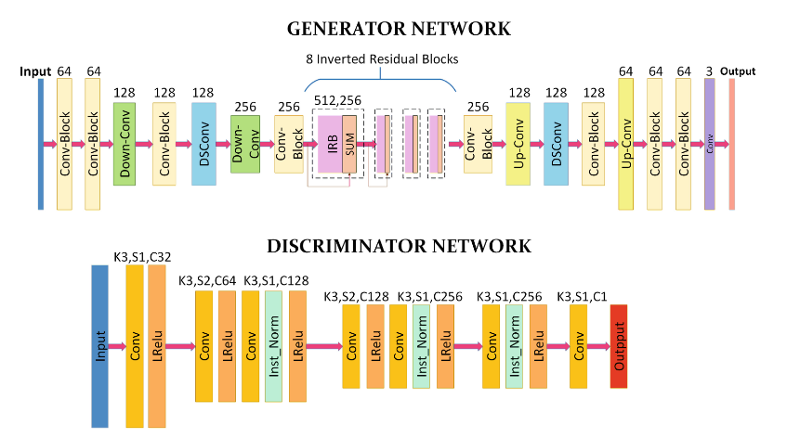
Model Architecture

Slide 8
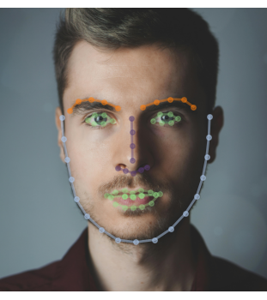
Methodology(2)
First, we find facial Landmarks from the face.
Then it visualizes the generated style upon the original image using the facial Landmarks.

Slide 9
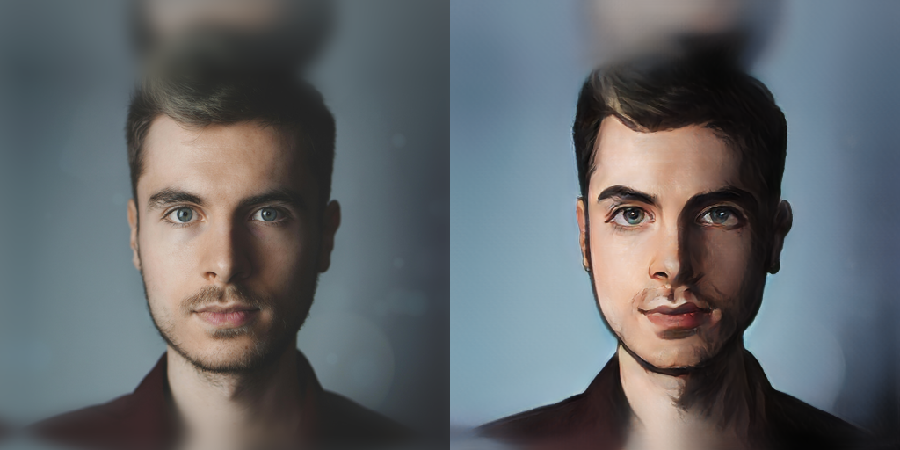
Result

Slide 10

Thank You!

