Slide 1
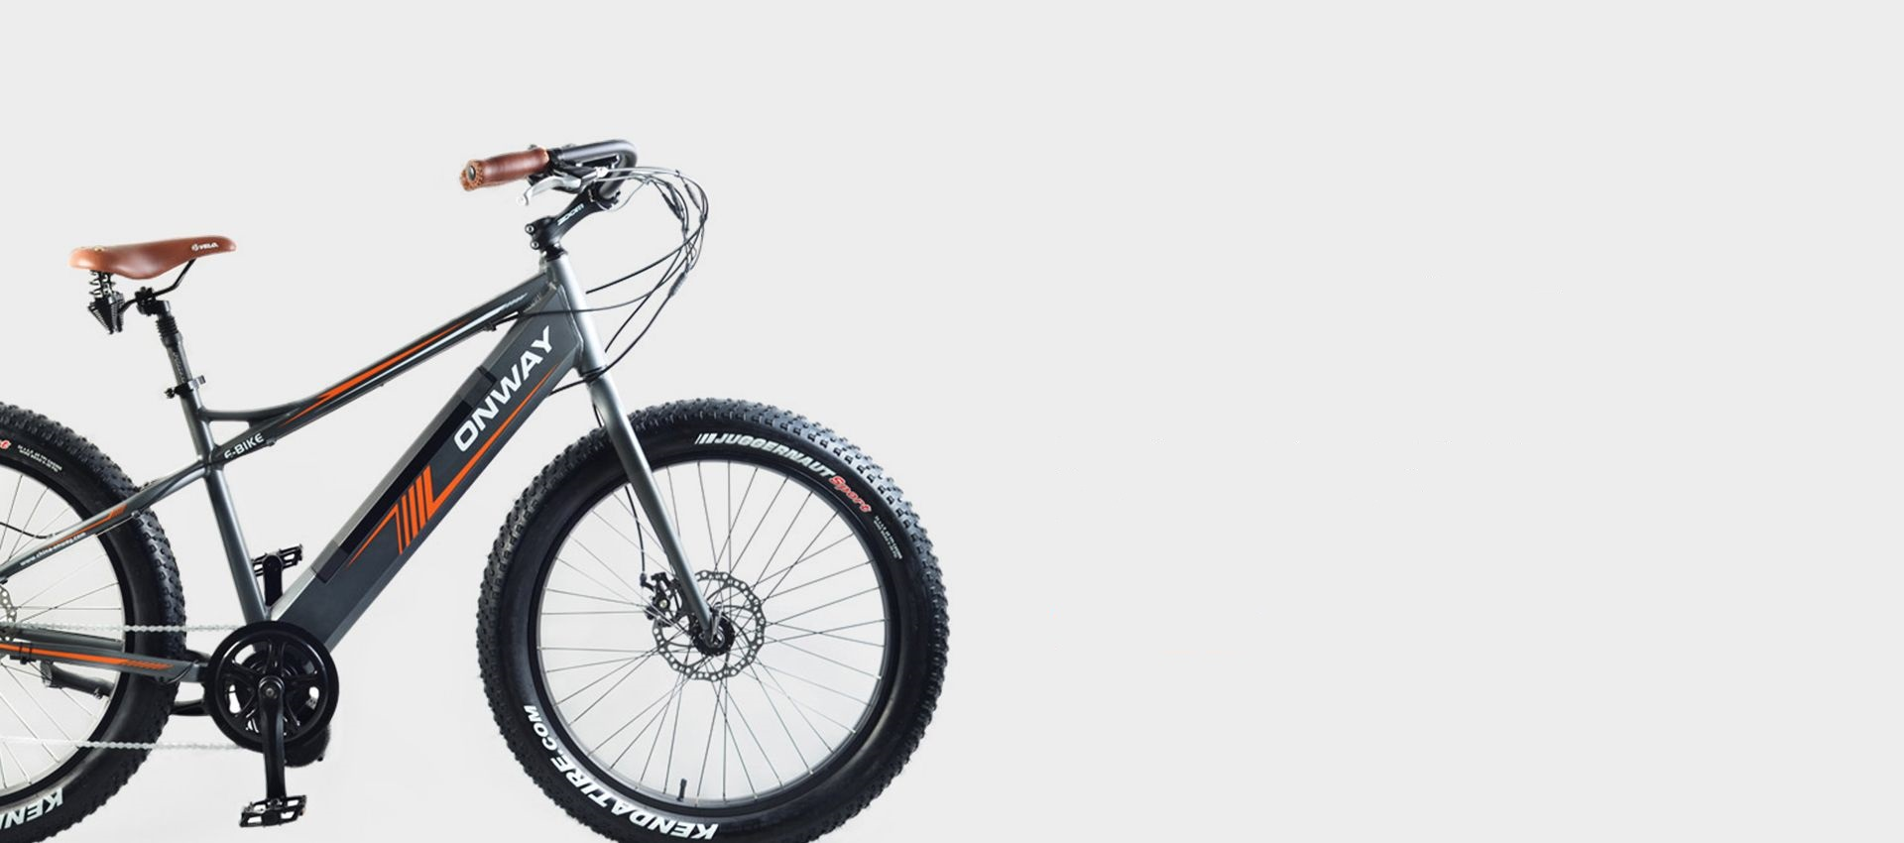
BIKE KING BORDERS
GLASGOW OUTDOOR EXPERIENCE

