Slide 1
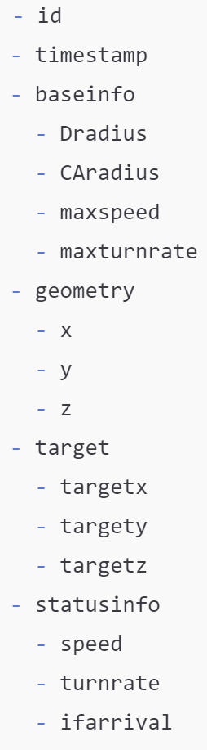
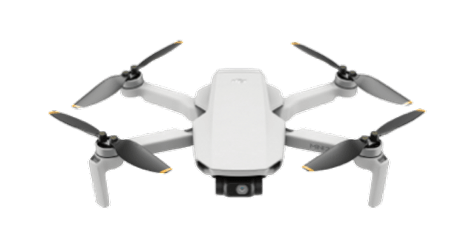

Move to
Landing
Social Force
json
json
json
id
x, y, z
id
x, y, z
id
x, y, z
json
targetx, target, targetz
timestamp, ifarrival
timestamp, ifarrival
Flask POST
Flask SSE API
id
Dradius
Class Drone
id
droneobject
CAradius
Dradius
CAradius
maxspeed
maxturnrate
maxspeed
x
y
z
speed
maxturnrate
targetx
targety
targetz
Move to
Landing

Slide 2
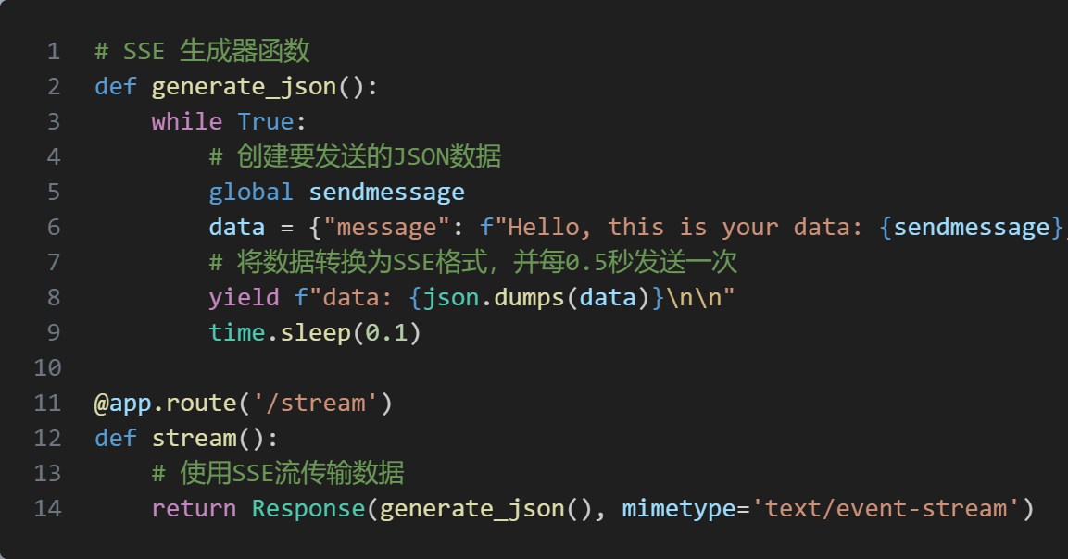
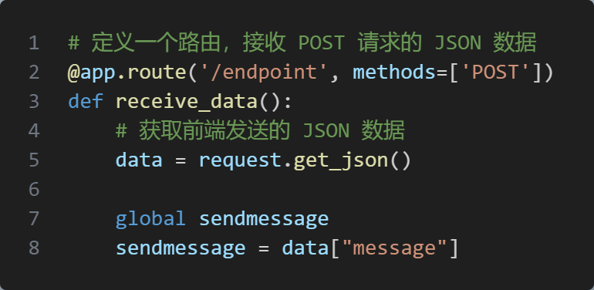
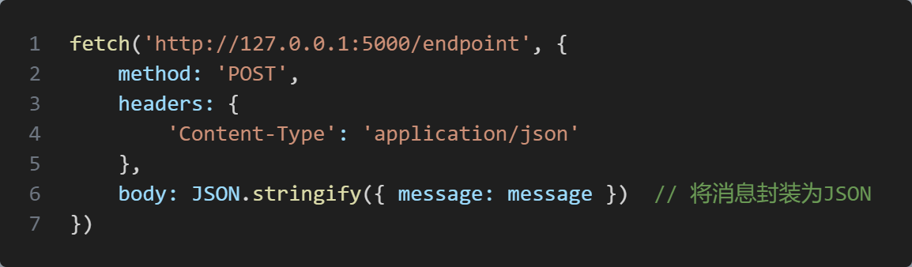
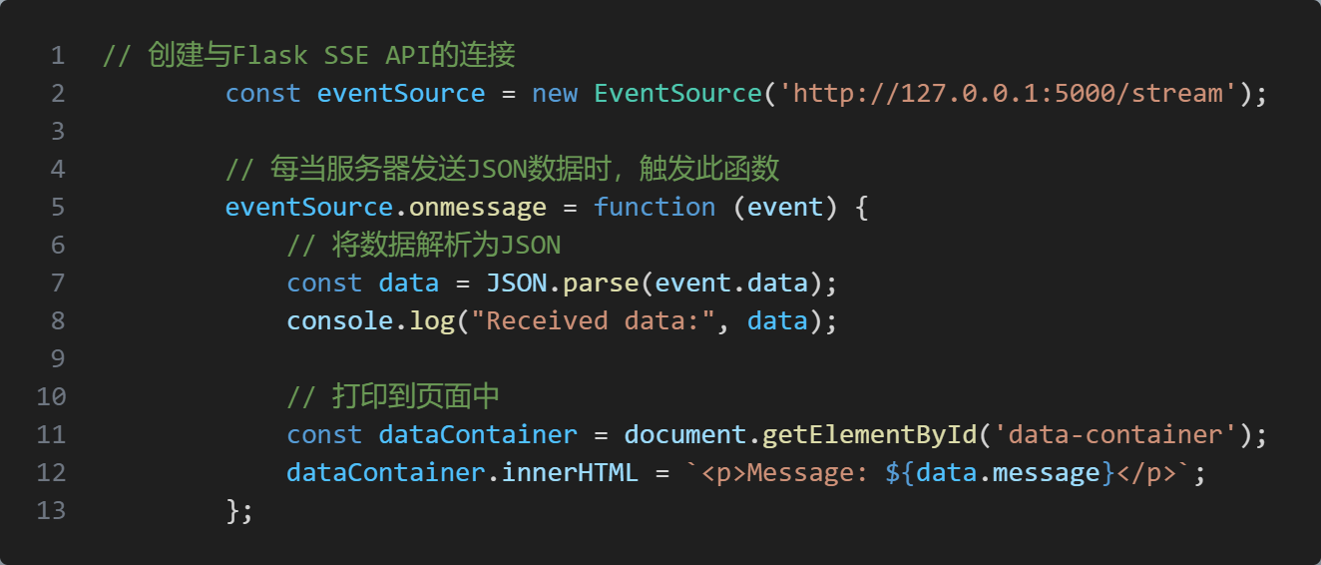
数据寄存变量(global)
后端输送数据至前端
后端接收数据
Flask POST
Flask SSE API 不间断读取
前端输送数据至后端
前端读取
条件下触发

