Slide 1
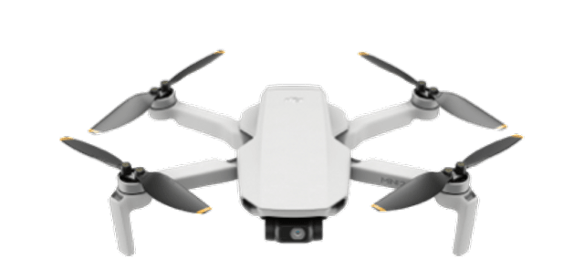

Move to
Landing
Social Force
json
json
json
id
x, y, z
id
x, y, z
id
x, y, z
json
targetx, target, targetz
timestamp, ifarrival
timestamp, ifarrival
Flask
Flask SSE API
id
Dradius
Class Drone
id
droneobject
CAradius
Dradius
CAradius
maxspeed
maxturnrate
maxspeed
x
y
z
speed
maxturnrate
targetx
targety
targetz
Move to
Landing

