Slide 1
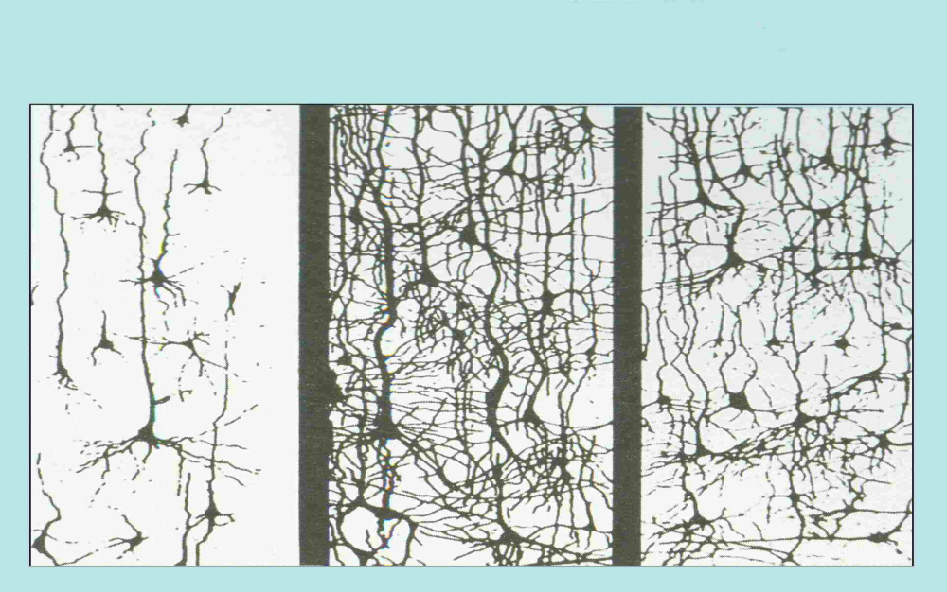
Early childhood brain development
At birth At 6 years At 14 years
Notes:
Images of brain development provided by Dr Jack Shonkoff in his visit to Melbourne last year. They highlight:
First, just how rapidly brains develop in the first few years of life, with proliferation of connections
Second, how later development – the ‘winnowing’ of connections that reflects learning of particular skills – builds on the network that develops in the earlier years
COAG identified early childhood development and child care as a key route to improved human capital formation because.
Children’s learning and development is most rapid, with significant impacts in school years and beyond
Social disadvantage continues to limit children’s chances – early childhood is a time when some children fall behind
The early years provides a particular window of opportunity; it will be much harder and much more expensive to help them later on

Slide 2
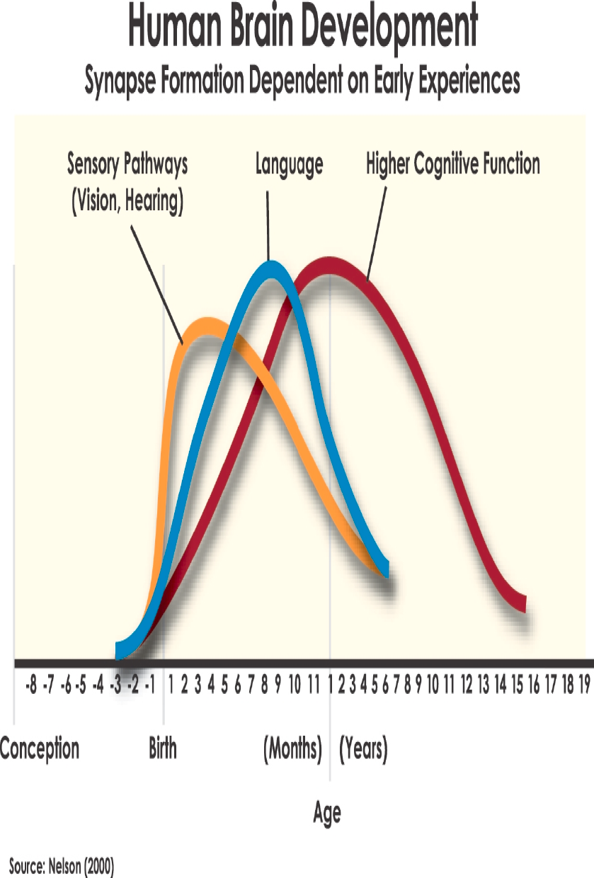
Brain development is most rapid in a child’s first year of life
Notes:
This diagram shows the rate and timing of the development of key skills in a child.
Early experiences determine whether a child’s developing brain architecture provides a strong or weak foundation for all future learning, behaviour and health.
A substantial amount of brain circuitry is constructed very early in life. And because brain architecture and skills are built continuously over time, policies that promote healthy development throughout the early years create a foundation for later school achievement, economic productivity, responsible citizenship, and successful parenting.

Slide 3
Economic advantage and educational attainment
100
High SES
90
By age 8, high SES children who initially have poor cognitive development overtake low SES children who initially have strong cognitive development
80
70
60
Average position in the distribution
50
40
30
20
10
0
22
28
34
40
46
52
58
64
70
76
82
88
94
100
106
112
118
Age in months
Source: Feinstein, Economica (2003)
Notes:
Background
Strong correlation between economic advantage and educational attainment
Socio-economic status impacts on outcomes before child even starts school
Long term correlation
Range of cognitive/thinking ability
2 groups: high cognitive
ability is lost over time in environment of low socio-economic status
Key points
Detailed early childhood studies are telling us that what happens in the family – the resources, the activities, the talk, the reading – makes a big difference to children.
Many of the differences that are associated with economic advantage and disadvantage emerge in the early years, and persist into school.
The graph shows how children in more advantaged families tend rise up the ranks, even if their initial cognitive score is low –
While the opposite is true for children in disadvantaged families.
High performing children from low socio-economic background lose their relative advantage by age 8 when they are overtaken by low performing children from high socio-economic backgrounds.
The graph tells us what we know. Families make a huge difference. But the most recent research is telling us that it is not how much a family earns that makes a difference. It is what they do. Families that sing, talk, draw and play together have children who do better later in school, regardless of their income.
It is the child’s early experience which drives their development and experiences occur both within and outside families.
_________________________
Background note: This study uses parent’s SES based on their occupational status (rather than income).

