Slide 1
JK Flip Flop dan Pengantar Counter

Slide 2














Gated SR Flip Flop

Slide 3






JK Flip Flop

Slide 4
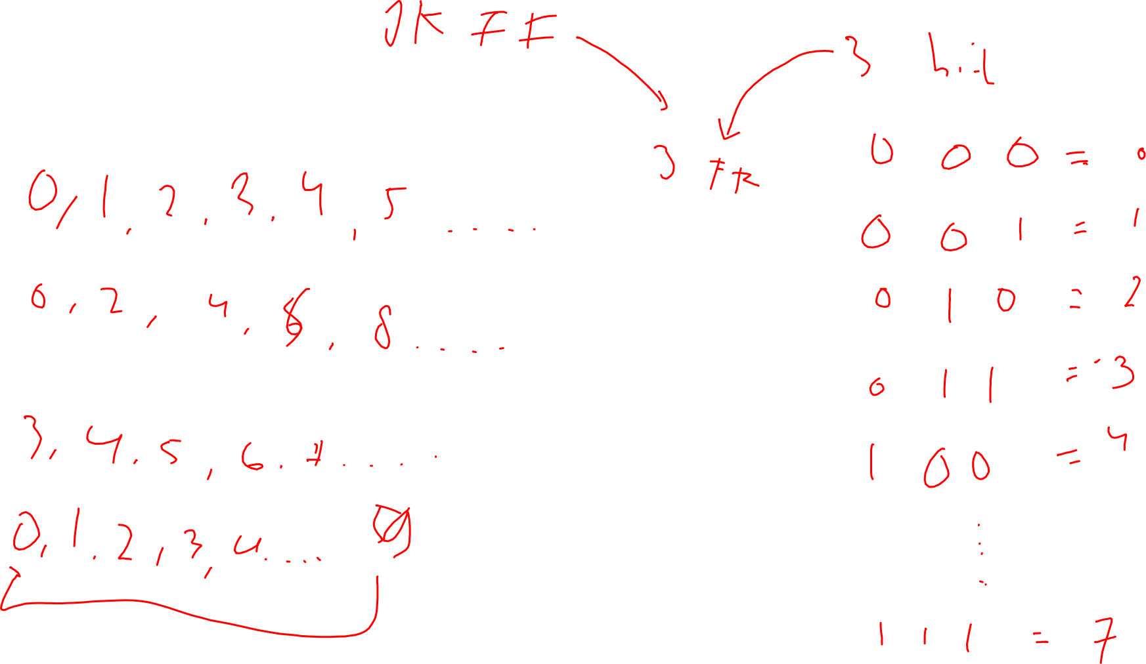
Counter

Slide 5
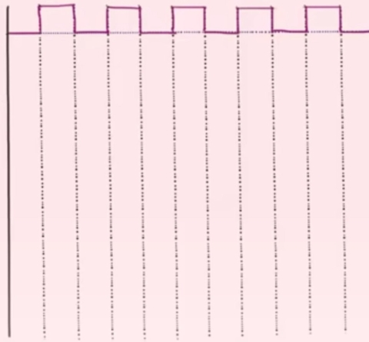
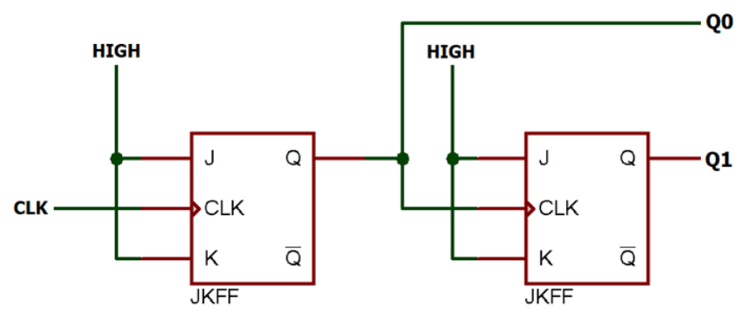



















2 bit Counter

Slide 6
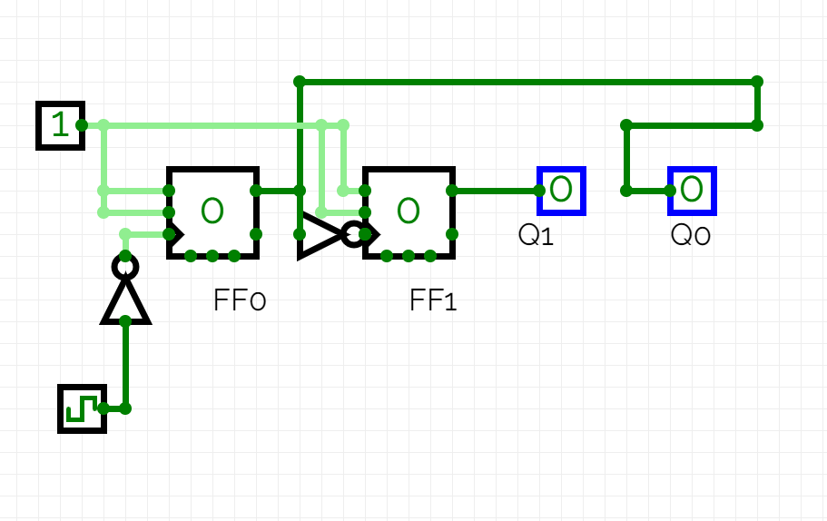

Slide 7
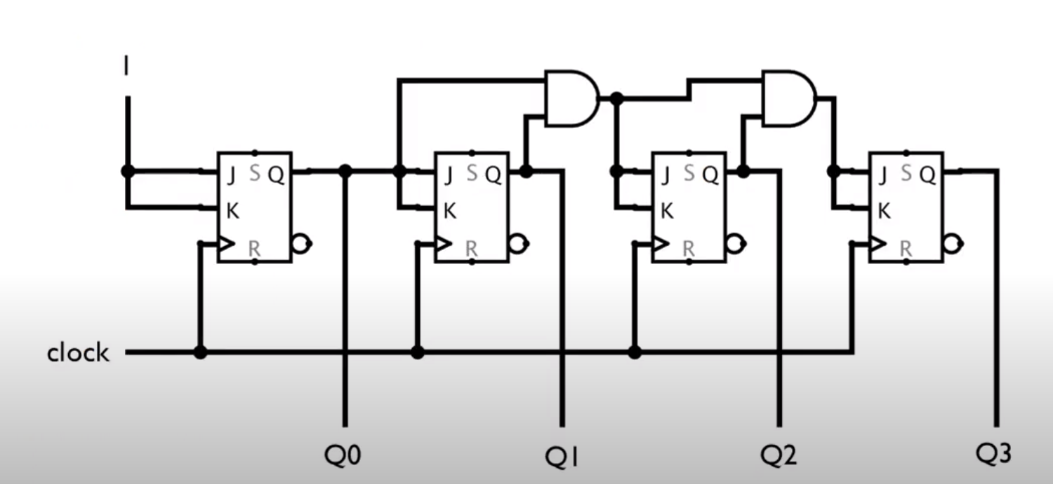













Slide 8
