Slide 1
DevCrew AI
7
specialized
agents
A multi-agent software engineering team
One sentence of input becomes a reviewed, tested, documented, deployable project.
3
human-in-the-loop
gates
Built with LangGraph · Streamlit · Chroma · pytest
5
collaboration
loops
Athoy Kanti Ray · Pritom Sarker · Kazi Safat Nawaz · Pranta Sen Gupta

Slide 2
THE PRODUCT
What the system does
1
You type one sentence
"Build a to-do list REST API with Flask"
2
The Supervisor plans and routes
It re-decides who runs next after every single step — nothing is a fixed pipeline.
3
Seven agents build, review and test
Requirements → architecture → code → review → real pytest → docs → deployment.
4
You approve, and can still change it
Three human gates. Even after it finishes, you can request a modification.
DevCrew AI
2

Slide 3
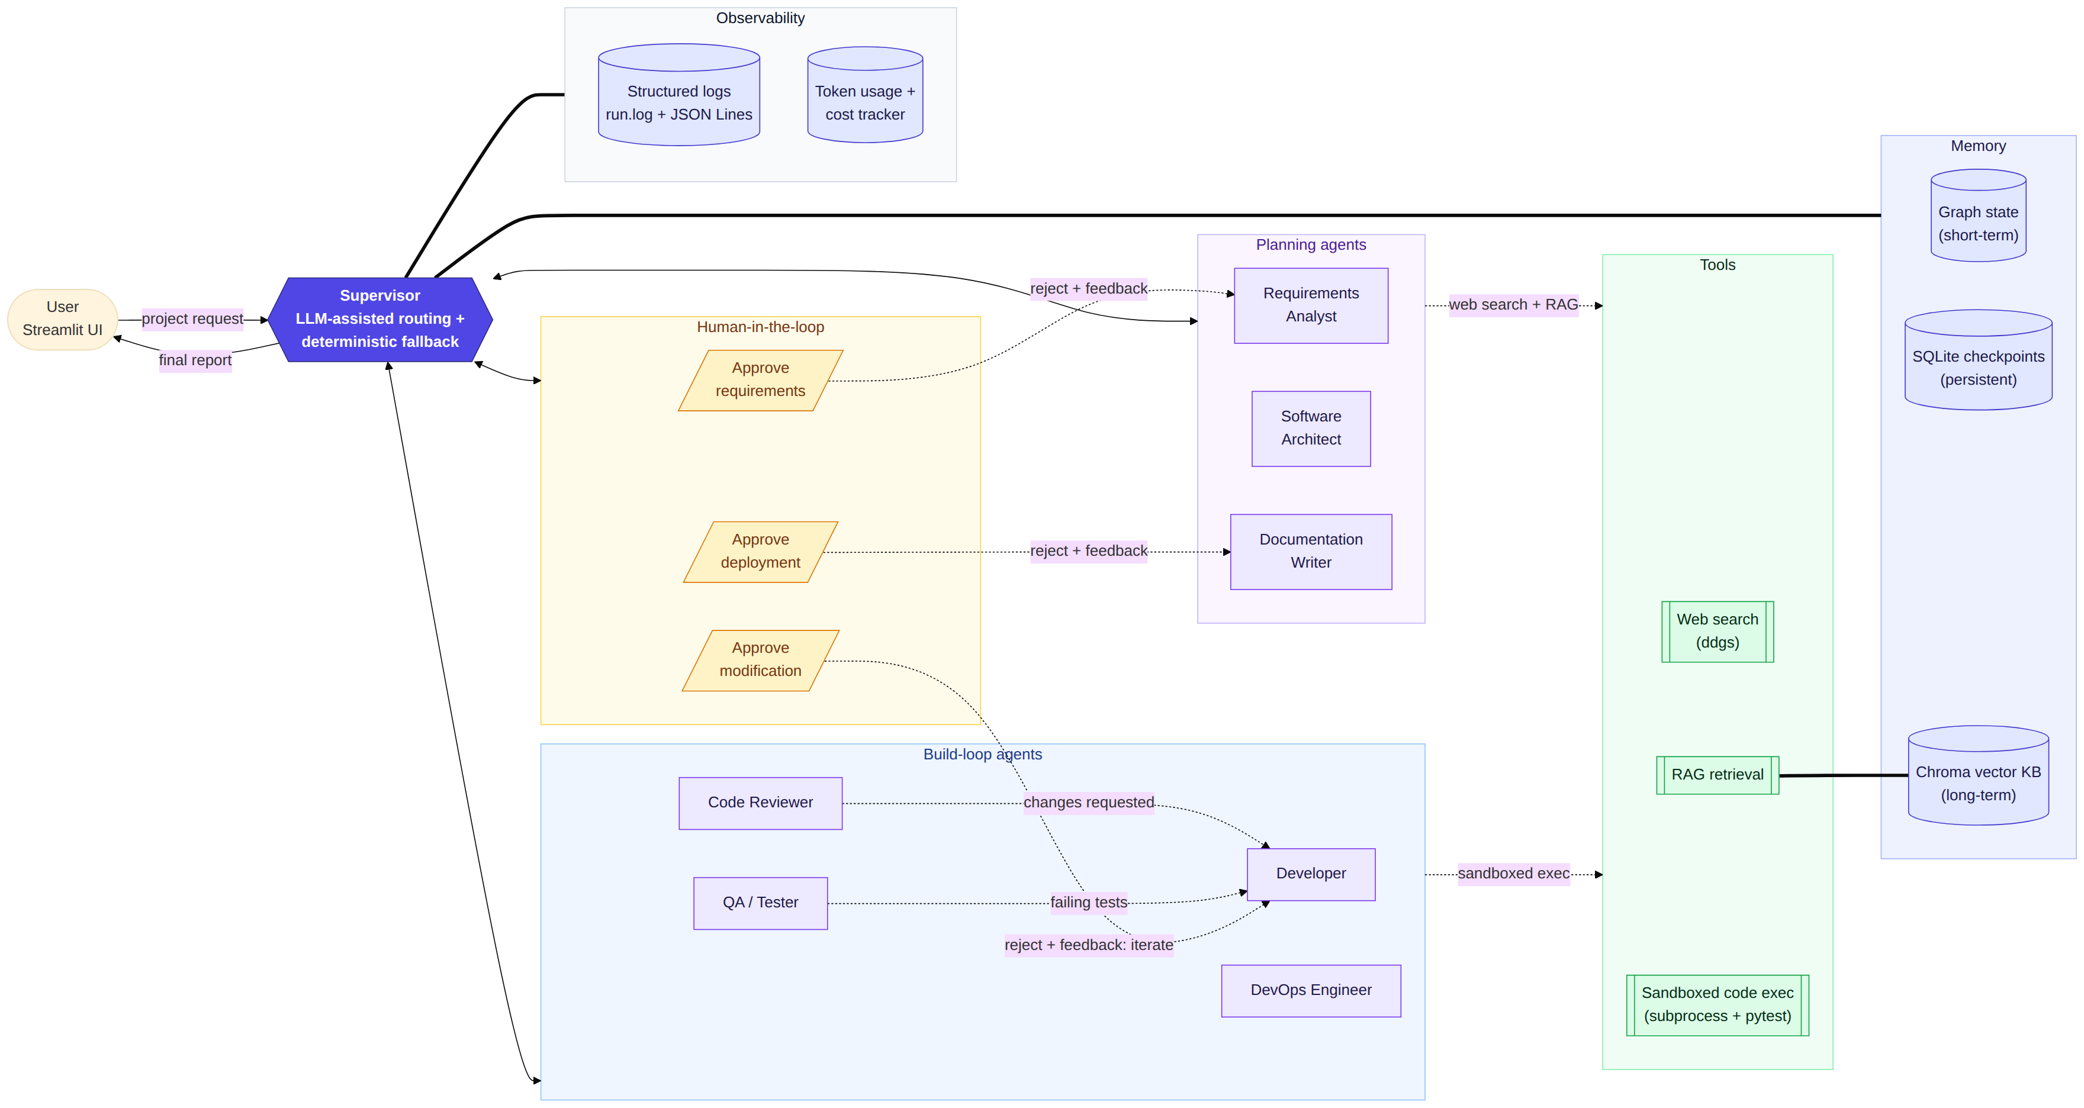
HUB-AND-SPOKE SUPERVISOR GRAPH
System architecture
Every agent reports back to the Supervisor — it re-decides the route from the shared state each turn.
DevCrew AI
3

Slide 4
MENTAL MODEL
Two ideas explain the whole codebase
1
One shared state object
2
Hub-and-spoke, not a pipeline
Every agent is a plain function that receives the whole state and returns only the keys it owns. Agents never import or call each other — they communicate through the state.
The Supervisor runs between every step. That is what makes this a supervisor architecture rather than a hardcoded sequence.
def agent_node(state: ProjectState) -> dict:
return {"my_key": value,
"agent_messages": [...],
"logs": [...]}
START -> supervisor
supervisor -> 7 agents | 3 gates | END
every node -> supervisor
# src/graph/build_graph.py
Message and log lists use append-only reducers, so no agent can overwrite another's history.
11 nodes, conditional edges, compiled with a SQLite checkpointer so runs survive a restart.
DevCrew AI
4

Slide 5
SRC/GRAPH/SUPERVISOR.PY
The Supervisor: LLM proposes, state machine disposes
def decide(state) -> (next_node, reason, overrides):
if not state.get("requirements_doc"):
return "requirements_analyst", ...
if "requirements" not in state["approvals"]:
return HUMAN_APPROVAL, ...
if not state.get("architecture_doc"):
return "architect", ...
...
# pure function - no LLM, no side effects, unit-tested
decide()
A pure priority ladder over the state. Returns the next node AND the reason, so routing is explainable.
route()
In live mode the LLM also proposes a next agent. Agreement → proceed. Disagreement → log a warning and trust the state machine.
supervisor_node()
Writes next_agent + supervisor_plan into state, logs the transition, and composes the final report at FINISH.
Real log line from a live run
WARNING | [supervisor] LLM routing pick 'architect' disagreed with the state machine ('human_approval') — using the deterministic decision.
We deliberately do not let the model skip a human approval gate.
DevCrew AI
5

Slide 6
WHY THIS IS A TEAM, NOT A CHAIN
Five collaboration loops
Code Reviewer
Developer
changes requested — fix only the reported issues
QA / Tester
Developer
pytest failed — the real report goes back into the prompt
Human
Requirements Analyst
SRS rejected — your feedback is injected and it rewrites
Human
Documentation Writer
deployment rejected — docs revised before packaging
Human
Developer
post-finish modification — iterate until you approve
Guarded by MAX_REVISIONS = 2 — the loop always terminates, and the final report says so honestly.
DevCrew AI
6

Slide 7
SRC/GRAPH/HITL.PY
Human-in-the-loop: the graph physically pauses
1
2
3
Approve requirements
Approve deployment
Approve modification
Reject sends your feedback back to the Requirements Analyst, which rewrites the SRS.
Nothing is packaged for deployment until a human signs off.
Reject with feedback iterates again instead of an all-or-nothing choice.
# the graph suspends here and state is saved
decision = interrupt({"stage": ..., "question": ...})
# the UI resumes the same thread_id later
Command(resume={"action": "approve"})
Why it matters
State is checkpointed to SQLite at the pause. The process can be killed and restarted — resuming the same thread_id continues from that exact point.
Approve · Reject with feedback · Retry last step from a checkpoint — all driven from the Streamlit sidebar.
DevCrew AI
7

Slide 8
TOOL INTEGRATION
Real tools, not simulated ones
1
2
3
Web search
Sandboxed execution
Vector retrieval
ddgs (DuckDuckGo)
subprocess + pytest
Chroma + local ONNX
The Requirements Analyst researches the domain before writing the spec. Fails soft: an empty list, never a crash.
Generated files are written to a temp directory and pytest runs in a subprocess with a 60-second timeout.
Artifacts are chunked, embedded and stored on disk, then retrieved by semantic similarity.
The QA agent makes no LLM call at all
project_dir = write_files(code_files)
passed, output = run_pytest(project_dir)
tests_passed is a real pytest exit code — not a model's opinion. That boolean is what the Supervisor routes on, and generated code is never exec()'d in-process.
DevCrew AI
8

Slide 9
SRC/GRAPH/STATE.PY · SRC/MEMORY/KNOWLEDGE_BASE.PY
Two kinds of memory
Short-term
Long-term
Scoped to one run
Persists across runs
ProjectState — the typed shared object every agent reads and writes
Chroma vector store on disk (./memory_store, collection devcrew_kb)
Append-only reducers for messages, logs and token usage
800-character chunks with 100-character overlap
SqliteSaver checkpoints — a paused run survives an app restart
Local ONNX MiniLM embeddings — no API key, no cost
Both are visible in the dashboard's Memory tab: the live shared state on top, the stored vector documents below.
Short-term answers "what is happening in this run". Long-term answers "what has this system learned across runs".
DevCrew AI
9

Slide 10
SRC/OBSERVABILITY/
Logging, cost tracking and error handling
1
2
3
Three log destinations
Token usage and cost
Failing safely
The graph state — rendered live in the UI
Real counts from the provider's usage_metadata
2 LLM retries with backoff, then a logged error
logs/run.log — human readable
Priced per million tokens from .env
Malformed JSON → retry → fall back to last valid
logs/run_<id>.jsonl — one JSON object per line
Summed per agent by a custom state reducer
Web search failure → empty list, pipeline continues
2026-08-19 01:27:38 | INFO | [supervisor] route -> requirements_analyst: The project has just started...
2026-08-19 01:28:11 | WARNING | [developer] Developer JSON parse failed, retrying once: ...
DevCrew AI
10

Slide 11
UI/APP.PY — STREAMLIT
The dashboard covers every required UI element
1
2
3
4
Dashboard
Live trace
Communications
Graph
active agents + workflow status
each graph step, streamed as it runs
full agent-to-agent message history
LangGraph topology, generated from the compiled graph
5
6
7
8
Tokens & cost
Logs
Memory
Final report
per-agent tokens and estimated USD
filterable by level, with error counts
shared state and vector store contents
the report, a .zip download, and modification requests
Plus sidebar controls: run, reset, approve, reject with feedback, and retry the last step from a checkpoint.
DevCrew AI
11

Slide 12
SIX MOMENTS
Live demo — what to watch for
1
The Supervisor's reasoning
2
The graph pausing for us
Each routing decision shows the reason it was taken, not just the destination.
We will reject the requirements once and watch the Analyst rewrite them.
3
The Reviewer rejecting the Developer
4
pytest actually running
Changes requested, sent back, fixed, reviewed again — the core loop.
The QA agent runs the generated tests in a subprocess. The verdict is an exit code.
5
Cost accumulating per agent
6
Changing the project after it finished
Real token counts from the provider, priced live.
A modification request re-runs the build loop and pauses at a third gate.
Fallback: MOCK_MODE=1 runs the entire pipeline offline, instantly, at zero cost — built as our demo insurance.
DevCrew AI
12

Slide 13
CHALLENGES
Three real bugs we found and fixed
1
Infinite supervisor loop
FIX
After max revisions the Supervisor moved on without recording that it had given up — so the next turn re-entered the same branch. Found in the server log repeating 13 times in 90 seconds.
decide() now returns an overrides dict setting review_bypassed / tests_bypassed, and the report says "bypassed" instead of faking success.
2
JSON with trailing text
FIX
The Developer's model returned a valid JSON object followed by prose. json.loads() rejected the whole response and crashed the run.
Switched to JSONDecoder().raw_decode(), which takes the first complete value and ignores the rest.
3
Silently unstyled HTML
FIX
A generated page linked a CSS file that existed — but its selectors did not match the HTML's class names, so the page rendered raw.
A mechanical validator compares class tokens to CSS selectors and forces one retry below 30% coverage.
Each fix shipped with a regression test — the suite runs offline in mock mode.
DevCrew AI
13

Slide 14
PRINCIPLES WE WOULD REUSE
What we learned
1
Never let a model grade its own work
2
Let the LLM advise, not decide
Every quality gate in our system is mechanical: a pytest exit code, a compile() check, a set comparison of CSS selectors. Ask an LLM "is this correct?" and it says yes.
The supervisor's routing is a deterministic state machine. The model proposes in parallel and we log disagreement. Reliability came from limiting the model's authority.
3
Design the shared contract first
4
Plan for non-determinism
We froze the state schema on day one. That single decision let four people build in parallel with almost no merge conflicts.
The same prompt does not give the same output twice. Retries, validators and fallbacks are not polish — they are what makes an agent system usable.
DevCrew AI
14

Slide 15
HONEST ASSESSMENT
Limitations and what comes next
What does not work well yet
What we would build next
Output is non-deterministic — a run can still produce imperfect code
Parallel agent execution for independent phases
Agents run strictly one at a time; docs and deployment could be parallel
Cross-project memory so the Architect learns from past designs
No manual pause mid-agent — we pause at gates instead
Container-isolated execution instead of a subprocess sandbox
The vector memory is not yet reused across separate projects
A manual pause control and step-by-step execution mode
We would rather show you a system whose limits we understand than claim it has none.
DevCrew AI
15

Slide 16
MODULE OWNERSHIP
Who built what
Athoy Kanti Ray
Pritom Sarker
Kazi Safat Nawaz
Pranta Sen Gupta
Orchestration
Planning & memory
Build loop & tools
UI & observability
src/graph/
agents + src/memory/
agents + src/tools/
ui/ + src/observability/
Shared state contract
Requirements Analyst
Developer + validators
Streamlit dashboard
Supervisor + routing
Architect, Doc Writer
Reviewer, Tester, DevOps
Live streaming trace
Three HITL gates
Chroma vector RAG
Sandboxed pytest runner
Token and cost tracking
Graph wiring + checkpoints
Web search tool
Retry and fallback logic
Structured logging
Each member owns their own folders, works on their own branch, and reviews another member's pull requests.
DevCrew AI
16

Slide 17
What we set out to prove
Multi-agent architecture
Agent collaboration
Supervisor + 7 specialized agents in a LangGraph hub-and-spoke topology
Five feedback loops — the system rejects and repairs its own work
Tool integration
Memory
Web search, sandboxed pytest execution, vector retrieval
Typed shared state + SQLite checkpoints + a persistent Chroma store
Observability
Human-in-the-loop
Live trace, per-agent token cost, three log destinations
Three gates that suspend the graph and resume from a checkpoint
github.com/ATHOY43259/Devcrew-ai
Runs offline in mock mode at zero cost.

Slide 18
Athoy Kanti Ray
Thank you
Orchestration — src/graph/
Pritom Sarker
Questions?
Planning & memory — agents + src/memory/
Kazi Safat Nawaz
Ask any of us about our own module — we can open the file and walk you through it.
Build loop & tools — agents + src/tools/
Pranta Sen Gupta
UI & observability — ui/ + src/observability/
github.com/ATHOY43259/Devcrew-ai

