Slide 1
TOC and Alkalinity soft-sensors for Foothills WTP
July 2026

Slide 2
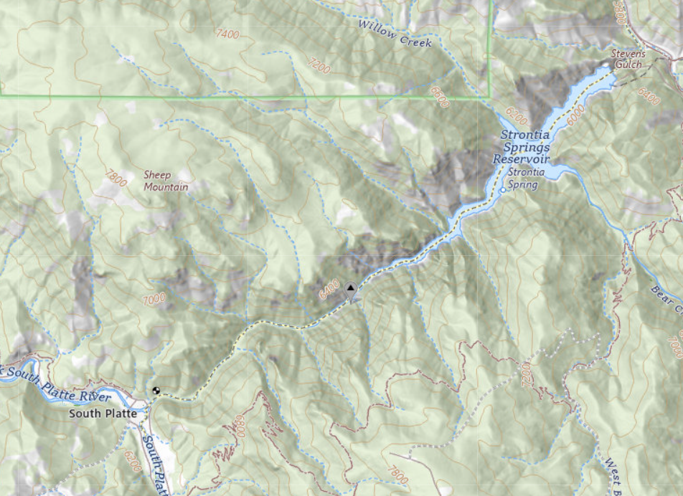
Goals
Craig mentioned Ed and Tad subscribe to USGS WQ alerts from the gage above Strontia Reservoir
Gage currently collects turbidity, temperature, conductivity, pH, and DO in 15 min intervals
Hypothesis: I can use the gage data to predict future TOC at Foothills influent, thus acting as an early warning system for WQ events

Slide 3
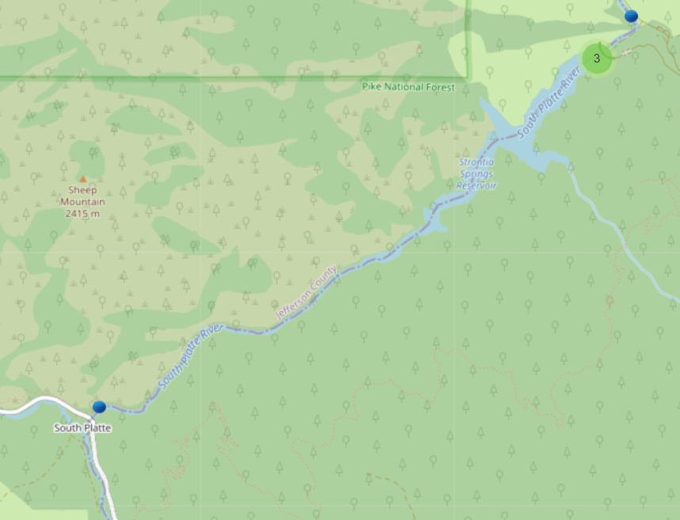
Methods
Write Python script to pull USGS WQ data from the Strontia gage, available beginning 4/1/2022
Write Python script to pull CO DNR/DWR streamflow gage data from above Strontia
Write Python script to pull NOAA precipitation data from Strontia weather station
Clean data and create “engineered features” to train a random forest ML model to predict TOC. Test the model using unseen data to evaluate performance.

Slide 4
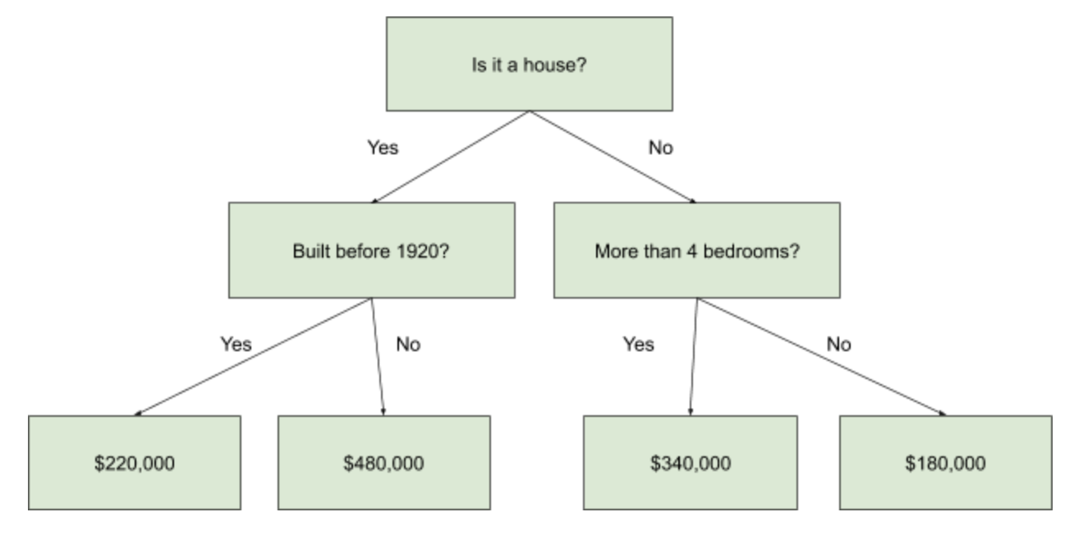
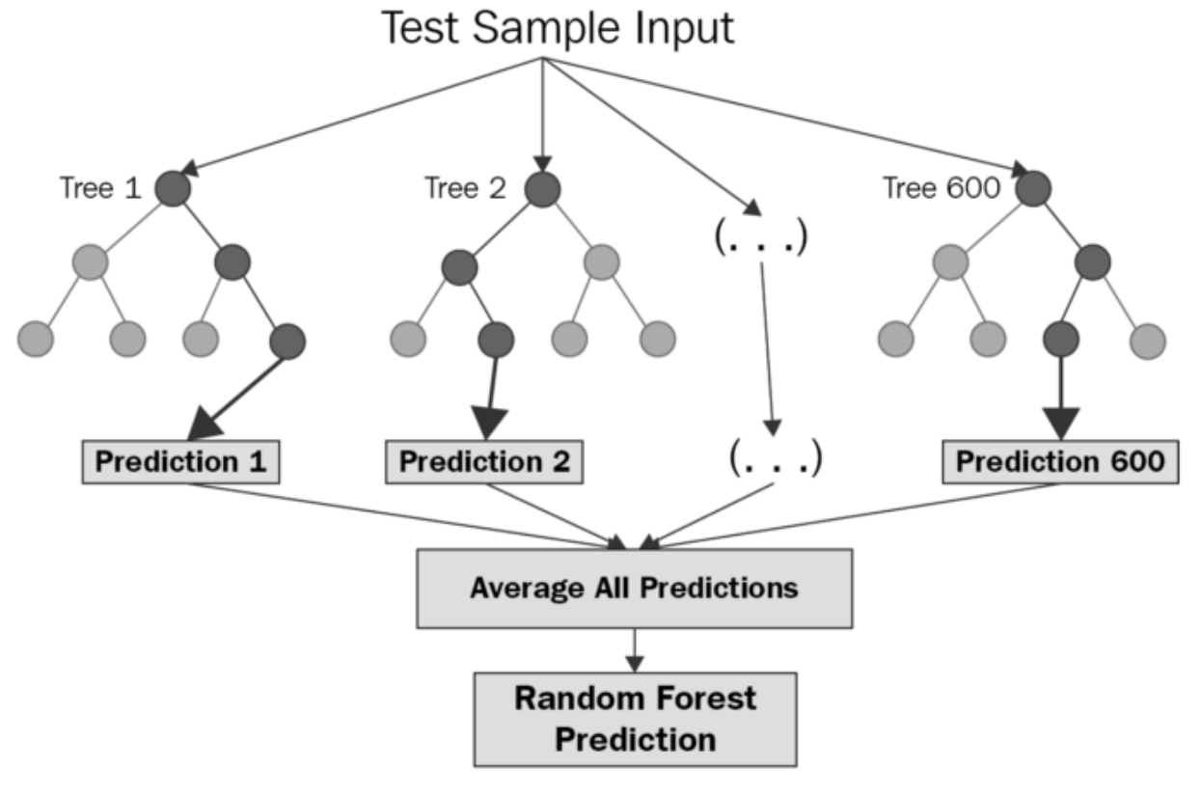
What is Random Forest? i.e. many “decision trees”

Slide 5
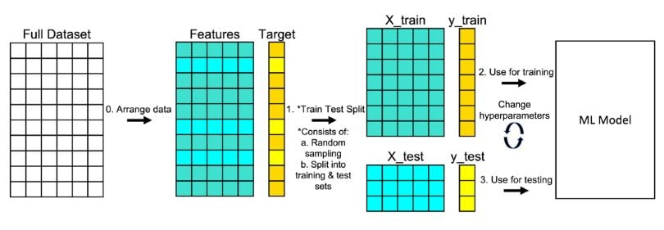
What is a train-test split?

Slide 6
Feature engineering
Shifted or “lagged” the USGS and DNR WQ and flow data by 4 days relative to Foothills influent TOC
Converted month to radians – help model understand January is “close” to December
Calculated rolling 7-day average for flow – detect rising and falling
Calculated rolling 3-day average for turbidity – detect rising and falling, reduce noise
Calculated rolling 7-day average for precipitation – detect rising and falling, large precipitation events/increased runoff
Calculated flow * turbidity for a “loading” parameter

Slide 7
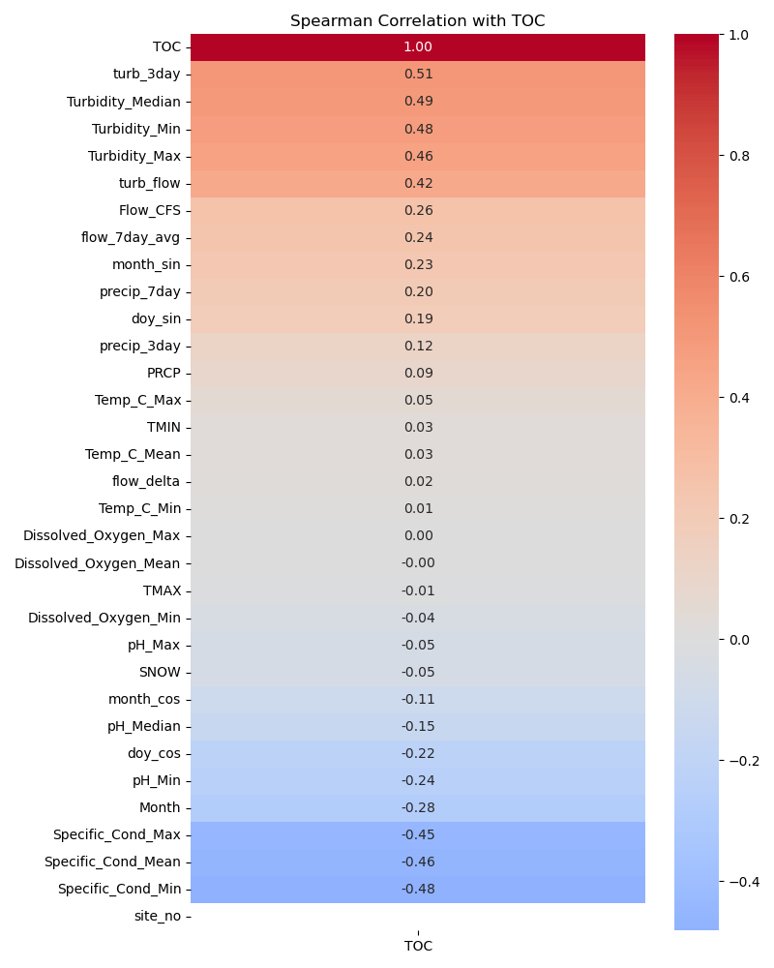
Correlation matrix
Examined spearman correlations of features as a starting point for choosing model predictors
Created a series of models with combinations of the highest correlated features until I landed upon the model with the best results
  Can continue to tweak as more data becomes available!

Slide 8
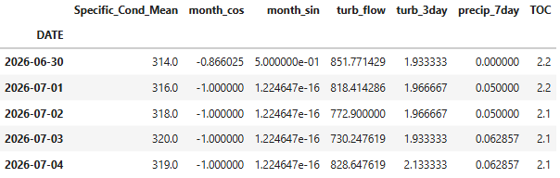
Finalized model

Slide 9
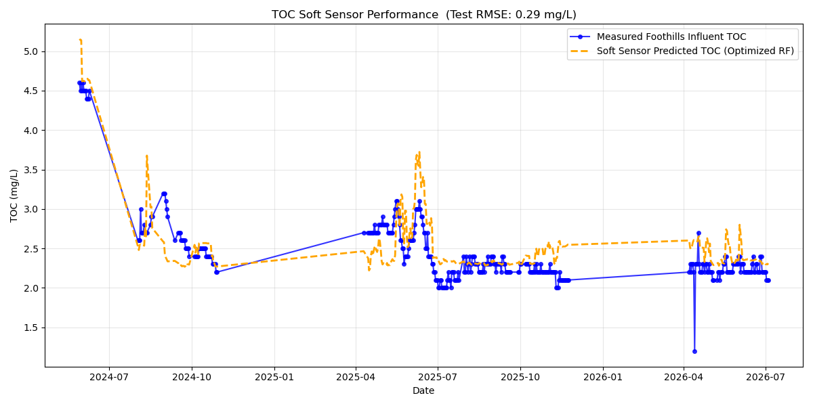
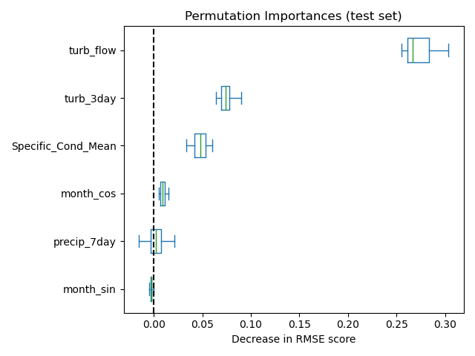
Results
Through feature engineering and model parameter tuning, achieved an R^2 of 0.59, RMSE of 0.29 mg/L, and MAPE of 9.52%
Prioritized accuracy of peaks over raw R^2 – stability of TOC most of the year makes it relatively powerful to just predict the mean. Model is not as useful for day-to-day operation.
Pretty good! Don’t expect it to get much better without more data – only a handful of outlier data currently. Model currently overestimates due to 2023 in training data

Slide 10
Predicting plant influent alkalinity

Slide 11
Hypothesis and Methods
Hypothesis: I can use the gage data to predict whether alkalinity will be above or below 60 mg/L at Foothills influent, thus acting as an early warning system for WQ events
Used Python scripts to pull USGS WQ data, DNR streamflow data, and NOAA precipitation data
Cleaned data and created “engineered features” to train both a random forest regression and classification ML model to predict alkalinity. Test the models using unseen data to evaluate performance.

Slide 12
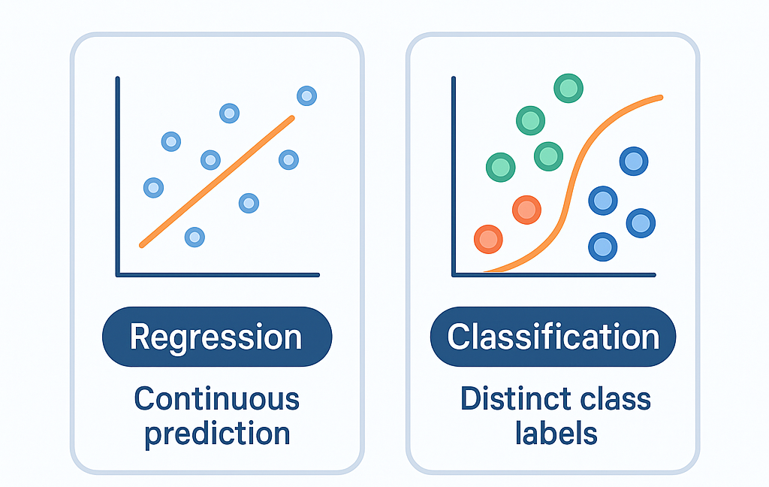
What is classification?

Slide 13
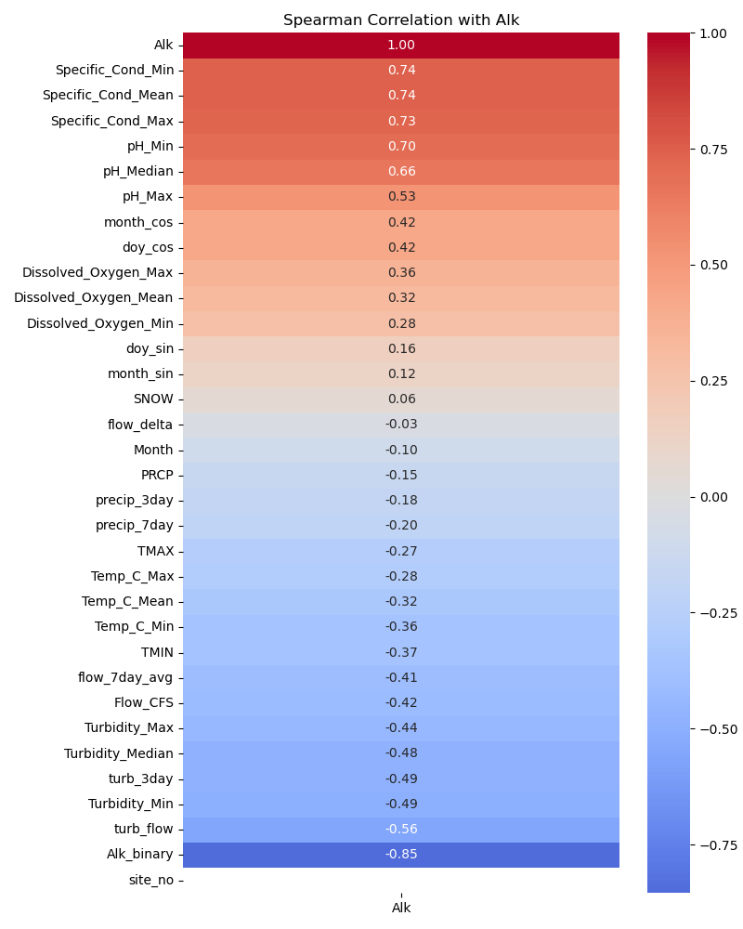
Correlation matrix
Examined spearman correlations of features as a starting point for choosing model predictors
Created a series of models with combinations of the highest correlated features until I landed upon the model with the best results

Slide 14
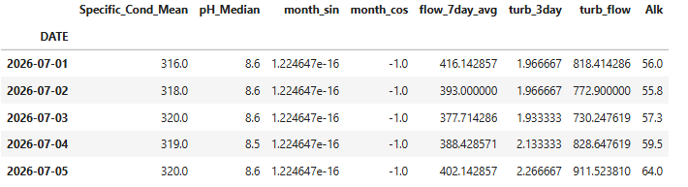
Finalized model

Slide 15
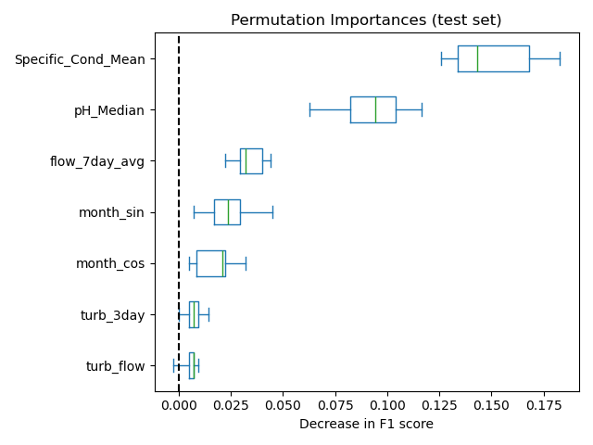


Results
Similar to TOC, model predicts alkalinity 4 days ahead of time.
Evaluating the model
  Precision: when we make a prediction, how often is it correct?
  Recall: how many of the <60 days out of the total proportion were identified?
  Accuracy: how many classifications out of all the total classifications were correct?

Slide 16
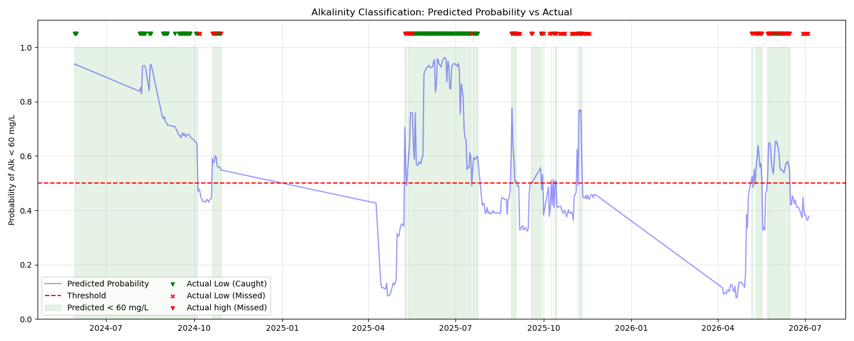
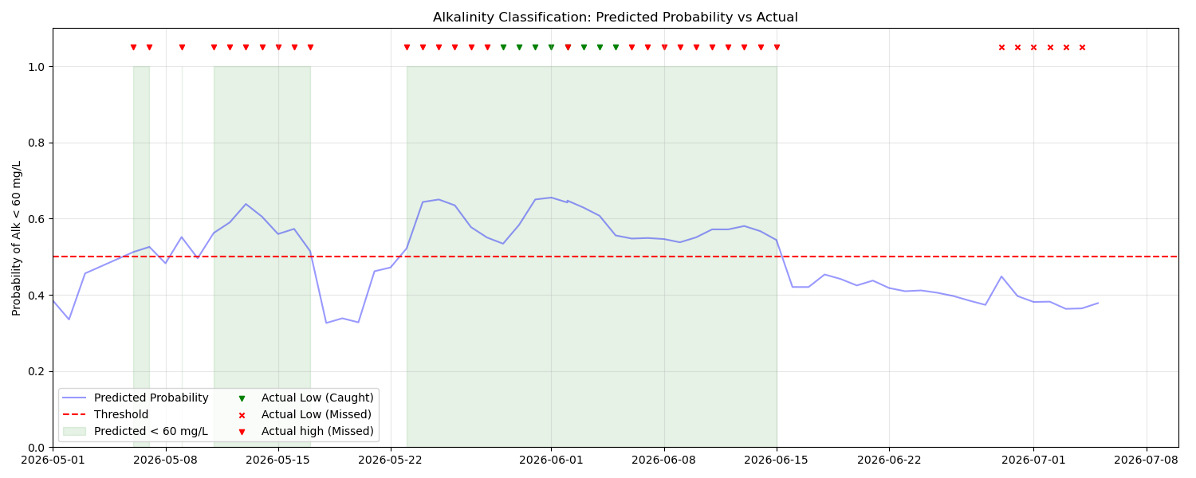
Results
Full and zoomed in for more recent testing period
Model has struggled late 2025 and 2026 with lots of back and forth – not sold on precision for catching as we cross the 60 mg/L threshold

Slide 17
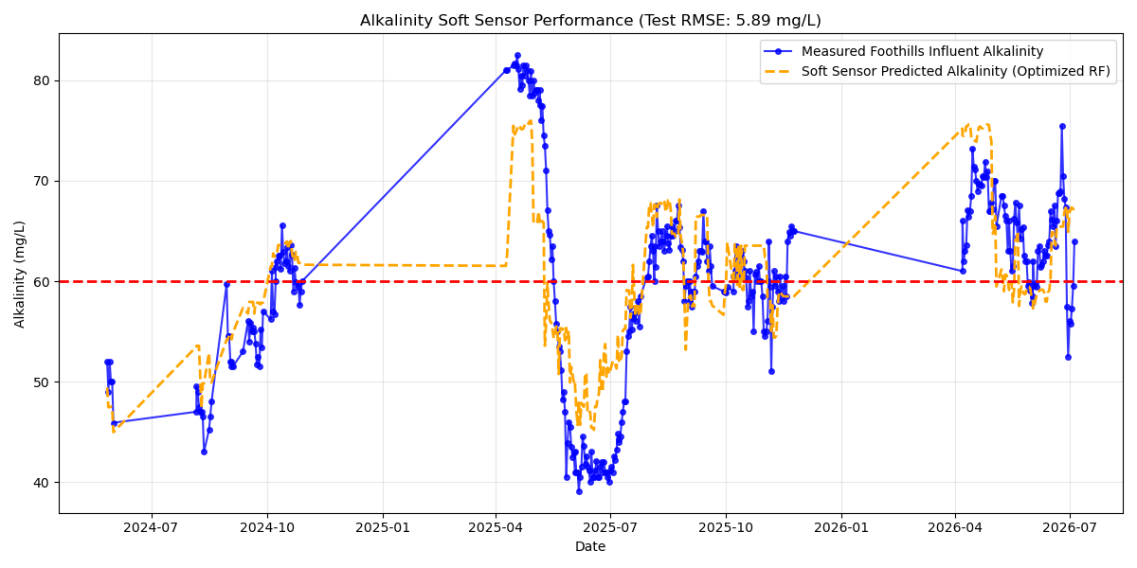
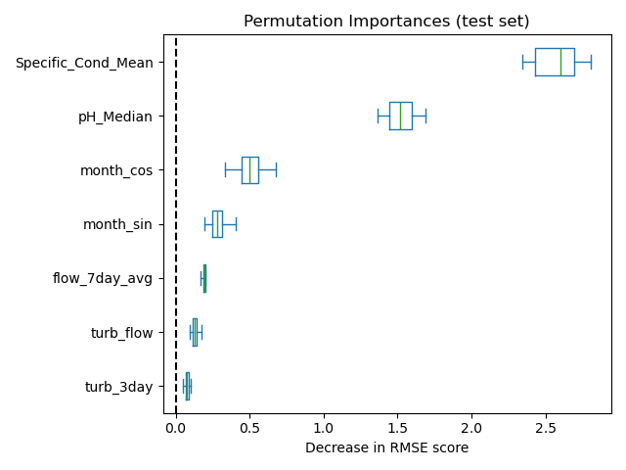
Results
Through feature engineering and model parameter tuning, achieved an R^2 of 0.65, RMSE of 5.89 mg/L, and MAPE of 8.34%
Similar to the classification model, struggles with back and forth around 60 mg/L
Don’t expect model to get resolution necessary to tell you on a day if it will be 61 or 59 mg/L

