Slide 1

Collision Avoidance Testing for Autonomous Vehicles with Global Map Modeling
ICRA 2021 – Submission 2176
Yun Tang, Yuan Zhou*, Fenghua Wu, Yang Liu, Jun Sun, Wuling Wang, Gang Wang

Slide 2
Content
Wrong yielding actions
Wrong overtaking
Wrong switch from yielding to overtaking
Emergency braking too soft
Lack of coordinated collision avoidance
Decision conflicts
Incorrect prediction
Obstacle failures

Slide 3
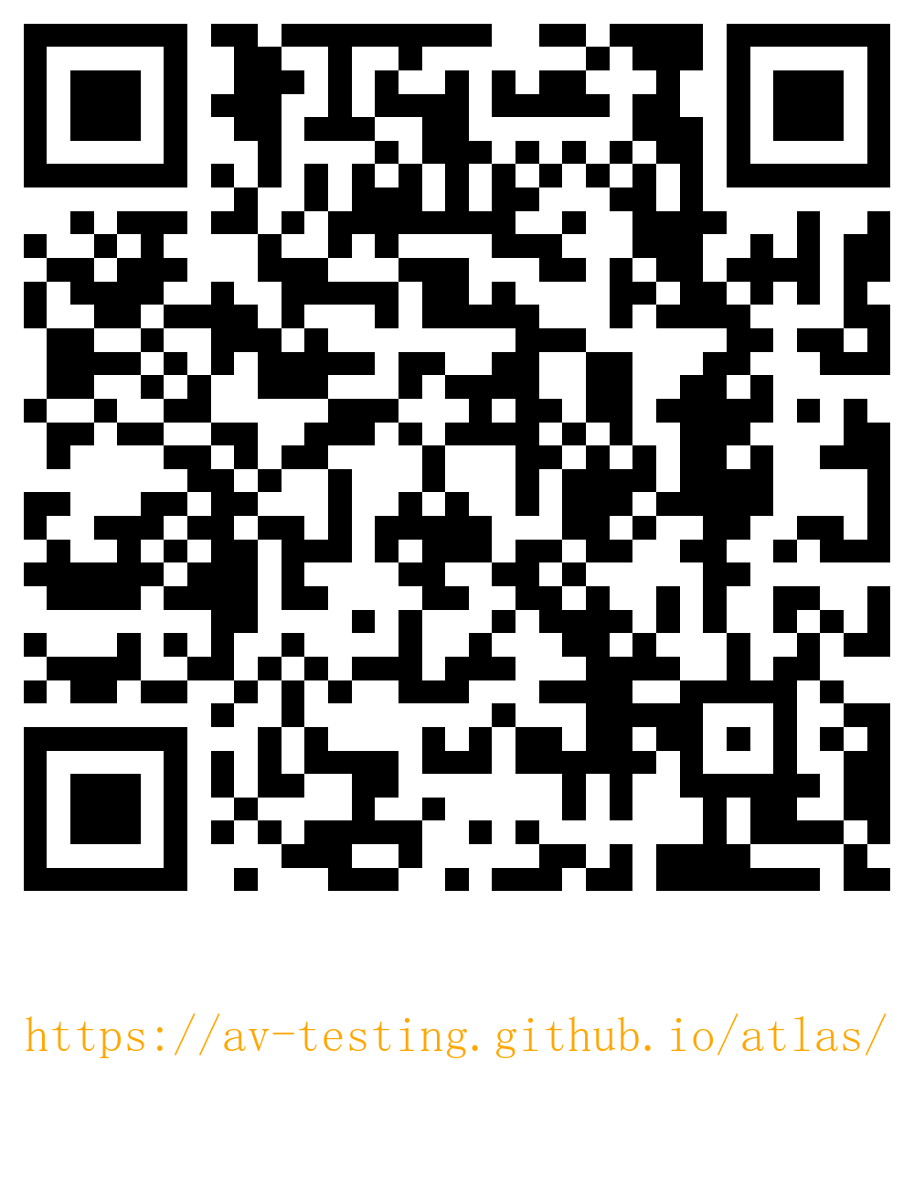
Thank You

