Slide 1
Adaptive control

Slide 2
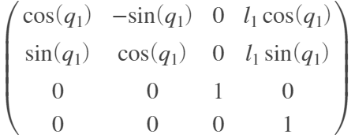
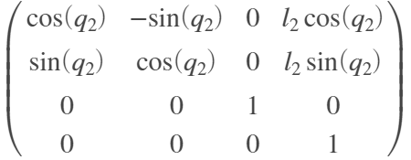
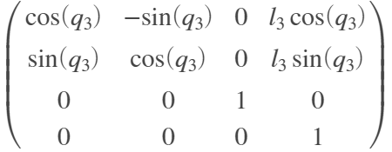
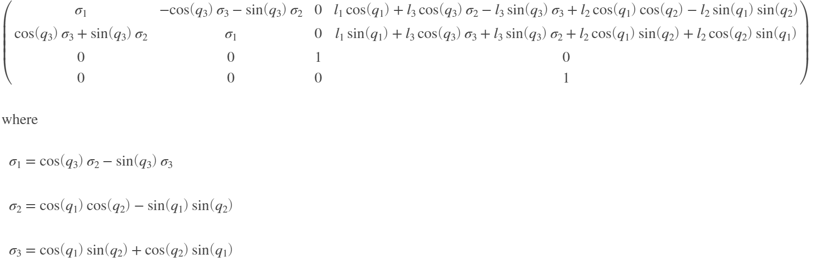
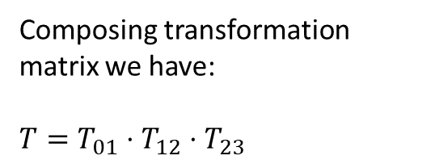

Model
We can define RRR planar robot kinematics model :
Second joint
Third joint
First joint
Composing transformation matrix we have:
$T=T_{01}⋅T_{12}⋅T_{23}$
$$T=$$

Slide 3
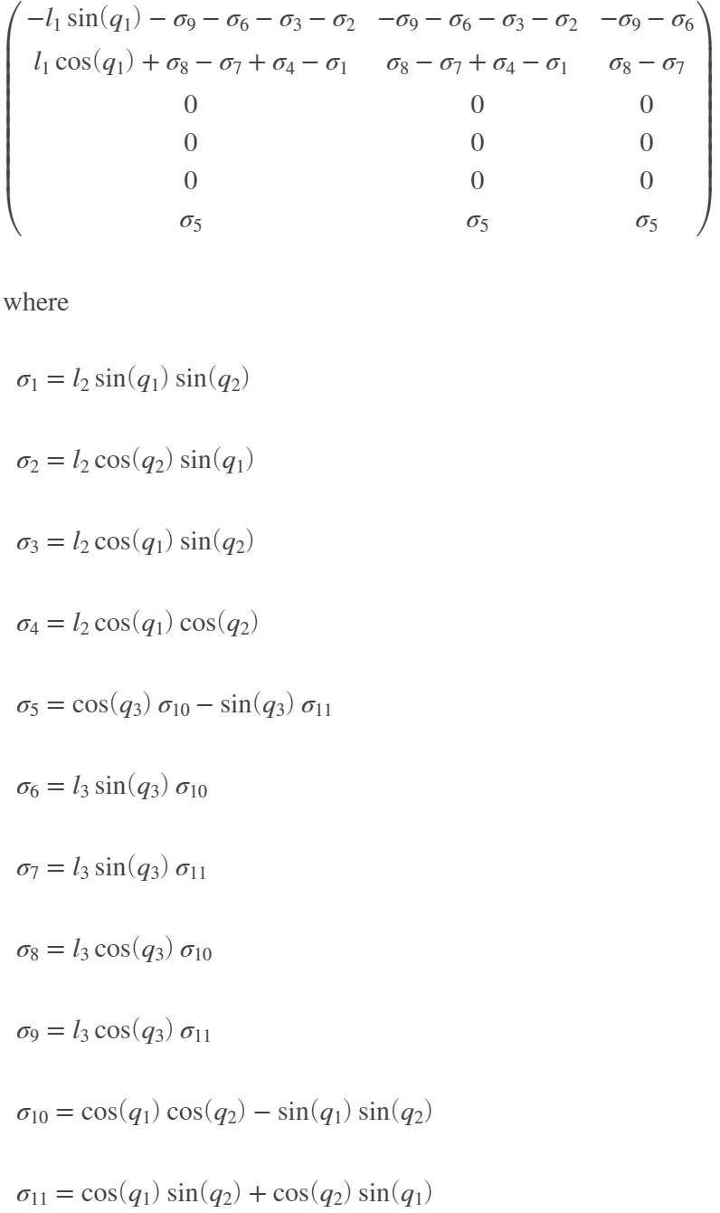
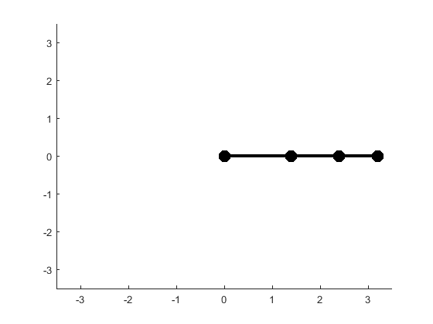

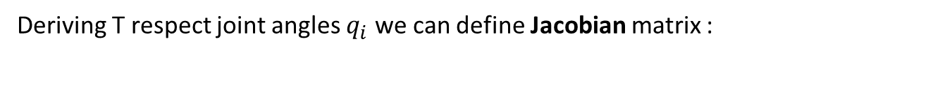
Model
Deriving T respect joint angles $q_{i}$ we can define Jacobian matrix :
$$J= \frac{∂T}{∂q}=$$

Slide 4
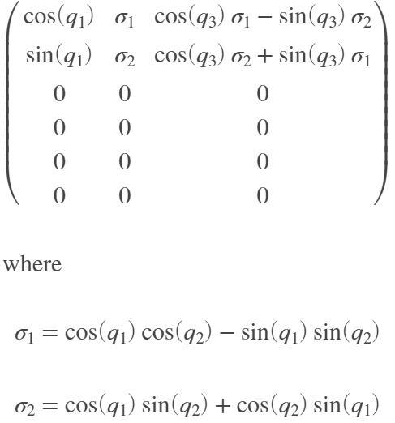
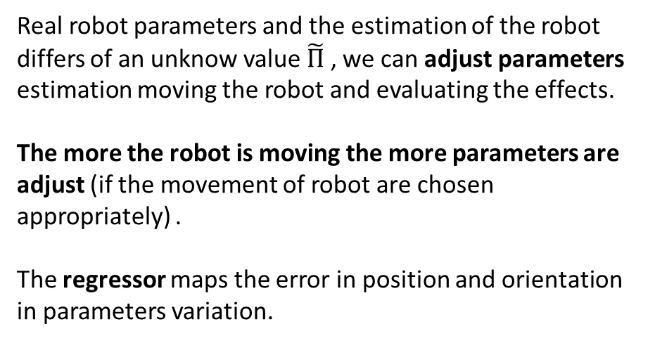

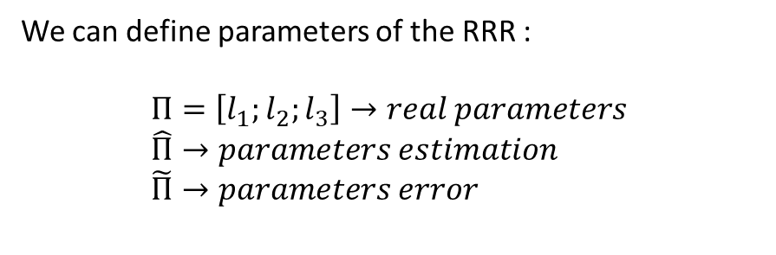
Model
For identification we follow 3 steps :
Choose exiting trajectory
Following trajectory using a controller
Mesure q and update parameters
We can define parameters of the RRR :
$Π=\left[l_{1};l_{2};l_{3}\right]→real parameters$
$\hat{Π}→parameters estimation$
$\tilde{Π}→parameters error$
We can compute the regressor as :
Real robot parameters and the estimation of the robot differs of an unknow value $\tilde{Π}$ , we can adjust parameters estimation moving the robot and evaluating the effects.
The more the robot is moving the more parameters are adjust (if the movement of robot are chosen appropriately) .
The regressor maps the error in position and orientation in parameters variation.
$$Y\left(q\right)=\frac{∂T}{∂Π}=$$

Slide 5
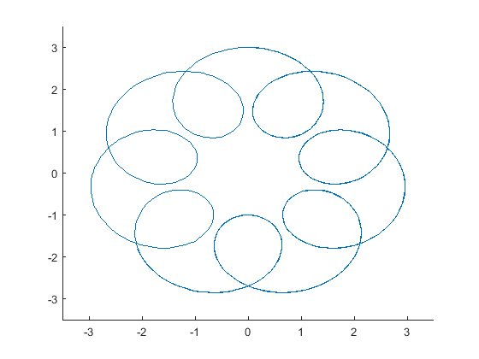



Trajectory
We have to chose the trajectory we want follow using end effector of RRR. So following trajectory are chosen :
The trajectory is chosen to be “rich” in terms of identification. Complicated trajectory performs better results compared to simple trajectory .
$$ξ_{des}\left(t\right)={[X}_{trj};Y_{trj}]$$

Slide 6
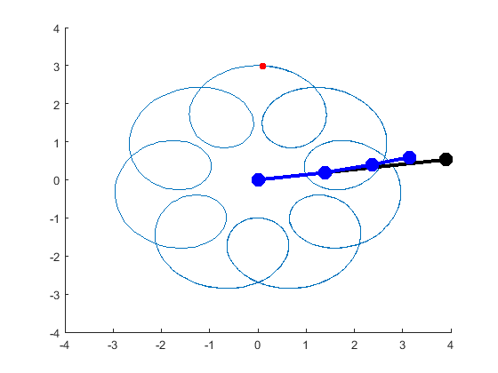
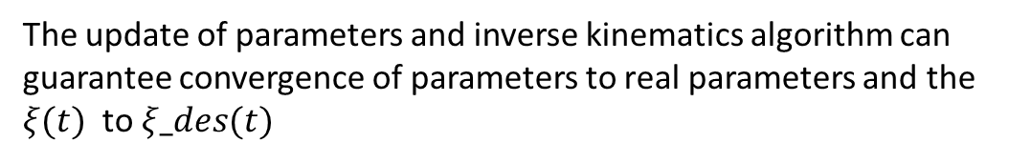


Identification
We can define a controller for the planar RRR :
$$u= \hat{J}{\left(q\right)}^{−1}⋅e=J{\left(q,\hat{Π}\right)}^{−1}⋅e$$
$$e=ξ−ξ_{des}$$
$$ξ_{des}\left(t\right)={[X}_{trj};Y_{trj}]$$
And we can define a parameters update rule :
$$\dot{\hat{Π}}=Y{\left(q\right)}^{T}⋅e$$
The update of parameters and inverse kinematics algorithm can
guarantee convergence of parameters to real parameters and the $ξ(t)$to $ξ_des(t)$

Slide 7
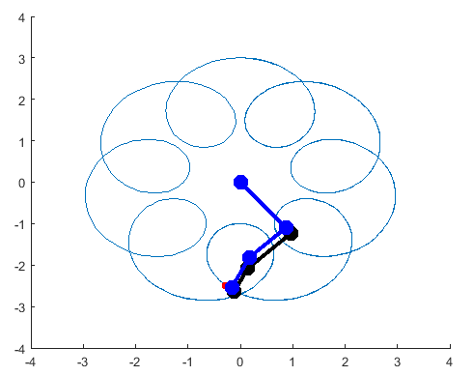
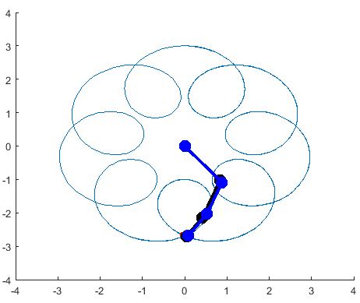
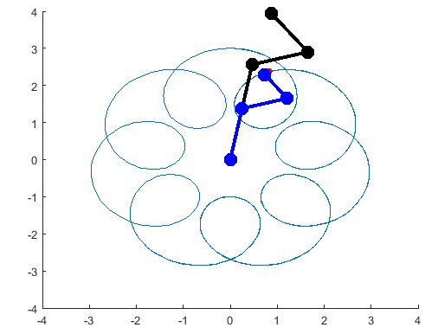
Identification
We can observe convercence of estimation of lengths of the three section of the RRR to real lengths. In black we have robot estimation and in blue real robot lengths.
$Π_{0}=\left[1.4 ;1;0.8\right]→real parameters$
$\hat{Π_{0}}=\left[4;2;1\right]→parameters estimation$
T = 1s
T = 5s
T = 20 s

Slide 8
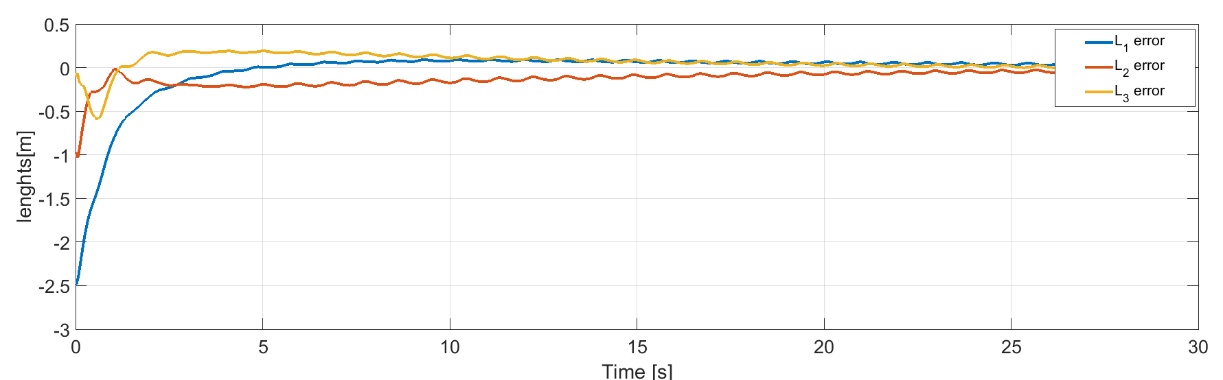
Results
Convergence of parameters can be observed. The oscillation of the error is generated by different control action ($\dot{q}$) given in input to control end effector to reach $ξ_{des}$.

