Slide 1
Biodiversity for the National Parks
Codecademy Capstone Option #2
Joseph Reed
February 2018

Slide 2
Objective:
Given two data sets perform some data analysis on the conservation statuses of species and investigate if there are any patterns or themes to the type of species that become endangered.
Joseph Reed
February 2018

Slide 3
Data Description:
We were provided with a data set that had information on different species in our National Parks. Below are some of the observations made regarding this data:
The overall shape of the data was 5,824 rows with 4 columns.
We had information on scientific name for each species, common name for each species and species conservation status.
We had 5,541 unique scientific names in the data set.
We had the following categories: Mammal, Bird, Reptile, Amphibian, Fish, Vascular Plant & Nonvascular Plant.
We had the following conservation statuses: Endangered, In Recovery, Species of Concern & Threatened. We also derived a status of No Intervention for rows with a None value in the column.
Joseph Reed
February 2018

Slide 4
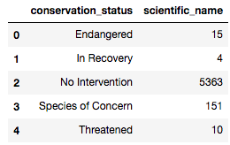
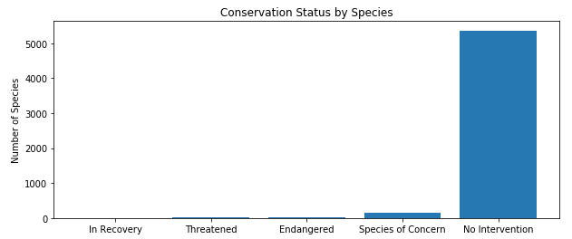
Data Description:
As you can see a small percent (3.25%) of the species fall into a conservation status requiring intervention with Species of Concern being the largest group. The majority of the species do not require any intervention.
Joseph Reed
February 2018

Slide 5
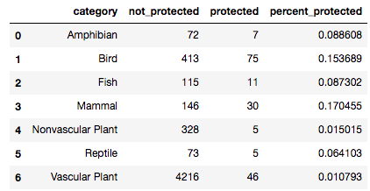
Data Description:
Next we did some data wrangling to see each category and count how many species in each were in protected status vs non protected status.
Based on the above numbers Mammals are the most likely to be endangered.
Joseph Reed
February 2018

Slide 6
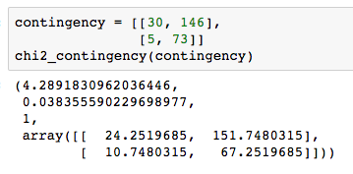
Significance Calculations:
We performed a chi squared test between Mammals and Reptiles to determine that there was a significant difference between the two.
Joseph Reed
February 2018

Slide 7
Recommendation for conservations concerns:
The categories with the highest number of species that require some level of intervention are Mammal and Bird.
Amphibians, Fish and Reptiles make up the categories with the middle number of species that require some level of intervention.
Nonvascular and Vascular plant species have the lowest number of species requiring some level of intervention.
Joseph Reed
February 2018

Slide 8
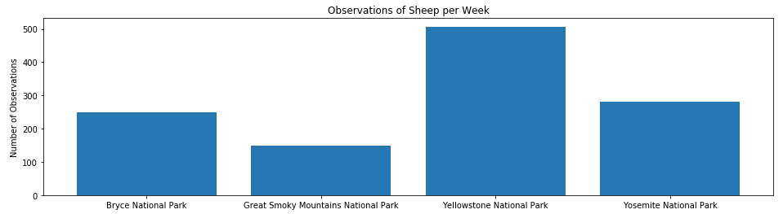
Sample Size Determination:
Conservationists have been recording sightings of different species at several national parks for the past 7 days.
Joseph Reed
February 2018

Slide 9
Sample Size Determination:
Using the number of sightings we want to determine the sample size needed to verify if a program at Yellowstone National Park to reduce the rate of foot and mouth disease at the park is working. We know that 15% of the sheep at Bryce National Park have foot and mouth disease. We want to be able to detect a reduction of at least 5% with confidence at Yellowstone National Park.
First we determine the minimum detectable effect using the following formula:
100 * .05 / .15 which gives us 33.33%
With this number and the above information we can now make use of a sample size calculator to determine the sample size needed.
Joseph Reed
February 2018

Slide 10
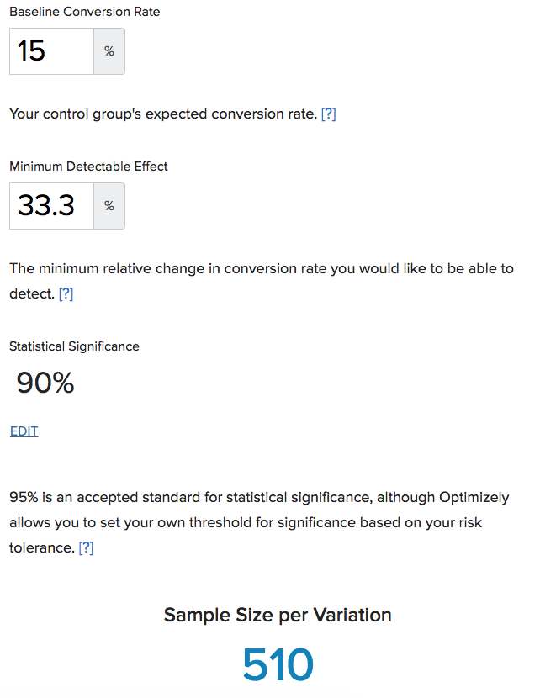
Sample Size Determination:
Next we utilize a sample size calculate and plug in the following numbers:
Joseph Reed
February 2018

Slide 11
Sample Size Determination:
And as you can see we get a sample size of 510. Using this number we can now determine how long we will need to conduct the study.
For Bryce National Park it took 7 days to get 250 sheep sightings so it will take a little over 2 weeks to get our 510 observations.
For Yellowstone National Park it took 7 days to get 507 sheep sightings so it will take 1 week to get our 510 observations.
Joseph Reed
February 2018

