Slide 1
QG Omega in a summer heavy rains over a South East USA box
Heather Deas
2008-08-12

Slide 2
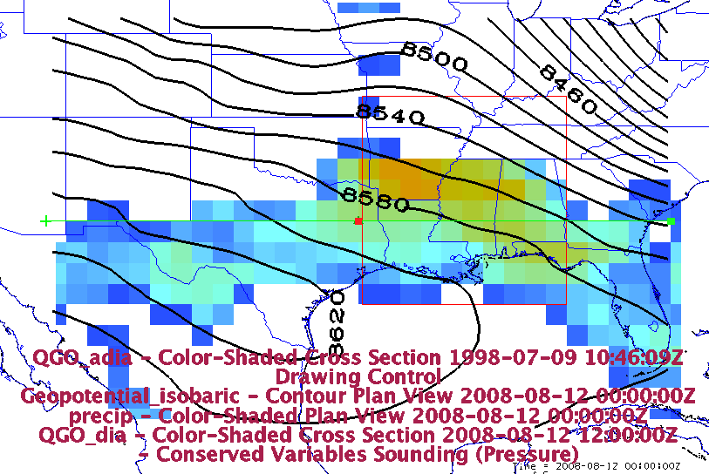
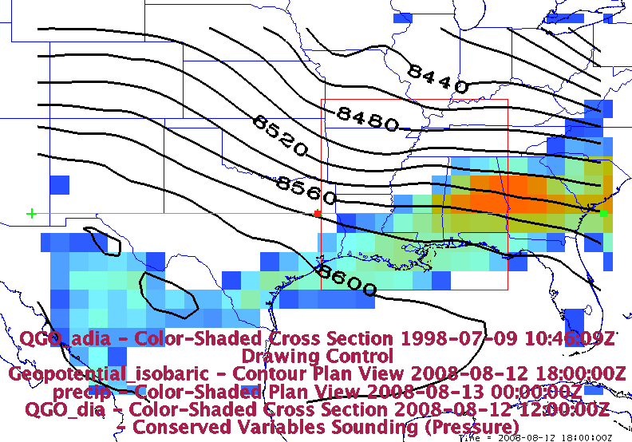
Mean rainfall on 2008-08-12
Mean from 0000Z – 1200Z
Mean from 1200Z – 000Z(8-13)

Slide 3
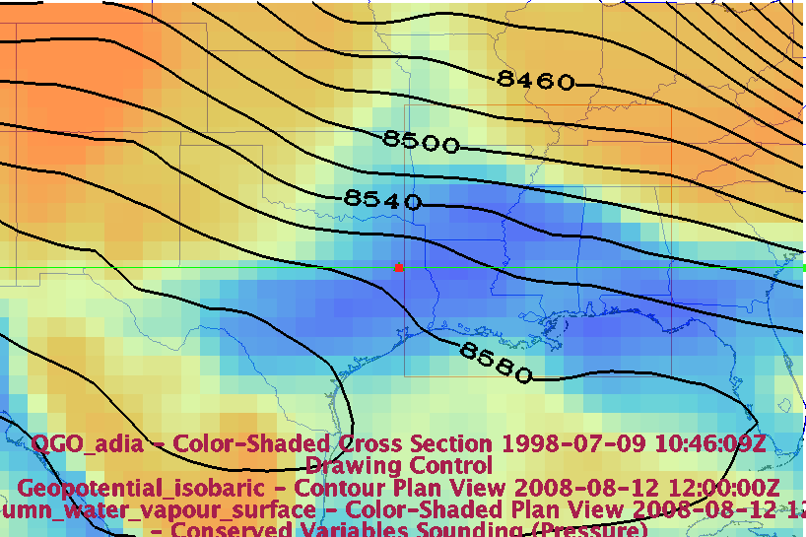
Column of Water Vapor at 12Z
The blue is the regions where column of water vapor is the greatest. These regions match up with the data from the previous slide of mean rainfall.

Slide 4
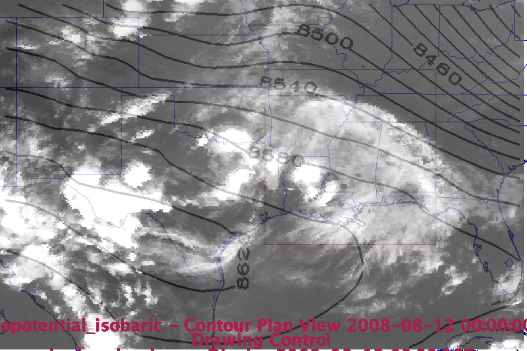
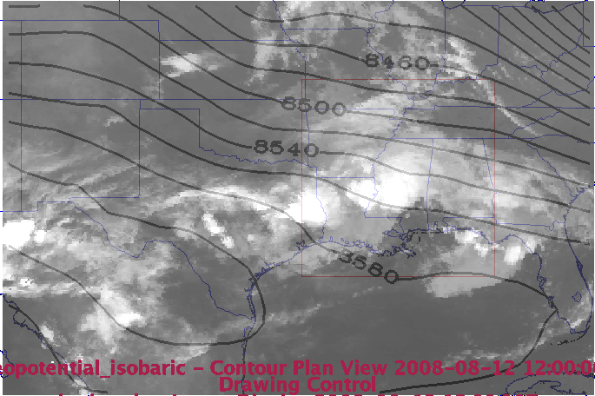
IR Satellite
0000Z
1200Z

Slide 5
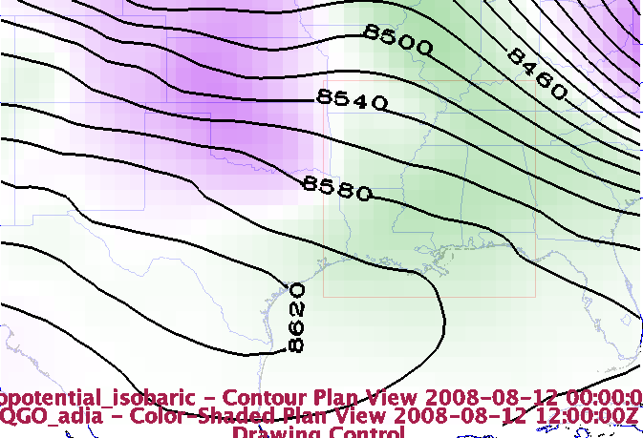
QG adiabatic omega at 500 hPa
The adiabatic omega is upward in the boxed region and the green corresponds to upward motion.

Slide 6
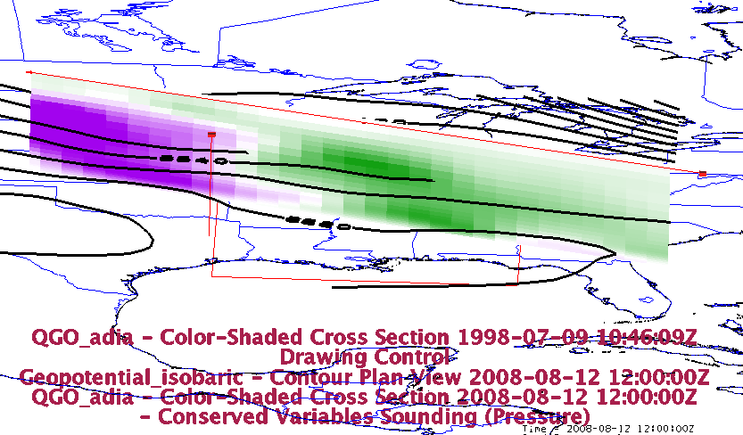
Cross section of QG adiabatic term
There is a tilt in the adiabatic term. It is strong at the surface and midlevels while weakening at the upper-levels

Slide 7
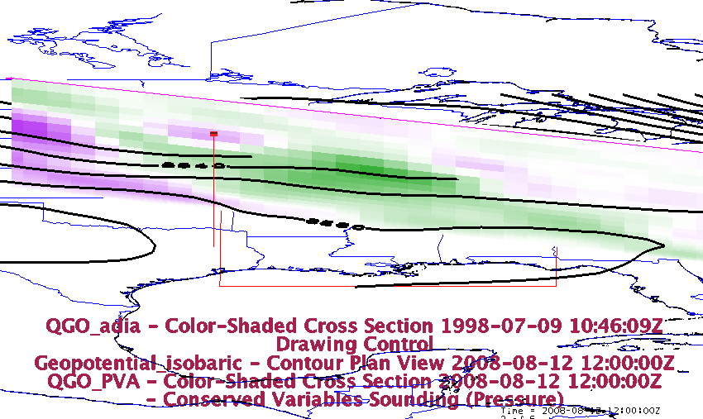
QG omega Potential Vorticity cross section
Strongest in mid-level, weaker towards to surface

Slide 8
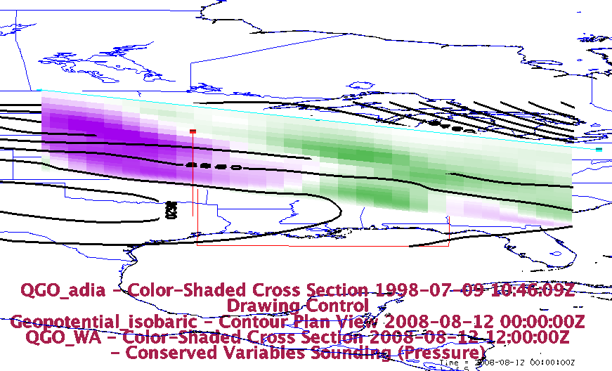
QG Omega for warm Advection
Upper level lift in the NW

Slide 9
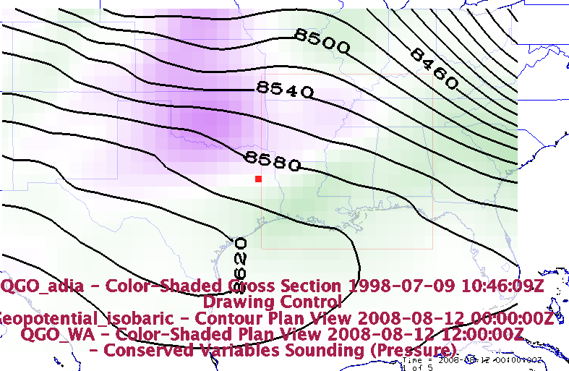
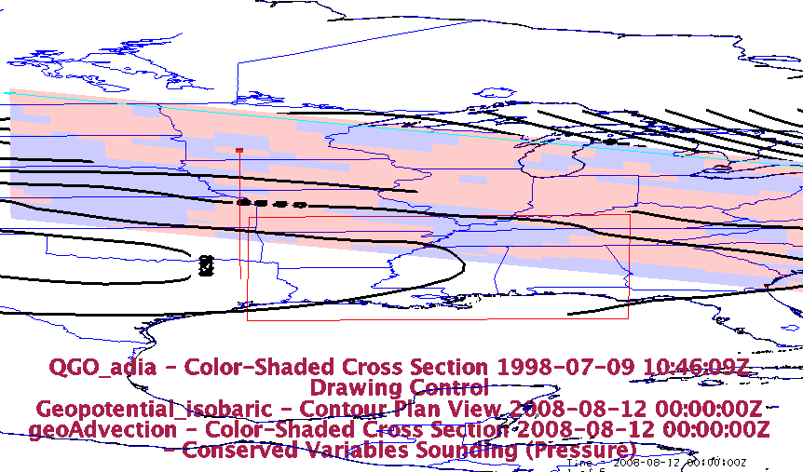
Warm Advection
GeoAdvection

Slide 10
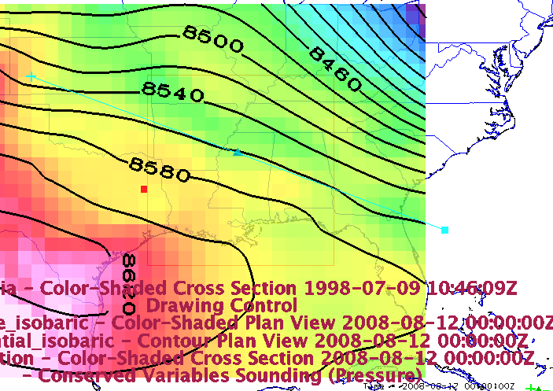
Cooler temperatures are advected south

Slide 11
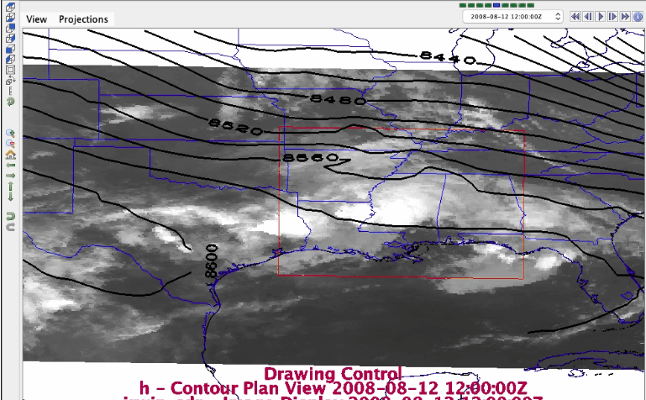
A large trough spanning half of the United States is moving eastward

Slide 12
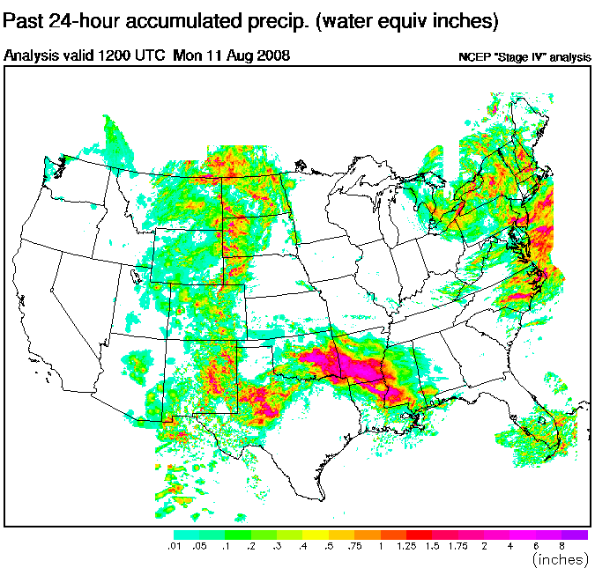
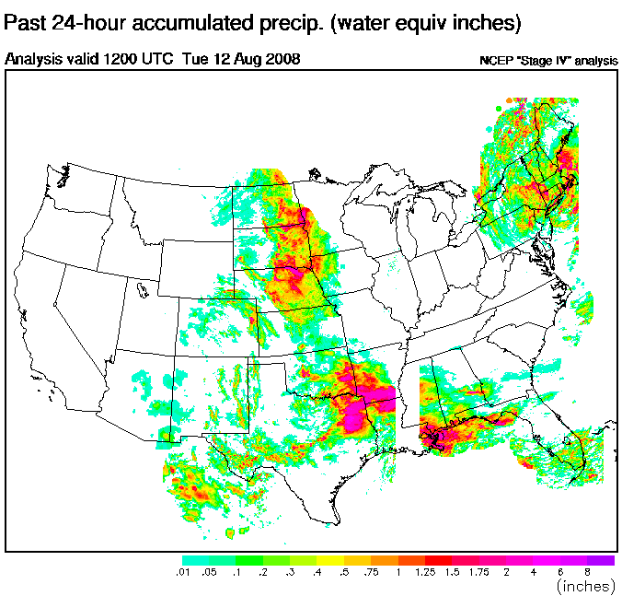
Daily Timescale rainfall:
here
12Z to 12Z daily rainfall totals spanning from 0Z to 0Z day

Slide 13
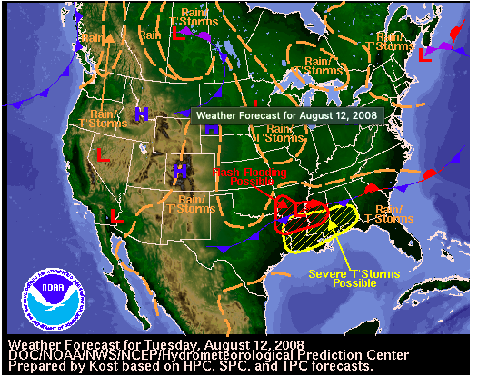
Forecast from the WPC archive
The Forecast warns of a possibility of flash flooding occurring in the low pressure system located at the surface.

Slide 14
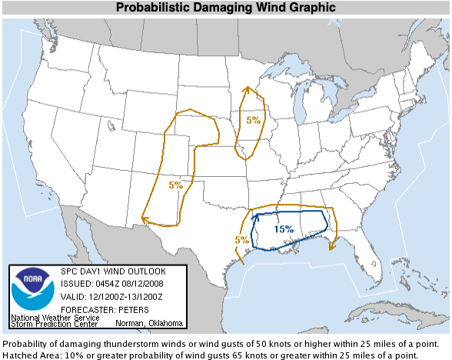
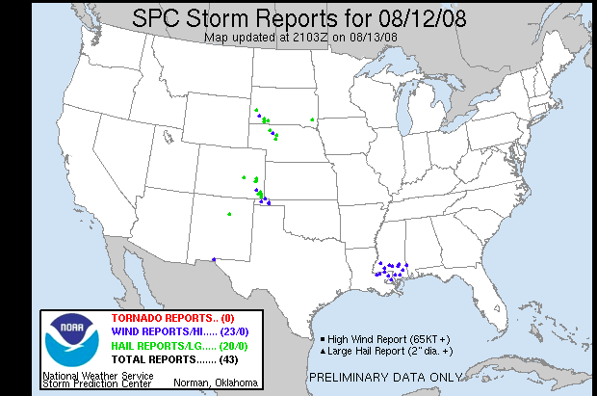
SPC Storm reports
Storm Prediction Center warned of high winds in south Mississippi and east Louisiana. There was a 15% chance of the winds causing damage and weather stations in Mississippi reported fallen trees and power lines.

Slide 15
Nasa World View case
https://worldview.earthdata.nasa.gov/?t=2000-06-17-T08%3A00%3A00Z&t1=2008-08-13-T06%3A00%3A00Z&as=2000-06-17-T06%3A00%3A00Z&ae=2000-06-27-T06%3A00%3A00Z&l=IMERG_Precipitation_Rate,GMI_Rain_Rate_Asc(hidden),GMI_Rain_Rate_Dsc(hidden),TRMM_Precipitation_Rate

Slide 16
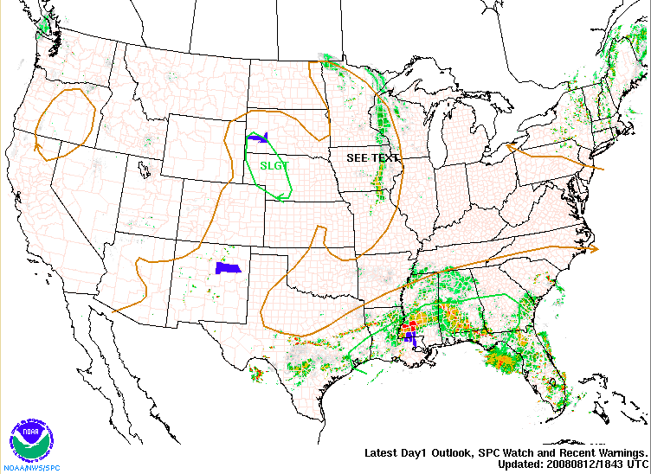
Watch/Warning summary

Slide 17
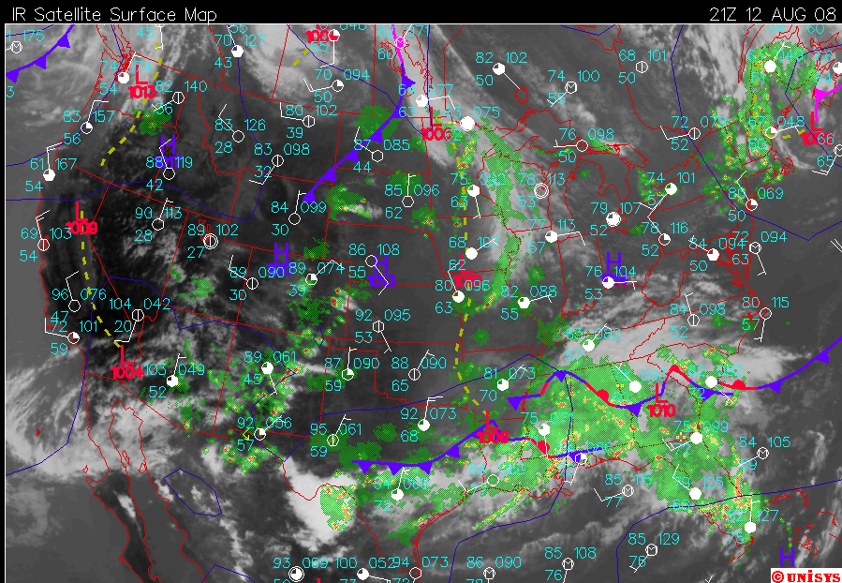
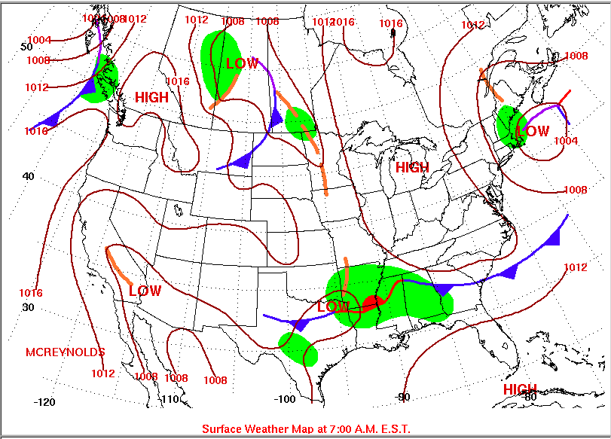
Surface low moving across the SE

Slide 18
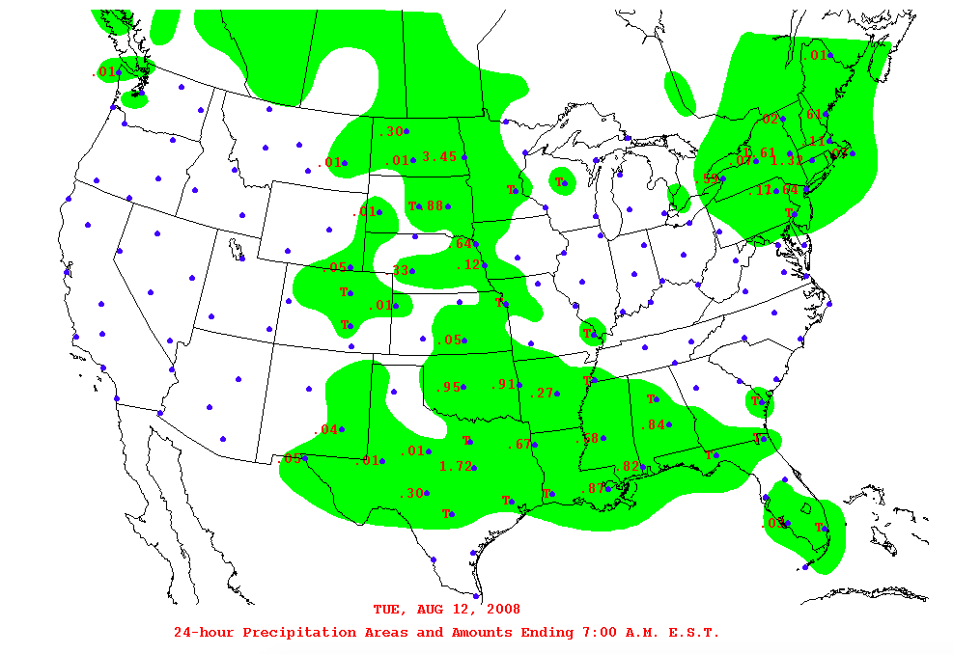
24-Hour precipitation map

Slide 19
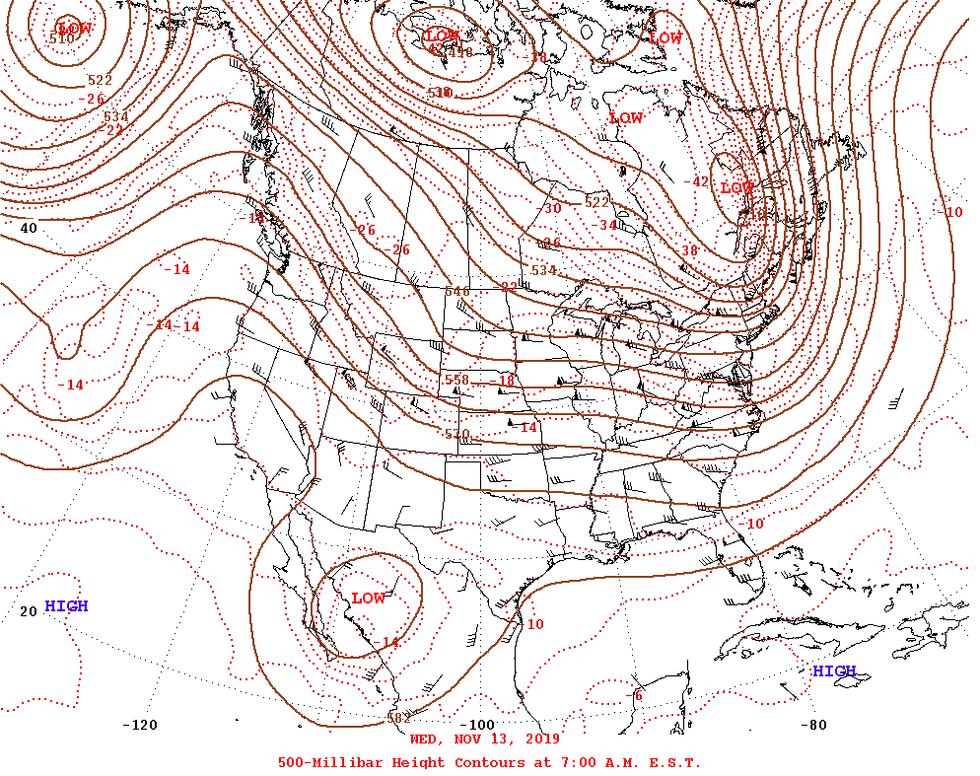
500 mb
There is a surface low as well as an upper level low at 500 mb

Slide 20
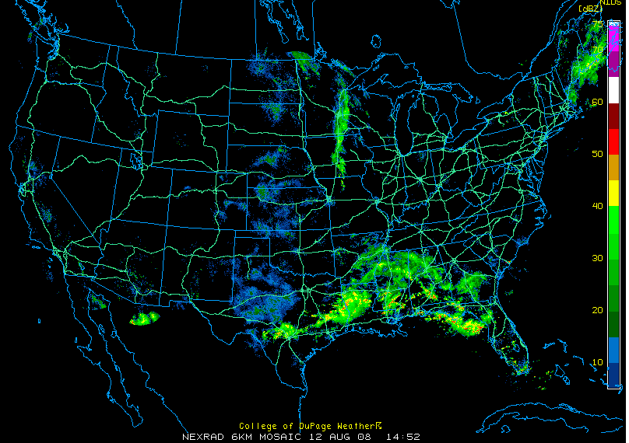
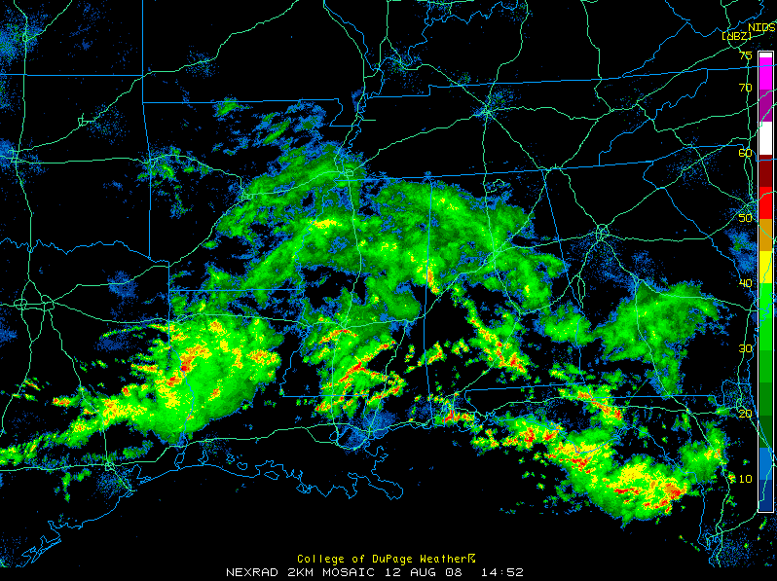
Radar from 08/12/2008

Slide 21
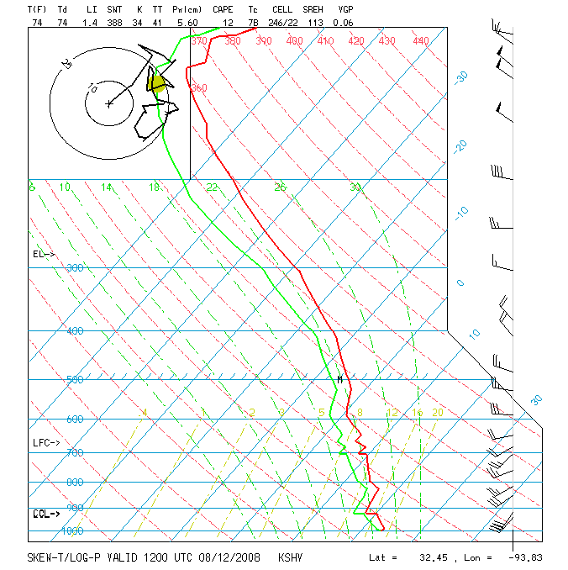
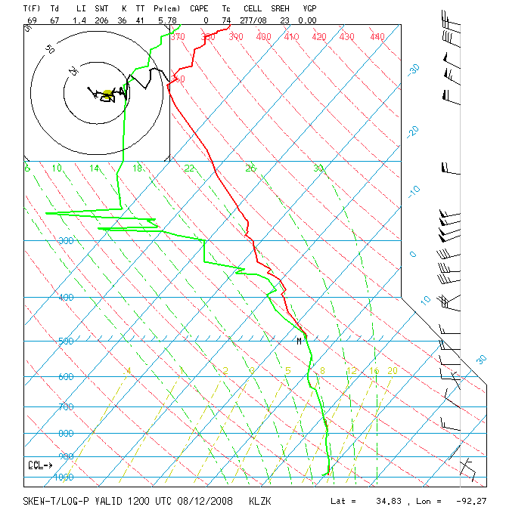
Soundings in Skew-T format
Shreveport, LA
Little Rock, Ar
Both soundings indicate rain since the

