Slide 1
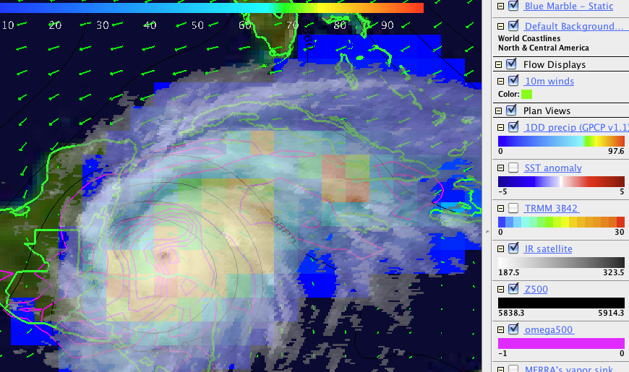
Learning to use the IDV like for class projects in 651
Brian Mapes, University of Miami
mapes@miami.edu

Slide 2
What is The IDV?
The Integrated Data Viewer
Free, supported software (Java, any platform)
product of decades of development
So it’s a bit old and Minecraft-like
Roots in meteorology, NSF-supported
→ skew-T displays, our derived quantities, etc.
Complicated, by necessity... since it does a lot

Slide 3
A simpler display engine
Panoply
https://www.giss.nasa.gov/tools/panoply/download/
Same underlying data-access libraries as IDV, much less functionality, much simpler
Requires Java 11 apparently (2022)

Slide 4
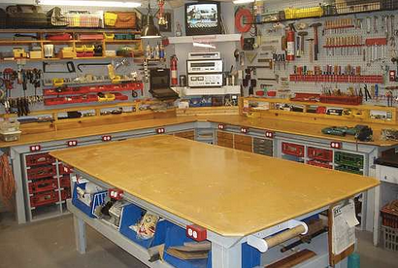
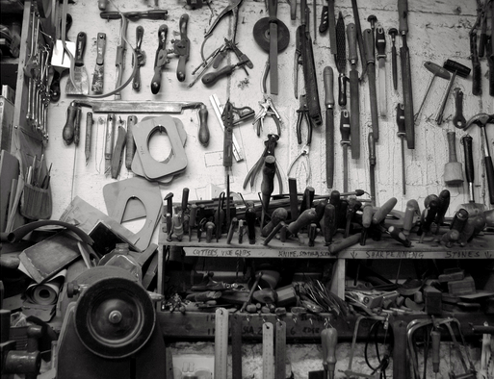

Orientation to The IDV: Take a breath. Read. Take time to think. Think like a maker.
←It is like this
←(with a few parts more like this...)
Not this→

Slide 5
Menus within menus
Tools are often available in more than one place
Right-click often pulls up menus with more options
Everything was created and named thoughtfully
decades of team development & committee decisions
Be patient, read, think
Every word in every menu is logical, and necessary

Slide 6
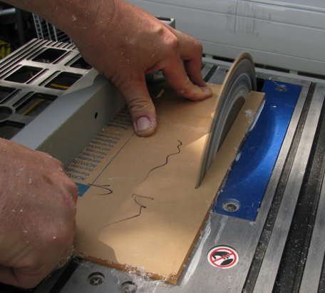
Getting used to an advanced workshop
Get a mouse (read Help->Panning and Zooming)
While trackpad gestures can be used, many features are easiest on a 3-button mouse.
right-click has useful menus
scroll wheel to zoom in and out
right-button drag to rotate 3D display (drag its front)
ctrl- right-button drag to move (pan) display (drag whole cube)
There are pitfalls!
Think before you click!
ALWAYS ALWAYS match Time Driver
“Measure twice, cut once”
Save your work, if you add value
There is no auto-save or back button!

Slide 7
What is a Bundle?
myfile.xidv is a bundle consisting of xml code only
just instructions -- including pointers to data servers
not very human readable: can only open it in The IDV
myfile.zidv is a bundle with data zipped into it
A larger file since the data is inside it
data will unzip into a temporary folder on your computer
this gives faster responses, and will work offline

Slide 8
Saving a bundle while you work
File→Save a .xidv bundle of your IDV session’s state any time.
File→Open that file to get right back to this point
same data, displays, views, etc. etc.
If you add value to the initial bundle, save it!
There is no autosave, no Back button!
A common error: there no stop button if you accidentally click to load the whole internet, blowing memory limits!

Slide 9
Performance (speed)
Data reading and rendering can take time
Be patient. It will finish, if memory is sufficient.
sub-processes are not possible to monitor in detail
Stretch, breathe, do something else.
Beats programming!

Slide 10
Install the IDV
Any platform, just a few clicks to install
Search “unidata idv” will find their page

Slide 11

Launch the IDV
Find the launcher, double click
Move it to the Dock if you plan to use often
Notice Help menu!

Slide 12
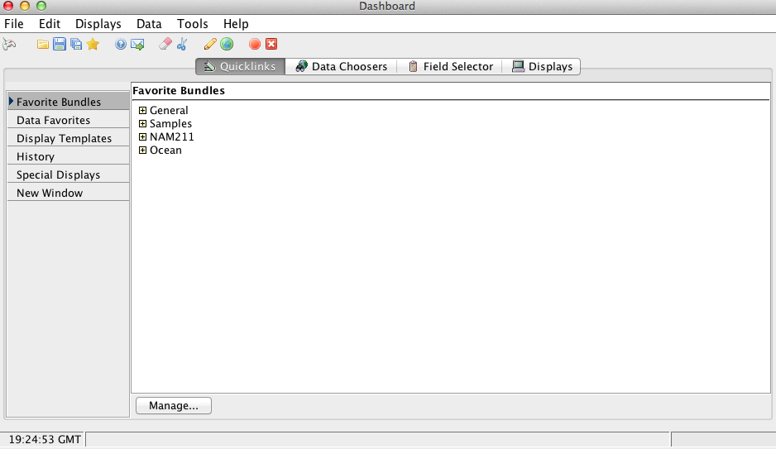
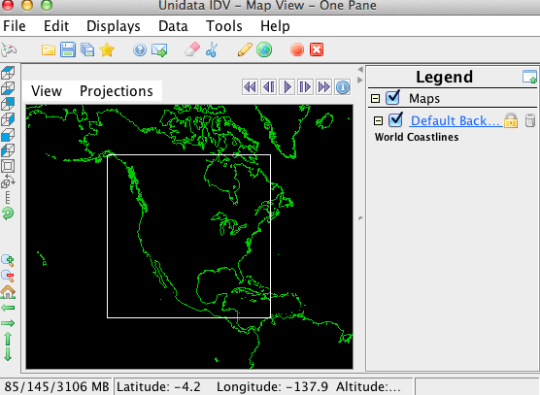
The IDV's windows
Two main windows:
Dashboard window
Display window
(may be more than one)

Slide 13
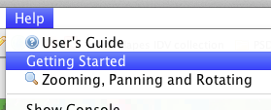
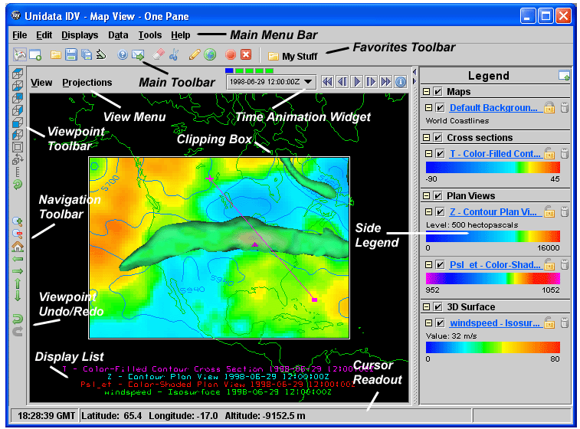
Display window's parts
HIDDEN!
Toggle for Memory Monitor

Slide 14

Recovering the Dashboard
If you close the dashboard, click here in the display window to get it back

Slide 15
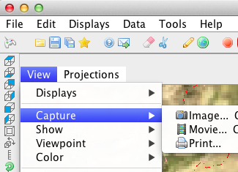
A very important corner:
Open a bundle
Save bundle (state)
Open Dashboard
Restore normal
top view after
too much rotation
and zooming
CAPTURE IMAGE OR MOVIE
view from east
view from south

Slide 16
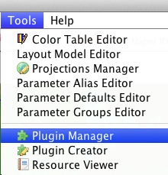
Installing plugins
A useful tool for customizing your IDV is a plugin.
Miscellaneous > Custom IDVs >Mapes IDV collection

Slide 17
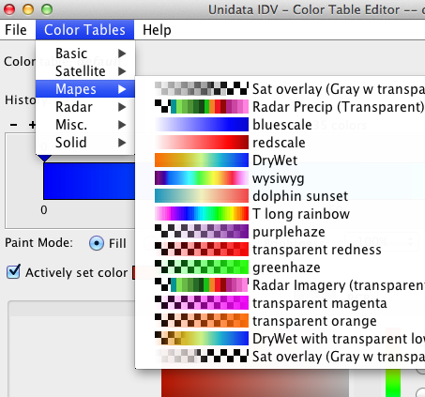
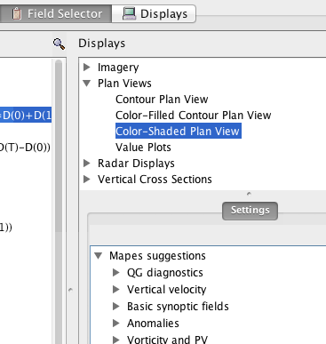
What is The Mapes IDV Collection?
MANY resources:
Custom color tables (DIVERGING, etc.)
Formulas → Grids → Mapes

Slide 18
About error messages....
You will get error messages sometimes.
for example if data servers are down, or ??
They are hard to interpret
Click OK. Move on. Sometimes it works anyway
Don't bother with Support Form every time...

Slide 19
Terminology: Learn these words!
Window
Pane or viewport
View
Projection
Display
If these are not clearly distinguished, you will have trouble asking for help clearly.

Slide 20
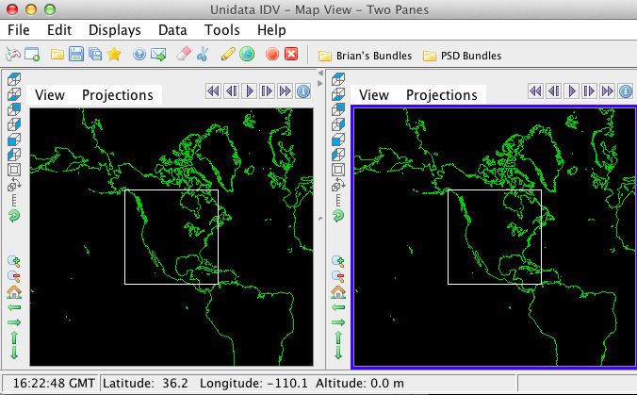
This window has two view panes

Slide 21
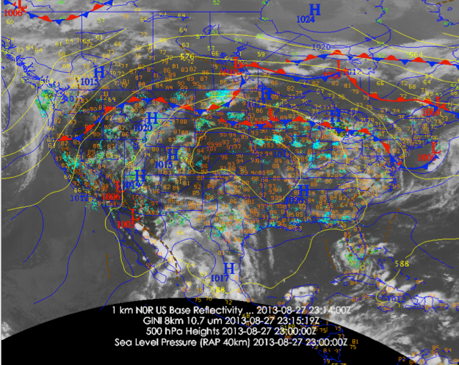
This is a view

Slide 22
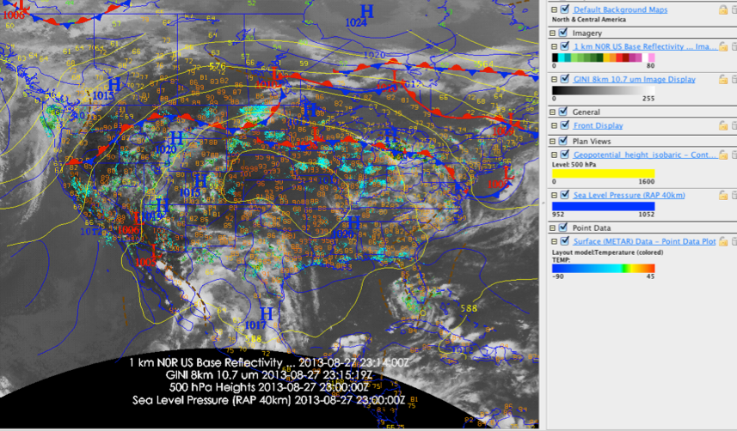
This view has several displays
This is the legend

Slide 23
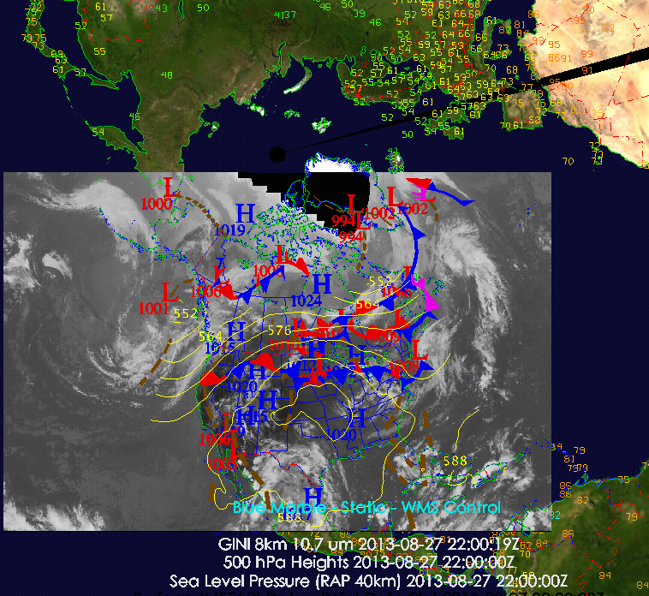
Same view and displays, different (polar) projection

Slide 25
MERRA2 dataset for projects
https://gmao.gsfc.nasa.gov/reanalysis/MERRA-2/docs/
2D fields all at https://goldsmr4.gesdisc.eosdis.nasa.gov/dods/
3D fields all at
https://goldsmr5.gesdisc.eosdis.nasa.gov/dods/
ALWAYS ALWAYS MATCH IDV TIME DRIVER!
Or you will download whole internet
ALWAYS SAVE YOUR VALUE-ADDED BUNDLE!
So you don’t cry when work is lost

Slide 26
You must make an account
1. Create an account at https://urs.earthdata.nasa.gov/users/new.
2. Log into that account. On that top page, select Applications/Authorized Apps. Select Approve More Applications. Approve NASA GESDISC DATA ARCHIVE.
3. Launch the IDV. In the Data Choosers tab of the Dashboard, select URLs at left, and paste in dods://goldsmr4.gesdisc.eosdis.nasa.gov/dods/M2T1NXSLV. IDV will ask you to sign in with your new NASA Earthdata credentials.
4. Set a time driver for a time of interest since 1980 (!) Study the Time Driver menu carefully, choosing either a start time and end relative to that, or vice versa. Notice that this dataset is hourly. For now, just ask for one time level but see how you will be able to select a range of times, and an interval (1h, 3h, 6h, whatever you like).
Create a quick Contour Plan View display of Z500 for your time.
Simon says: ALWAYS ALWAYS match time driver. ALWAYS ALWAYS match display region. ALWAYS ALWAYS save the bundle (overwrite) when you have improved it.
5. Explore the awesome power of other MERRA-2 datasets. All 3D ones are on https://goldsmr5.gesdisc.eosdis.nasa.gov/dods/, 2D ones are on https://goldsmr4.gesdisc.eosdis.nasa.gov/dods/. Search for "hourly" to find the instantaneous (hourly or 3-hourly) weather sets, search “monthly” for climate sets.
ALWAYS ALWAYS save the bundle after you improve it, overwriting the old one.
ALWAYS ALWAYS match Time Driver before you Create Display.

