Slide 1
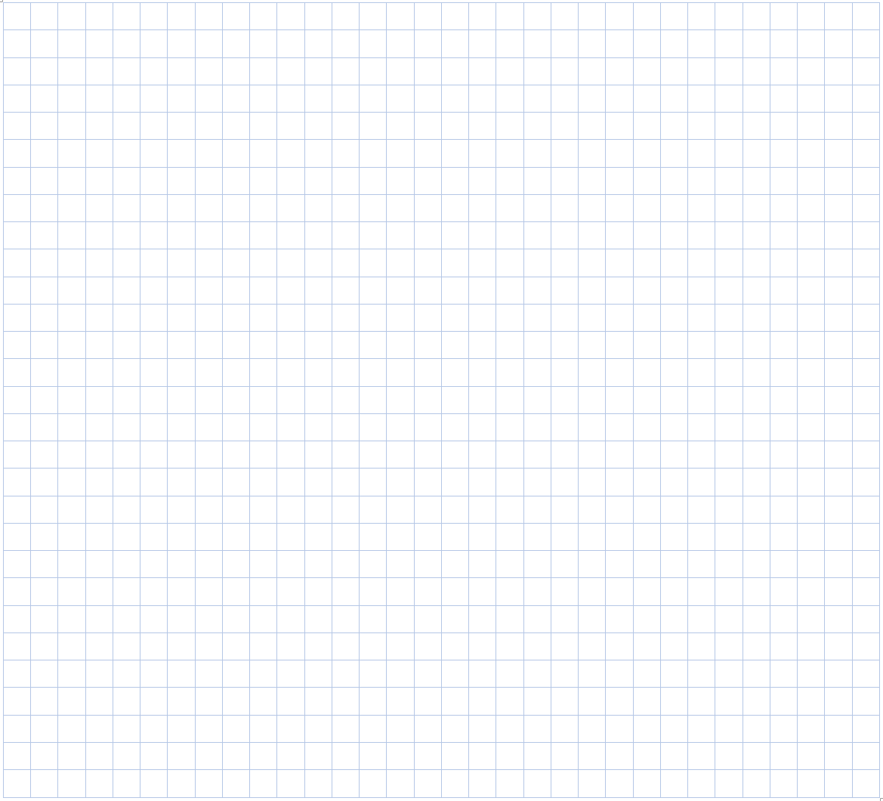
Legend:
y (km)
x,y grid 100km
velocity scale
1 cell = 10m/s
1000
500
-1000
-500
500
1000
x (km)
-500
-1000

Slide 2
v (m/s)
20
10
-20
-10
10
20
u (m/s)
-10
-20

