Slide 1
Bayes Rule
Greg Hakim
University of Washington

Slide 2
Bayes Rule and Data Assimilation
P(x|y) = P(y|x) P(x) / P(y)
P(x|y) : “posterior” this is the “analysis” (everything we know about x, knowing y)
P(y|x) : “likelihood” of observations, y, given state, x. This is a function of x
P(x) : “prior” --- this is what we know about x before we get y
P(y) : “evidence” --- marginal probability of the observations

Slide 3
Example: coin toss with an unknown coin
What is the probability that coin produces heads? I.e., P(‘H’) is unknown
Let P(‘H’) = x, is a random variable
P(x) is distributed on [0,1]
x=0: tails with probability 1
x=1: heads with probability 1
How to find x?
Frequentist: observe the flip of the coin N times, and count heads, C. P(x) = C /N
Bayesian: start with an hypothesis, and update it with the observations using Baye’s rule

Slide 4
Coin toss example. Three tosses: Y = ‘HHT’
Frequentist: x = 2/3
Bayesian: P(x|y = ‘HHT’) = P(‘HHT’|x) P(x) / P(y)
P(‘HHT’|x): likelihood of the observations given the (true!) value for x
Each toss is independent (does not depend on any other toss), so
P(‘HHT’|x) = P(H) P(H) P(T)
= P(H) P(H) (1-P(H))
= x * x * (1-x)
= x² – x³
What to choose for the prior, P(x)?
Don’t know anything, so choose an uninformed prior, P(x) = C = 1 (integrates to 1 on [0,1])

Slide 5
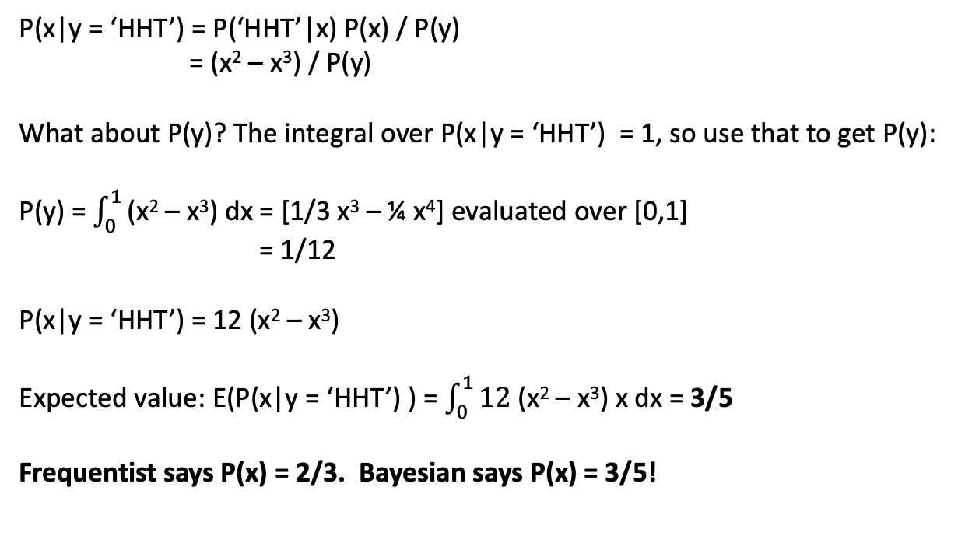
Coin toss example. Three tosses: Y = ‘HHT’
P(x|y = ‘HHT’) = P(‘HHT’|x) P(x) / P(y)
= (x² – x³) / P(y)
What about P(y)? The integral over P(x|y = ‘HHT’) = 1, so use that to get P(y):
P(y) = $\int_{0}^{1}{\text{(}\text{x}\text{2}\text{ – }\text{x}\text{3}\text{)}}$ dx = [1/3 x³ – ¼ x⁴] evaluated over [0,1]
= 1/12
P(x|y = ‘HHT’) = 12 (x² – x³)
Expected value: E(P(x|y = ‘HHT’) ) = $\int_{0}^{1}{12 \text{(}\text{x}\text{2}\text{ – }\text{x}\text{3}\text{)}}$ x dx = 3/5
Frequentist says P(x) = 2/3. Bayesian says P(x) = 3/5!

Slide 6
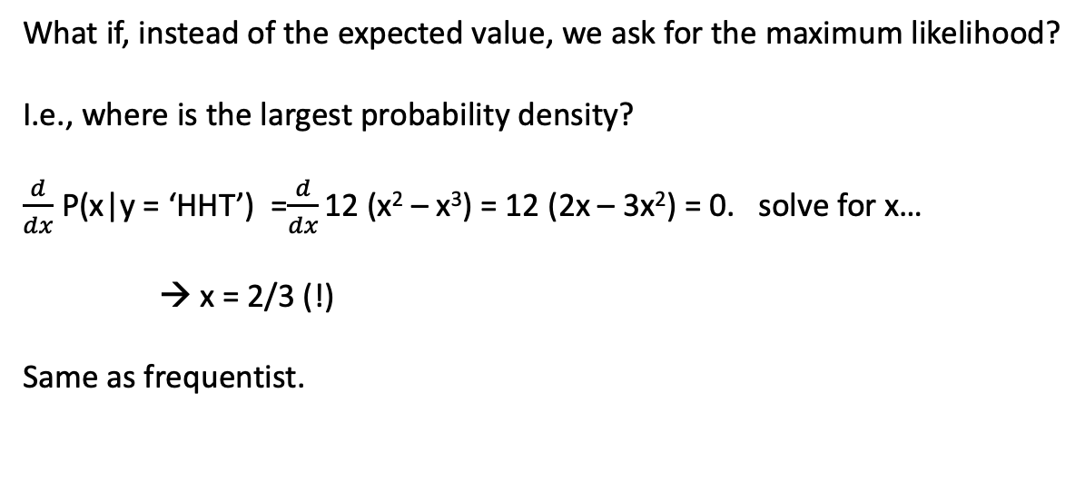
Coin toss example. Three tosses: Y = ‘HHT’
What if, instead of the expected value, we ask for the maximum likelihood?
I.e., where is the largest probability density?
$\frac{d}{dx}$ P(x|y = ‘HHT’) =$\frac{d}{dx}\text{12 (}\text{x}\text{2}\text{ – }\text{x}\text{3}\text{)}$ = 12 (2x – 3x²) = 0. solve for x…
→ x = 2/3 (!)
Same as frequentist.

Slide 7
Revisit the coin toss for sequential obs
Since the observations are independent, we can write
P(x|y = ‘HHT’) = P(x|’H’) P(x|’H’) P(x’T’)
So we can update P(x|y) one observation at a time
P(x|y = ‘H’) with prior P(x) = 1
P(x|y = ‘H’) with prior P(x|y = ‘H’)
P(X|y = ‘T’) with prior P(x|y = ‘HH’)
Gives the same answer for P(x|y = ‘HHT’)
This notion of breaking the problem along lines of independence will come up several times
Go to Jupyter notebook

