Slide 1
Separating flow by scale: Eddy flux as a transport in addition to bulk flux / advective transport
Brian Mapes
ATM651
from: Markowski and Richardson 2011 book

Slide 2
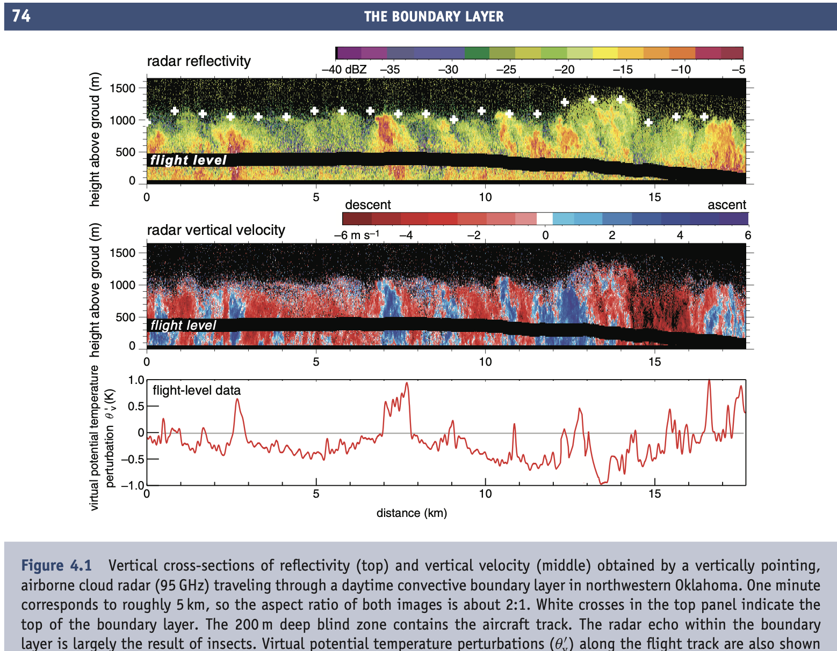
FLUX
by “small” scales
we don’t care to bookkeep all their details
but their effect on larger scales (which we care about) cannot be neglected
deviations from mean
“turbulence”

Slide 3
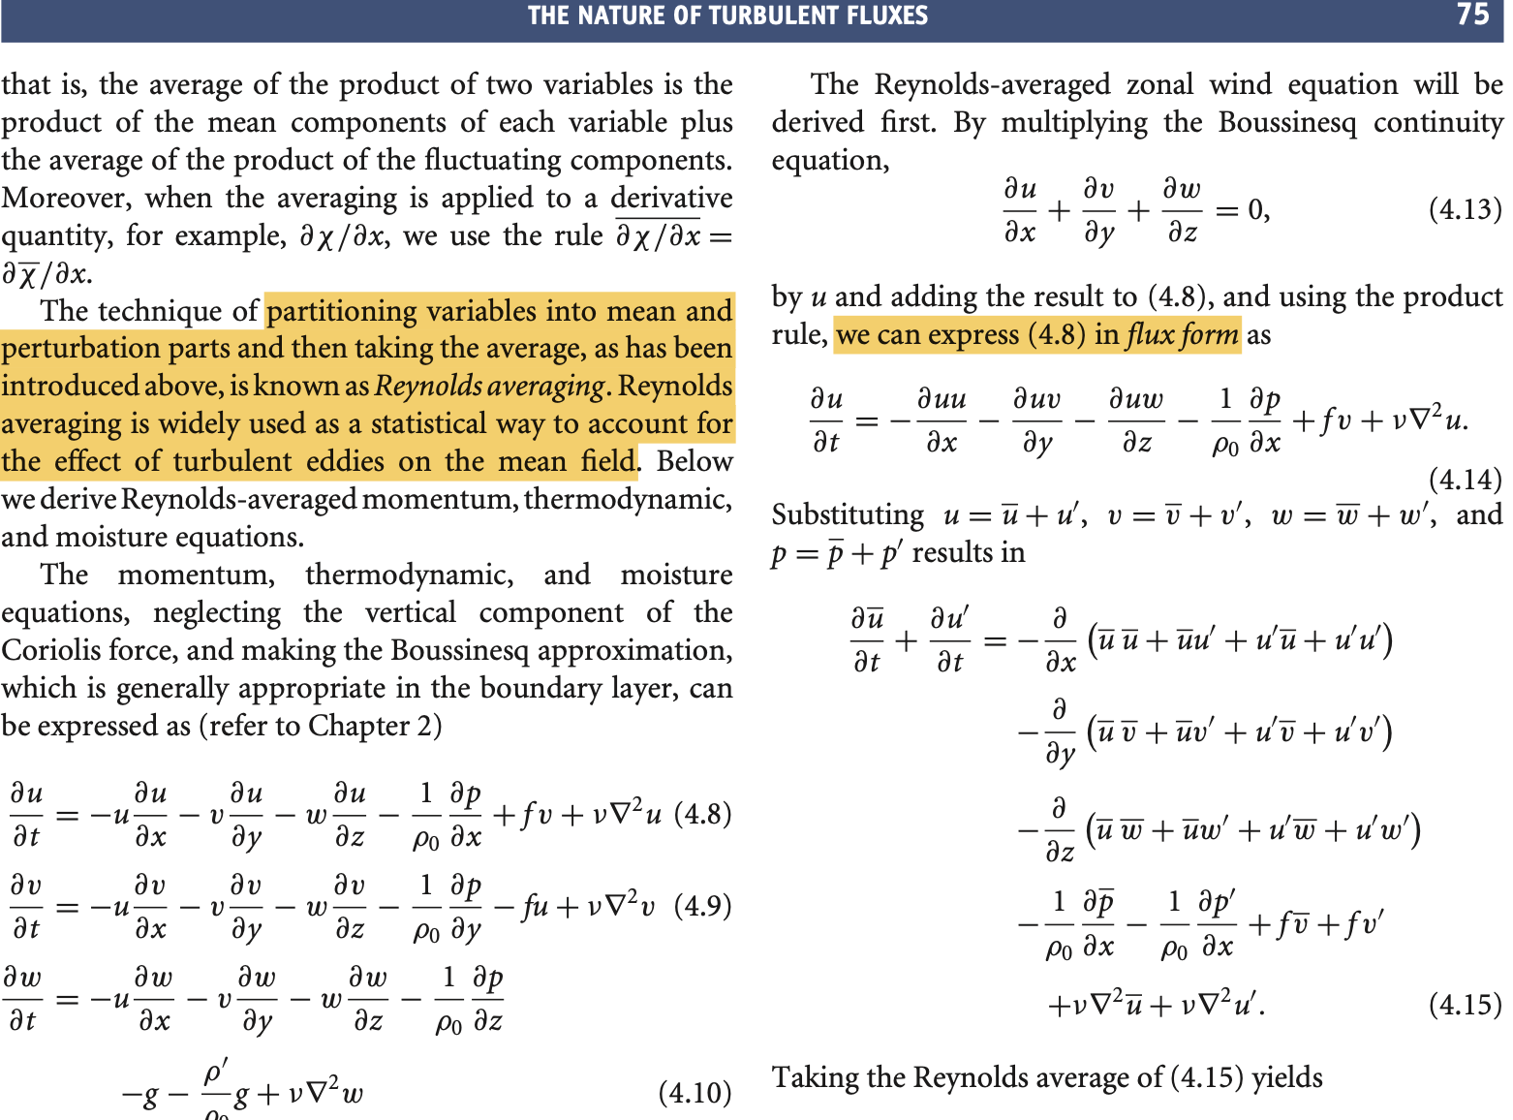
FLUX FORM of transport
Maroki and Richardson 2011
Ch 4

Slide 4
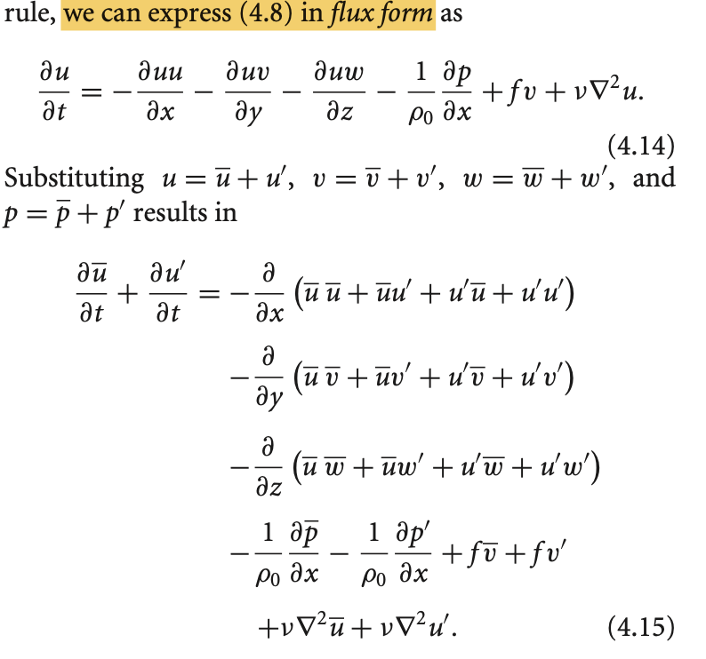

Slide 5
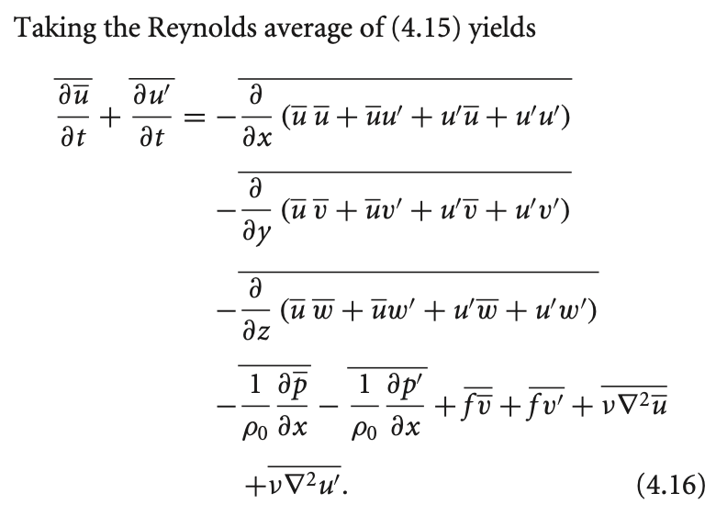
ZERO

Slide 6
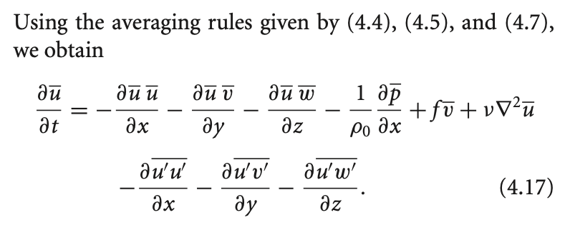
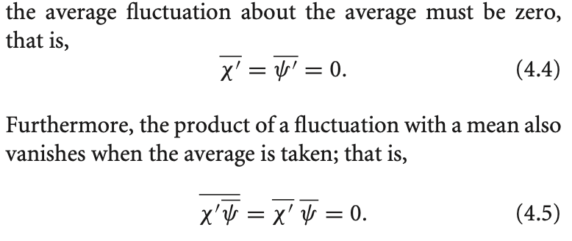
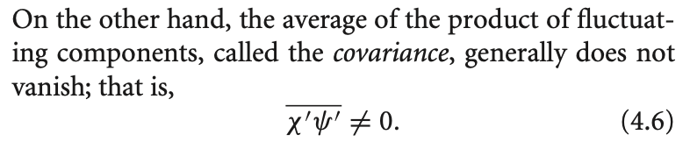

Slide 7
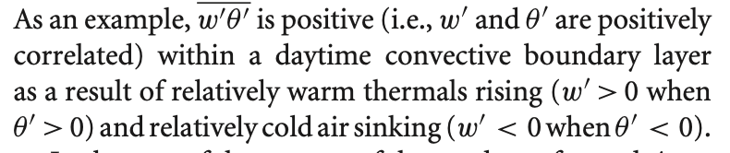
Covariances of velocity w/ stuff: eddy flux
Momentum flux is a bit abstract, so consider heat flux:

Slide 8
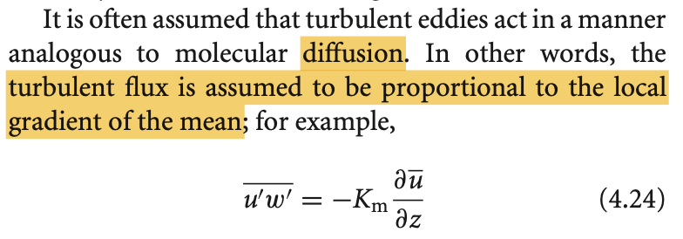
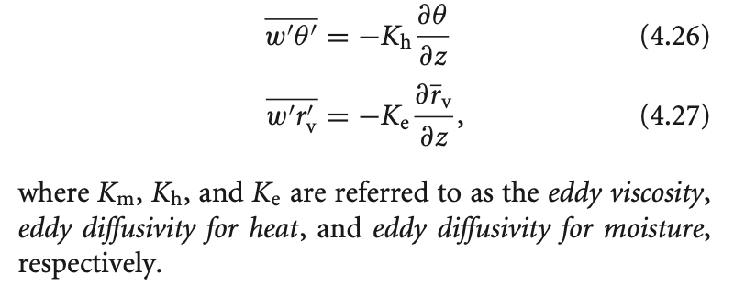
Treating eddy flux as a function of mean gradient:

Slide 9
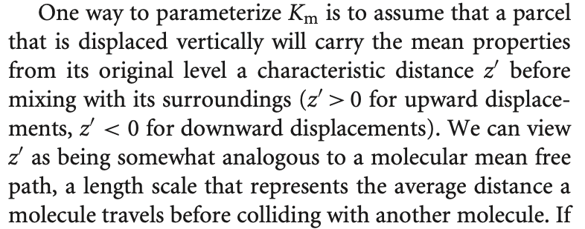
Treating eddy flux as a function of mean gradient:
What determines K?
how strong is the small-scale w’?
RMS(w’) or stdev(w’) or TKE (turbulent kinetic energy)
How far do those small-scale drafts go, exchanging air properties?
a “mixing length” L

