Slide 1
Separating flow by scale: Eddy flux as a transport in addition to bulk flux / advective transport
Brian Mapes
ATM651
from: Markowski and Richardson 2011 book

Slide 2
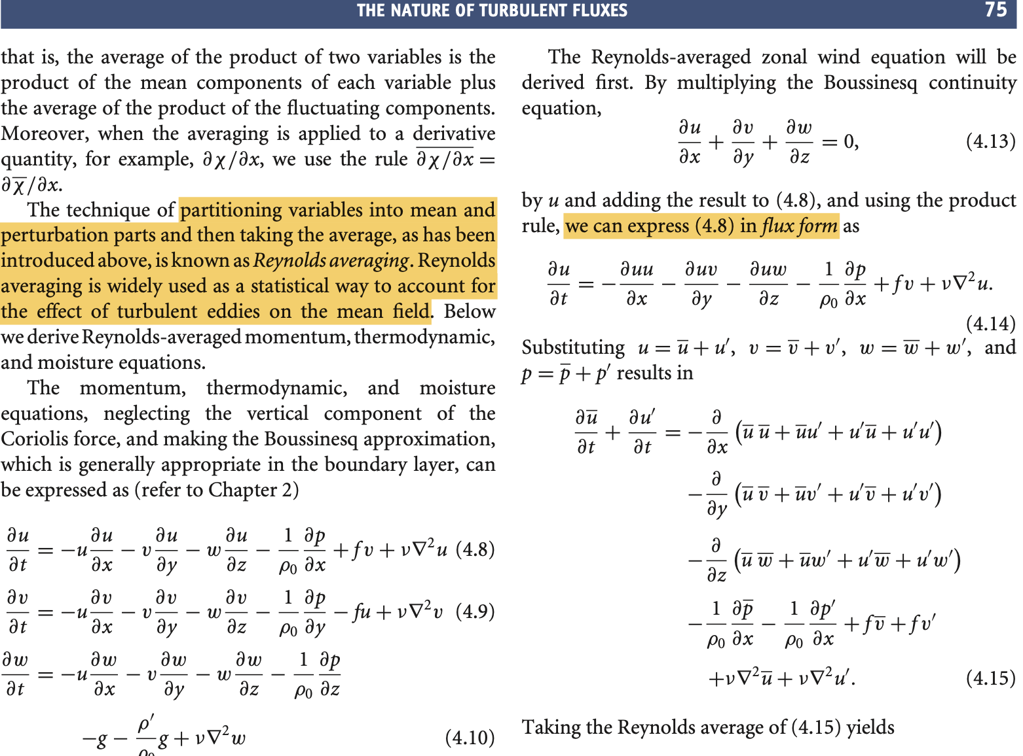
FLUX FORM of transport
Maroki and Richardson 2011
Ch 4

Slide 3
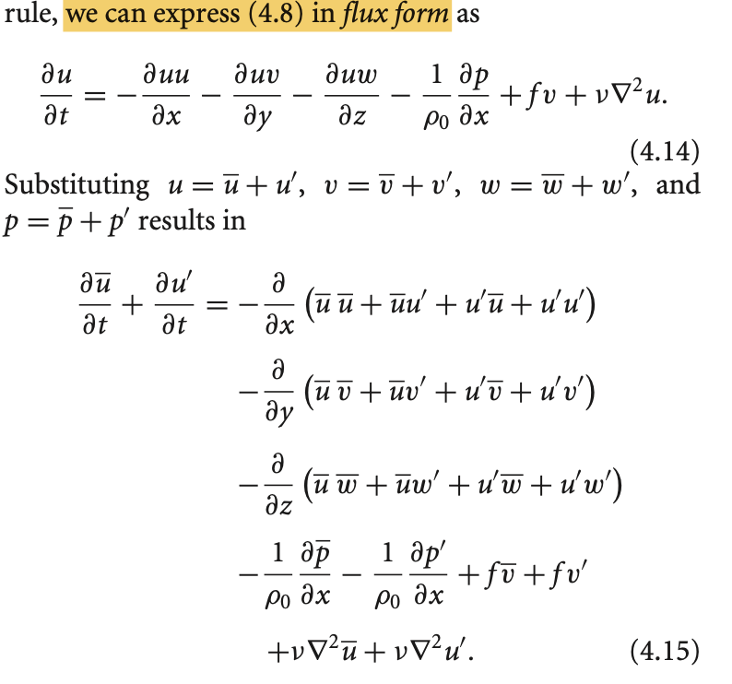

Slide 4
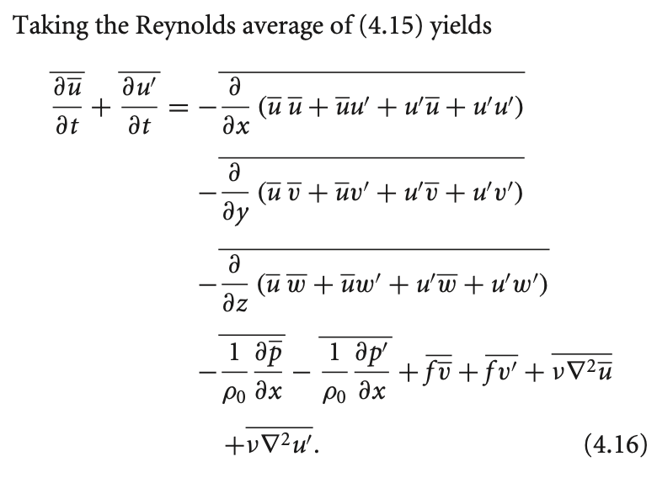
ZERO

Slide 5
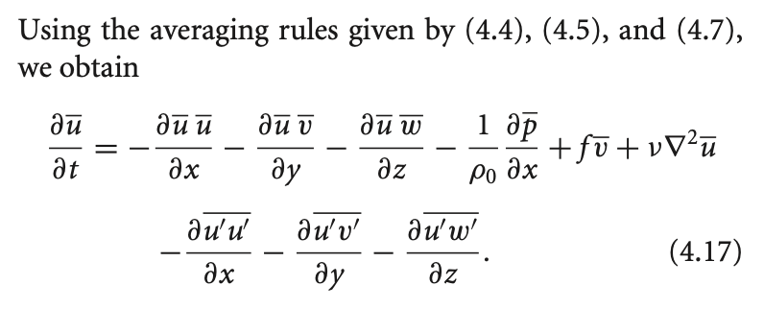
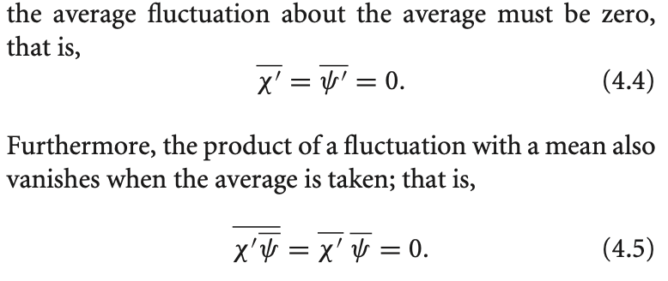
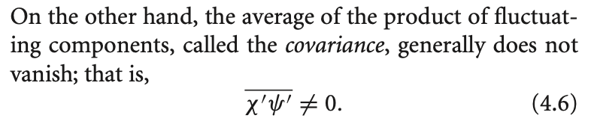

Slide 6
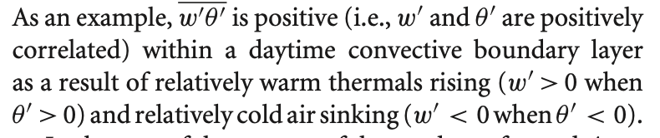
Covariances of velocity w/ stuff: eddy flux
Momentum flux is a bit abstract, so consider heat flux:

