Slide 1
Wallace-Hobbs section 7.2 Forces
ATM 651
fall 2023

Slide 2
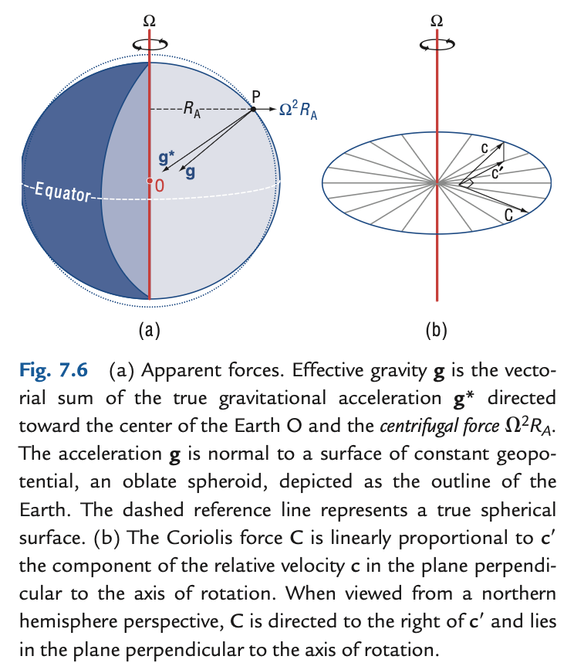
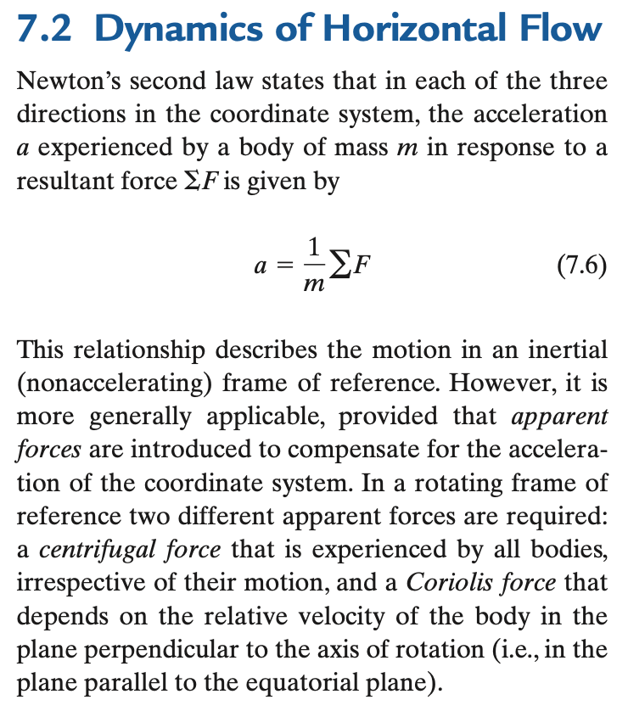
Dynamics (more causal than kinematics, still deterministic or mechanistic)

Slide 3
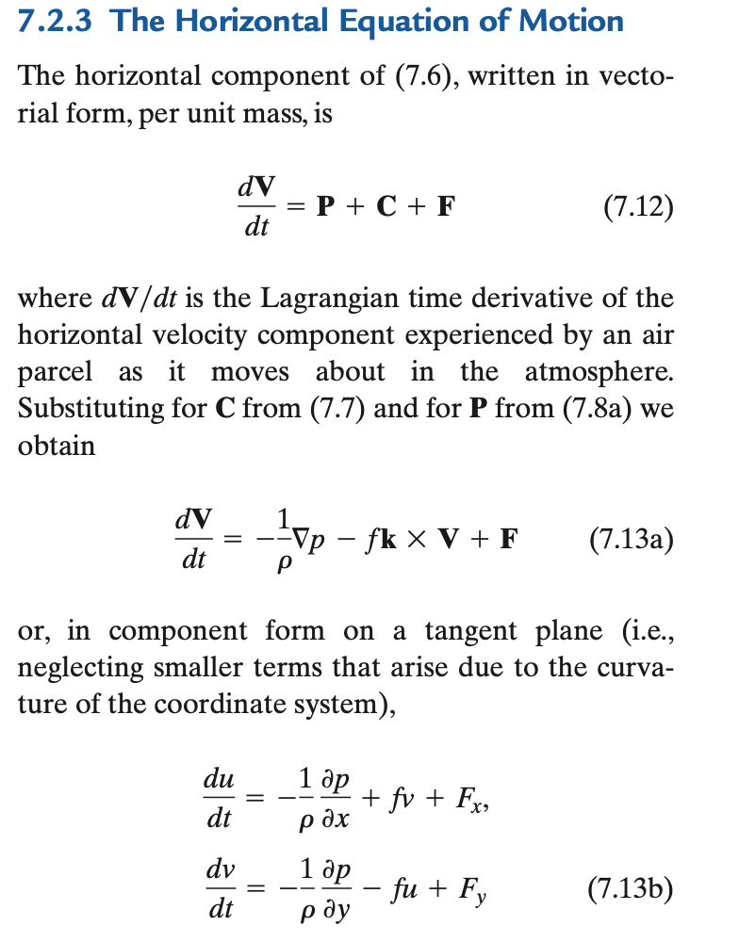
momentum equation
3 equations in 3D
Vertical is so different: hydrostatic
p holds up air against gravity
αdp/dz = -g
α = 1/ρ
”specific volume”
oceanographer: what is “volume flux”?
Horizontal is Chapter 7: vector form

Slide 4
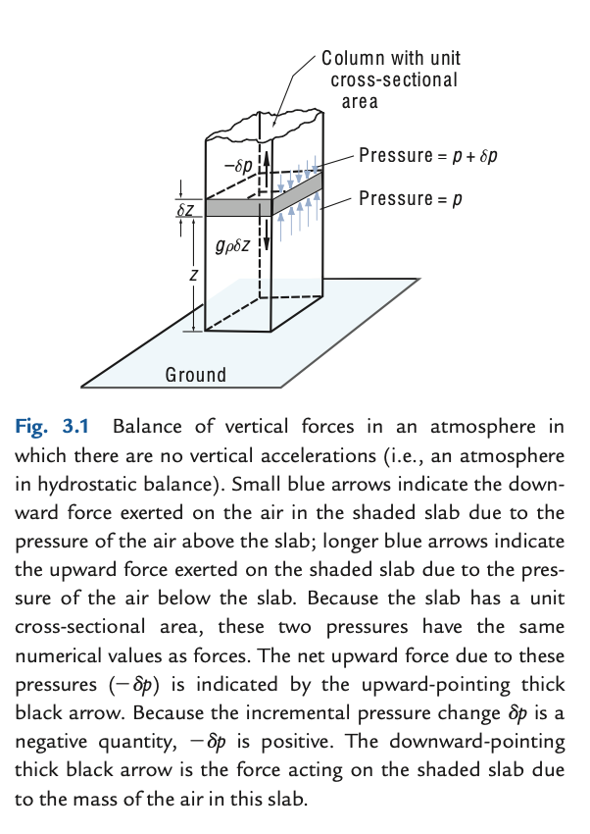
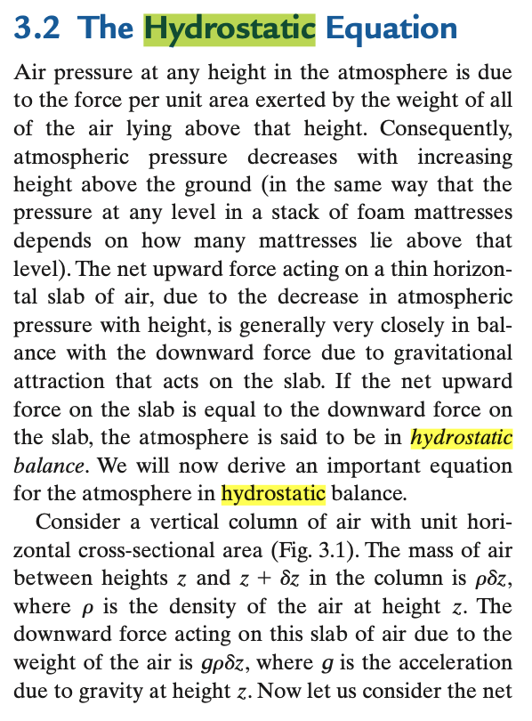
Read this on your own (part of WH ch 3)

Slide 5
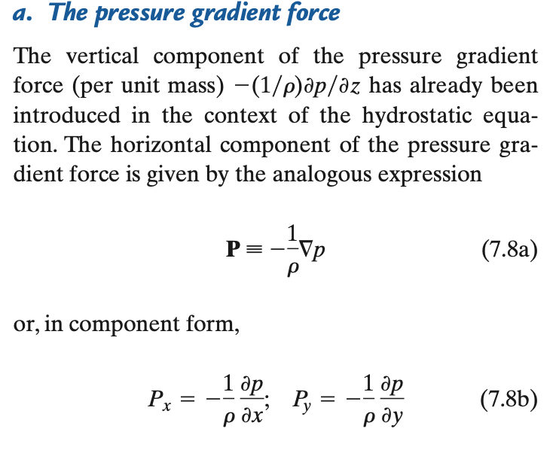
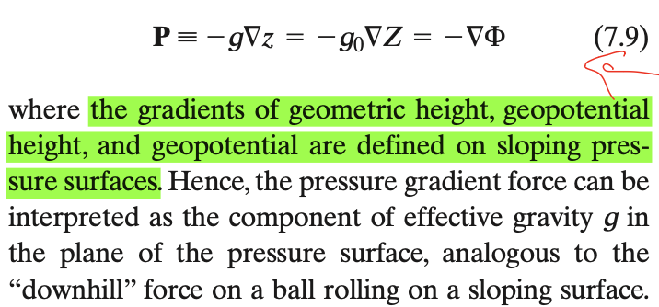
The PGF
Momentum flux convergence (flux in – flux out of box)
recalling that pressure is a flux of momentum, units (kg m/s) m⁻² s⁻¹
think ping pong ball gun knocking over plywood (but omnidirectional)
recall that p is not “given” except in undergrad spoon-feeding: it adjusts
p is the field whose PGF has a divergence that balances all other force divergences

Slide 6
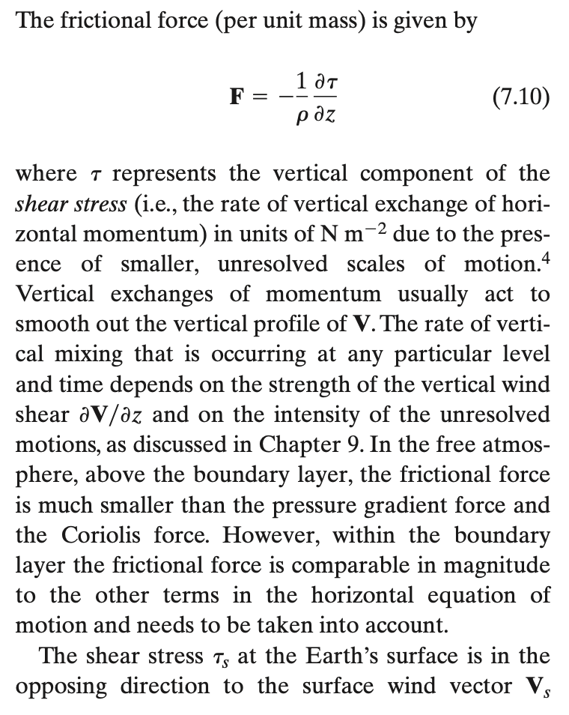
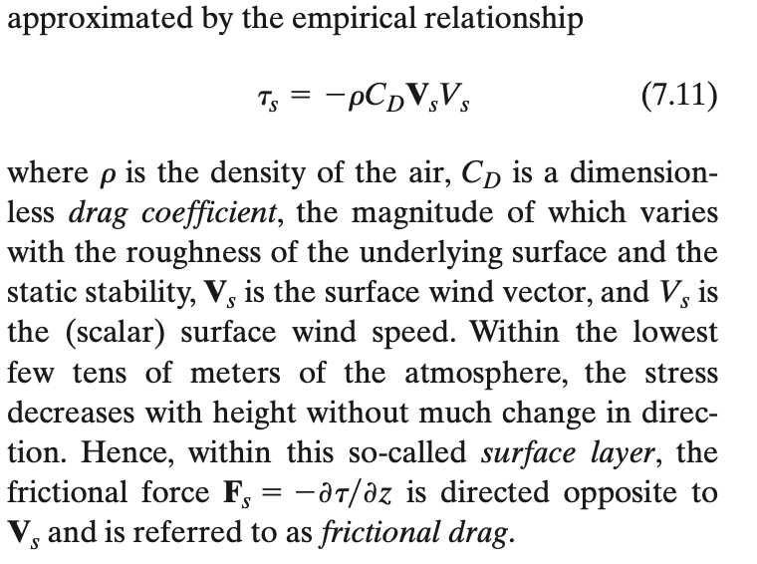
←Note: convergence of a flux!

Slide 7
The concept of “inertial forces”
“Forces” really means per unit mass (accelerations)
Like the “force” of gravity is an acceleration g (9.8 m/s/s or N/kg)
What is an inertial ”force” (or acceleration)?
(Wikipedia) Inertia is the propensity for continuation of an object in its current motion. The term is properly understood as shorthand for "the principle of inertia" as described by Newton in his first law of motion.
If dV/dt = 0, motion could be called “inertial”, but RHS has terms
On a rotating sphere, unit vectors are rotating in dV/dt. Coriolis force!
At a point, ∂V/∂t = advection of V (← another “inertial force”) + PGF + Fric…

Slide 8
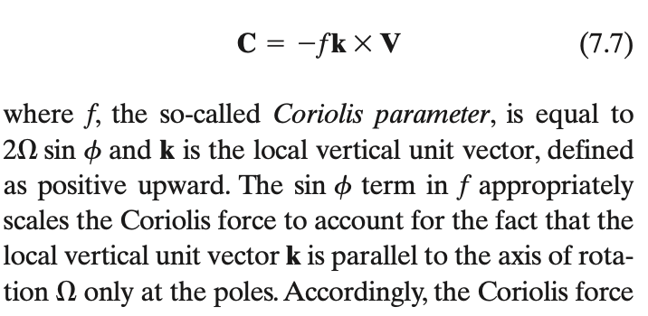
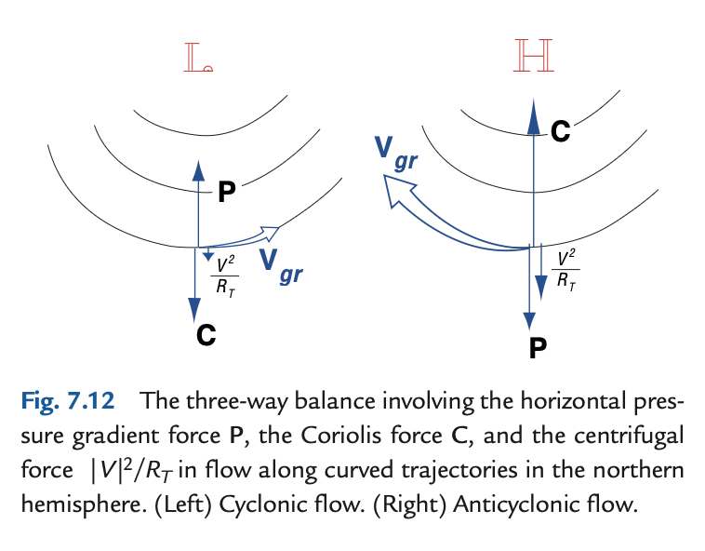
Coriolis and “centrifugal” forces
−(V.∇) V
advection of vector momentum V
2Ω x V , strictly (in 3D)

Slide 9

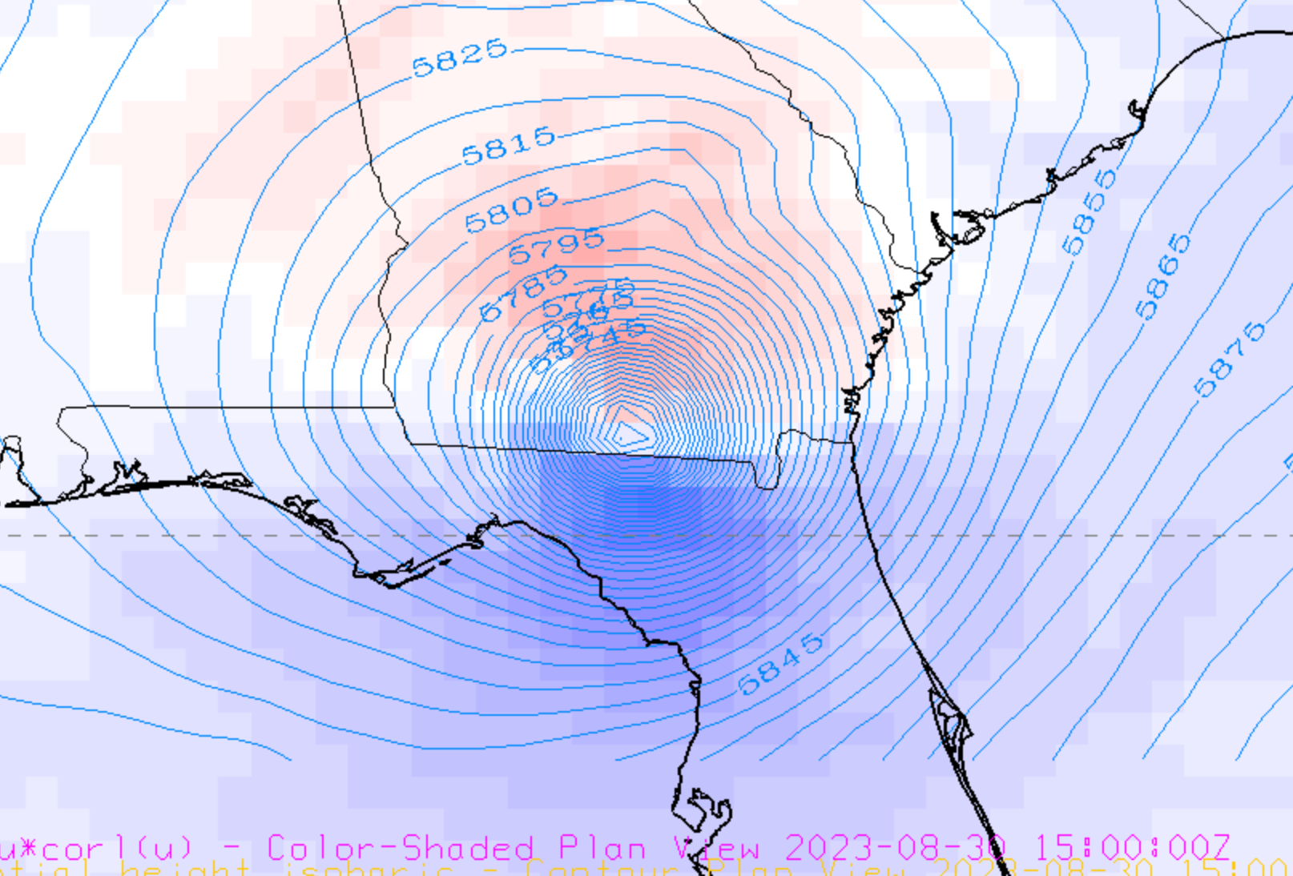
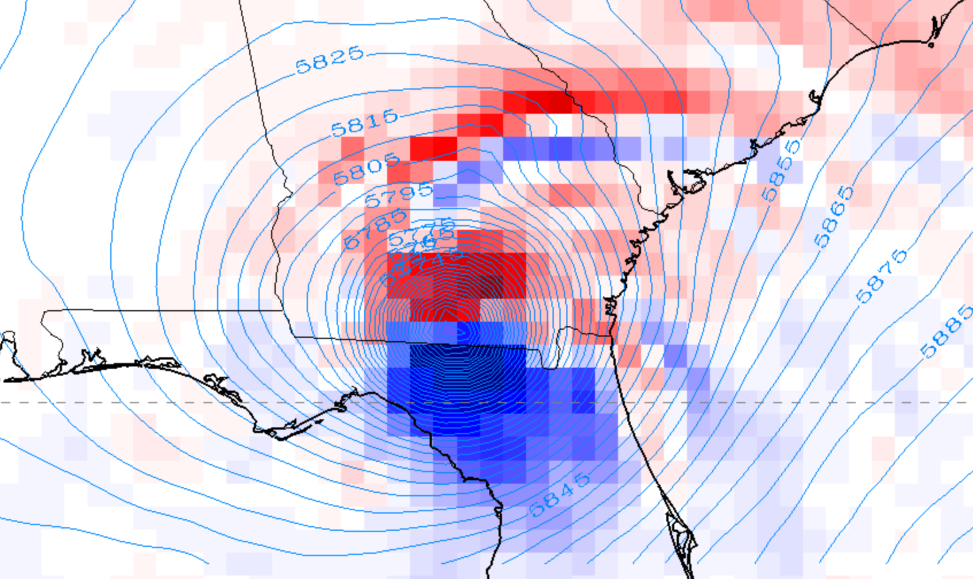
Coriolis and “centrifugal” forces
−(V.∇) V
advection of vector momentum V
(which term?)
fraction of g
2Ω x V , strictly (in 3D)
500mb

