Slide 1
Conserved-variable soundings and convective destabilization Continuing from Warmcore-Coolcore lab
ATM 405, fall 2021
Brian Mapes, Univ of Miami

Slide 2
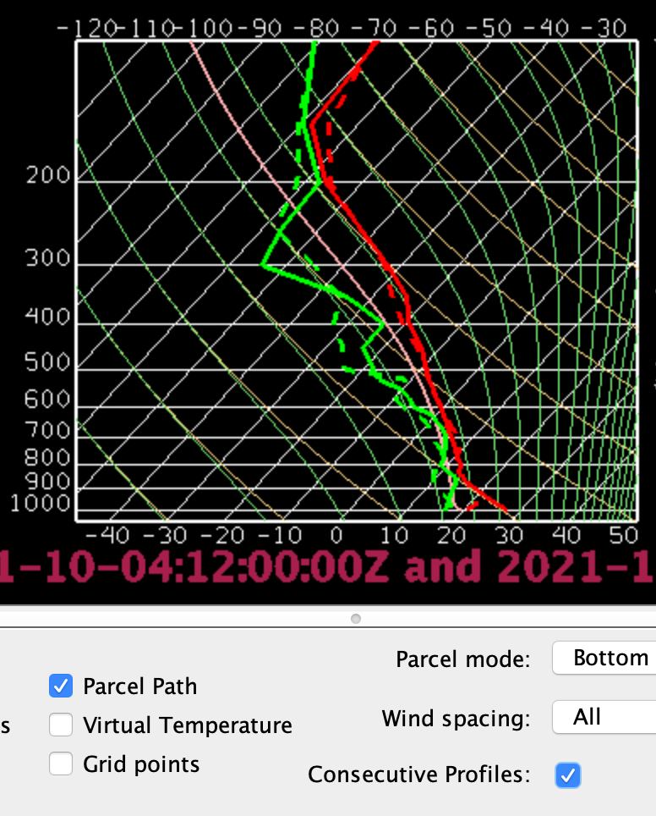
You did this sounding exercise in Part 2. Today is just a slight extension (applied to today’s weather)
Viewing the bundle from the south, locate and illustrate in captured images a region where the height of θ surfaces is rising with time, due to horizontal advective motion of an upper-level cool-core vortex (and thus its underlying θ bump).
Place the sounding probe in a relevant location, turn on Consecutive Profiles, and see if you can detect the upward motion in terms of sounding changes. Explain your reasoning. Features in the dewpoint trace should ascend along Mixing Ratio isopleths, while the T trace should ascend along potential temperature isopleths.
But if the air saturates, the latent heating spoils conservation of both θ and mixing ratio! See if you can use the IR satellite display to choose an ascending or descending area without complications from condensation of water.

Slide 3
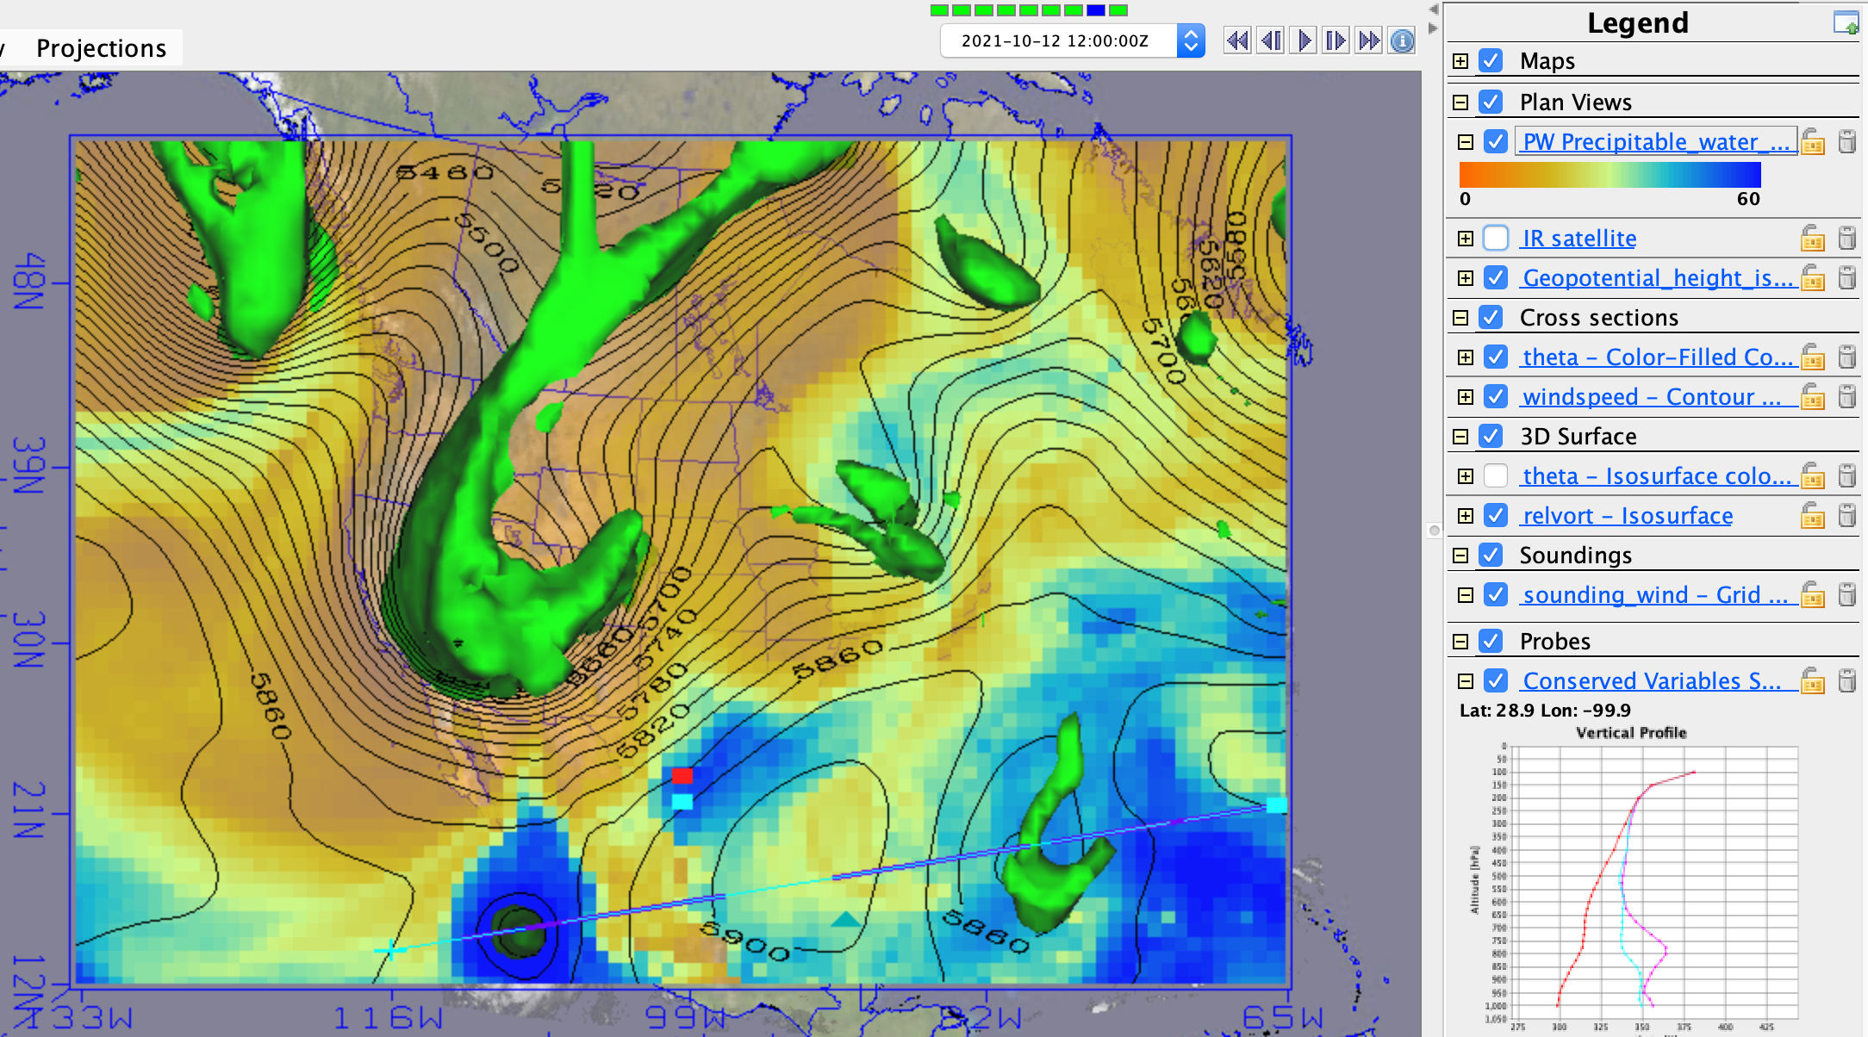
Today we have a warm-core as well as cool core cyclones, and some moisture pools

Slide 4
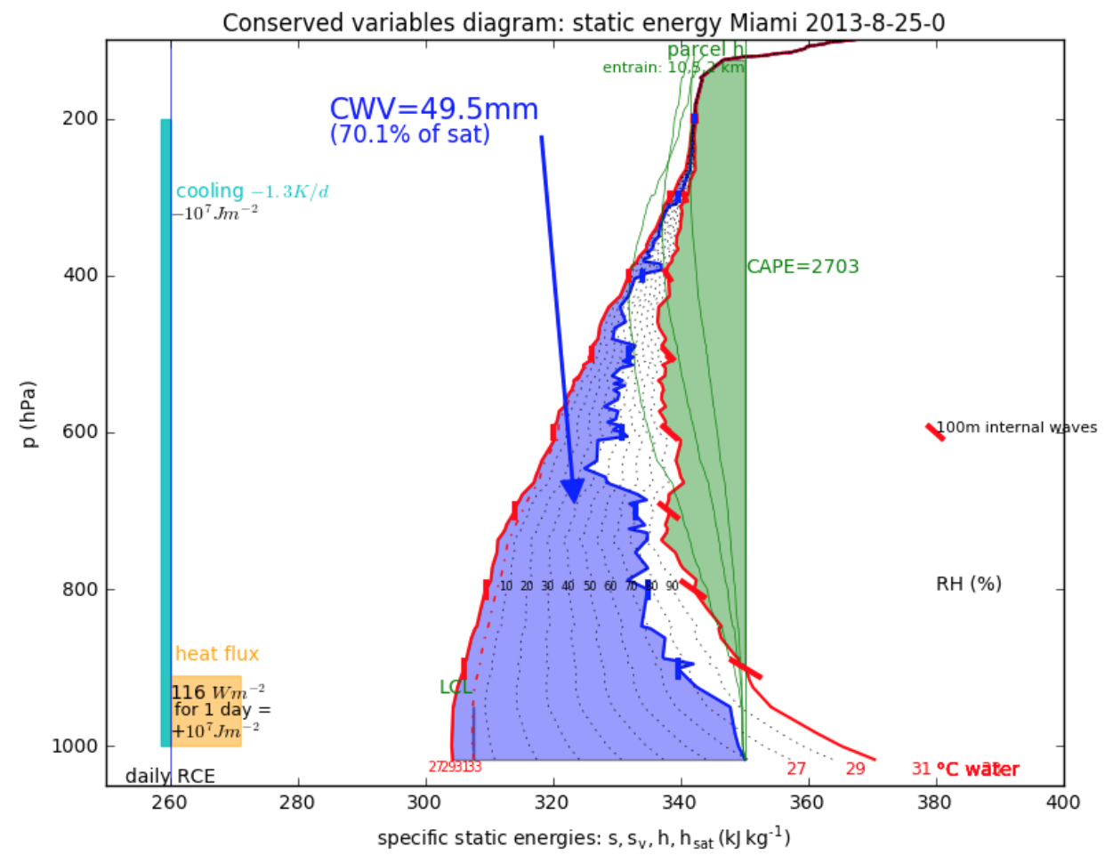
Analyze lifted-parcel buoyancy (instability) with a conserved-variable profile plot

Slide 5
Background on conserved-variable plots
dry static energy s =C_{p}T + gz is conserved for dry ascent (just like θ), but is increased when condensation releases latent heat
moist static energy (MSE) h = C_{p}T + gz + Lq_{sat}*RH is conserved (like theta-e, θ_{e}) even when water condenses in an updraft
saturated MSE h_{sat} = C_{p}T + gz + Lq_{sat}(T) (like saturation theta-e, θ_{e,sat}) is a function only of temperature, not of RH.
Notice that since q_{sat} is a strictly increasing function of T, h_{parcel} > h_{sat,env} strictly indicates T_{parcel} > T_{env} or in other words that the parcel is buoyant

Slide 6
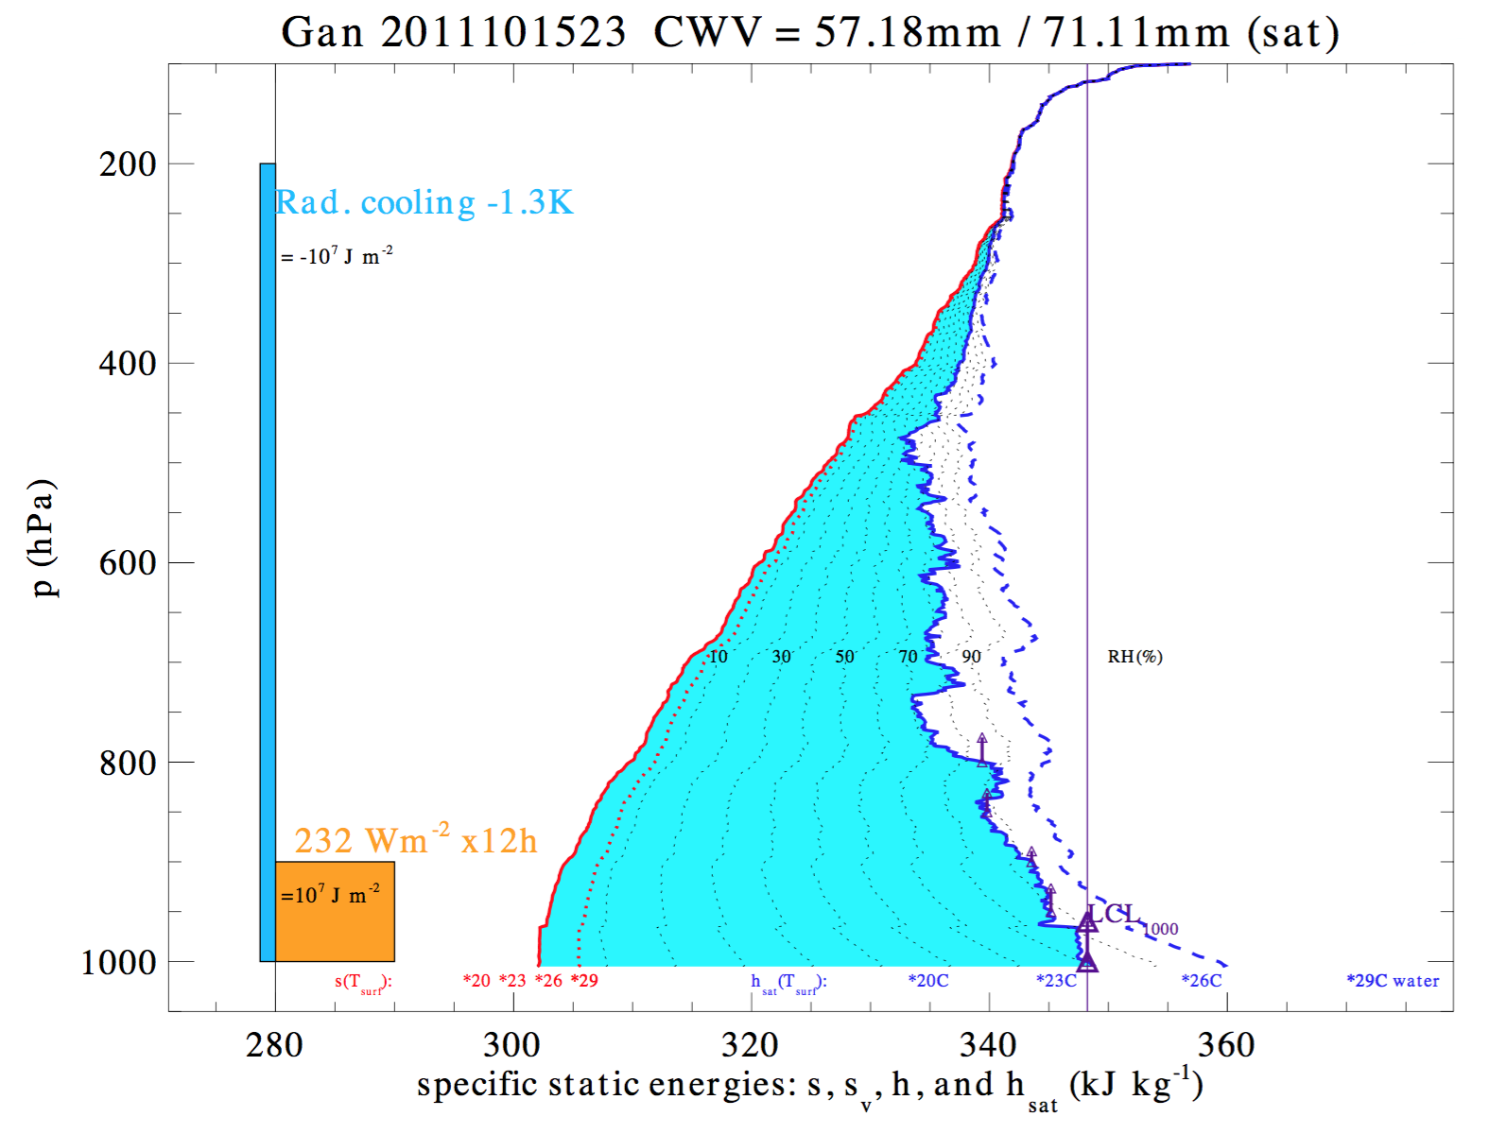
h_{sat} = C_{p}T + gz
+ Lq_{sat}(T,p)
s =C_{p}T + gz
h = C_{p}T + gz
+ Lq_{sat}*RH

Slide 7
Column water vapor (CWV)
α this area

Slide 8
Undilute
parcel
conserves
h

Slide 9
This gap
indicates
parcel
thermal
buoyancy

Slide 10
Mixing
draws
parcel
toward
h curve

Slide 11
Analyze lifted-parcel buoyancy (instability) with a conserved-variable profile plot
← mixing with dry
layer makes updraft h value zag to the left (quenches buoyancy)

Slide 12
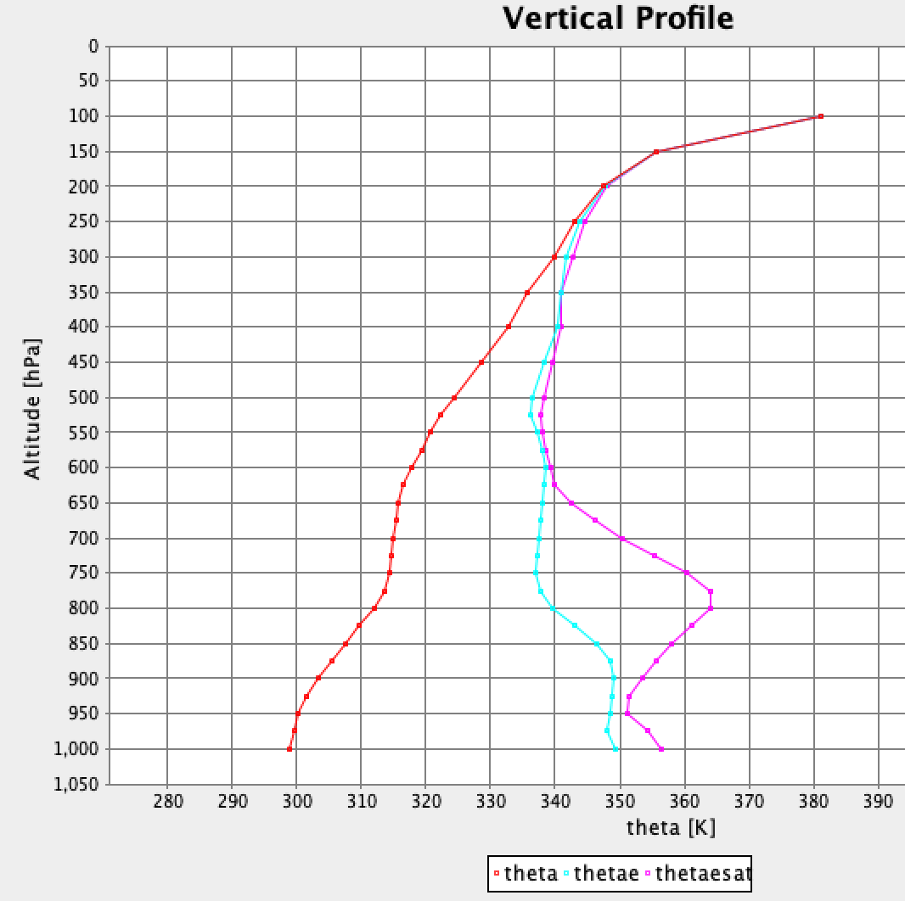

The IDV Probe version of it
Theta (red) shows dry static stability (always increases with height)
Theta-e (blue) adds the moisture contribution. Conserved upon saturated ascent.
Saturation theta-e (magenta) shows environmental T in proper units for parcel buoyancy comparison
This gap
indicates
parcel
thermal
buoyancy
Undilute lifted parcel

Slide 13
The IDV Probe version of it
TOTALLY CAPPED UNLESS UNDILUTE PARCELS ARE LIFTED ABOVE 700MB LEVEL, AND STILL NOT BUOYANT IF THEY MIX A LOT WITH ENV.
Theta (red) shows dry static stability (always increases with height)
Theta-e (blue) adds the moisture contribution. Conserved upon saturated ascent.
Saturation theta-e (magenta) shows environmental T in proper units for parcel buoyancy comparison
Parcel mixing with env. is drawn toward cyan curve (env.. theta-e)

Slide 14
Assignment: 1. undilute parcel
Examine the overall weather evolution, noticing PW tongues as well as how moving vortices are bending theta surfaces up or down.
Move the probe and sounding to a meteorological setting where convection is initially limited by surface h (too cool and/or dry; no lifted parcel of surface air can be buoyant at any level), but then it becomes unstable at a later time.
Show and describe the setting and the two times. Show the conserved-variable Probe, and how the skew-T parcel buoyancy curve agrees with the conserved variable version
Describe what changed: surface air warmed or moistened? Upper levels cooled? Was lifting by one of our moving cool-core vortices involved? Sunshine on the surface during daytime? Horizontal advection of moisture?

Slide 15
Assignment: 2. Capping inversion
Move the probe and sounding to a meteorological setting where convection is initially limited by a capping inversion (negative buoyancy or CIN at low levels preventing parcels from achieving their positive upper-level buoyancy and CAPE), but then convection begins at a later time.
Show and describe the setting and the two times. Show the conserved-variable plots, and how the skew-T parcel buoyancy curve agrees.
Describe what changed: surface air warmed or moistened? Capping-layer cooled? Was lifting by one of our moving cool-core vortices involved?

Slide 16
Assignment: 3. moisture-limited
Move the probe and sounding to a meteorological setting where lifted surface air could be buoyant, but PW is too low initially (and deep convection is not evident in the IR), but then when enough PW arrives the column undergoes deep convection.
Capture the 2 conserved-variable diagrams (unstable but too dry, then convecting). Annotate a plausible mixing-diluted parcel’s ascent path on the two diagrams, showing how this diluted-updraft process changes from not having deep buoyancy to having deep buoyancy.

Slide 17
Climate view
Pressure coordinate is proportional to mass
Horizontal axis is energy per unit mass
Integral (Area between curves) is total energy

Slide 18
radiation
Convection
links
these
sfc. flux

Slide 19
s for a Minnesota
winter day
h for a
Minnesota
winter day

Slide 20
s for a Minnesota
winter day
a month of
1K/d cooling
h for a
Minnesota
winter day

