Slide 1
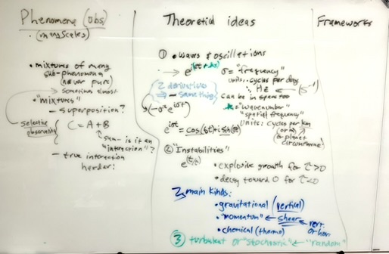
Concept map/survey mid-course

Slide 2
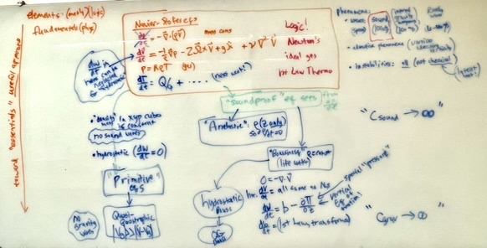
Concept map/survey mid-course The equation sets for

Slide 3
The Boussinesq equations (compared to primitive and anelastic)

Slide 4
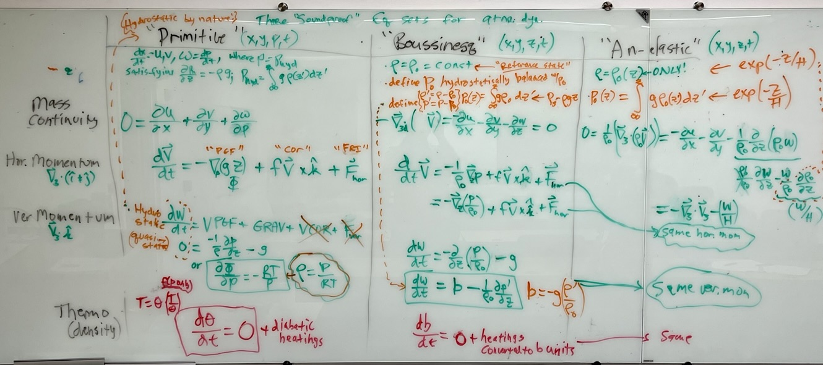
The Boussinesq equations (compared to primitive and anelastic)

Slide 5
This ppt a shorter version of
https://miami.box.com/s/diw2d1gluypougxhjy0f3qj8dra2t0ru

Slide 6
Gravity waves as simplest solutions
Simplest solutions to stratified fluid eqs
involving inescapable, linear terms
Everywhere all the time in stratified fluids!
complications (nonlinearity, friction, heating, rugged boundary conditions) are all just “sources and sinks”
“propagation” is a form of energy transport
GWs carry a vertical flux of hor. momentum!

Slide 7
Simplest gravity wave case: Boussinesq equations in x-z plane
No friction, no Coriolis
https://pog.mit.edu/src/810/igw_3.pdf
Assume wavelike solutions exp(i (kx+mz- σt)) ➔ σ ² = N² k² (k² + m²)^{-2.} σ = N cos θ
Parcels bob up and down at frequency N for vertical displacement (buoyancy restoring force)
Sloping motions bob up and down more slowly
Horizontal motions feel no restoring force from b

Slide 8
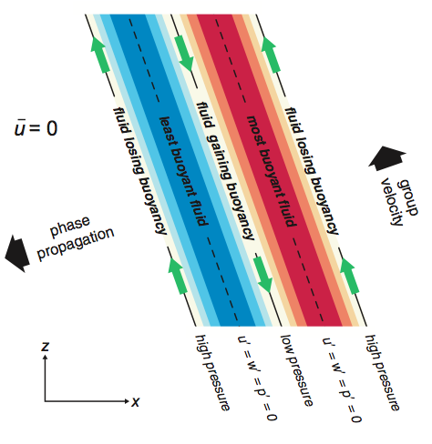

Note: momentum is being fluxed (u’w’ <0 here)

Slide 9
Any jiggling with a frequency between N and f will excite them
source has a horizontal, vertical size → k,m
oscillator has a frequency → ω https://www.youtube.com/watch?v=BDQD_gM3M24
moving thing has a velocity c → constrains their ratio, the wave phase speed c=ω/k
heating has a depth (→ vertical wavenumber m)

Slide 10
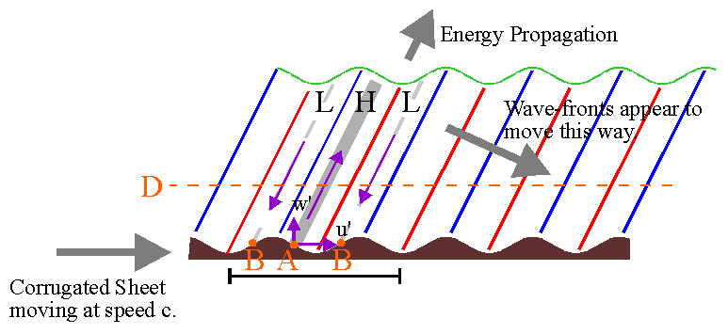
Mountain waves
Wind over bumps is a source term. Excites horizontal wavenumber k @ frequency ck

Slide 11
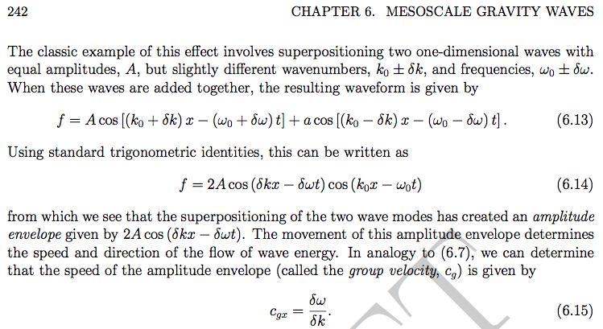

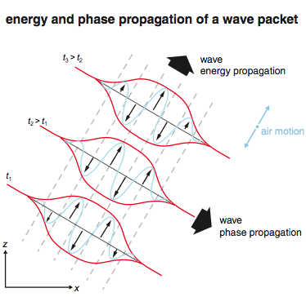


Slide 12
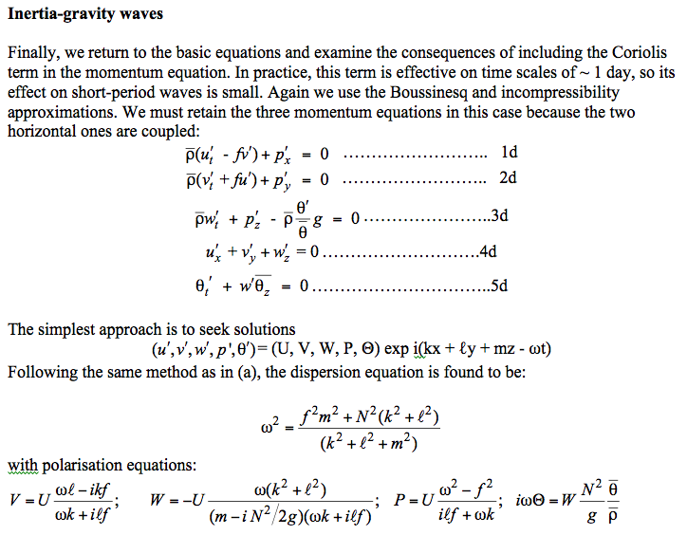
Courtesy:
Geraint Vaughan

Slide 13
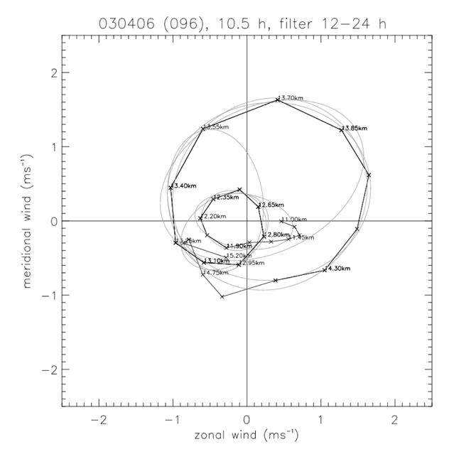
Inertio-gravity waves
These rather forbidding equations hide a pleasing elegance to the gravity-wave solutions which become more evident if x is taken to be the direction of propagation of the wave. Then ℓ=0 and V = -iUf/ω. V and U are in quadrature, causing the wind vector to rotate elliptically – clockwise for upward energy propagation and anticlockwise for downward. For oscillations near to the inertial frequency (which are common in the lower stratosphere) the ellipses are nearly circles, as shown in the example below measured by a VHF radar at Aberystwyth, Wales.
Geraint Vaughan

Slide 14
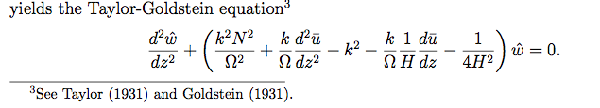
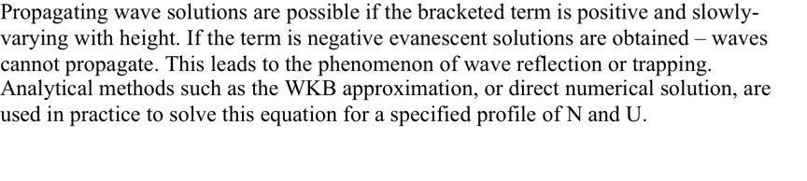
Taylor-Goldstein eq
Don’t assume wavelike in z, only in x & t
Permit U(z), and ρ(z) (Anelastic)

Slide 15
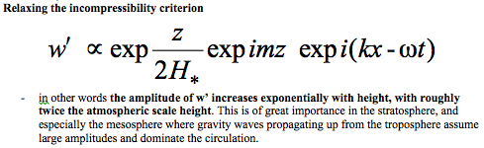
Taylor-Goldstein eq
Don’t assume wavelike in z, only in x & t
Permit U(z), and ρ(z) (Anelastic)

Slide 16
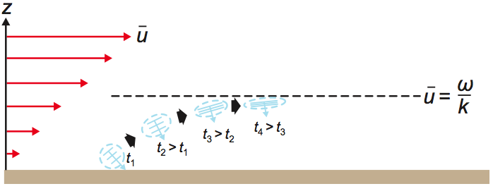
Critical level, where u = c or intrinsic frequency → 0
dumps westerly momentum below critical level
think QBO (downward propagation of u)

Slide 17
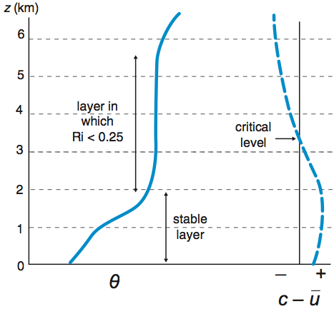
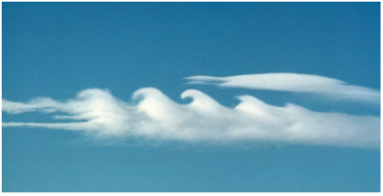
“overreflection”: ideal for wave trapping/ducting

Slide 18
Importance of gravity waves
For middle atmopshere: Systematic upward flux of zonal momentum [u’w’]
goes as (wind amplitude) x (tilt of motions)
tilt goes with frequency (ω = N cosφ)
high frequencies are highly weighted in this importance metric
systematic ⬅ E/W asymmetry
asymmetric sources
form drag in flow over obstacles (mtns or cloud tops)
asymmetric filtering on the way up (critical levels etc.)
even w/ symmetric sources, but base state flows/ shears
detectability an issue for global assessment
vertical wavelengths for satellite kernels, etc.

Slide 19
Importance of gravity waves
Notes: w’T’ = 0 so they don’t carry heat flux vertically
when viewed in terms of w field, emphasizes short wavelength and high frequency waves
These ideas can almost close off from view another important role for long (hydrostatic) waves: as an adjustment mechanism
carrying heat away from convection horizontally
adjusting stratification profile
to moist adiabatic

Slide 20
Importance of gravity waves 2.
adjusting stratification: vertical displacement
strong interactions with convection
goes as (w amplitude) x (period or duration)
low frequency components especially important
like from net heating events (zero frequency limit)
a whole different slice of (k,l,m,ω) space
which is only really 3D since dispersion relation holds:

Slide 21
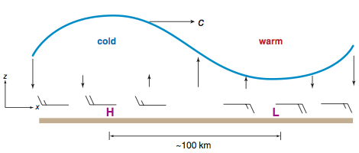
Internal waves in resting Boussinesq stratified fluid
Aligning x with the wave (l=0),
Hydrostatic, or low frequency limit (m >> k,l)
ω = N k/m
c = cg = N/m = vert. wavelength/ BV period
“Horizontally propagating vertical modes”

Slide 22
Low frequency (or hydrostatic) internal gravity waves: vertical modes view
w=0 BC at top and bottom of stratified layer discretizes allowable vertical wavenumbers m
w = sin(kz)
wave numbers ½, 1, 1.5, ... of the layer
waveguide or duct
no vertical propagation, or upward + downward propagation are equal (reflections) yielding standing oscillations (vertical modes)
The higher you place the lid, the closer together the wavelengths permitted

Slide 23
Example: response to deep convective heat sources
Boussinesq, hydrostatic, constant-N, nonrotating, resting basic state
ω = N k/m is dispersion relation for waves
Heating is forcing, confined to ‘troposphere’
lower portion of deep stratified fluid under lid
Heating turns on at t=0 and then maintained
2 modes of tropospheric layer
convective (sin(z) all positive)
stratiform (sin(2z) vertical dipole)

Slide 24
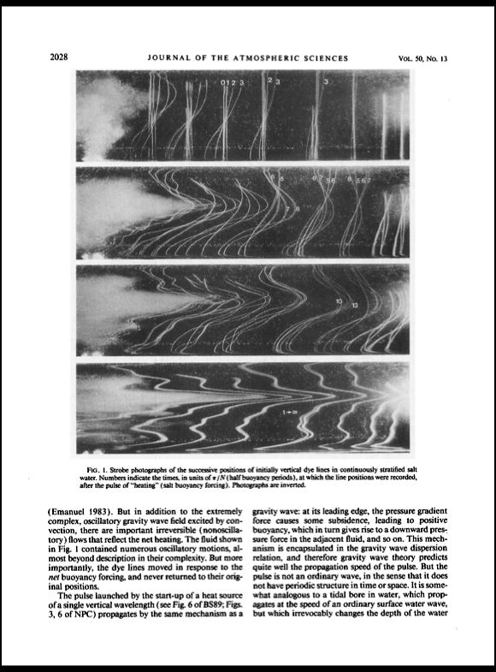
Longer vertical wavelengths travel faster horizontally
early
A complex convective event in a salt-stratified tank excites many vertical wavelengths in the surrounding fluid (photo inverted to resemble a cloud).
Strobe-illuminated dye lines are displaced horizontally, initially in smooth, then more sharply with time.
late
Mapes 1993 JAS

Slide 25
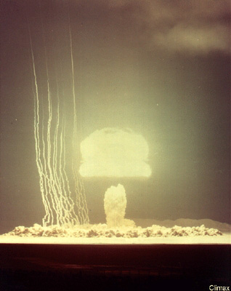
Glimpses of invisible env. flow

Slide 26
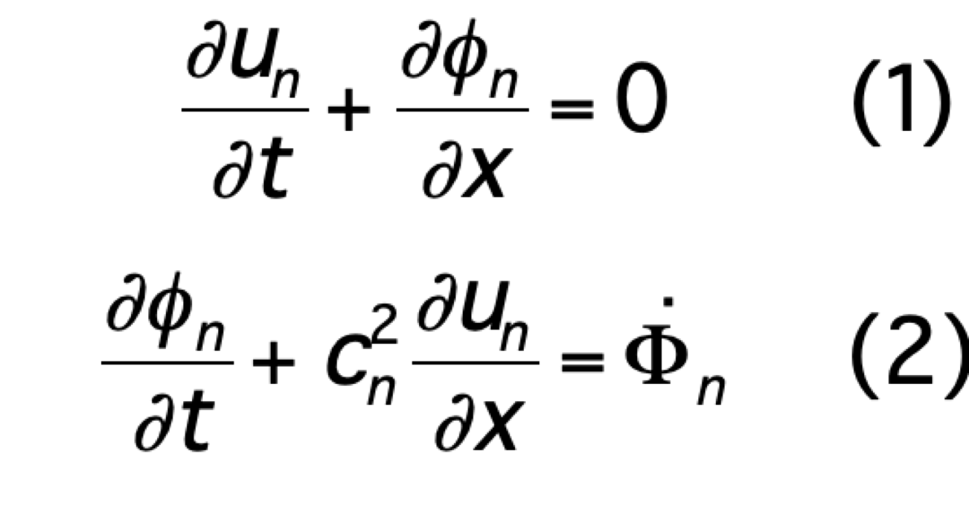
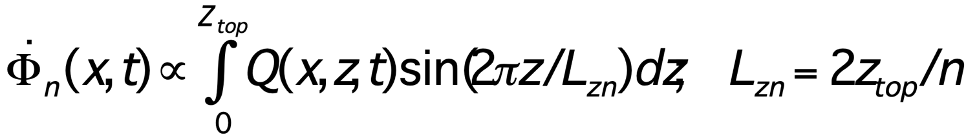
Solution procedure
Governing equations
Unknowns: u(x,z,t), w(x,z,t), T(x,z,t), p(x,z,t)
Known: Q(x,z,t)
Since N is const.
Fourier transform in z
along with B.C.s
Shallow water system (1 for each Fourier mode: n = 1, 2,3,..)
Stefan Tulich ppt

Slide 27
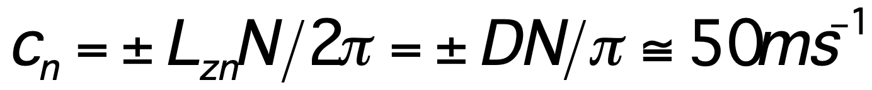
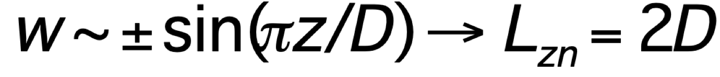
Sketch of solution*
Vertical velocity w at times t_{i} < t < t_{f}
-c_{n}
c_{n}
Stefan Tulich ppt
*References: Nicholls et al. 1991; Mapes 1998

Slide 28
Sketch of solution
Horizontal velocity u at time t < t_{f}
-50 m/s
50 m/s
Stefan Tulich ppt

Slide 29
Sketch of solution
Temperature T at time t < t_{f}
-50 m/s
50 m/s
Warm
Stefan Tulich ppt

Slide 30
Sketch of solution
Times after the heating is switched off (t > t_{f})
-50 m/s
Warm
Warm
50 m/s
Stefan Tulich ppt

Slide 31
Sketch of solution
Times after the heating is switched off (t > t_{f})
-50 m/s
-50 m/s
-50 m/s
-50 m/s
50 m/s
50 m/s
50 m/s
Warm
Warm
50 m/s
Warm
Warm
Warm
Warm
Warm
Warm
Warm
Warm

Slide 32
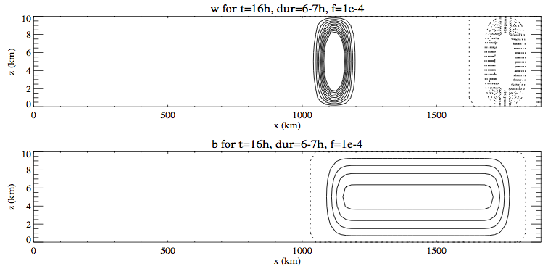
Let’s just look at tropopase lid case
here for f=0, 6h heating event 16 hours ago
w field at t=16h, 10h after a 6h heating event happened at the origin.
T field for same case

Slide 33
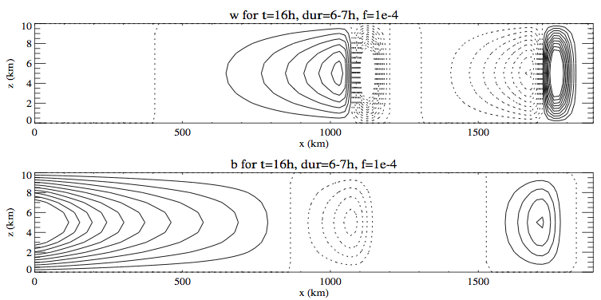
What does f do?
Traps heat within a Rossby deformation radius of the origin, held back by thermal wind shear
inertio-gravity waves
b
trapped
inertio-gravity waves (zero-sum waves) escape

Slide 34
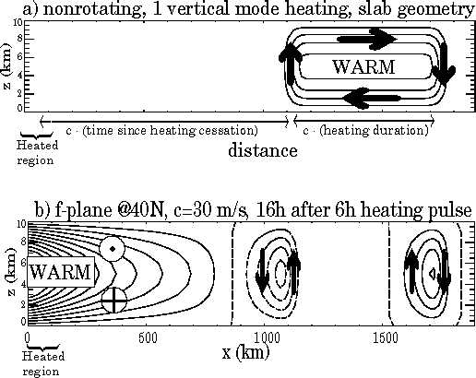
On an f plane, the heat is trapped, waves can’t carry it beyond c/f
W
W
W
C
W
Rossby radius
Notes:
We saw that heating radiates “warm rolls” of fluid in nonrotating dynamics.
Well, with f, the warmth gets trapped exponentially near the heated regionby geostrophic balance. All that’s left of the radiating waves is little sub-Rossby scale IGWs that don’t make a lasting vertical displacement of isentropes, just transient.

