Slide 1
The omega equation
Why is there upward motion ahead of these upper-level troughs/ cyclonic vortices?

Slide 2
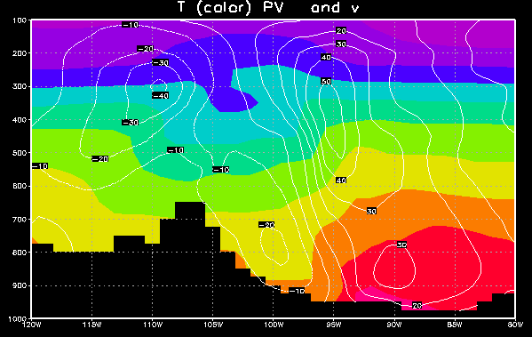
v and T: thermal wind balance
warm core above
cyclonic
(Trof)
cold core = low thickness
warm core
cyclonic
Low

Slide 3
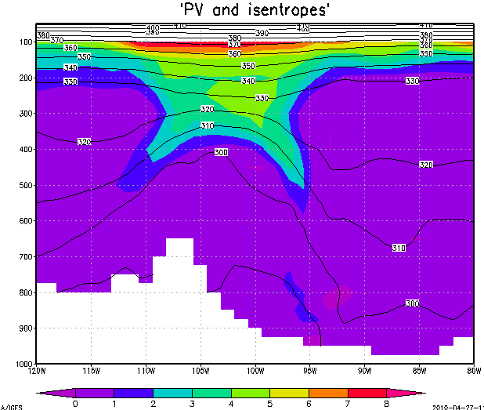


cyclonic ζ
(Trof)
Thermal wind balance prevails: There is a Z trough (trof) for geostrophic balance, with a cold core beneath it, supporting it hypsometrically (in hydrostatic balance).

Slide 4

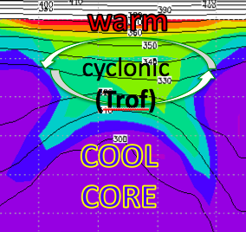

Unsheared advection of T, u, v, vort, PV:
no problem, whole structure moves
cyclonic
(Trof)

Slide 5


Sheared advection breaks thermal wind balance
cyclonic ζ
(Z trof)

Slide 6


Sheared advection breaks thermal wind balance
Z Trof

Slide 7
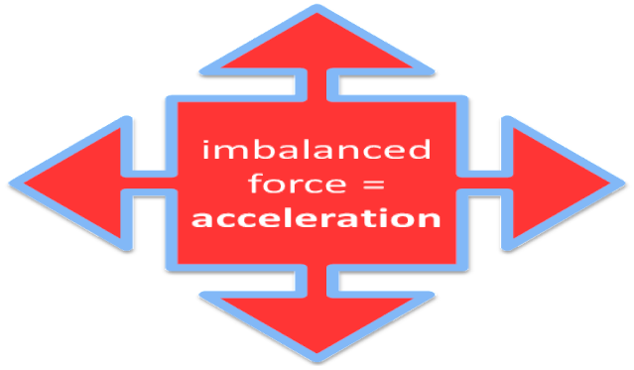
Sheared advection breaks thermal wind balance
Z Trof
L

Slide 8
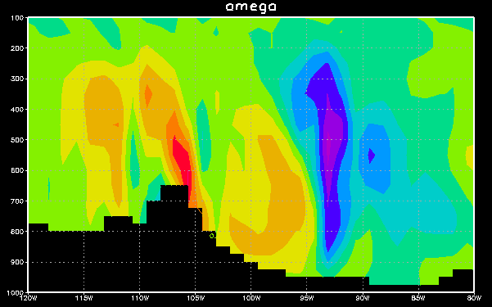
East-west section: omega
trof
thkness
in order
to create the
needed
cool core
(low ΔZ),
so balance
can again prevail
…

Slide 9
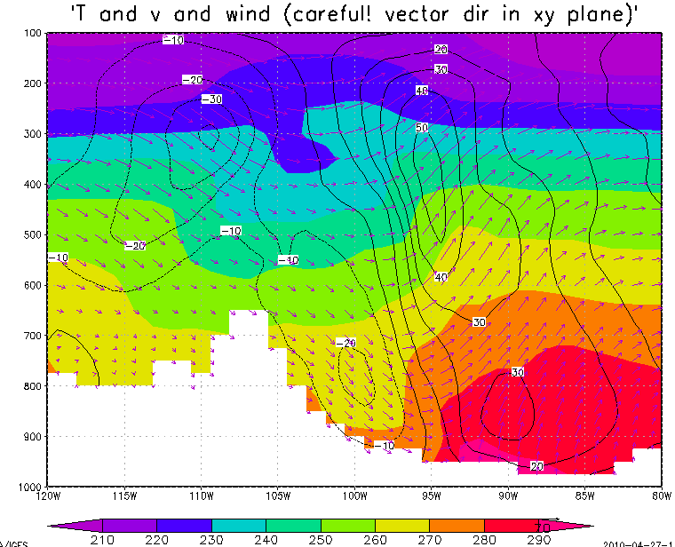
Warm horizontal advection demands even more upward motion, if the cool core is to be built
TROF
cool air flowing south
warm air flowing north
warm air flowing north

Slide 10
East-west section: omega
(2 reasons for ascent)
to build
Z Trof
vorticity
advecting in
overhead
demands
cool core
(low thk)
for its
trof
warm
advection →
unwanted
thickness

Slide 11
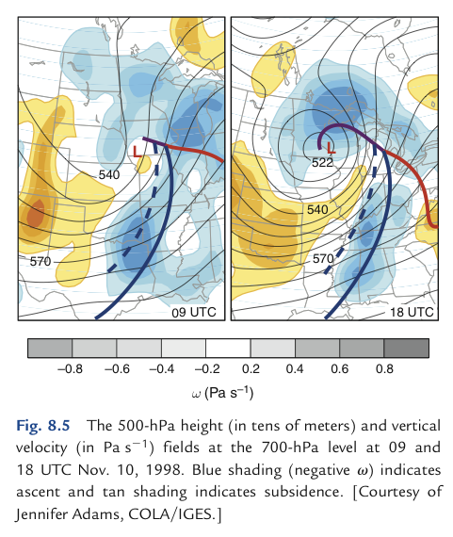
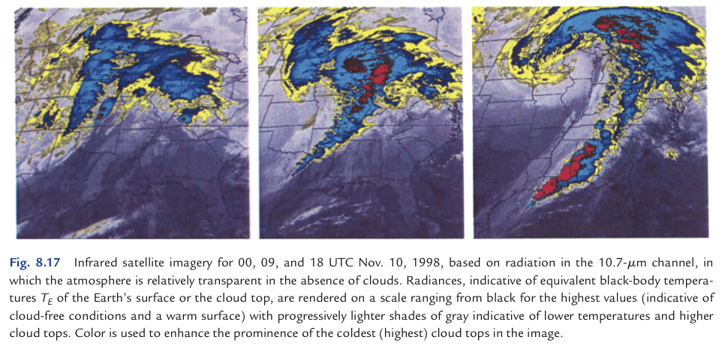
Vertical motion and clouds

Slide 12

Illustrator: COMET/MetEd
go to https://www.meted.ucar.edu/labs/synoptic/qgoe_sample/

