Slide 1
Wallace-Hobbs section 7.2 Forces
ATM 651
fall 2023

Slide 2
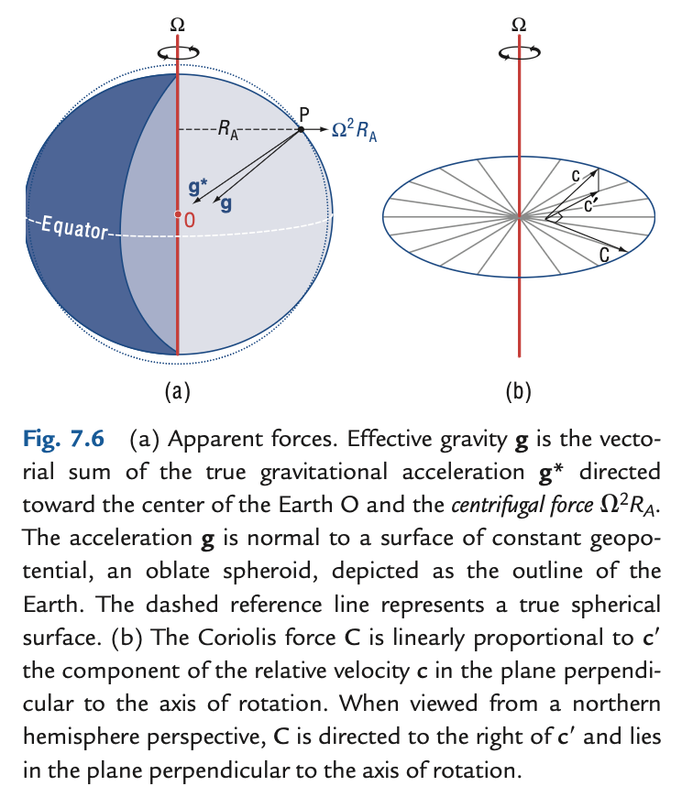
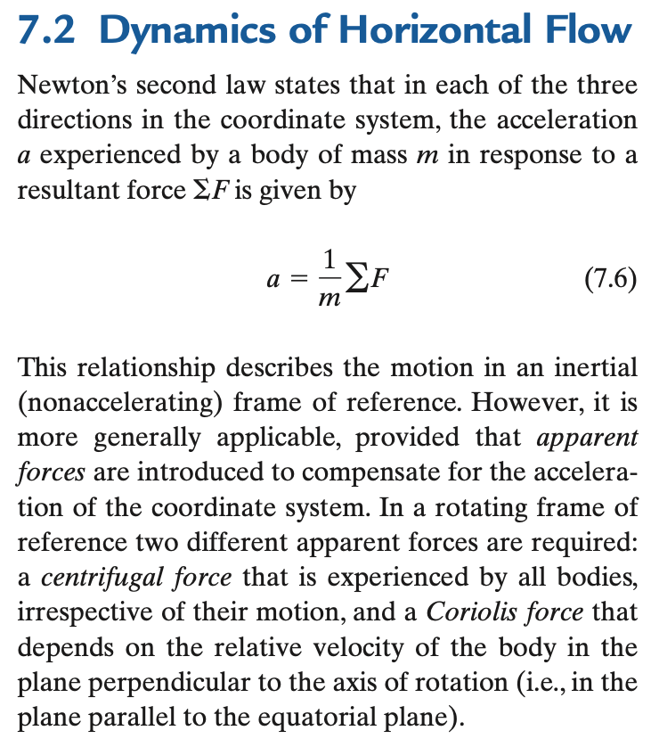
Dynamics (more causal than kinematics, still deterministic or mechanistic)

Slide 3
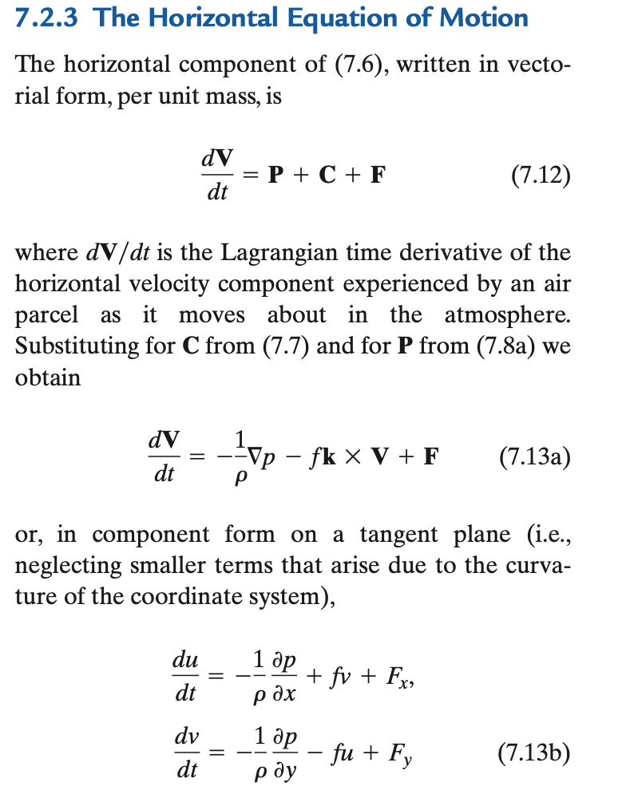
The whole equation
3 equations since V = <u,v,w>
Vertical is so different: hydrostatic
p holds up air against gravity
Horizontal is Chapter 7

Slide 4
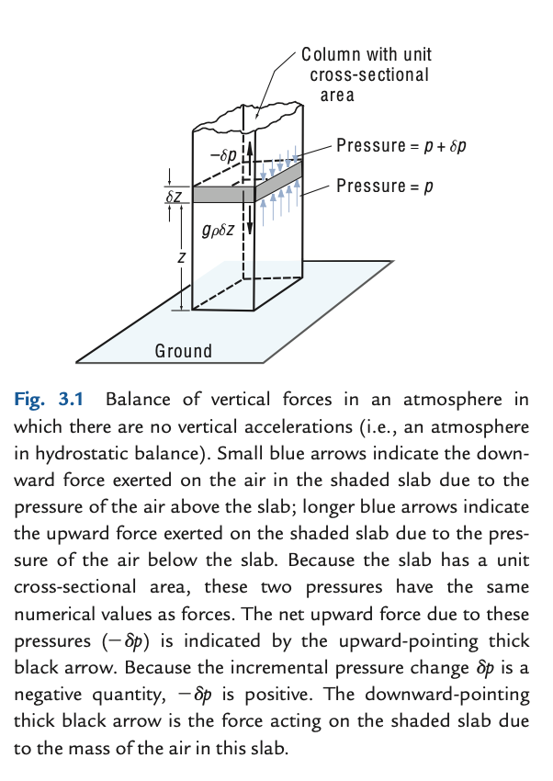
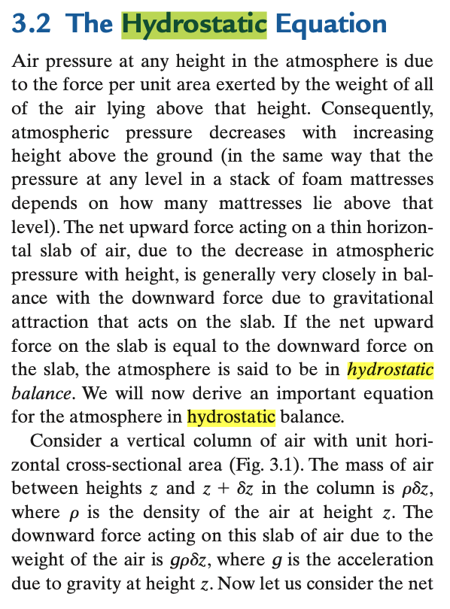
Read this on your own (part of WH ch 3)

Slide 5
The concept of “inertial forces”
“Force” really means force per unit mass (acceleration)
Like the “force” of gravity is an acceleration g (9.8 m/s/s or N/kg)
What is inertial ”force” (or acceleration)?
Inertia is the continuation of an object in its current motion until some force causes its speed or direction to change. The term is properly understood as shorthand for "the principle of inertia" as described by Newton in his first law of motion. (Wikipedia)
If dV/dt = 0, the motion could be called “inertial”
On a rotating sphere, unit vectors vary in space and time. Coriolis force!
At any point on Earth, ∂V/∂t = advection of V ← another “inertial force”!

Slide 6
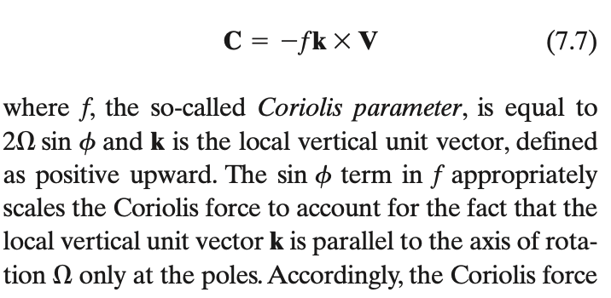
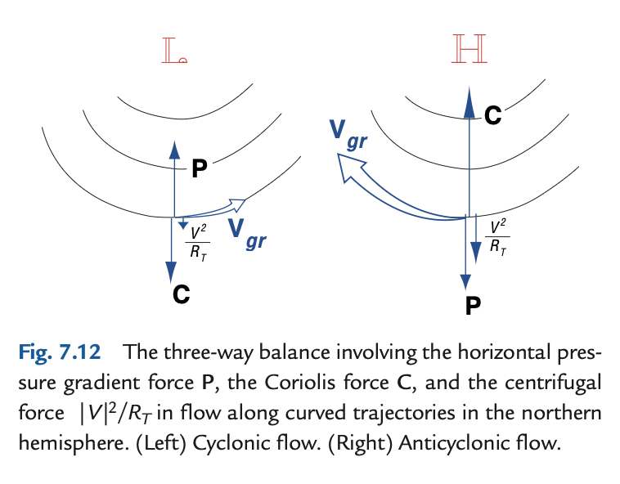
Coriolis and “centrifugal” forces
−(V.∇) V
advection of vector momentum V
2Ω x V , strictly (in 3D)

Slide 7
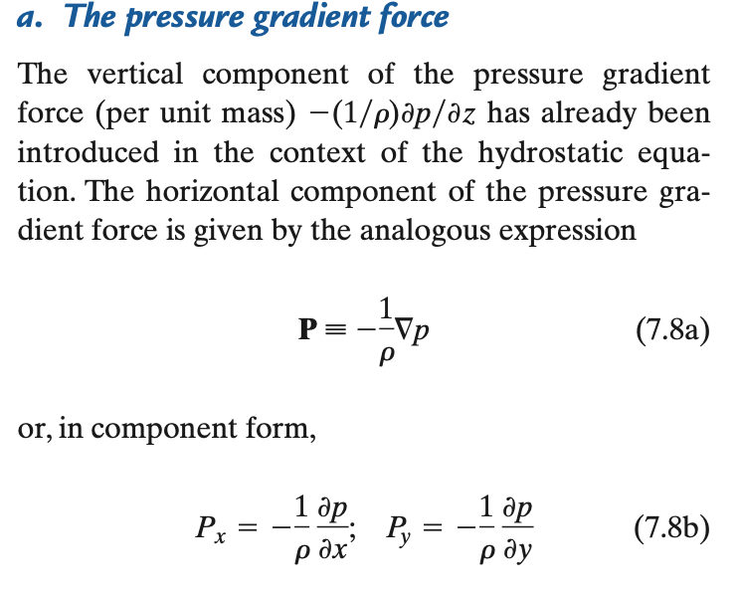
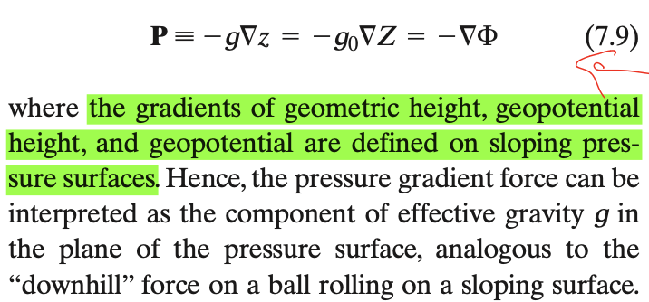
The PGF
Momentum flux convergence (flux in – flux out of box)
recalling that pressure is a flux of momentum, units (kg m/s) m⁻² s⁻¹
think ping pong ball gun (omnidirectional)
and recall that p is not “given” except in undergrad spoon-feeding
p is the field whose PGF has a divergence that balances all other force divergences

