Slide 1
Kinematics of 2D horizontal flow
ATM 651
fall 2024
Wallace and Hobbs Ch 7.1

Slide 2
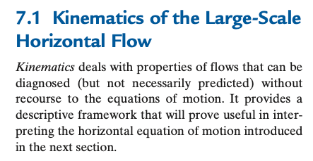
Kinematics vs. dynamics
description only – no forces and F=ma and all that!

Slide 3
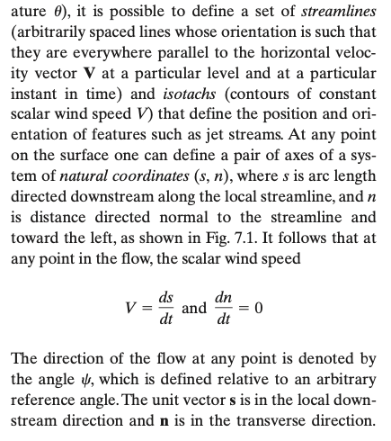
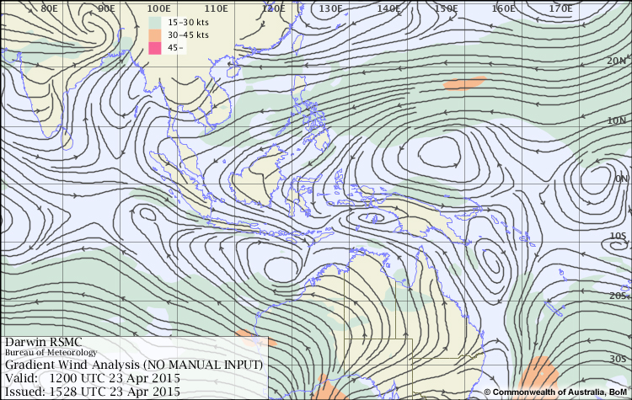
Streamlines and isotachs: flow at an instant
https://www.meted.ucar.edu/labs/synoptic/kinematics/streamlining/print.php
so traditional, see windy.com for modern view

Slide 4
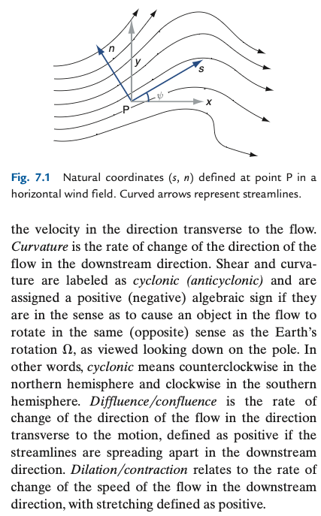
Natural coordinates
all italic words are on the vocabulary midterm, do try to internalize them
they are chosen to be intuitive-sounding
once your intuition is calibrated ☺
sign definitions a bit tedious

Slide 5
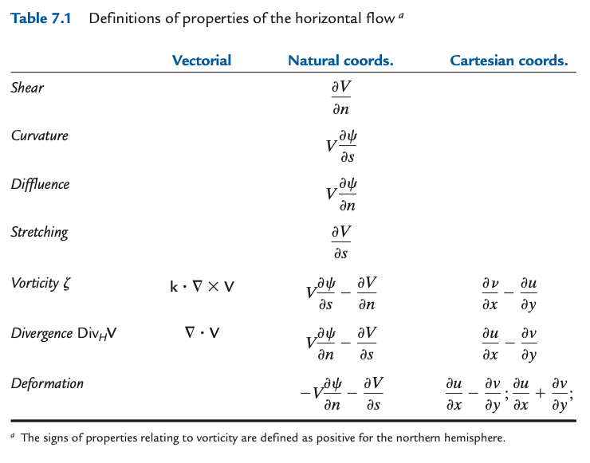
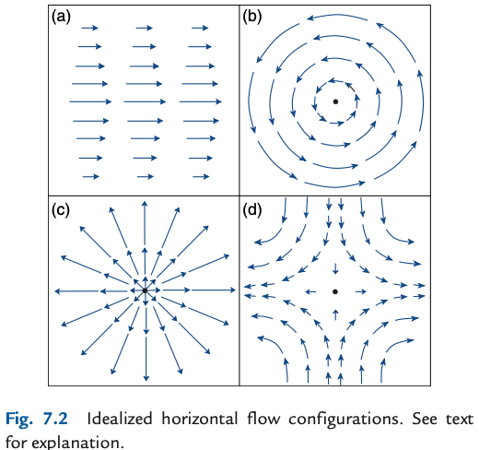
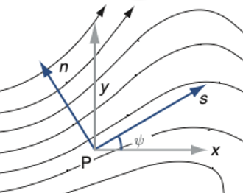
All the kinematic terms: 2 components (u,v) varying in 2 dimensions (x,y) = 4 possible derivatives, but recombined
More italicized words to know
Find errors in this table!
hint here

Slide 6
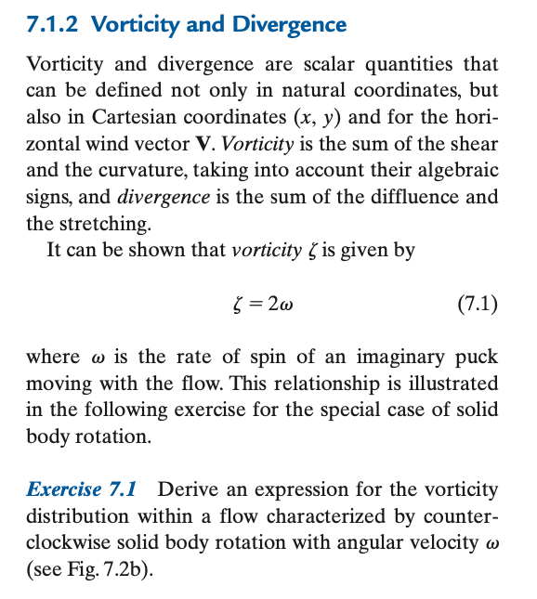
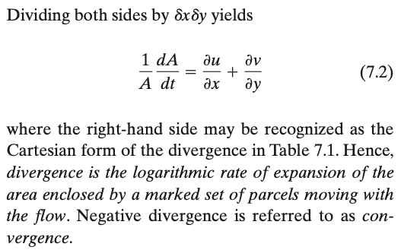
Vorticity and divergence
Units are inverse time. What process’s timescale is that an (inverse) measure of?
Why that factor of 2? →

Slide 7
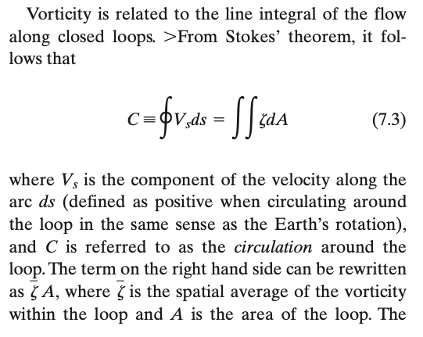
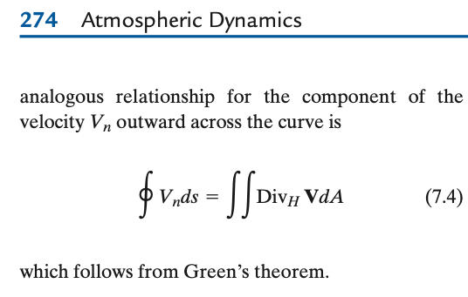
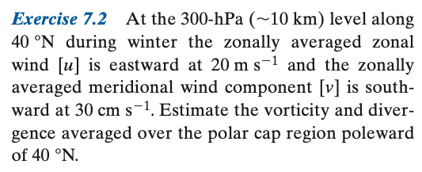
Circulation Theorem, Divergence Theorem

Slide 8
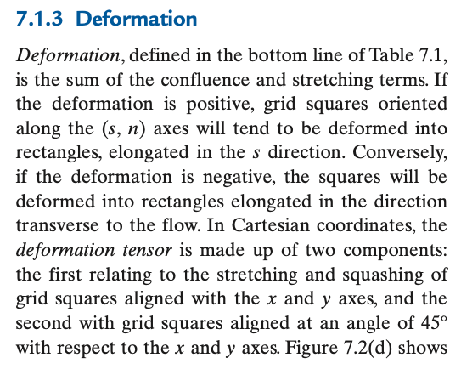
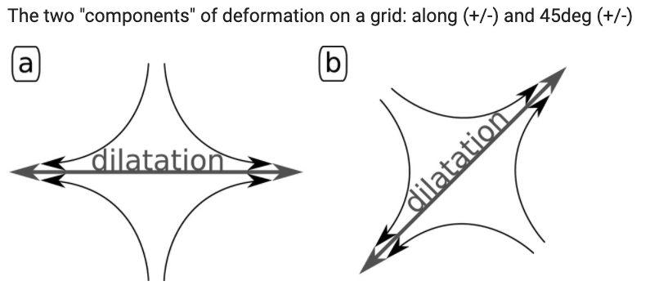
def NOT div or vor: the other 2 combinations of the 4 possible derivatives δ(u,v)/δ(x,y)
The two kinds are not orthogonal ‘components’ as for vectors
rather, at a 45º angle

Slide 9
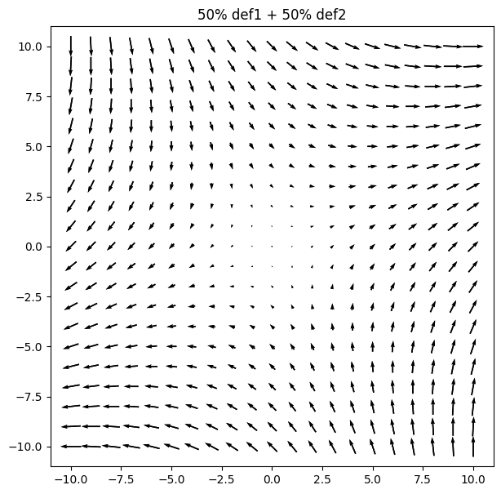
def NOT div or vor: the other 2 combinations of the 4 possible derivatives δ(u,v)/δ(x,y)
The two kinds are not orthogonal ‘components’ as for vectors
rather, at a 45º angle
Linear combinations of the 2 just rotate the angle!
https://colab.research.google.com/drive/1uY31iYu5dZ5E9F-UoYrpWQf4UnJLvoKG

Slide 10
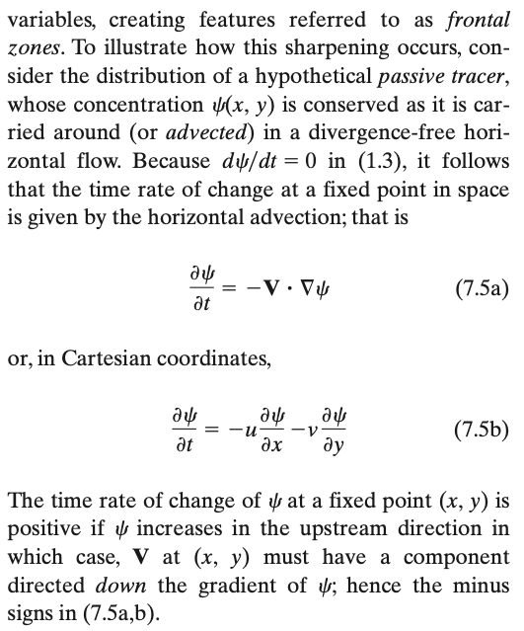
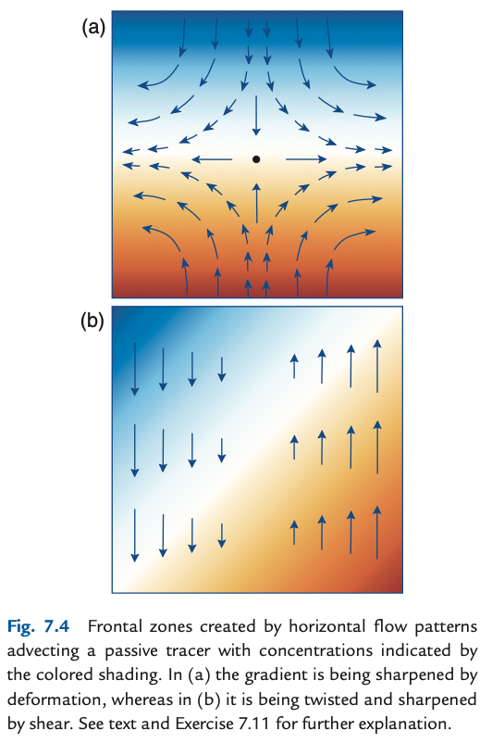
Effects of deformation
sharpening the gradient (def)
twisting too (shear = vor + def)

Slide 11
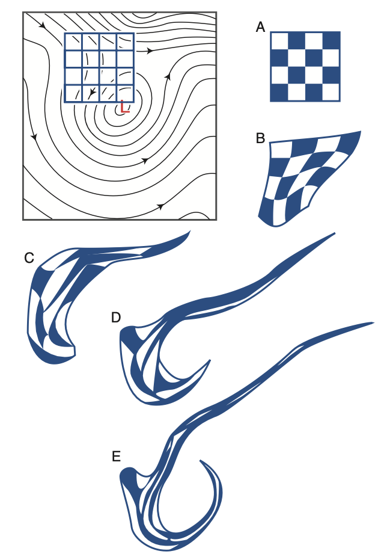

deformation deforms…. . . .
Perhaps not rotated (if no vorticity)!
Perhaps no Area changes (if no vergence)!
https://colab.research.google.com/drive/1uY31iYu5dZ5E9F-UoYrpWQf4UnJLvoKG

Slide 12
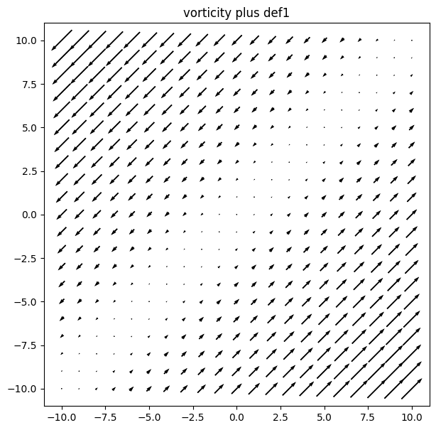
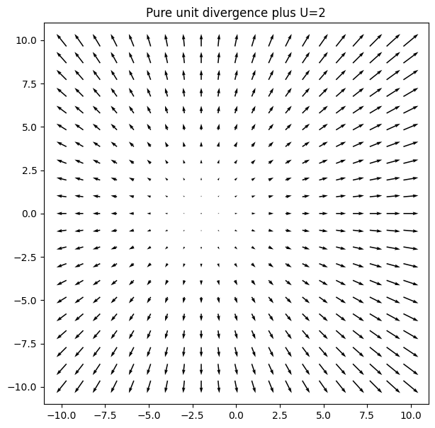
Important combinations
curvey + curvey = straight!
Adding mean flow just moves the center

Slide 13
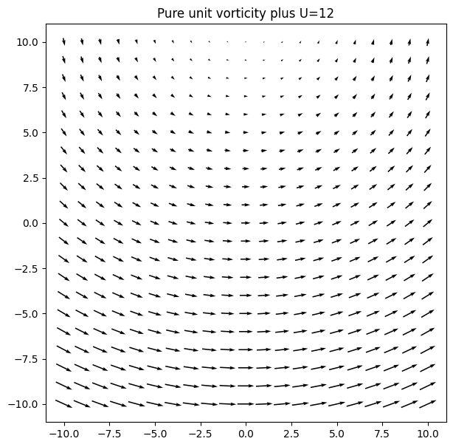
Important combinations
curvey + curvey = straight!
Adding mean flow just moves the center

Slide 14
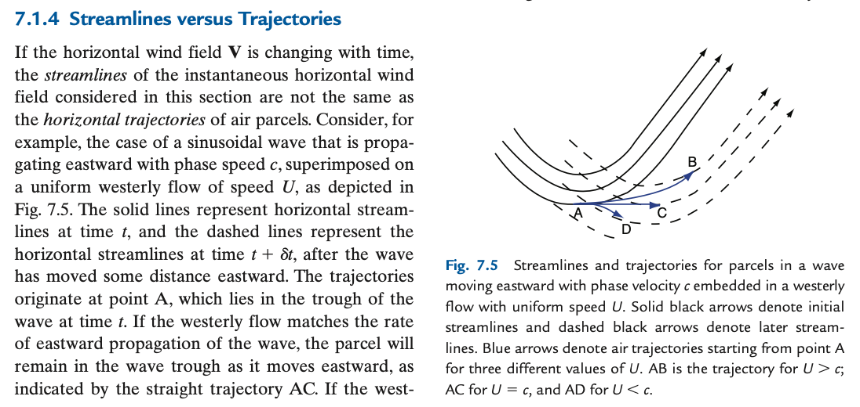
More italicized words to learn carefully!

Slide 15
Which are these?
earth.nullschool.net
windy.com
hysplit
Can streamlines ever cross?

Slide 16
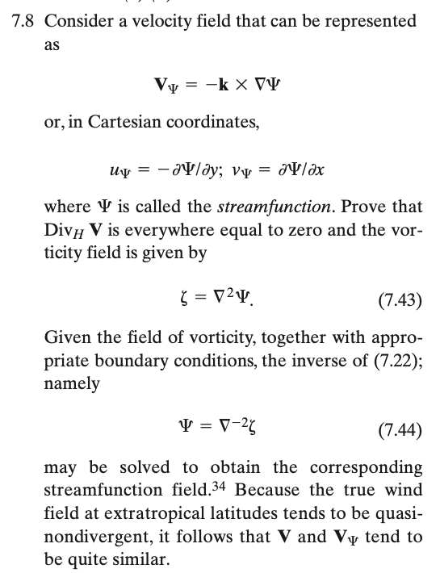
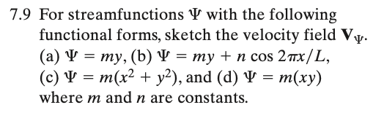

Streamlines and streamfunction

Slide 17
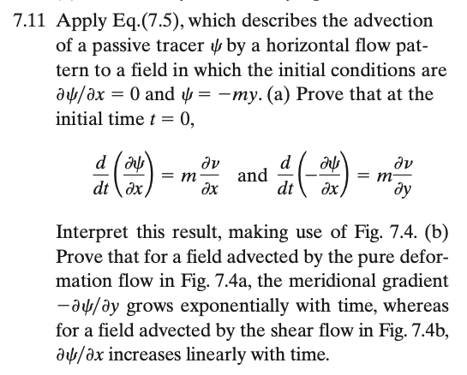
Harder one

