Slide 1
p surfaces on a z-coordinate diagram
for NH westerly jet stream in thermal wind balance
→
z
150 mb
thinner mass (Δp) layers,
cooler compared to
← that
big thickness of mass (Δp)
layers: warm compared to that →
200 mb
300 mb
Jet stream
into page
PGF is “downhill”
Coriolis force to R
500 mb
small thickness of
mass (Δp) layers:
cooler, compared to that→
same mass (Δp) layers
are thicker: warmer than
← that
700 mb
1000 mb
North
South

Slide 2
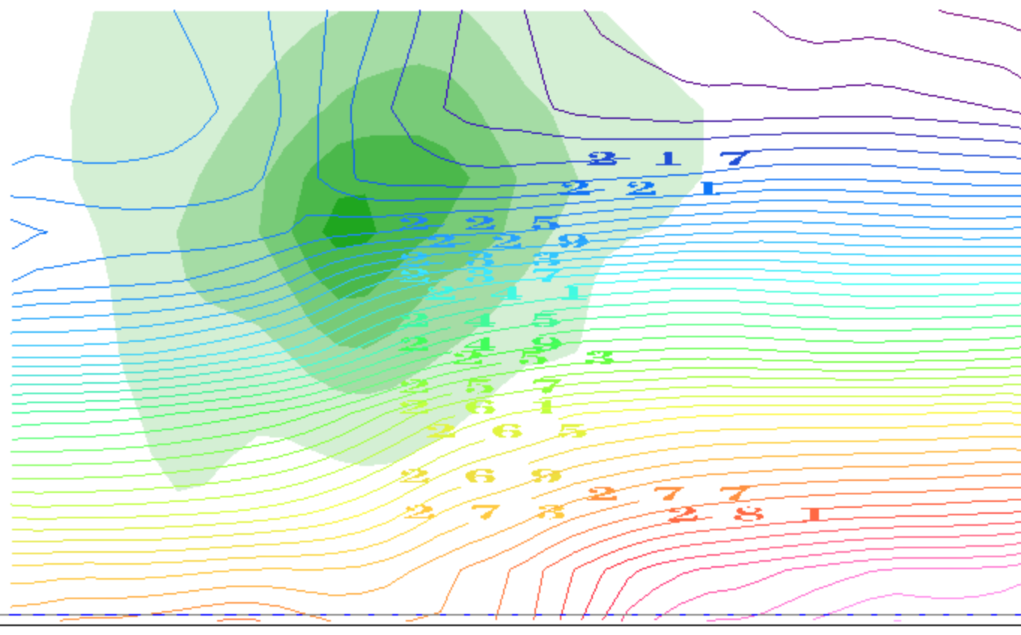
contours of T(K): it decreases with height
(plus the horizontal gradients due to TWB)
thinner mass (Δp) layers,
cooler compared to
← that
big thickness of mass (Δp)
layers: warm compared to that →
small thickness of
mass (Δp) layers:
cooler, compared to that→
same mass (Δp) layers
are thicker: warmer than
← that
North
South

Slide 3
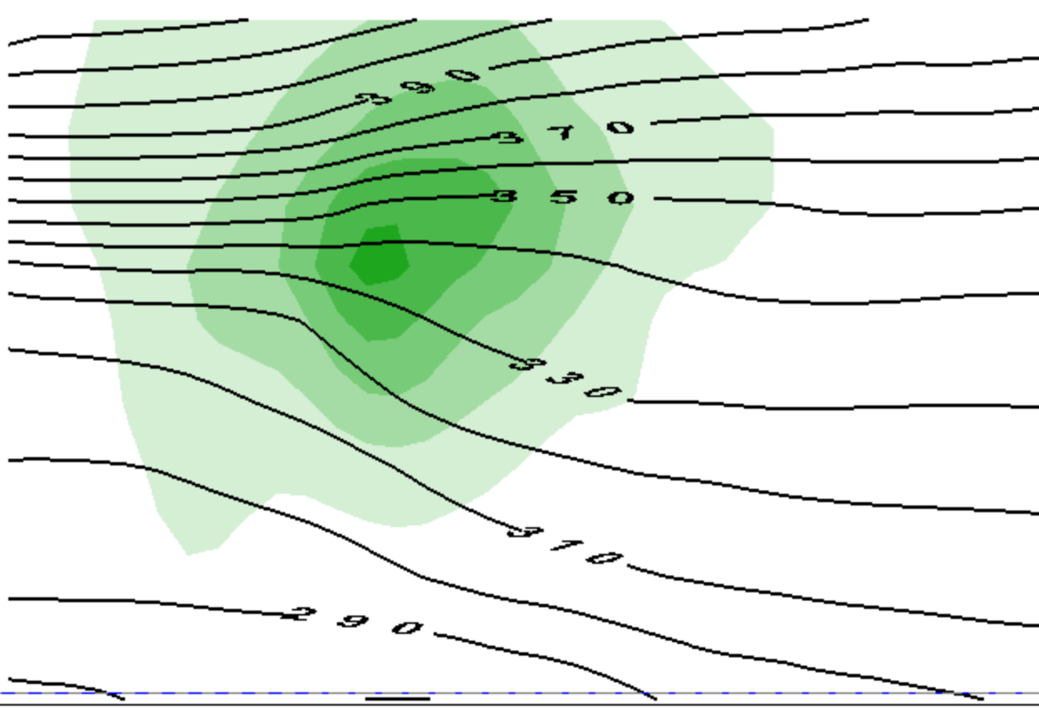
contours of θ(Κ): it increases with height
(plus the horizontal gradients due to TWB)
thinner mass (Δp) layers,
cooler compared to
← that
big thickness of mass (Δp)
layers: warm compared to that →
small thickness of
mass (Δp) layers:
cooler, compared to that→
same mass (Δp) layers
are thicker: warmer than
← that
North
South

Slide 4
This is only half the story of a vortex
cooler than
← that
warmer than
that →
cooler than
that→
warmer than
← that

Slide 5
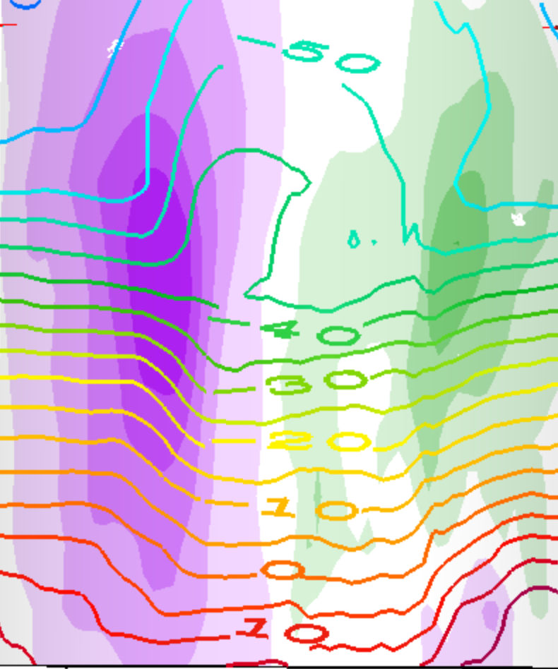
This is a whole vortex (two jets)
T(K) contours
cooler than
that →
warmer than
← that
cooler than
← that
warmer than
that →
warmer than
that →
cooler than
← that
cooler than
that→
warmer than
← that

Slide 6
This is a whole vortex (two jets)
T(K) contours
warmer than
← that →
above the core
cooler than
← that →
below the core

Slide 7
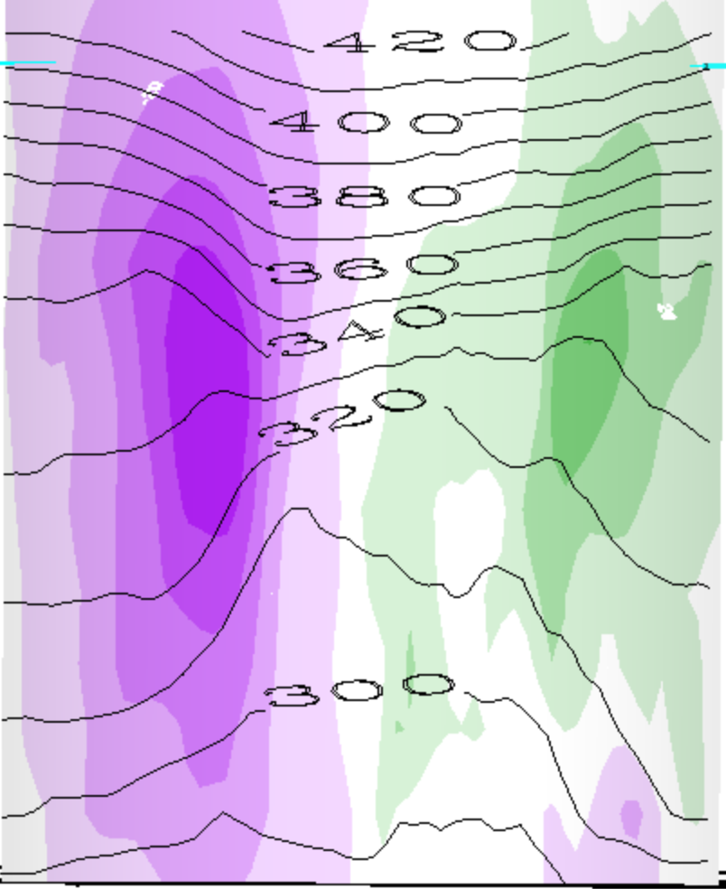
This is a whole vortex (two jets)
θ(K) contours
warmer than
← that →
above the cyclone
cooler than
← that →
below the cyclone

Slide 8
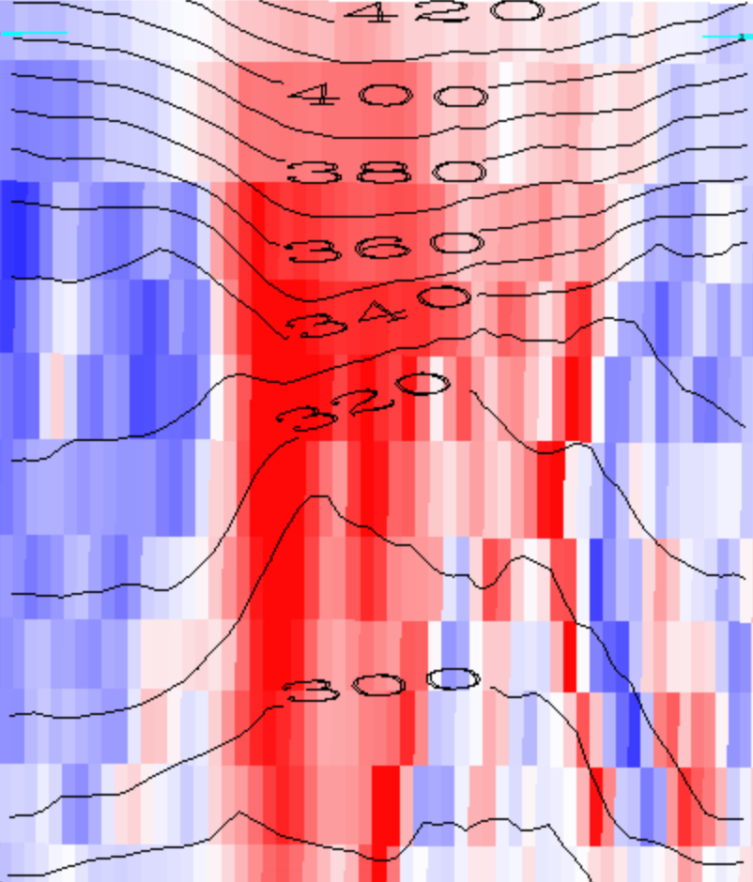
Red is positive vorticity , θ(K) contours
warmer than
← that →
above the cyclone
cooler than
← that →
below the cyclone

Slide 9
Red is positive vorticity , θ(K) contours
warmer than
← that →
above the cyclone
Cyclonic Vortex
cooler than
← that →
below the cyclone

Slide 10
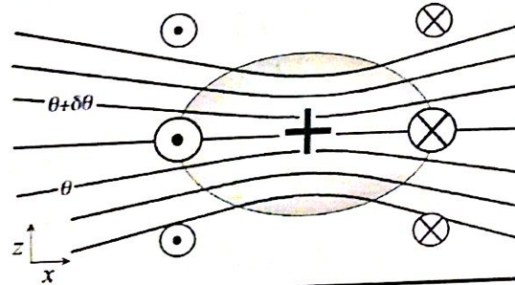
Generalization: PV
1. We will see that every cyclonic vortex obeying vertical (hydrostatic) and horizontal (geostrophic or other) balance looks similar to this (maybe stretched or shrunk):
PV > 0

Slide 11
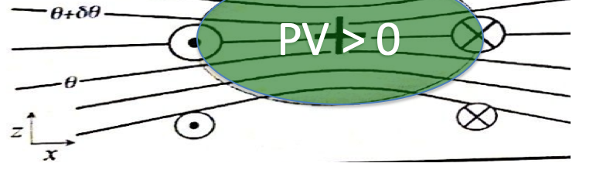
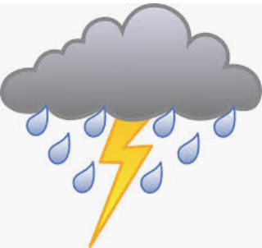
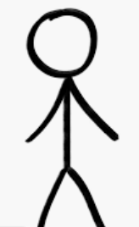
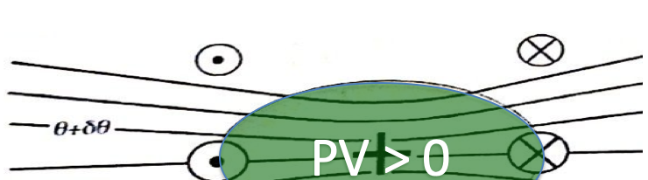
Since our main weather concern is in the lower troposphere (where water is),
This is called a cool core cyclone:
This is called a warm core cyclone:

Slide 12
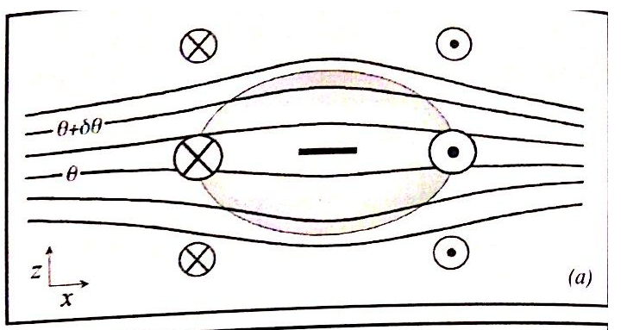
Balanced anticyclones exist too...
Just the opposite of a cyclone...
PV < 0

Slide 13
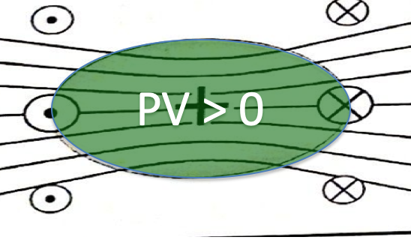
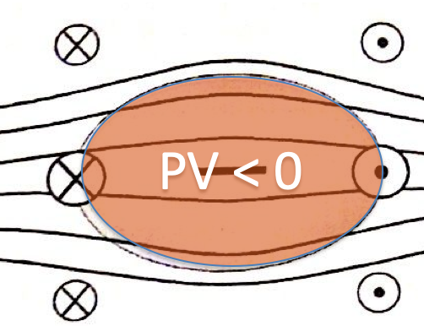
Vorticity (or PV) blobs
Where do they come from?
How do they interact?
(this we studied, in the horizontal plane)
Do they get destroyed?
(Soon: tackling the complications)

Slide 14
IDV lab assignment -- part 1
In the following slides, make and label and explain nice clear illustrations like slides 13-17, but for
a warm core anticyclone
a warm core cyclone
a cool core anticyclone

Slide 15
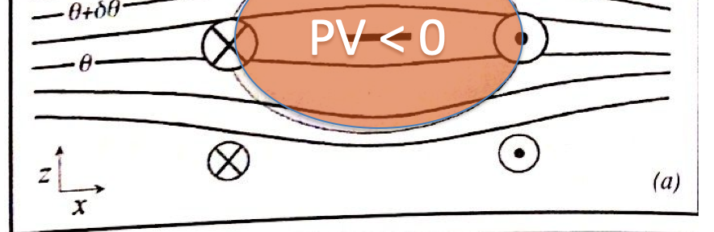
A warm core anticyclone
Where? Describe the situation.

Slide 16
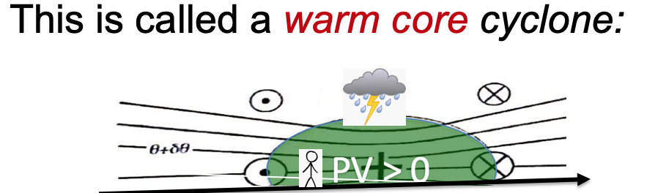
A warm core cyclone
Where? Describe the situation

Slide 17
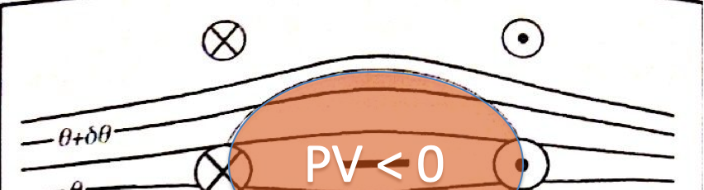
A cool core anticyclone
Where? Describe the situation

