Slide 1
Revisiting what we learned
Brian Mapes
ATM 651, Fall 2020

Slide 2
Part I: Grammar (fundamentals)
math notation
physics principles and laws

Slide 3
Physical units: made for this science!
MKS (or SI) system: Earth, Water, fingers
m = (Pole-Eq distance)/10⁷
kg = (mass of 1m³ water)/10³
K = (T_{boil} - T_{freeze})/10
s = (rotation time of Earth)/24/60/60
Some long-lost 6-fingered people owned “angle” (360º)
so time’s circular nature fell into their grasp
(maybe cuz 12 mo/y)?

Slide 4
Calculus of multi-dimensional fields
T(x,y,z,t), etc.
the 4 partial derivatives are obvious:

Slide 5
Calculus of fields in space-time
time is special
moving frame of reference x_{r}(t only), y_{r}(t), z_{r}(t)
Chain rule:
dT/dt = ∂T/∂t + ∂T/∂x (dx_{r}/dt) + …
If reference frame follows fluid motion, dx_{r}/dt = u
but also used for time series measured by moving ship

Slide 6
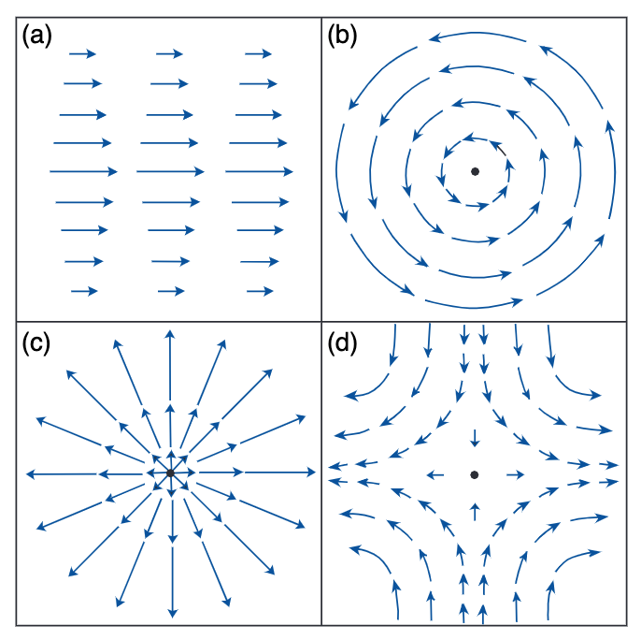
Calculus of fields in space-time
vectors are objects with direction, magnitude
Kinematics in 2D
vorticity
divergence
deformation
shear = 1 + 3

Slide 7
Vectors
vectors are objects with direction, magnitude
addition is straightforward (like walking)
multiplication = product of magnitudes,
times
cosine of angle between them (projection or shadow) for the scalar or inner or dot product
sine of angle unit vector, times unit vector orthogonal to both, for cross product (in 3D only)

Slide 8
(factor) operator(operand)
Example: derivative (of ANYTHING)
∂/∂t
clearer as ∂/∂t()
anything to left is multiplied
anything to right is operated on

Slide 9
V dot grad: a useful combination of vector and operator notation:
Or if we use p as a vertical coordinate,

Slide 10
del dot V: the divergence of V
Convergence is negative divergence

Slide 11
We Have Laws of Physics!
d/dt(T) = (diabatic heating)-(adiabatic cooling)
d/dt(V) = a = (sum of all Forces per unit mass)
ρ = p/RT equation of state (density = …)
Mass is conserved: humble heart of fluid dyn.
total mass is conserved
dry air mass is conserved
total water mass of all phases “ “
etc. etc.

Slide 12
OK, we assembled the ”governing” partial differential equations (PDEs)
All possible weathers are solutions to these
What would it mean to understand or grasp something more? (“dynamics”)
Before computers, we had only mathematical manipulations illustrative of concepts via various special cases

Slide 13
What can we do with the PDEs I
1. Seek leading-order balances
discard or ignore small-valued terms
based on scale analysis of term size
for example, geostrophy
Coriolis force ~ fU
Mom. advection -u ∂u/∂x ~ U U/L
a.k.a. “inertial forces”
Ratio Adv/Cor is called Rossby number
Ro = U/fL, small for geostrophic flows

Slide 14
What PDE terms to throw out?
frictional forces (too complicated)
➔ inviscid
thermodynamic heatings (too complicated)
➔ adiabatic
time derivatives
➔ balance, equilibrium, steady-state, time-mean
example: hydrostatic balance (dw/dt <<< g and VPGF)
use p_{hyd} as a “mass coordinate” in the vertical
greatly simplifies mass continuity (∂ρ/∂t vanishes exactly)

Slide 15
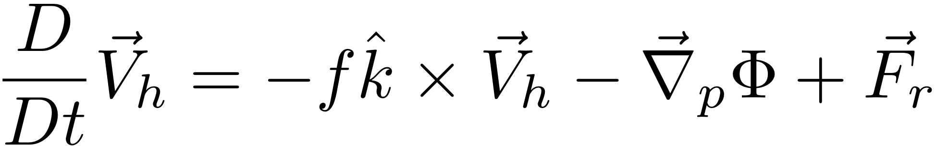
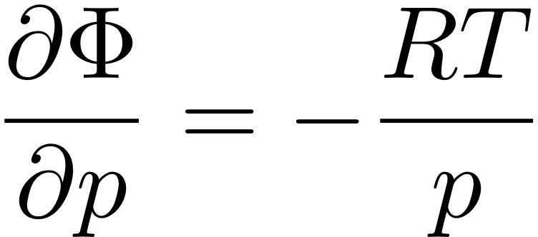


“The Primitive Equations”
(meaning elemental, fundamental)
PGF becomes
-g times slope ∂Ζ/∂x
of p surfaces! →
F=ma in the HORIZONTAL (in p coords)
← dw/dt neglected formally
HYDROSTATIC (w/ ideal gas law to eliminate ρ)
← ∂ρ/∂t vanishes exactly!
MASS CONSERVATION
FIRST LAW OF THERMO
s: dry static
energy
θ: potential
temperature
“static stability
parameter”
S_{p} = (∂s/∂p /C_{p}) = (∂θ/∂p T/θ)
Notes:
\frac{D}{Dt} \vec V_h = -f \hat k \times \vec V_h - \vec \nabla_p \phi +\vec F_r
\frac {\partial \Phi}{\partial p} = - \alpha \equiv -\frac{1}{\rho}
\alpha = \frac{RT}{p}
\frac {\partial u}{\partial x} + \frac {\partial v}{\partial y} + \frac {\partial \omega}{\partial p} = 0
\frac {D_hT}{Dt} + S_p \omega = J/C_p

Slide 16
What can we do with the PDEs II
2. Try to get conservation form
d/dt(stuff) = 0
∂/∂t(stuff) = transport
= advection
upwind values comin’ at ya!
= convergence of flux
integrates to zero over any closed domain!

Slide 17
Conservation quasi-laws
d/dt(stuff) = 0
potential temperature or dry static energy
gives dry adiabatic lapse rate for well mixed layer
relative vorticity
absolute vorticity
potential vorticity

Slide 18


Holy Grail: eliminate RHS terms!
Gotta avoid dragging thermo into this via Φ.
Get rid of Φ at any cost. Curl to the rescue!
Ker-CHING!
We are Masters of the Universe with our sexy vector identities!
The grail is in the bag!
Notes:
\nabla \times (\frac{D}{Dt} \vec V_h) = \nabla \times (-f \hat k \times \vec V_h) - \nabla \times (\nabla_p \Phi)

Slide 19
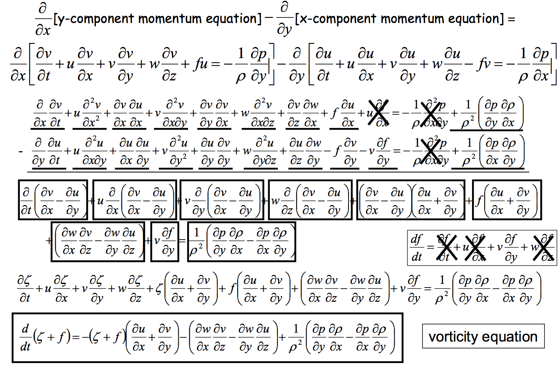
Heh heh ... did I say "any cost"... ? gulp

Slide 20
Conservation quasi-laws
d/dt(relative vorticity) = 0
vorticity elements induce tangential flow:
V_{tan} α 1/distance
that tangential flow in turn advects vorticity:
vorticity elements orbit (same sign), prominade like smoke rings (opposite sign), shred each other, merge, interact in groups, etc. → heart of the horizontal forecast problem, chaos, etc.

Slide 21
Conservation quasi-laws
d/dt(absolute vorticity) = 0
all of the above, AND -v ∂f/∂y
(advection of planetary vorticity)
→ Rossby waves
westward phase propagation speed
eastward group (energy) “ “
both proportional to wavelength²
Long waves act as Rossby waves
Short waves are just advected vortices
(troughs or lows)

Slide 22
Conservation quasi-laws
d/dt(potential vorticity) = 0
all of the above, AND
stability → vorticity conversion
when air descends from the stratosphere into theupper troposphere and spins up cool core cyclones a bit more, mainly

Slide 23
Conservation quasi-laws
d/dt(PV) = κ ∂Q/∂z
Finally we care about a nonzero RHS, because it is only one term, profound
Cyclonic at base of latent heating
→ warm core cyclones (hurricanes)
Cyclonic at top of radiative cooling
→ cool core polar vortex (and tentacles)

Slide 24
What can we do with the PDEs III
3. Build complete numerical models
Primitive equation solvers = “dynamical core”
Physical processes
Treatments for nonfluid processes
latent heat of phase changes of water
microphysics of condensed particles
radiative energy transfer including cloud effects
electrical processes, etc. etc.
Approximations for fluid motions finer than mesh
turbulence in the PBL, surface conduction and friction
cumulus activity including downdrafts, etc. etc.
internal gravity waves, frictional dissipation of wind KE, etc. etc.

Slide 25
The atmosphere moves because of
heating / cooling, damped by Friction
F=MA in the HORIZONTAL
Friction keeps it finite
HYDROSTATIC (w/ ideal gas law to eliminate ρ)
MASS CONSERVATION
FIRST LAW OF THERMO
J makes it go!
Notes:
\frac{D}{Dt} \vec V_h = -f \hat k \times \vec V_h - \vec \nabla_p \phi +\vec F_r
\frac {\partial \Phi}{\partial p} = - \alpha \equiv -\frac{1}{\rho}
\alpha = \frac{RT}{p}
\frac {\partial u}{\partial x} + \frac {\partial v}{\partial y} + \frac {\partial \omega}{\partial p} = 0
\frac {D_hT}{Dt} + S_p \omega = J/C_p

Slide 26
Part II: Logic (combinations)
equation sets
combinations of assumptions
multi-step reasoning
multi-time-step evolution

Slide 27
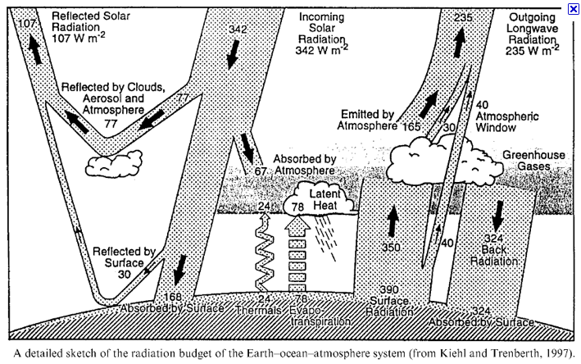
mean J maintains mean state, gradients of J make it go

Slide 28
Heating and cooling driven flows
Sun heats surface, atmos. cools by IR
troposphere cools 1-2 K/day ~ 150 W m⁻²
Tropics warmed by latent heat release in rain
also ~ 150 W m⁻² or 3-4 mm/d of P=E
localized → warm core vortices (TCs)
Poles: no sun, cooold troposphere in winter
→ cold core “polar vortex” at tropopause
Jet stream instability in midlatitudes
tentacles stretch or break off of polar vortex
→ cool core synoptic cyclones (troughs, lows)

Slide 29
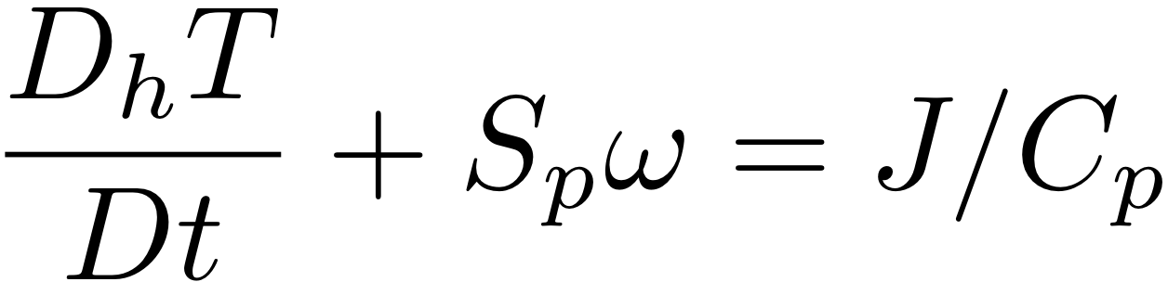
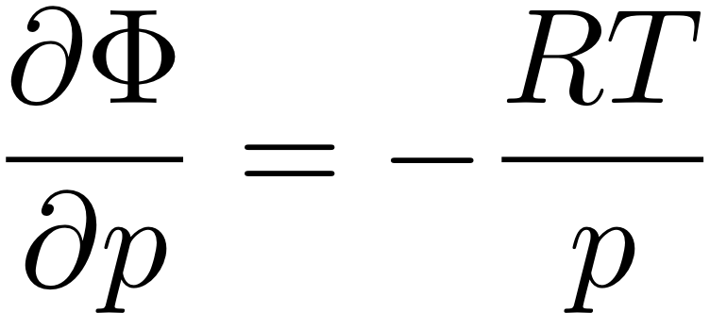
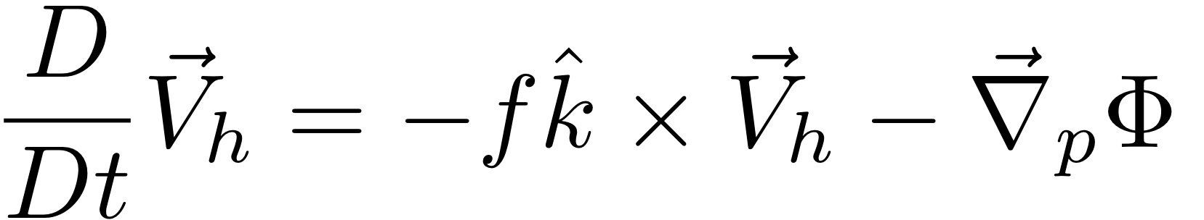
HW: use The Primitive Equations to compute how a local heating J drives flow in an initially motionless atmosphere
J causes T to increase
net change of T =
amount of heat added/Cp
2. Warmer T causes increased thickness of the heated column
3. High Φ over hot column pushes wind outward
4. Surface pressure drops (remember, omega = Dp/Dt; Holton eq. 3.44)
Notes:
Homework 5, MSC 405. Due Thursday, April 13
This problem set walks through the heated-air-rising process above, for a 100 km patch of latent heating in an initially motionless atmosphere.
ALL ANSWERS MUST HAVE UNITS, BUT NUMBERS CAN BE SIMPLE ROUGH ESTIMATES.
Suppose the heating J corresponds to the latent heat released during 1cm of rain over a 100km x 100km area. Let’s figure out how much ΔT that causes.
What is the volume of water condensed (m³)?
What is the mass of water condensed (kg)?
How much latent heat is released (Joules)? (L = 2.5 x 10⁶ J per kg of water).
How many kg of air are in a 1 square meter column of atmosphere, if surface pressure p is 1000mb? M=p/g
How many kg of air are therefore in a 100km x 100km column?
If Cp = 1000 J/(kg K), by how many K can the heat from c. warm the air mass from e.?

Slide 30
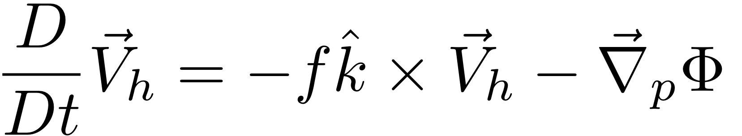
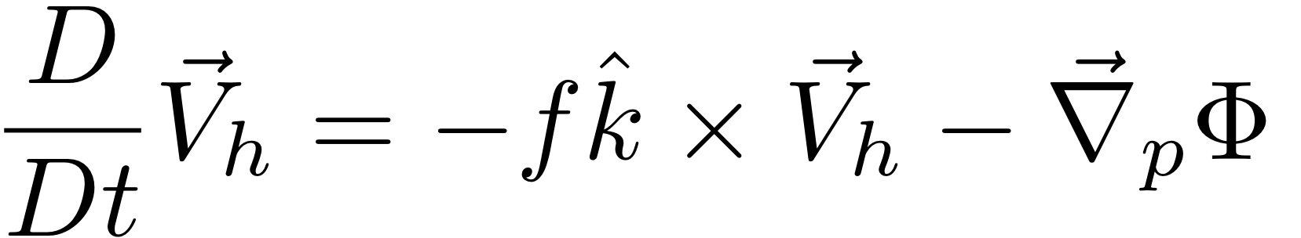
HW: use The Primitive Equations to compute how a local heating J drives flow in an initially motionless atmosphere
5. Low Φ under hot column pulls wind inward
6. Hot air rises (finally!)
ω =~ ρgw
7. Coriolis force turns inflowing and outflowing air to make round-and-round flow
Notes:
Homework 5, MSC 405. Due Thursday, April 12
This problem set walks through the sequential process above, for a 100 km patch of latent heating in an initially motionless atmosphere.
ALL ANSWERS MUST HAVE UNITS, BUT NUMBERS SHOULD BE ROUGH: 1-2 SIGNIFICANT DIGITS.
Suppose the heating J corresponds to the latent heat released during 1cm of rain over a 100km x 100km area. Let’s figure out how much ΔT that causes.
What is the volume of water condensed (m³)? (1 point)
What is the mass of water condensed (kg)? (1 point)
How much latent heat is released (Joules)? (1pt) (L = 2.5 x 10⁶ J per kg of water).
How many kg of air are in a 1 square meter column of atmosphere, if surface pressure p is 1000mb? M=p/g (1)
How many kg of air are therefore in a 100km x 100km column? (1)
If Cp = 1000 J/(kg K), by how many K can the heat from c. warm the air mass from e.? (1)

Slide 31
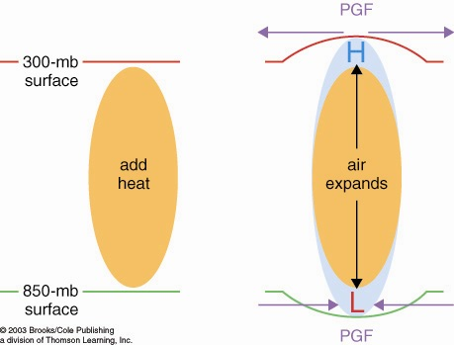
How heated air rises and a warm core vortex develops: the Primitive Equation view. 7 logical steps
1. Warmed column of air gets thicker
2. Air accelerates
due to PGF
2. Air accelerates
due to PGF
1. 200 mb
surface
bulges
upward
0. Heating (maybe latent heating by condensation in a patch
of convection over warm water someplace)

Slide 32
How heated air rises and a warm core vortex develops: the Primitive Equation view. 7 logical steps
3. Mass removal and 4. surface pressure drop
3. Mass removed
from column
3. Mass removed
from column
4. less mass of air in column
= lower surface pressure
L

Slide 33
How heated air rises and a warm core vortex develops: the Primitive Equation view. 7 logical steps
5. Low level inflow accelerates, 6. heated air rises
6. warm
air
rises!
(continuity)
5. Air accelerates
due to PGF
5. Air accelerates
due to PGF

Slide 34
How heated air rises and a warm core vortex develops: the Primitive Equation view. 7 logical steps
ANTI
CYCLONIC
Warm Core
Vortex
in thermal wind
balance
CYCLONIC
FLOW
7. Coriolis turns flow to right

Slide 35
Heating and cooling driven flows
Sun heats surface, atmos. cools by IR
troposphere cools 1-2 K/day ~ 150 W m⁻²
Tropics warmed by latent heat release in rain
also ~ 150 W m⁻² or 3-4 mm/d of P=E
localized → warm core vortices (TCs)
Poles: no sun, cooold troposphere in winter
→ cold core “polar vortex” at tropopause
Jet stream instability in midlatitudes
tentacles stretch or break off of polar vortex
→ cool core synoptic cyclones (troughs, lows)

Slide 36
HW: use The Primitive Equations to compute how a local heating J drives flow in an initially motionless atmosphere
J causes T to decrease
net change of T =
amount of heat added/Cp
2. Warmer T causes decreased thickness of the cooled column
3. High Φ over cool column pulls wind inward
4. Surface pressure rises (remember, omega = Dp/Dt; Holton eq. 3.44)
Notes:
Homework 5, MSC 405. Due Thursday, April 13
This problem set walks through the heated-air-rising process above, for a 100 km patch of latent heating in an initially motionless atmosphere.
ALL ANSWERS MUST HAVE UNITS, BUT NUMBERS CAN BE SIMPLE ROUGH ESTIMATES.
Suppose the heating J corresponds to the latent heat released during 1cm of rain over a 100km x 100km area. Let’s figure out how much ΔT that causes.
What is the volume of water condensed (m³)?
What is the mass of water condensed (kg)?
How much latent heat is released (Joules)? (L = 2.5 x 10⁶ J per kg of water).
How many kg of air are in a 1 square meter column of atmosphere, if surface pressure p is 1000mb? M=p/g
How many kg of air are therefore in a 100km x 100km column?
If Cp = 1000 J/(kg K), by how many K can the heat from c. warm the air mass from e.?

Slide 37
HW: use The Primitive Equations to compute how a local heating J drives flow in an initially motionless atmosphere
5. High Φ under cool column pushes wind out
6. Cool air sinks (finally!)
ω =~ ρgw
7. Coriolis force turns inflowing and outflowing air to make round-and-round flow
Notes:
Homework 5, MSC 405. Due Thursday, April 12
This problem set walks through the sequential process above, for a 100 km patch of latent heating in an initially motionless atmosphere.
ALL ANSWERS MUST HAVE UNITS, BUT NUMBERS SHOULD BE ROUGH: 1-2 SIGNIFICANT DIGITS.
Suppose the heating J corresponds to the latent heat released during 1cm of rain over a 100km x 100km area. Let’s figure out how much ΔT that causes.
What is the volume of water condensed (m³)? (1 point)
What is the mass of water condensed (kg)? (1 point)
How much latent heat is released (Joules)? (1pt) (L = 2.5 x 10⁶ J per kg of water).
How many kg of air are in a 1 square meter column of atmosphere, if surface pressure p is 1000mb? M=p/g (1)
How many kg of air are therefore in a 100km x 100km column? (1)
If Cp = 1000 J/(kg K), by how many K can the heat from c. warm the air mass from e.? (1)

Slide 38
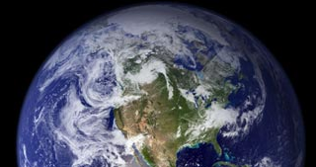
How cooled air sinks and a cool core vortex develops:
the Primitive Equation view. 7 logical steps
1. Cooled column of air gets thinner
2. Air accelerates
due to PGF
2. Air accelerates
due to PGF
200 mb
surface
IR cooling
cold
air
1. 200 mb
surface
bulges
downward

Slide 39
How cooled air sinks and a cool core vortex develops:
the Primitive Equation view. 7 logical steps
3. Mass drawn in
to column
3. Mass drawn in
to column
L
4. more mass of air in column
= higher surface pressure
H

Slide 40
How cooled air sinks and a cool core vortex develops:
the Primitive Equation view. 7 logical steps
L
6. Cold air sinks
5. Air accelerates
due to PGF
5. Air accelerates
due to PGF
H

Slide 41
How cooled air sinks and a cool core vortex develops:
7. Coriolis force turns the winds
L
CYCLONIC
FLOW
Cool
core
Vortex
ANTI
H
CYCLONIC

Slide 42
The geostrophically balanced polar vortex:
The Coriolis force on the westerly jet stream
prevents cold pool of Arctic air from sinking down
and covering the whole Northern Hemisphere
L
Cor.
PGF
PGF
Cor
Heavy cold air
would like to sink
if it could
H

Slide 43
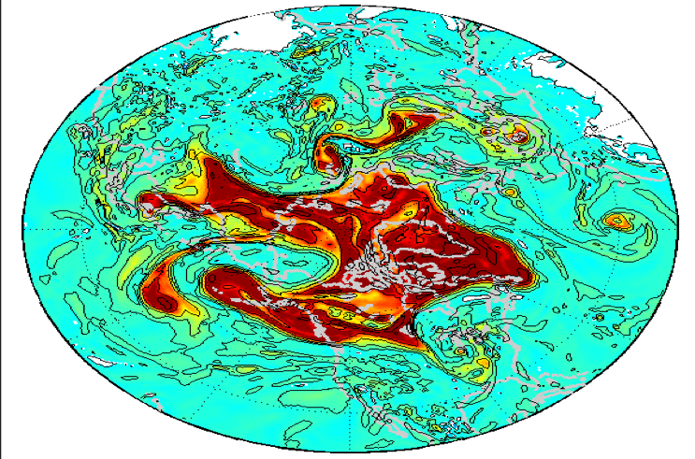
Polar vortex is unstable:
Jet stream develops Rossby waves.
These break
(like surf).
Rossby wave troughs (or cutoff bits of the cold-core polar vortex) are midlat. storms
They make clouds

Slide 44
Part III: Rhetoric
Logic was the combination of Grammar elements (basic ideas and terms).
Rhetoric is the further stringing together of such logical sets of firm principles for a strategic purpose

Slide 45
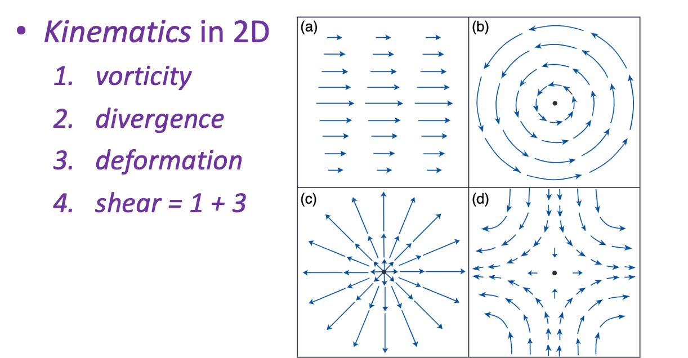
Dividing the flow into parts
We saw that whole vector fields can be decomposed.

Slide 46
Dividing the flow into parts
We saw that whole vector fields can be decomposed. Other decompositions:
Primary plus Secondary: why?
Secondary may be smaller in magnitude
linearizable, dynamics becomes tractable (Ro waves)
Secondary may be smaller in scale
maybe we only want its stats, like a turbulent eddy flux
Secondary may be especially important
engine driving the balanced flywheel, for instance
or maintainer of the balance approximation’s validity

Slide 47
Dividing the flow into parts
Primary plus Secondary: examples
Time mean (climatology) plus anomaly
Spatial mean (e.g. jet streams) plus eddies
Balanced (e.g. geostrophic) plus imbalanced
Geostophy may be a good enough approximation to the advecting flow, or to the advected momentum, or both (QG)
These are all merely definitions:
residual = total - approximation
Is it useful? Only if you intend something strategic! Keep your eyes on the concept, not just the algebra!

