Slide 1
The big idea of it
In the thermal wind lab, you learned about how the slope of pressure surfaces (indicating the PGF) balances the Coriolis force in geostrophic flow
You also learned how thickness (between pressure surfaces) is proportional to T
This gave you a 3D view of T around wind jets.
But wind always blows in circuits (circulations), so it is often more useful to think of vortices (with vorticity as the budget equation) as the fundament of flow.
Then T is understood in terms of warm and cool cores.

Slide 2
p surfaces on a z-coordinate diagram
for NH westerly jet stream in thermal wind balance
→
z
150 mb
thinner mass (Δp) layers,
cooler compared to
← that
big thickness of mass (Δp)
layers: warm compared to that →
200 mb
300 mb
Jet stream
into page
PGF is “downhill”
Coriolis force to R
500 mb
small thickness of
mass (Δp) layers:
cooler, compared to that→
same mass (Δp) layers
are thicker: warmer than
← that
700 mb
1000 mb
North
South

Slide 3
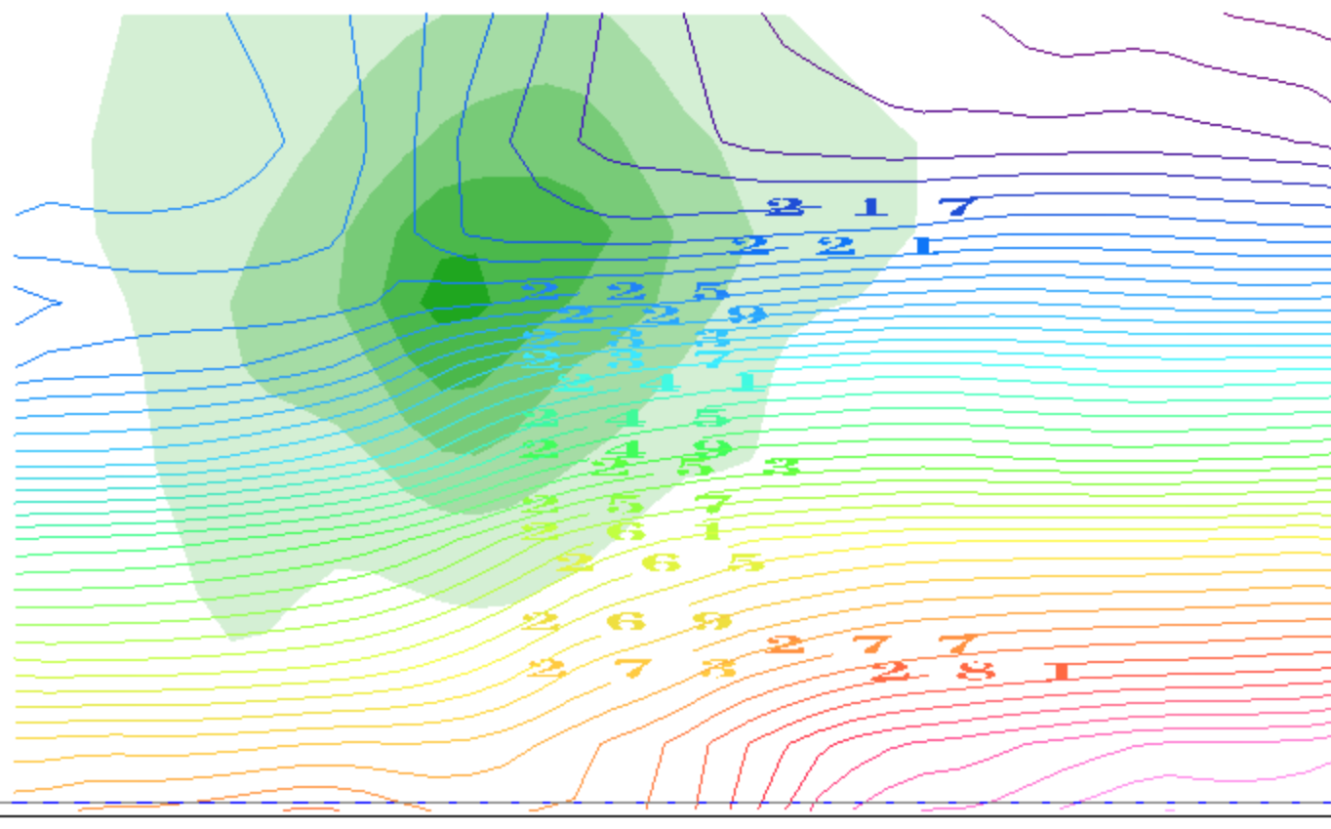
contours of T(K): it decreases with height
(plus the horizontal gradients due to TWB)
thinner mass (Δp) layers,
cooler compared to
← that
big thickness of mass (Δp)
layers: warm compared to that →
small thickness of
mass (Δp) layers:
cooler, compared to that→
same mass (Δp) layers
are thicker: warmer than
← that
North
South

Slide 4
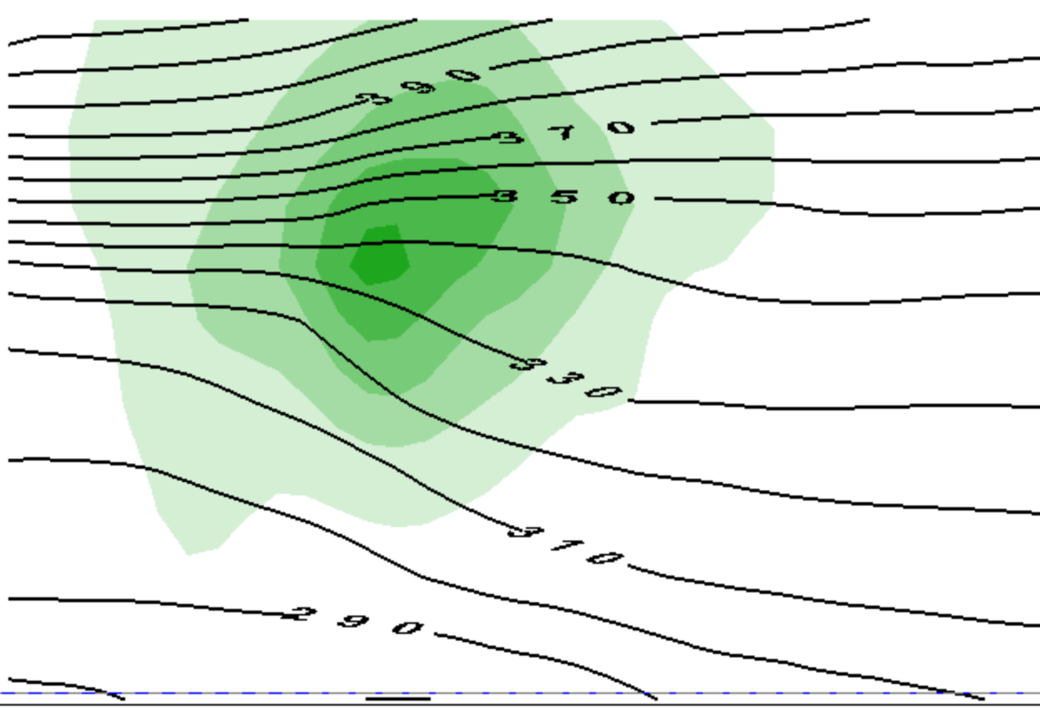
contours of θ(Κ): it increases with height
(plus the horizontal gradients due to TWB)
thinner mass (Δp) layers,
cooler compared to
← that
big thickness of mass (Δp)
layers: warm compared to that →
small thickness of
mass (Δp) layers:
cooler, compared to that→
same mass (Δp) layers
are thicker: warmer than
← that
North
South

Slide 5
This is only half the story of a vortex
cooler than
← that
warmer than
that →
cooler than
that→
warmer than
← that

Slide 6
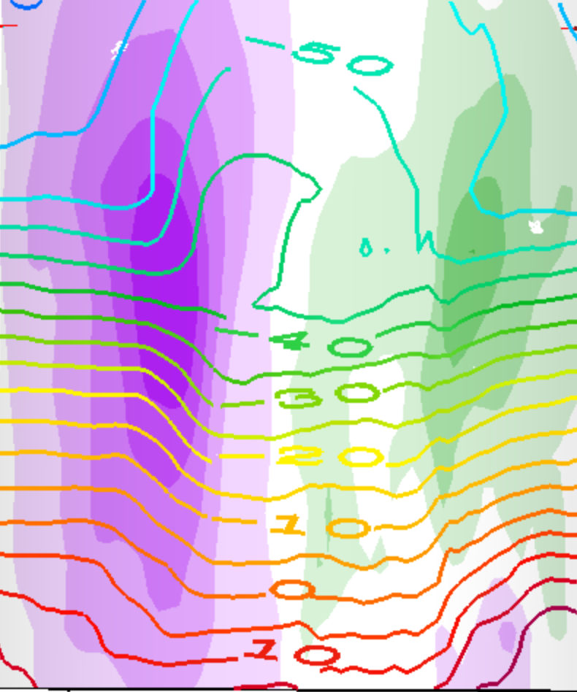
This is a whole vortex (two jets)
T(K) contours
cooler than
that →
warmer than
← that
cooler than
← that
warmer than
that →
warmer than
that →
cooler than
← that
cooler than
that→
warmer than
← that

Slide 7
This is a whole vortex (two jets)
T(K) contours
warmer than
← that →
above the core
cooler than
← that →
below the core

Slide 8
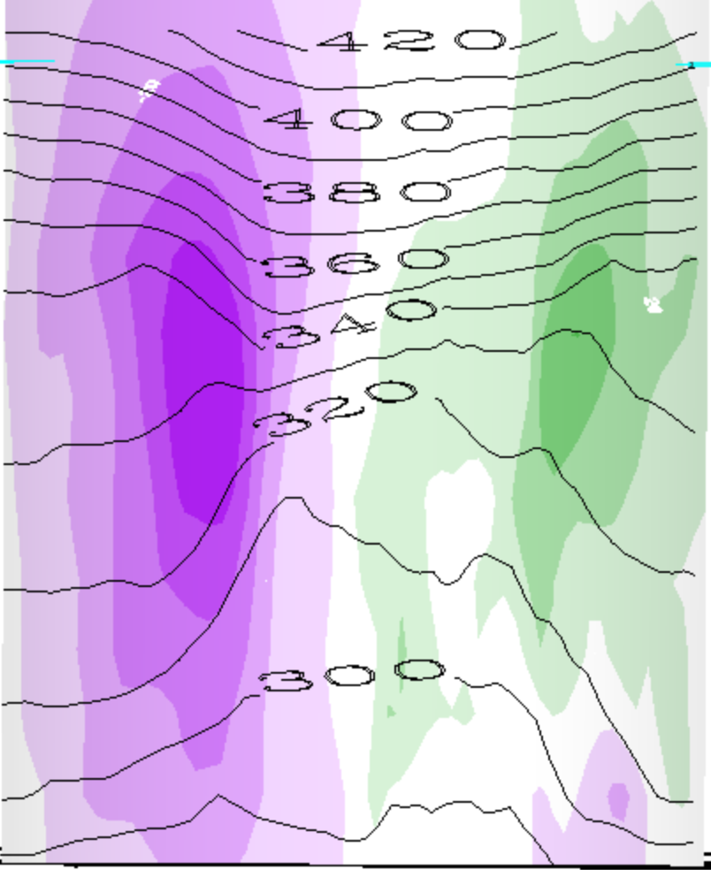
This is a whole vortex (two jets)
θ(K) contours
warmer than
← that →
above the cyclone
cooler than
← that →
below the cyclone

Slide 9
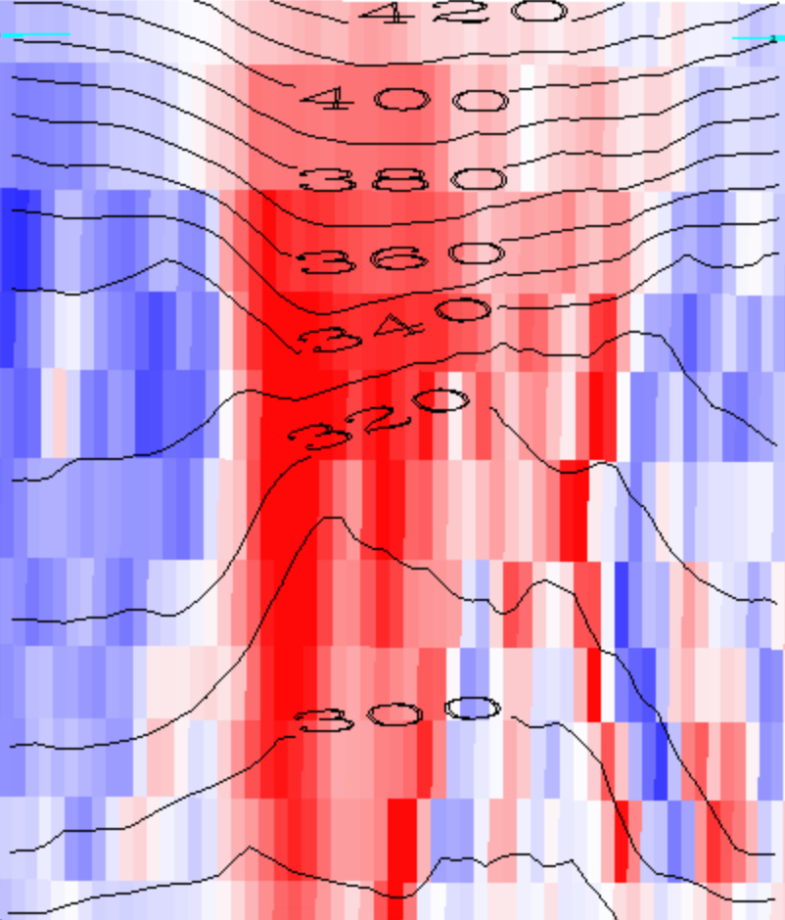
Red is positive vorticity , θ(K) contours
warmer than
← that →
above the cyclone
cooler than
← that →
below the cyclone

Slide 10
Red is positive vorticity , θ(K) contours
warmer than
← that →
above the cyclone
Cyclonic Vortex
cooler than
← that →
below the cyclone

Slide 11
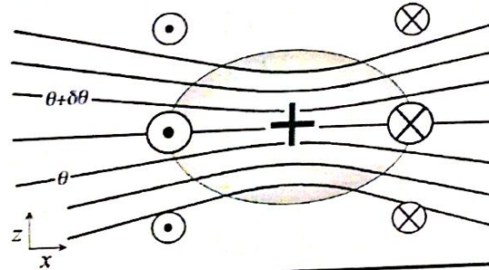
Generalization: PV
1. We will see that every cyclonic vortex obeying vertical (hydrostatic) and horizontal (geostrophic or other) balance looks similar to this (maybe stretched or shrunk):
PV > 0

Slide 12
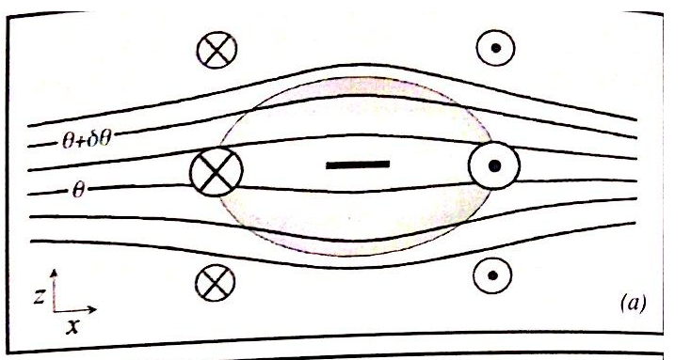
Balanced anticyclones exist too...
Just the opposite of a cyclone...
PV < 0

Slide 13
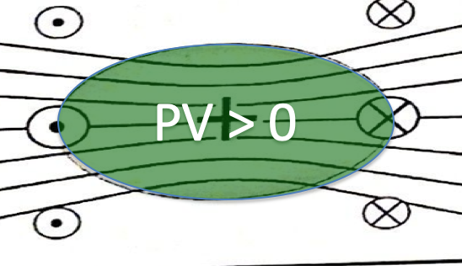
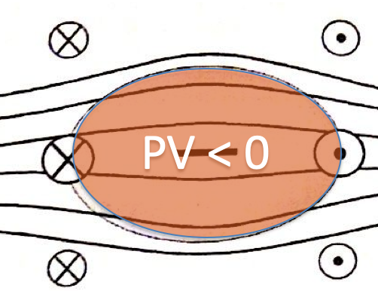
Vorticity (or PV) blobs
Where do they come from?
How do they interact?
(this we studied, in the horizontal plane)
Do they get destroyed?
(Soon: tackling the complications)

Slide 14
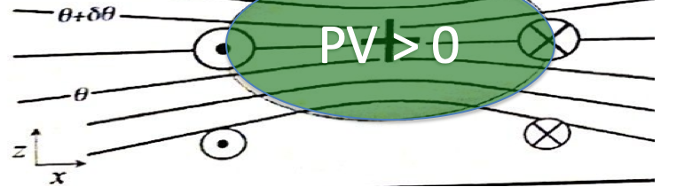
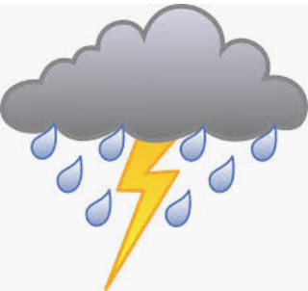

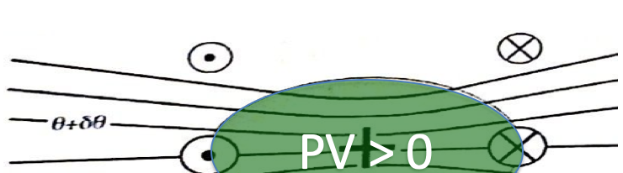
Since our main weather concern is in the lower troposphere (where water is),
This is called a cool core cyclone:
This is called a warm core cyclone:

Slide 15
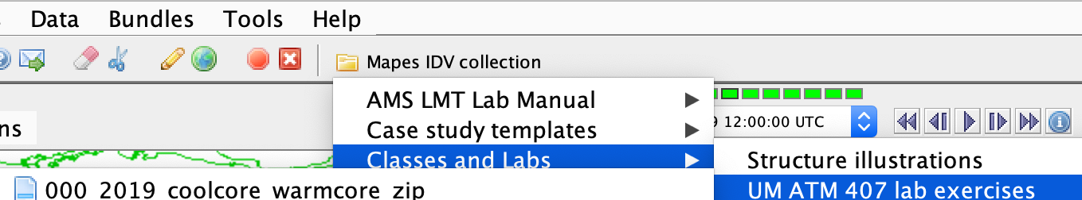
IDV lab assignment -- part 1
Open Mapes IDV → UM ATM407…
0000_coolcore_warmcore…
Explore ALL of its displays, at ALL of its times (loop the animation). Learn to use the IDV. The Help menu has pan-zoom help on top. A mouse is a HUGE help for 3D views.

Slide 16
IDV lab assignment -- part 1
In the following slides, make and label and explain nice clear illustrations like slides 13-17, but for
a warm core anticyclone
a warm core cyclone
a cool core anticyclone

Slide 17
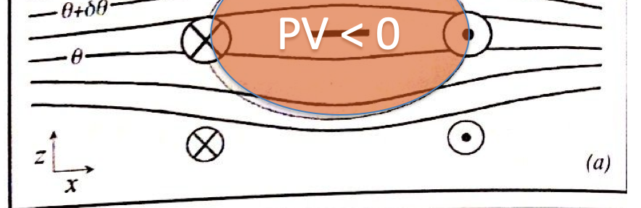
A warm core anticyclone
Where? Describe the situation.

Slide 18
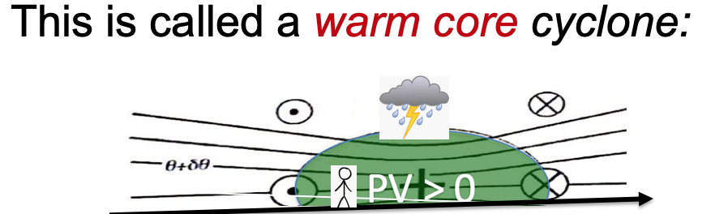
A warm core cyclone
Where? Describe the situation

Slide 19
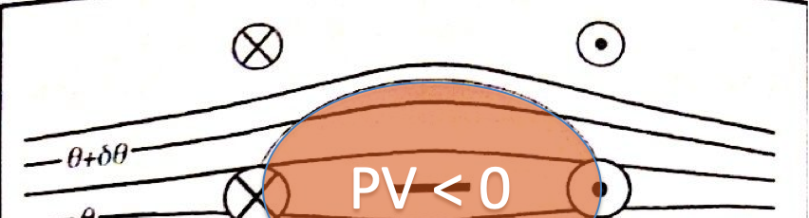
A cool core anticyclone
Where? Describe the situation

Slide 20
Isentropic surfaces
Isentrope contours on the cross sections above are slices of isentropic surfaces
surfaces of constant entropy
or potential temperature, or dry static energy C_{p}T + gz
Let’s learn to see isentropic surfaces
They are almost like material surfaces
because Dθ/Dt = 0 for adiabatic flow
(plus nonadiabatic or “diabatic” complications)
Their vertical motion is air vertical motion!
the holy grail, for clouds+rain (weather)

Slide 21
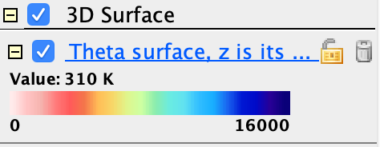

IDV Lab assignment part 2
In the same bundle, activate (check) the display called “Theta surface, z is its color”
Adjust the value (310K, 330K, 360K)
Use vorticity isosurfaces and cross sections in an illustrated description of its topography.
Is there a mean north-south slope? hint:
What vorticity features (Part I) explain dimples?
What vorticity features (Part I) explain peaks?

Slide 22
Mean slope of the 310K isosurface

Slide 23
A depression in the 310K surface Where? Describe the situation

Slide 24
A peak on the 310K isosurface Where? Describe the situation

Slide 25
Mean slope of the 330K isosurface

Slide 26
A depression in the 330K surface

Slide 27
A peak on the 330K isosurface

Slide 28
Mean slope of the 360K isosurface

Slide 29
A depression in the 360K surface

Slide 30
A peak on the 360K isosurface

Slide 31
Use the Print facility of Powerpoint
to put a PDF of this into your class Github repository
so we can look them over in class

