Slide 1
PV is conserved is our strongest statement to explain weather But then where does PV come from?
ATM 405/561
Brian Mapes, Univ of Miami

Slide 2
Outline
Brief review of conservation of PV concept
https://www.notion.so/miamimapes/Horizontal-vorticity-and-PV-as-explanations-for-cyclones-anticyclones-2e6d2c075dba44699dc822ca5748e2e8
Motivated by that, examine diabatic heating profiles with hungry eyes, and explain what you find. Practice telling an illustrated narrative well.

Slide 3
Questions about it
1. Using the concepts from the handout, and earlier homework, explain how patches or elements of relative vorticity advect other patches of relative vorticity, under the assumption that relative vorticity is sorta almost conserved.
2. Using the concepts from the handout, and earlier homework, explain how planetary vorticity is converted to relative vorticity, so that their sum, the absolute vorticity, is almost conserved. Consider a loop of air moving in latitude, and explain how the different Coriolis force felt by its northern and southern side act as a torque on the fluid loop.
3. Using the concepts from the handout, and the reading, explain how static stability is converted to absolute vorticity, so that potential vorticity, their product, which is the essence of vortices (cyclones and anticyclones) is really really almost conserved.
4. Using the concepts from the handout, strategize what you will look for in vertically resolved data about diabatic heating rate in the atmosphere to explain the ultimate source of PV.

Slide 4

Remember absolute vorticity?
Absolute vorticity ζ_{a} = f + ζ_{rel}
Exists from f alone, but the f part can also be converted to actual wind circulation ζ_{rel} whenever air moves toward the equator
It is amplified exponentially by convergence, and relaxed exponentially toward 0 by divergence:

Slide 5

Horizontal convergence also spreads material surfaces apart vertically
So the RATIO PV = -g ζ_{a} (∂θ/∂p) remains unchanged
by horizontal divergence!

Slide 6
PV is conserved -- almost
Here is the key term that generates PV on the Earth
In this lab, you will learn (and show me you learned) about the nature of diabatic heating in the atmosphere.

Slide 7
PV is conserved -- almost
Here is the key term that generates PV on the Earth
We have available T tendencies, not theta tendencies, but can still eyeball the sense of the term above since
For large scale motions, f is most of the absolute vorticity. Therefore, you will estimate/explain:

Slide 8
PV is conserved -- almost
APPROXIMATE term that generates PV on the Earth
Mostly, you are looking for WHERE HEATING RATE INCREASES WITH HEIGHT, WEIGHTED BY f. In both hemispheres… so be careful with ”cyclonic”.

Slide 9
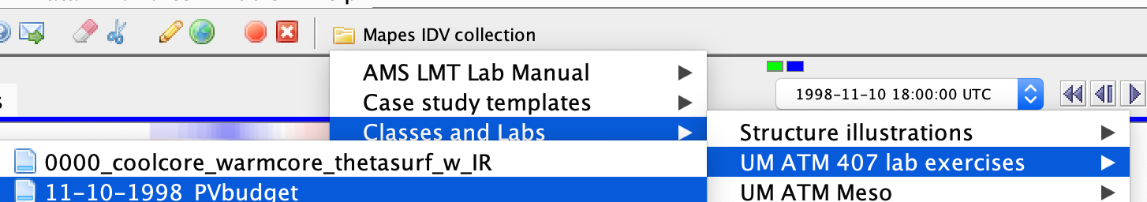
Assignment part 1: global view
Open the bundle 11-10-98 PV budget
Orient yourself to its displays, in both windows
a pole-to-pole transect of the zonal mean heating rates (averaged around the whole Earth)
A map view with many displays.

Slide 10
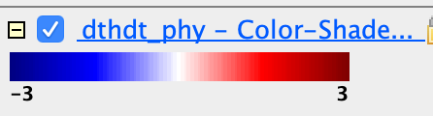
Assignment part 1: global view
What time of year is it? How can you see that fact in the all-physics (diabatic) column-integrated heating rate map dthdt_phy?

Slide 11
Assignment part 1: global view
Now turn to the Transect View window, showing average cross sections all around the Earth. Create a slide showing the transect of diabatic heating. Label it: where is the south pole, the north pole? Hint: Antarctica is mountainous. The units of all heating rates are are K/s. What is the color range in K/day?

Slide 12
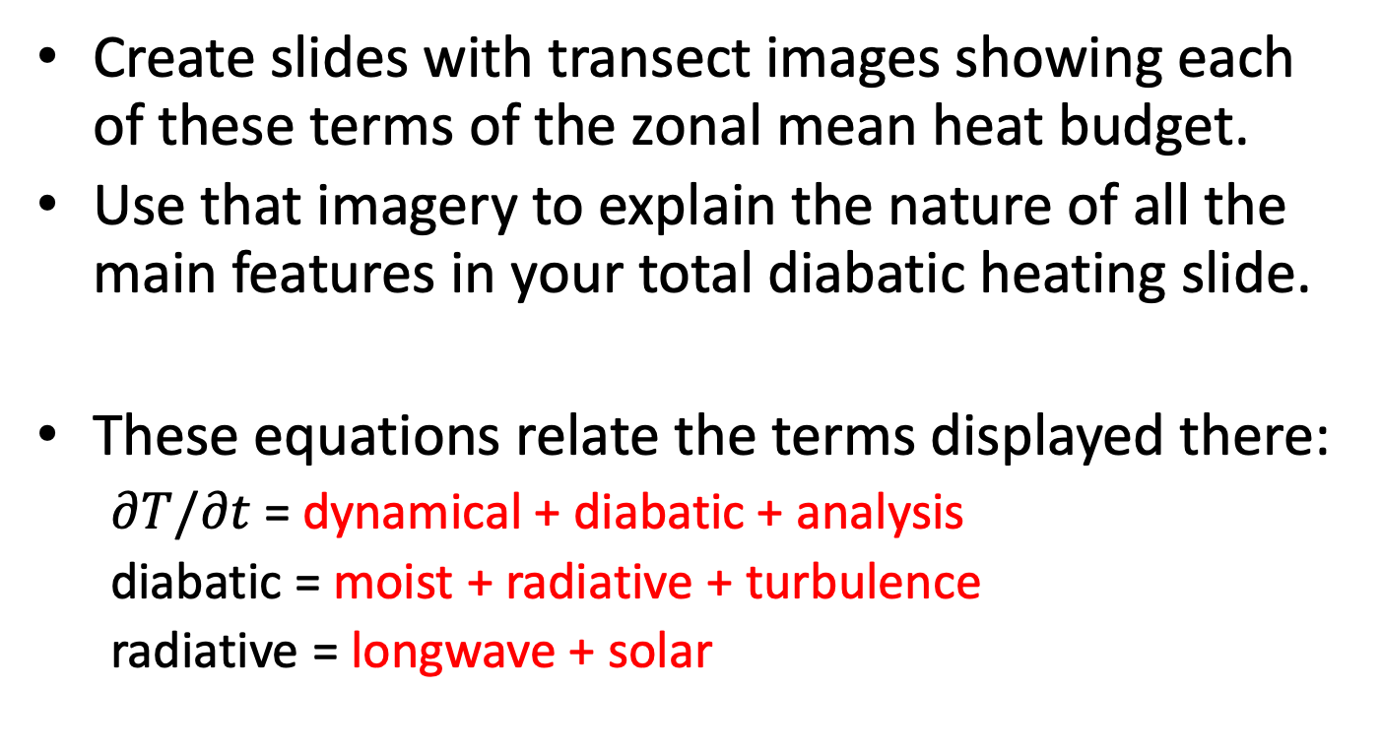
Assignment part 1: global view
Create slides with transect images showing each of these terms of the zonal mean heat budget.
Use that imagery to explain the nature of all the main features in your total diabatic heating slide.
These equations relate the terms displayed there:
$∂T/∂t$ = dynamical + diabatic + analysis
diabatic = moist + radiative + turbulence
radiative = longwave + solar

Slide 13
Assignment part 1: global view
From your total diabatic heating, indicate areas where PV tendency is positive and negative. Also label these areas as cyclonic or anticyclonic tendencies.
Does the PV transect itself resemble areas where your PV tendency is strong?
Is PV mostly contained in the vorticity factor of its product, or the static stability factor? Show and label images to explain your answer.

Slide 14
Assignment part 2: Local view
Now activate the cross section displays in the map view window.
These are like the cross sections you have examined before: you can drag them around to storms or other features
Drag them to north-south positions that slice through tropical and higher latitude weather features that interest you (as seen on the other displays).

Slide 15
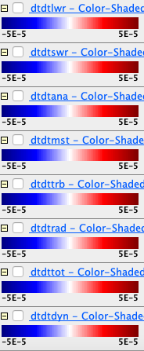
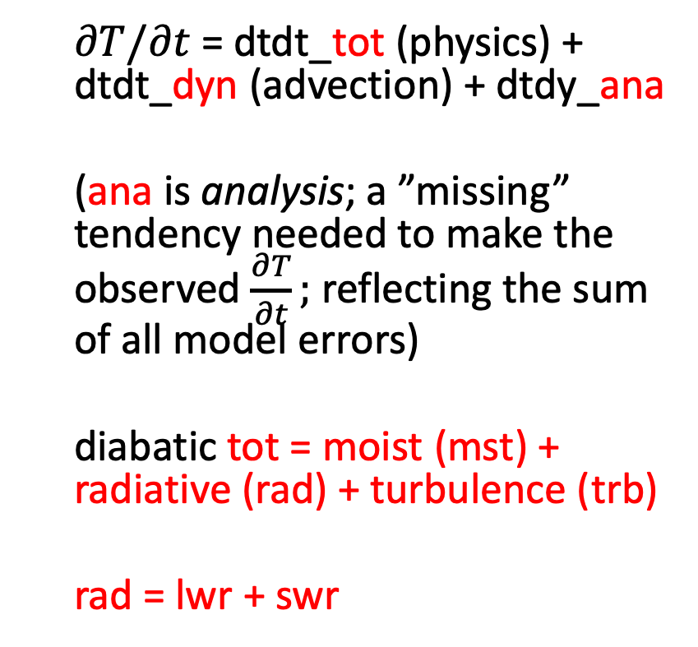
Legend explanation for cross sections
longwave
shortwave
$∂T/∂t$ = dtdt_tot (physics) + dtdt_dyn (advection) + dtdy_ana
(ana is analysis; a ”missing” tendency needed to make the observed $\frac{∂T}{∂t};$ reflecting the sum of all model errors)
diabatic tot = moist (mst) + radiative (rad) + turbulence (trb)
rad = lwr + swr
analysis
(0 for perfect model)
moist mst
(convection & cloud cond. )
turbulence
(PBL)
SW+LW radiation
total physics (”diabatic”)
dynamic (advective)

Slide 16
Assignment part 2: Local view
Make comparison figures between the global average transects and your local cross-sections, and address these questions:
Does the moist heating (condensation related processes) correspond to the high cloudiness you infer from the OLR display?
Does its vertical gradient imply large PV sources in any places relevant to storm-scale PV budgets?

Slide 17
Assignment part 2: Local view
Make comparison figures between the global average transects and your local cross-sections
LW radiation can be understood as water vapor cooling, cloud top cooling, and cloud base warming. Use cloudiness and longwave cross-section images in tandem to show an example of a place where cloud effects are dominant
What do these strong vertical heating gradients imply as a PV source?

Slide 19
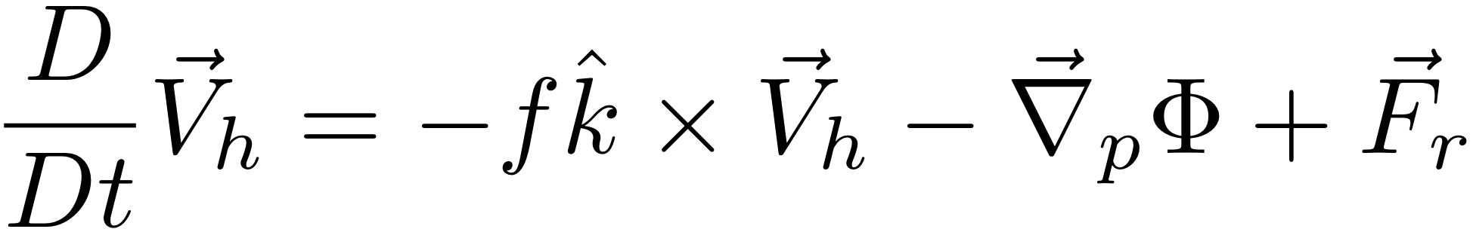
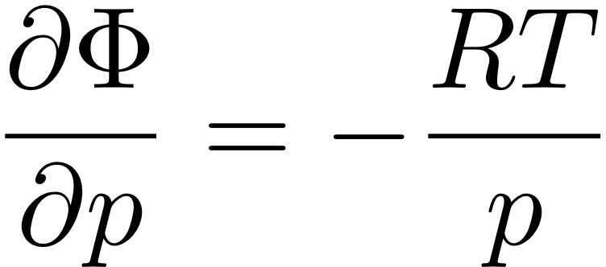


“The Primitive Equations”
(meaning elemental, fundamental)
F=MA in the HORIZONTAL
HYDROSTATIC (w/ ideal gas law to eliminate ρ)
MASS CONSERVATION
FIRST LAW OF THERMO
Notes:
\frac{D}{Dt} \vec V_h = -f \hat k \times \vec V_h - \vec \nabla_p \phi +\vec F_r
\frac {\partial \Phi}{\partial p} = - \alpha \equiv -\frac{1}{\rho}
\alpha = \frac{RT}{p}
\frac {\partial u}{\partial x} + \frac {\partial v}{\partial y} + \frac {\partial \omega}{\partial p} = 0
\frac {D_hT}{Dt} + S_p \omega = J/C_p

Slide 20
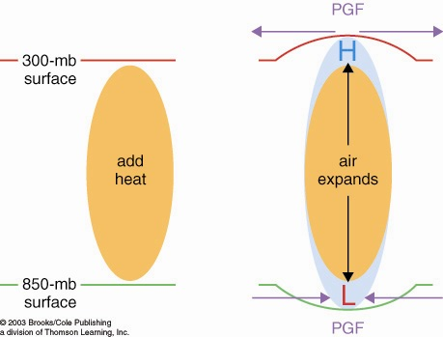
How heated air rises and a warm core vortex develops: the Primitive Equation view. 7 logical steps
1. Warmed column of air gets thicker
2. Air accelerates
due to PGF
2. Air accelerates
due to PGF
1. 200 mb
surface
bulges
upward
0. Heating (maybe latent heating by condensation in a patch
of convection over warm water someplace)

Slide 21
How heated air rises and a warm core vortex develops: the Primitive Equation view. 7 logical steps
3. Mass removal and 4. surface pressure drop
3. Mass removed
from column
3. Mass removed
from column
4. less mass of air in column
= lower surface pressure
L

Slide 22
How heated air rises and a warm core vortex develops: the Primitive Equation view. 7 logical steps
5. Low level inflow accelerates, 6. heated air rises
6. warm
air
rises!
5. Air accelerates
due to PGF
5. Air accelerates
due to PGF

Slide 23
How heated air rises and a warm core vortex develops: the Primitive Equation view. 7 logical steps
ANTI
CYCLONIC
Warm
Core
Vortex
CYCLONIC
FLOW
7. Coriolis turns flow to right

Slide 24
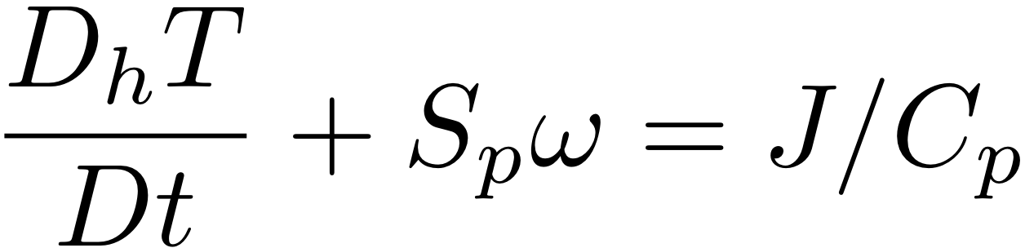
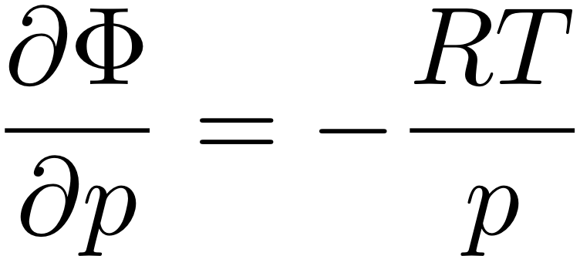
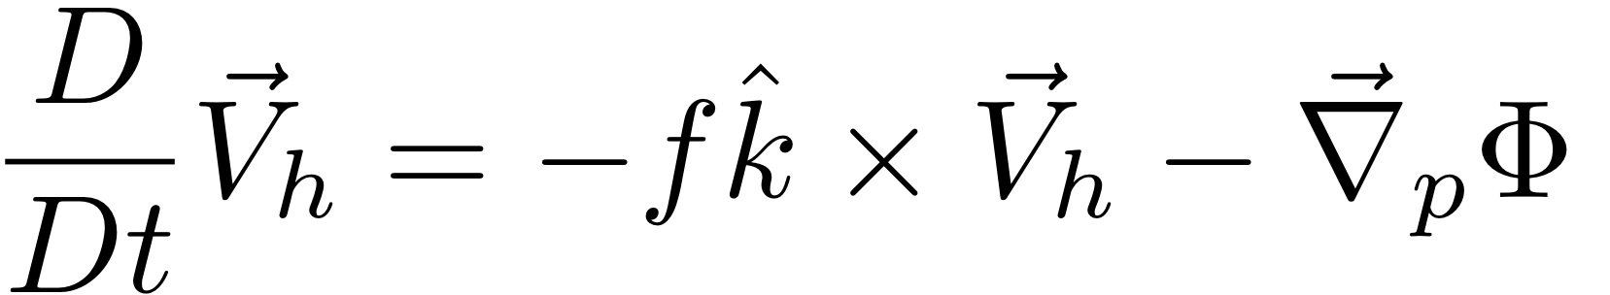
HW: use The Primitive Equations to compute how a local heating J drives flow in an initially motionless atmosphere
J causes T to increase
net change of T =
amount of heat added/Cp
2. Warmer T causes increased thickness of the heated column
3. High Φ over hot column pushes wind outward
4. Surface pressure drops (remember, omega = Dp/Dt; Holton eq. 3.44)
Notes:
Homework 5, MSC 405. Due Thursday, April 13
This problem set walks through the heated-air-rising process above, for a 100 km patch of latent heating in an initially motionless atmosphere.
ALL ANSWERS MUST HAVE UNITS, BUT NUMBERS CAN BE SIMPLE ROUGH ESTIMATES.
Suppose the heating J corresponds to the latent heat released during 1cm of rain over a 100km x 100km area. Let’s figure out how much ΔT that causes.
What is the volume of water condensed (m³)?
What is the mass of water condensed (kg)?
How much latent heat is released (Joules)? (L = 2.5 x 10⁶ J per kg of water).
How many kg of air are in a 1 square meter column of atmosphere, if surface pressure p is 1000mb? M=p/g
How many kg of air are therefore in a 100km x 100km column?
If Cp = 1000 J/(kg K), by how many K can the heat from c. warm the air mass from e.?

Slide 25
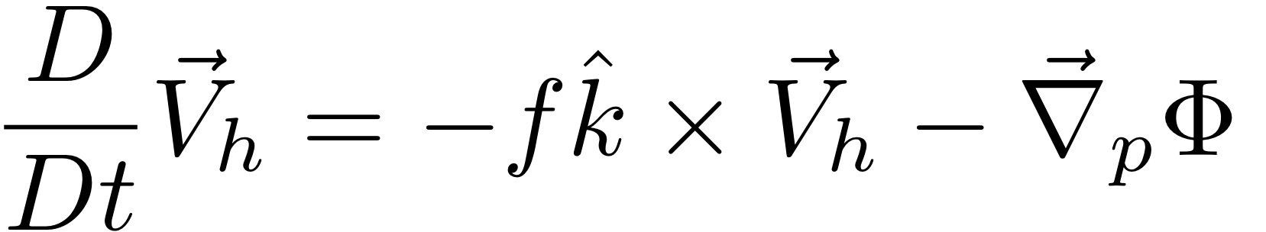
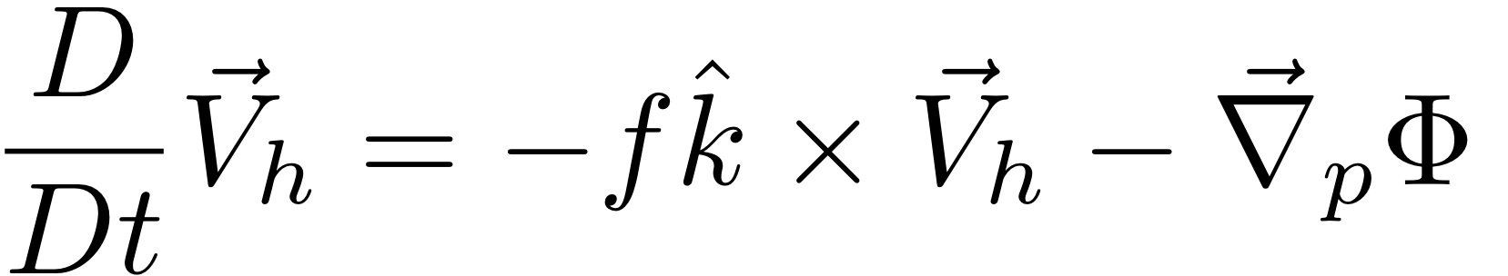
HW: use The Primitive Equations to compute how a local heating J drives flow in an initially motionless atmosphere
5. Low Φ under hot column pulls wind inward
6. Hot air rises (finally!)
ω =~ ρgw
7. Coriolis force turns inflowing and outflowing air to make round-and-round flow
Notes:
Homework 5, MSC 405. Due Thursday, April 12
This problem set walks through the sequential process above, for a 100 km patch of latent heating in an initially motionless atmosphere.
ALL ANSWERS MUST HAVE UNITS, BUT NUMBERS SHOULD BE ROUGH: 1-2 SIGNIFICANT DIGITS.
Suppose the heating J corresponds to the latent heat released during 1cm of rain over a 100km x 100km area. Let’s figure out how much ΔT that causes.
What is the volume of water condensed (m³)? (1 point)
What is the mass of water condensed (kg)? (1 point)
How much latent heat is released (Joules)? (1pt) (L = 2.5 x 10⁶ J per kg of water).
How many kg of air are in a 1 square meter column of atmosphere, if surface pressure p is 1000mb? M=p/g (1)
How many kg of air are therefore in a 100km x 100km column? (1)
If Cp = 1000 J/(kg K), by how many K can the heat from c. warm the air mass from e.? (1)

Slide 26
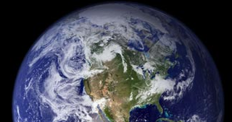
How cooled air sinks and a cool core vortex develops:
the Primitive Equation view. 7 logical steps
1. Cooled column of air gets thinner
2. Air accelerates
due to PGF
2. Air accelerates
due to PGF
200 mb
surface
IR cooling
cold
air
1. 200 mb
surface
bulges
downward

Slide 27
How cooled air sinks and a cool core vortex develops:
the Primitive Equation view. 7 logical steps
3. Mass drawn in
to column
3. Mass drawn in
to column
L
4. more mass of air in column
= higher surface pressure
H

Slide 28
How cooled air sinks and a cool core vortex develops:
the Primitive Equation view. 7 logical steps
L
6. Cold air sinks
5. Air accelerates
due to PGF
5. Air accelerates
due to PGF
H

Slide 29
How cooled air sinks and a cool core vortex develops:
7. Coriolis force turns the winds
L
CYCLONIC
FLOW
Cool
core
Vortex
ANTI
H
CYCLONIC

Slide 30
The geostrophically balanced polar vortex:
The Coriolis force on the westerly jet stream
prevents cold pool of Arctic air from sinking down
and covering the whole Northern Hemisphere
L
Cor.
PGF
PGF
Cor
Heavy cold air
would like to sink
if it could
H

Slide 31
Polar and stratospheric "Reservoirs" of ζ_{a} or PV
Potential vorticity: PV = -g ζ_{a} (∂θ/∂p)
The polar latitudes, where f is large, are a "reservoir" of high PV even when there is no wind!
The stratosphere where (∂θ/∂p) is large is a "reservoir" of PV even when there is no wind!
When tentacles or pieces of the polar & stratospheric PIZZA or OCTOPUS of PV stretch or break off into the midlatitudes, they become our upper-tropospheric synoptic cyclones.

Slide 33
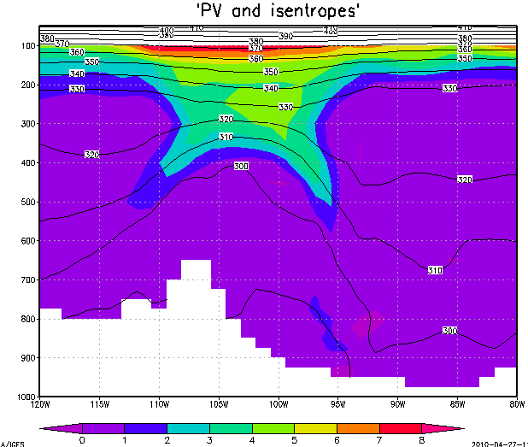
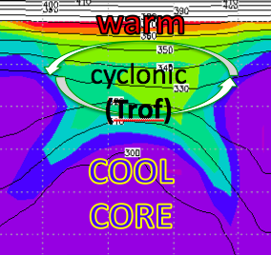
Unsheared advection of T, u, v, vort, PV:
no breaking of balance
warm
cyclonic
(Trof)
COOL
CORE

Slide 34
Sheared advection breaks thermal wind balance
Coriolis force
COOL
CORE
Z Trof

Slide 35
Sheared advection breaks thermal wind balance
imbalanced force = acceleration
COOL
CORE
Z Trof
L

Slide 36
Sheared advection breaks thermal wind balance
imbalanced force = acceleration
COOL
CORE
Z Trof
L

Slide 37
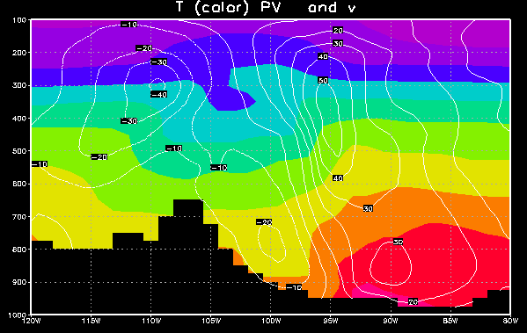
But there is some T advection too
cool air flowing south
warm air flowing north
L

Slide 38
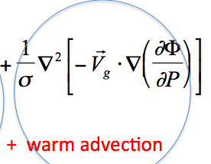
But there is some T advection too
Upward motion ~
cool air flowing south
warm air flowing north
L

Slide 39
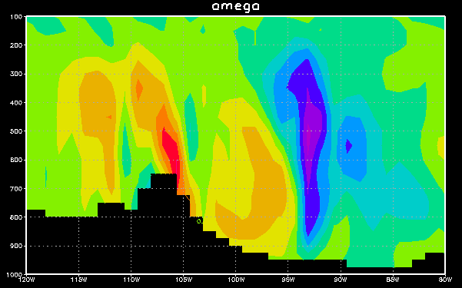
East-west section: omega

