Slide 1
Game playing of decision support for continuously weather-sensitive enterprises (spoonful of sugar for data analysis skills)
Brian Mapes
Rosenstiel school of marine and atmospheric science, U of Miami

Slide 2
My path to here
Lover of data & analysis, especially today’s clean free Ju-Py world
Had been teaching PhD/research oriented Applied Data Analysis
Epistemological puzzles: EOFs, spectra, regression, ‘significance’ (credence)
One-year MPS credential changes graduate course landscape
Students taking many class credit$ -- not to ponder such ‘puzzles’ !
But some modern data analysis training very much wanted

Slide 3
Daydreaming a new course…
Highest level, cleanest possible programming/analysis
parsing & lightly editing already-working codes
with plenty of blue-sky project possibilities… shading into research…
Motivation+evaluation are the pain of teaching: try overt game-play!
and in teams: social fun as motivation, “cooper-tition” spirit
Social relevance: I’m not actually against it, here in my ivory tower…

Slide 4
Course-level structure
3-4 “modules” of 3-4 weeks, different business sector + season details
for generality; & can course-correct/redesign if 1st module is lame
Realistic weather unspooled by instructor
real or slightly accelerated rate (days, weeks)?
fake details: forecast archive sets with spoofed yyyy metadata
students must learn to analyze & forecast from the data, not websites
Classroom meetings, say 3 days a week for an hour

Slide 5
Course-level structure
Classroom meetings, say 3 days a week for an hour
teams tally their $core$ from weather verification data (Jupyter notebook)
view forecasts for next meeting, adjust preparations (which feed into 1.)
some class time left for explanations, presentations, discussions, debriefs…
Evaluations:
yes, team’s business $score (taste of competition, teamwork/shared outcomes)
anonymized team evaluations of its members (soft skills, participation)
R&D projects: explore strategies with archival data and same scoring code
geographic portfolio hedging, add climate offsets, toggle insurance (to estimate its correct price), compare climatology/persistence to forecasts, downscaling, etc. etc.

Slide 6
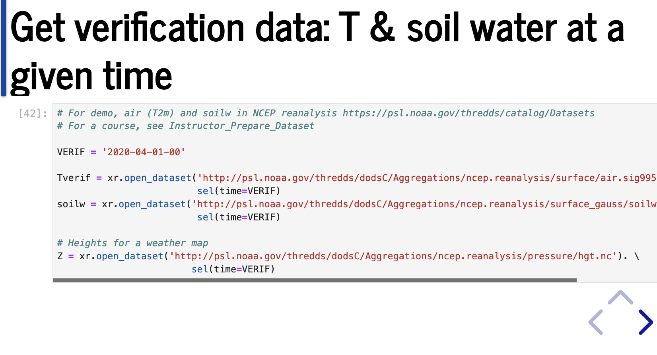
Details: it’s all about the code base…

Slide 7
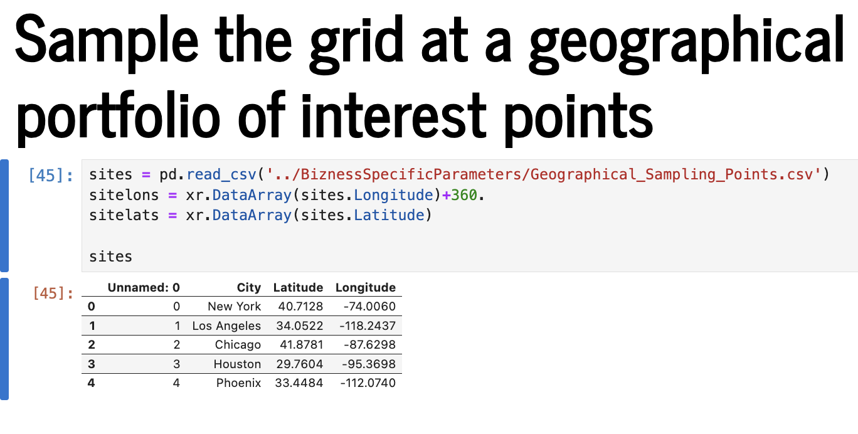
Details: it’s all about the code base…

Slide 8
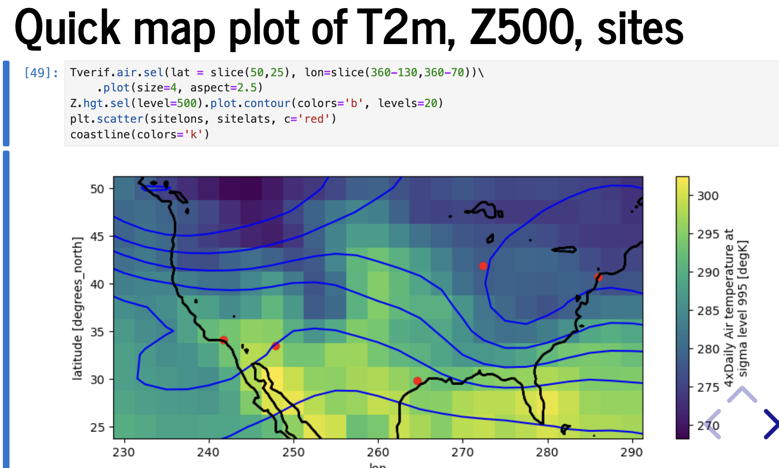
Details: it’s all about the code base…

Slide 9
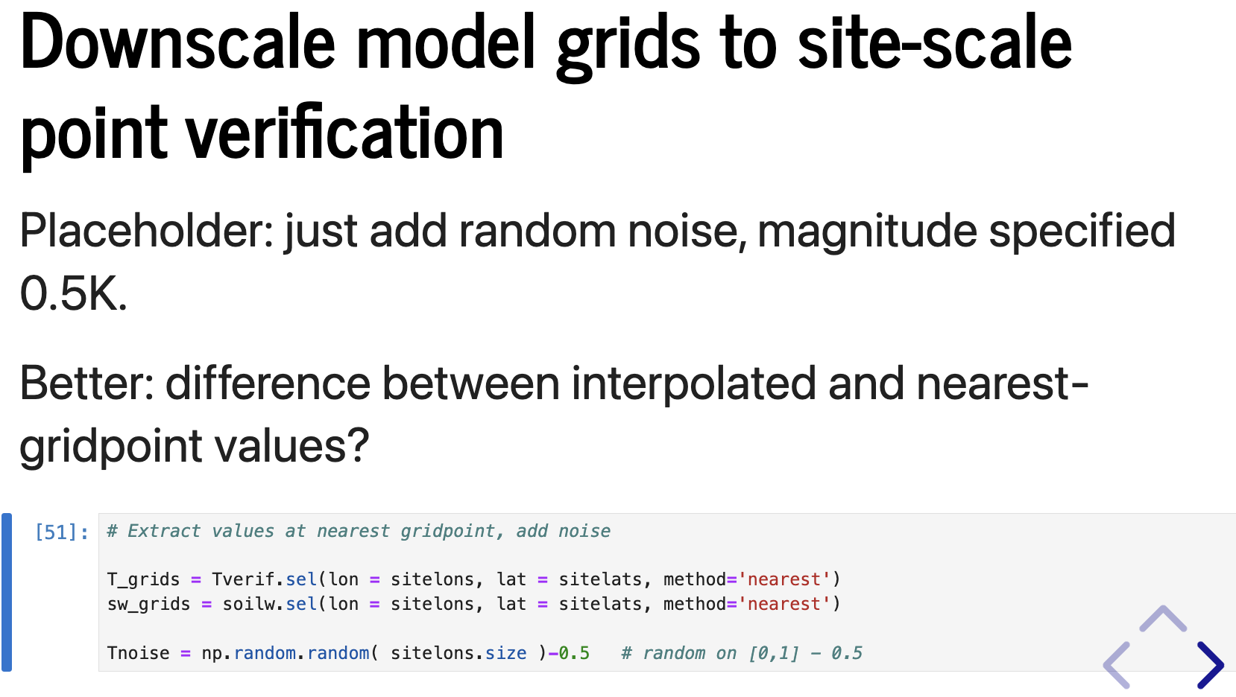
Details: it’s all about the code base…

Slide 10
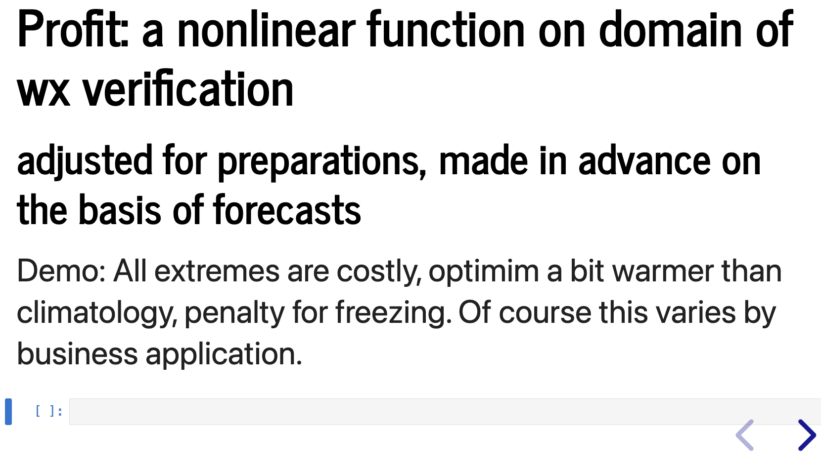
Details: it’s all about the code base…

Slide 11
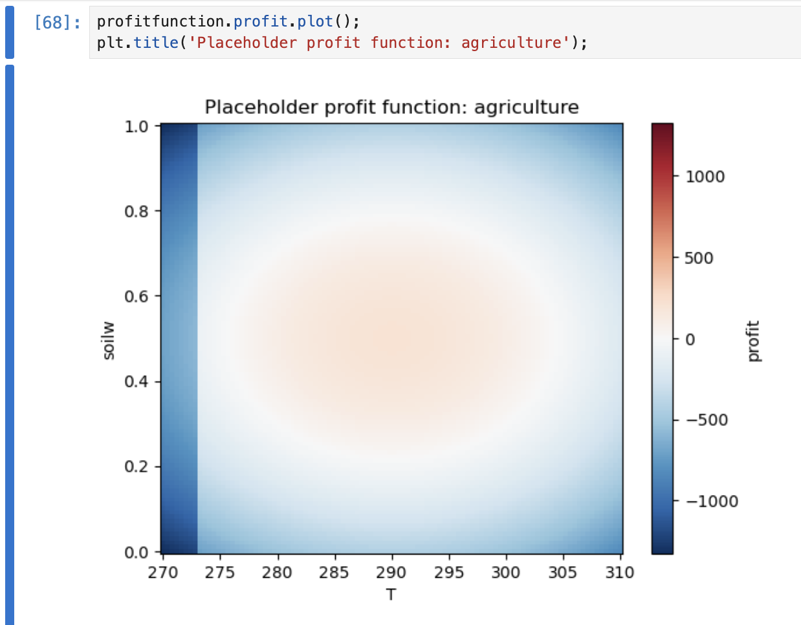
Details: it’s all about the code base…

Slide 12
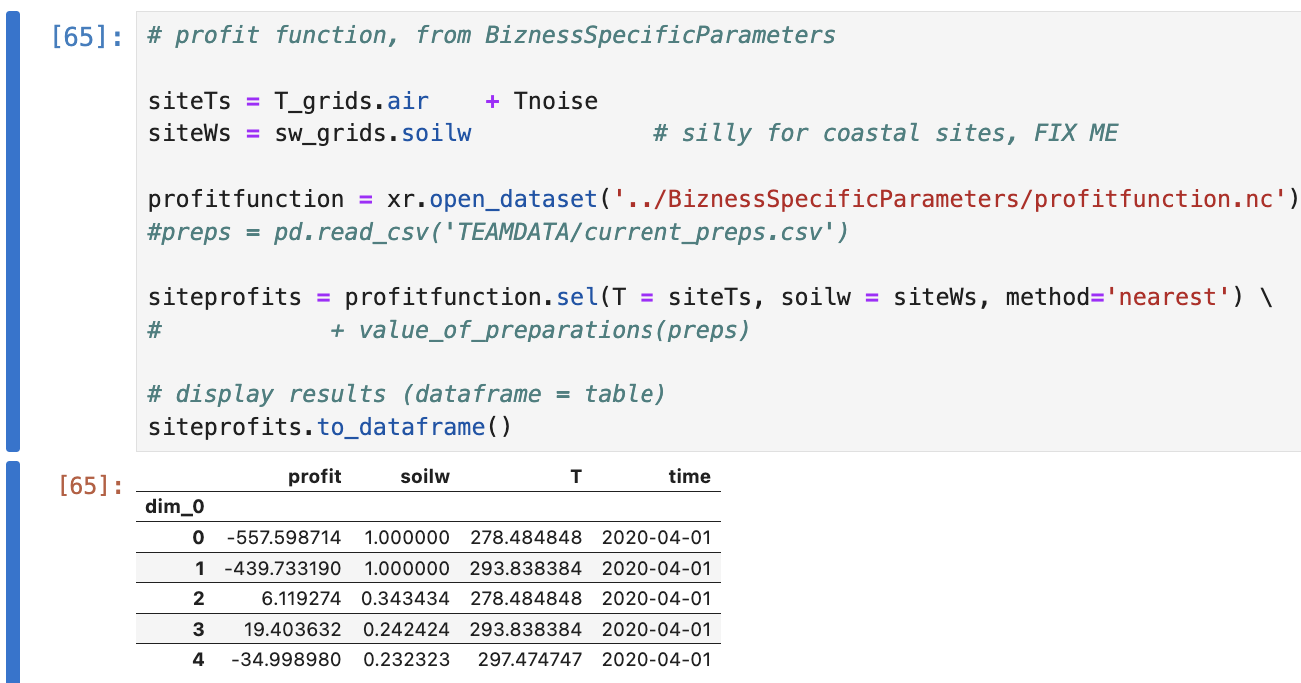
Details: it’s all about the code base…

Slide 13
A true entrepreneur here
Started a company, MindTheGap.com
Hired sales and copyright law teams
Franchise licenses available

Slide 14
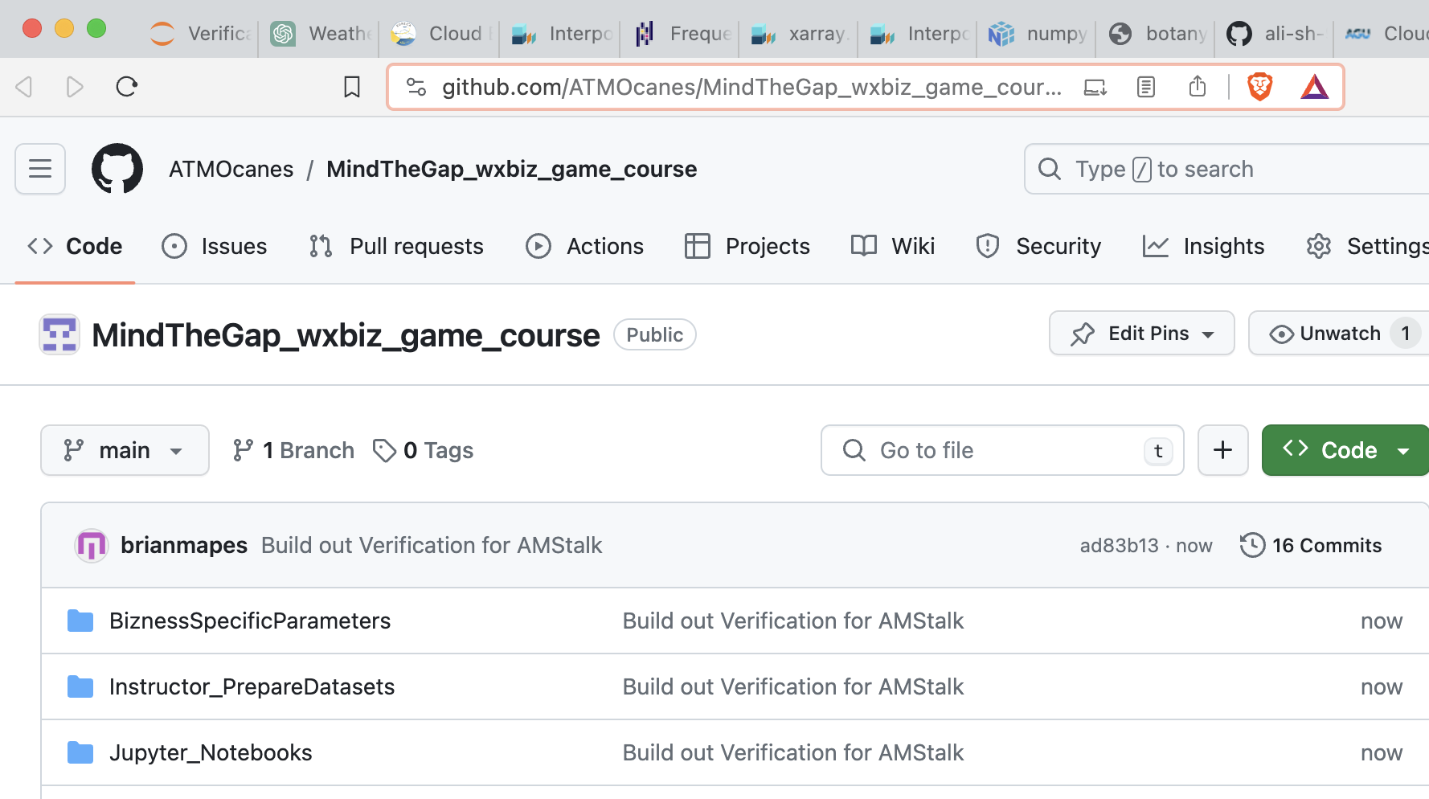
Just kidding! Total impostor… it’s all free
https://github.com/ATMOcanes/ MindTheGap_wxbiz_game_course

Slide 15
A game-based course idea
Course description in syllabus: it is a daydream, never tried, but some (untested) structural details will be offered.
After an initial game play session with shuffled cards and timers, to illustrate the core structure of decision options and outcome scoring, student teams will play out a set of similarly-structured 3-4 week time blocks with game details based on different weather-sensitive business sector scenarios (agriculture, transport/logistics, energy, insurance, etc.). In these games, weather forecast data sets from GFS archives will be progressively unveiled on an actual week-by-week timeline, through crucial seasons but probably not including the drama of disasters. Data will be drawn from secret years so that players cannot easily peek ahead at the actual weather that verified. Codes will be provided for weather data analysis access, and plausible cost-loss model computations or truth tables expressing how strategic decisions, preparations, and weather variables to define daily and weekly profits and losses. Besides participating and playing each class session's decision cycle, class will include student presentations of the results of strategic research explorations. Specifically, each student will do one or more in-depth project in which they consult published literature, or express the game's sensitivity to tweaks of the weather data (e.g. downscaling from grids), or using other-years or ensemble data archives, or tweaks to the business model code notebooks, etc. Students will be randomly assigned to teams of 2-4, shuffled for each block or game scenario. Different geographical footprints for different firms or portfolios may make each team's situation slightly different, such that competition is not zero-sum or adversarial. An independent study week between each intensive block will provide students time to evaluate and report on outcomes, prepare for the next block, and work on a research project. A final presentation/report on lessons learned, along with anonymized teammate evaluations of individuals' contributions, will determine student ranking... with a little bit of reward (and prestige, perhaps small recognition prizes) for strategic success in the games' scores of course

