Slide 1
Game playing of decision support for continuously weather-sensitive enterprises (a spoonful of sugar for data analysis skills)
Brian Mapes
Rosenstiel school of marine atmospheric & earth science
University of Miami

Slide 2
My path to this Mind The Gap session
Lover of data & analysis, esp. new clean free Ju-Py world
Formerly taught PhD/research oriented Applied Data Analysis
Epistemological puzzles: EOFs, spectra, regression, ‘significance’ (credence)
One-year MPS program changed graduate course landscape
MPS students taking many class credit$ -- and not to ponder ‘puzzles’ !
Some modern data analysis training very much wanted, though

Slide 3
Daydreaming a new course…
High-level, clean Jupyter notebooks of analysis code
students parse & lightly edit, never start from scratch
blue-sky project possibilities… shading into research…
Motivation+evaluation are the pain of teaching: try game-play!
teams: social fun as motivation, “cooper-tition” spirit to bettering
Social relevance/ $ : I’m not against it, here in my ivory tower…

Slide 4
Course-level structure notions
3-4 “modules” of 3-4 weeks, different business sectors + seasons
agriculture, transport/logistics, energy, etc.
Realistic weather data, unspooled by instructor
at real or slightly accelerated rate: synoptic timescale fits decisions
fake details: forecast archive sets with spoofed yyyy metadata
students must learn to analyze & forecast from the data, not websites
Classroom meetings, say 3 days a week for an hour

Slide 5
Course-level structure notions
say, 3 days a week for an hour
teams tally profit/loss from wx verification data
adjust preparations/portfolio based on forecasts & research
(explanations, discussions, debriefs, guest lectures…)

Slide 6
Course-level structure notions
Student performance evaluation:
(shuffled) teams’ profit-loss (taste of competition, teamwork)
anonymized, mediated team evals of members (‘soft skills’…)
R&D: explore strategies w/ archival data & profilt model
adjust geographic portfolio of sites: optimizing, hedging
add climate-scenario offsets, how will it change outcomes?
price modeling for insurance
value of forecast data-fussing vs. simple climatology/persistence
downscaling impacts research, … etc. etc.

Slide 7
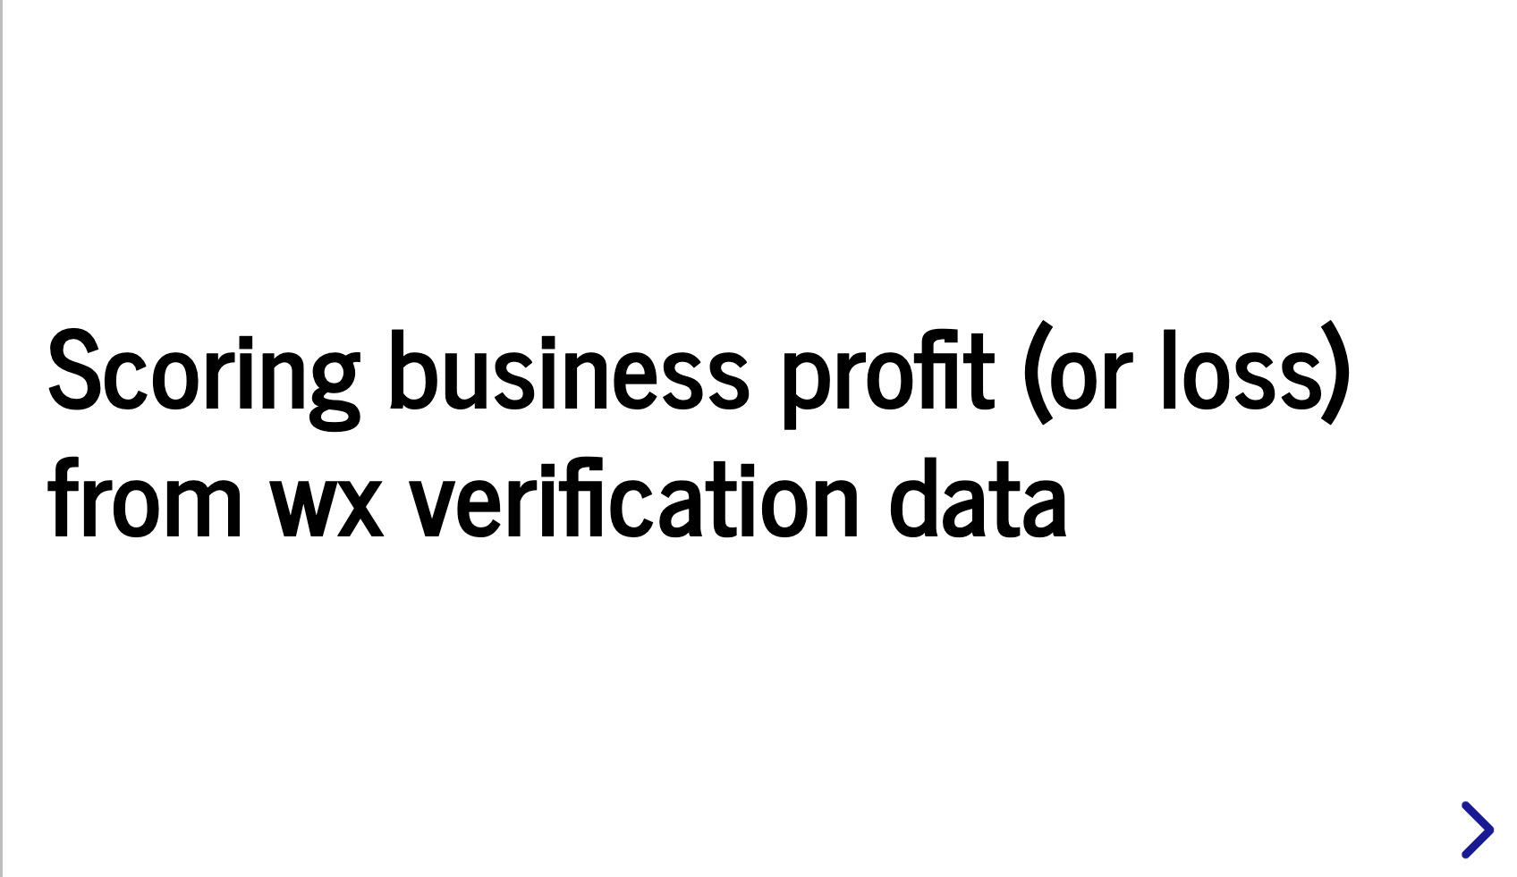
Details: it’s all about the code base…

Slide 8
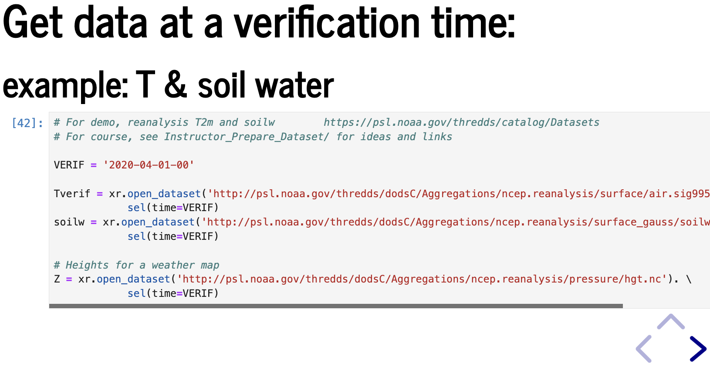
Details: it’s all about the code base…

Slide 9
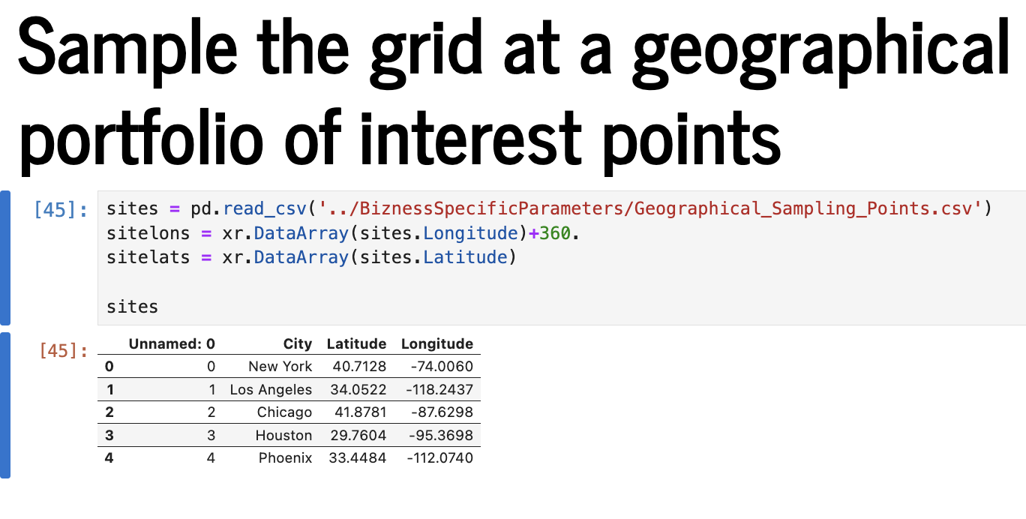
Details: it’s all about the code base…

Slide 10
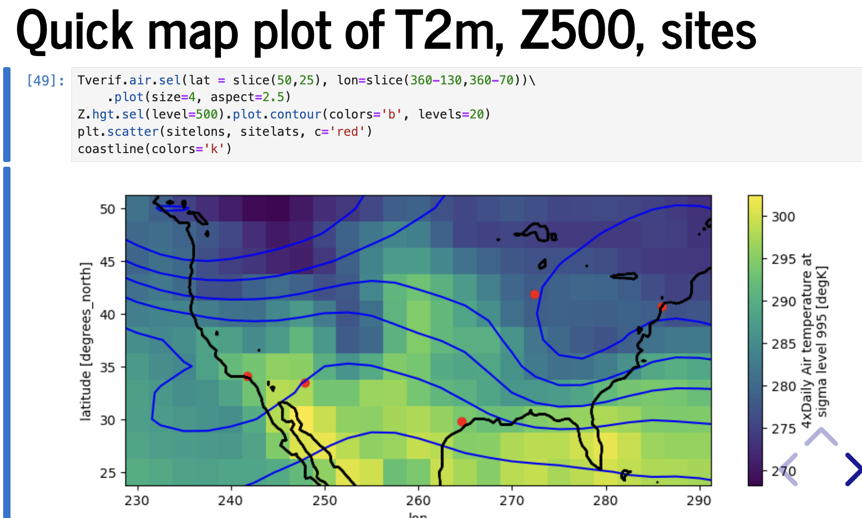
Details: it’s all about the code base…

Slide 11
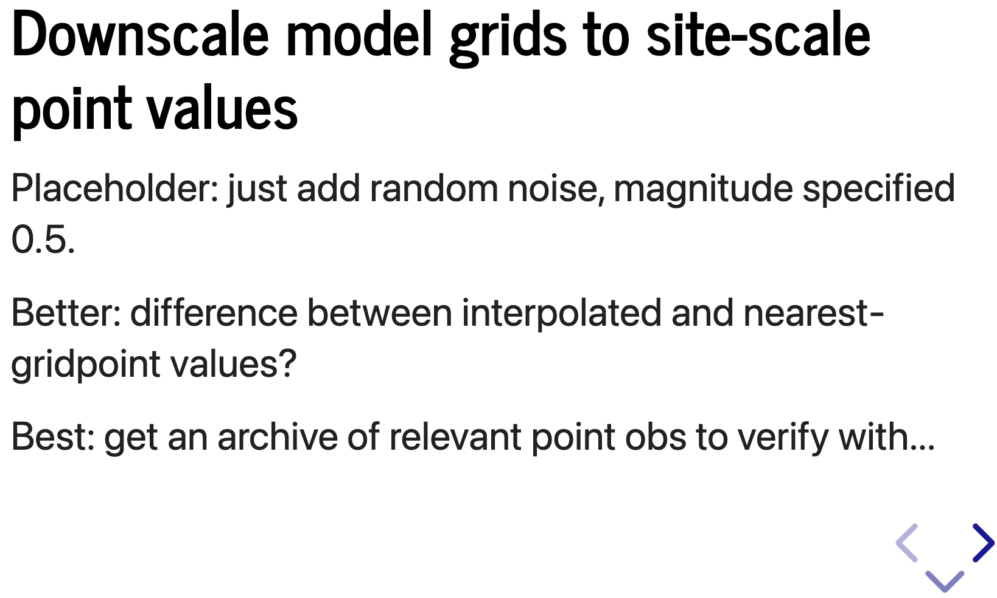
Details: it’s all about the code base…

Slide 12
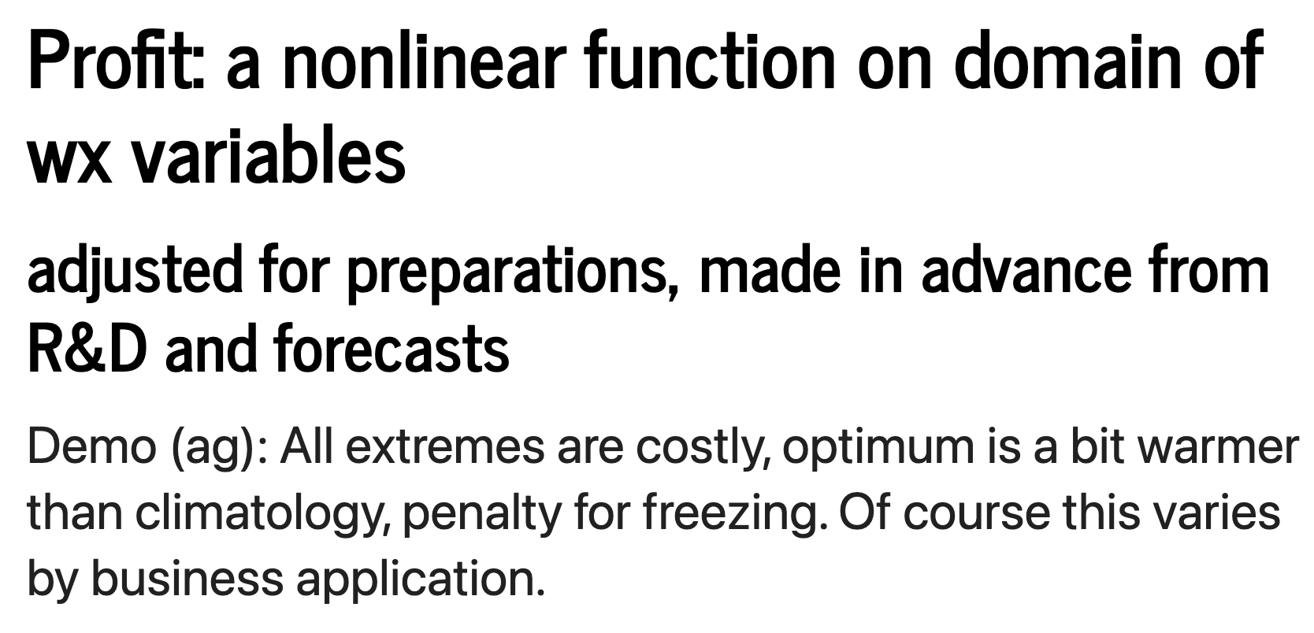
Details: it’s all about the code base…

Slide 13
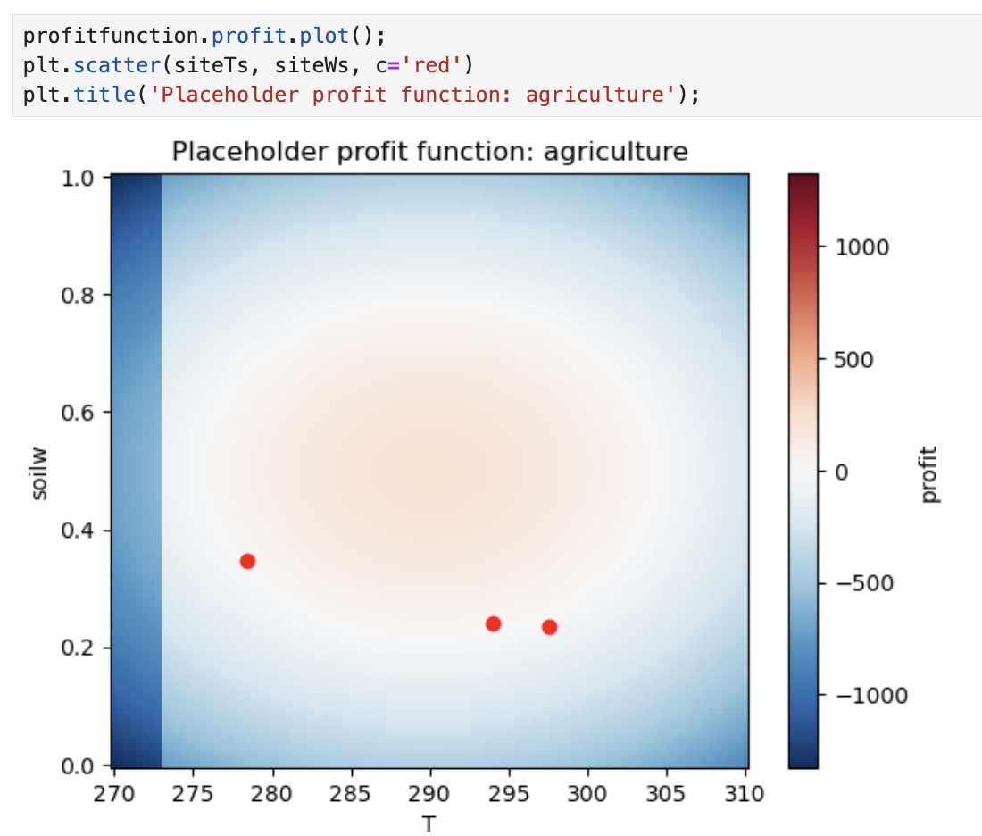
Use insurance to clip losses
But at a cost…

Slide 14
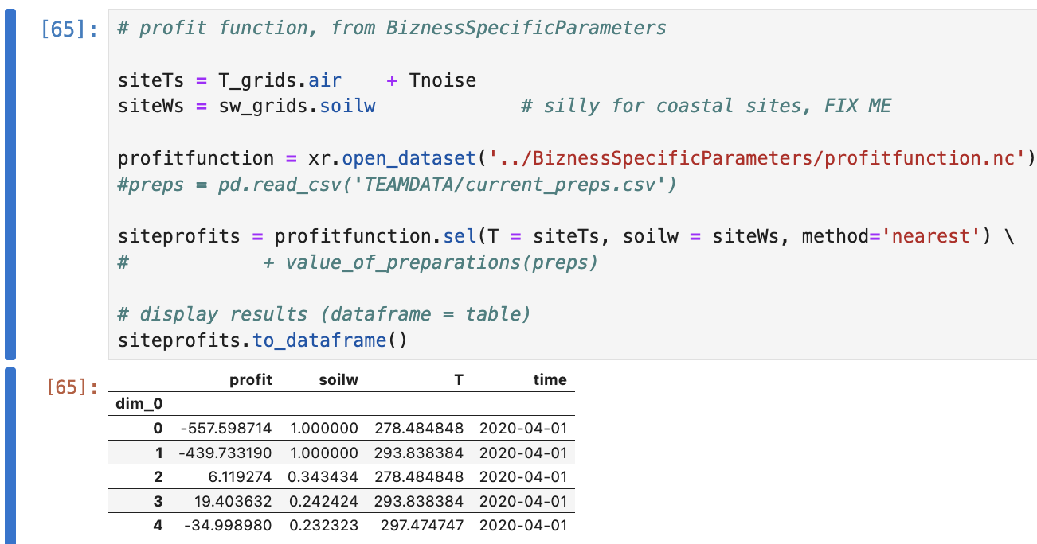
Details: it’s all about the code base…

Slide 15
Fun with shuffled teams… needs big class… hey, why not franchise, interschool?
Basically another forecast contest
but with a score in $, based on an application
A plug-and-play ‘franchise’ course for busy faculty, with automated/standardized evals?
Suitable for comparative pedagogy research?
curriculum gatekeepers love that sort of thing…

Slide 16
A true entrepreneur here
Started a company, MindTheGap.com
Hired sales & copyright defense teams
Franchise licenses available, ask after

Slide 17
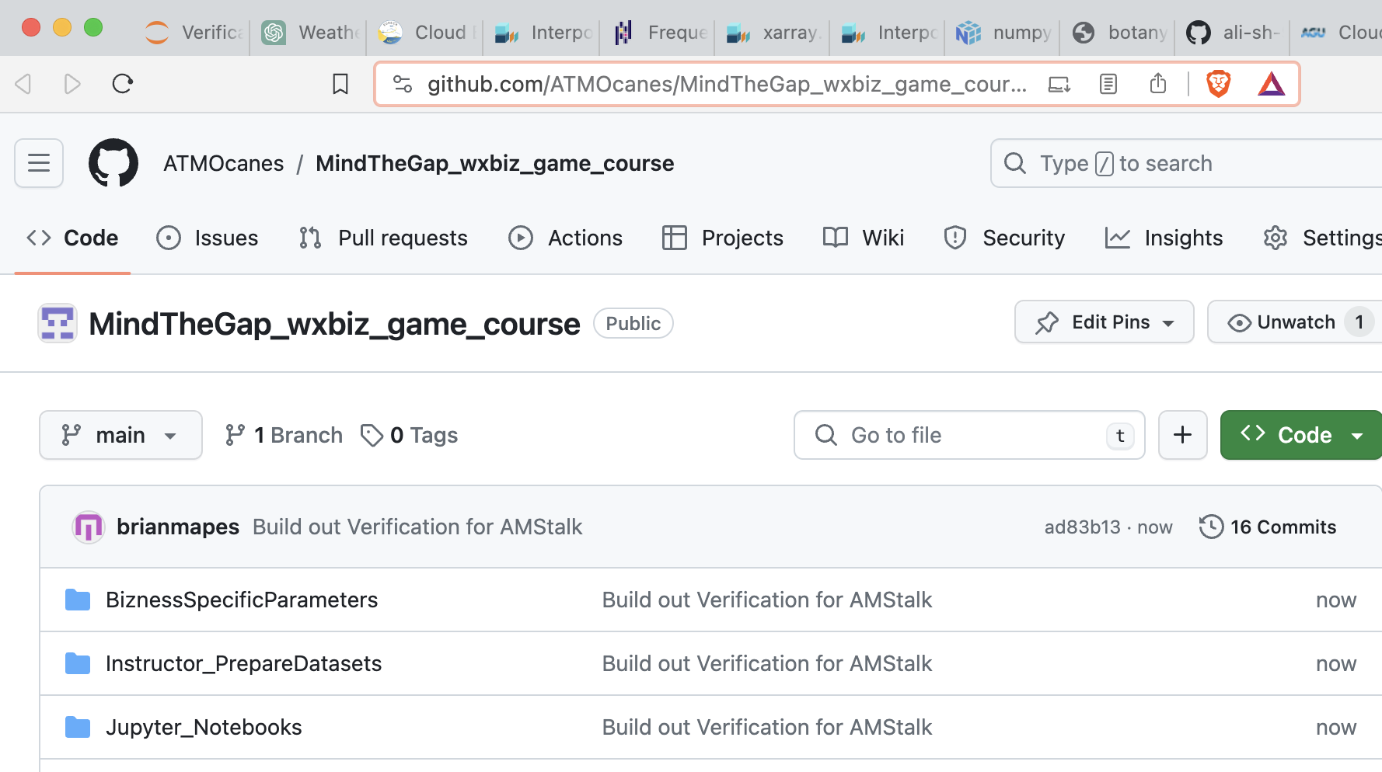
Just kidding! Total impostor… it’s all free…
https://github.com/ATMOcanes/ MindTheGap_wxbiz_game_course

Slide 18
Summary
A lazy impostor daydreamed a course with motivations & evaluation basically automatic
after prep. of datasets & rules & codes (FUN)
got as far as a skeleton of code notebooks…
https://github.com/ATMOcanes/ MindTheGap_wxbiz_game_course
I realistically won’t do this alone at my small U
happy to brainstorm/collaborate with more energetic colleagues at bigger schools if any appear: mapes@miami.edu

Slide 19
A game-based course idea
Course description in syllabus: it is a daydream, never tried, but some (untested) structural details will be offered.
After an initial game play session with shuffled cards and timers, to illustrate the core structure of decision options and outcome scoring, student teams will play out a set of similarly-structured 3-4 week time blocks with game details based on different weather-sensitive business sector scenarios (agriculture, transport/logistics, energy, insurance, etc.). In these games, weather forecast data sets from GFS archives will be progressively unveiled on an actual week-by-week timeline, through crucial seasons but probably not including the drama of disasters. Data will be drawn from secret years so that players cannot easily peek ahead at the actual weather that verified. Codes will be provided for weather data analysis access, and plausible cost-loss model computations or truth tables expressing how strategic decisions, preparations, and weather variables to define daily and weekly profits and losses. Besides participating and playing each class session's decision cycle, class will include student presentations of the results of strategic research explorations. Specifically, each student will do one or more in-depth project in which they consult published literature, or express the game's sensitivity to tweaks of the weather data (e.g. downscaling from grids), or using other-years or ensemble data archives, or tweaks to the business model code notebooks, etc. Students will be randomly assigned to teams of 2-4, shuffled for each block or game scenario. Different geographical footprints for different firms or portfolios may make each team's situation slightly different, such that competition is not zero-sum or adversarial. An independent study week between each intensive block will provide students time to evaluate and report on outcomes, prepare for the next block, and work on a research project. A final presentation/report on lessons learned, along with anonymized teammate evaluations of individuals' contributions, will determine student ranking... with a little bit of reward (and prestige, perhaps small recognition prizes) for strategic success in the games' scores of course

