Slide 1

Handoff NYC
AI care plans for multilingual families after hospital discharge
AI Software Track
AI for Health & Public Good
Pirtom Shil Supta • Rahat Hossain • Israel Pina

Slide 2

Handoff NYC
The discharge gap starts at the hospital door
Families leave with instructions they are responsible for—but may not understand.
•
Discharge paperwork is often long, technical, and hard to scan.
•
Caregivers may not speak English or have medical training.
•
Medication timing, red flags, and follow-up steps can be missed.
•
The result is stress, confusion, and avoidable risk at home.
Our focus: turn paperwork into a caregiver-ready care plan.
AI Innovation Challenge • 2

Slide 3

Handoff NYC
A CUNY student caregiver needs clarity—fast
The product is built around one realistic, local user story.
USER JOURNEY
A CUNY student caring for their grandmother after a hospital visit needs a translated and simplified care plan so they can understand medications, warning signs, and follow-up appointments without medical training.
The winning demo should make this story obvious in 30 seconds.
AI Innovation Challenge • 3

Slide 4
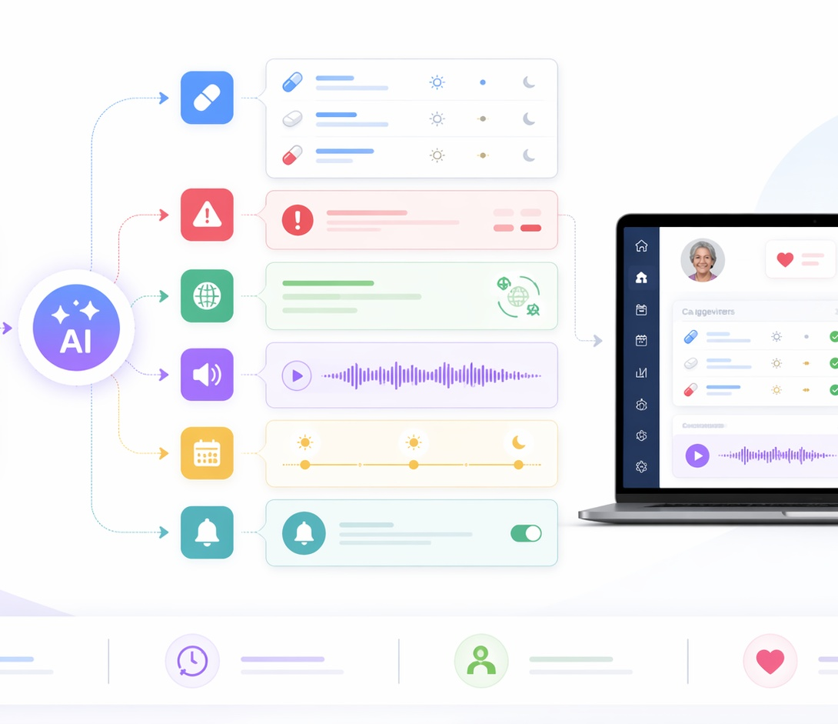
Handoff NYC
From discharge PDF to care plan
A single AI workflow transforms confusing hospital paperwork into an accessible, multilingual, voice-enabled plan.
1
Upload a synthetic discharge document
2
AI extracts meds, instructions, red flags
3
Translate + simplify for the caregiver
4
Play audio briefing + show review flags
AI Innovation Challenge • 4

Slide 5
Handoff NYC
MVP: small enough to finish, strong enough to win
P0 features are focused on the core demo flow.
📄
Upload
🧠
Extract
🌍
Translate
Synthetic discharge PDF or image
Medications, care tasks, red flags, contacts
At least 2–3 demo languages
🔊
Audio
⚠️
Safety
✅
Reminders
Spoken caregiver briefing
Confidence labels + review flags
Medication and follow-up checklist
AI Innovation Challenge • 5

Slide 6
Handoff NYC
AI is doing work the user cannot do manually
The system is more than a chatbot: it chains multiple AI tasks into one care workflow.
01
Document understanding
02
Structured extraction
03
Plain-language rewrite
Read PDF/image and locate relevant sections
Return care plan as predictable JSON
Convert jargon into caregiver-friendly text
04
Translation + speech
05
Confidence + flags
Make text accessible across language and literacy barriers
Expose uncertainty and ask for human review
Guardrail: explain existing instructions, never invent medical advice.
AI Innovation Challenge • 6

Slide 7
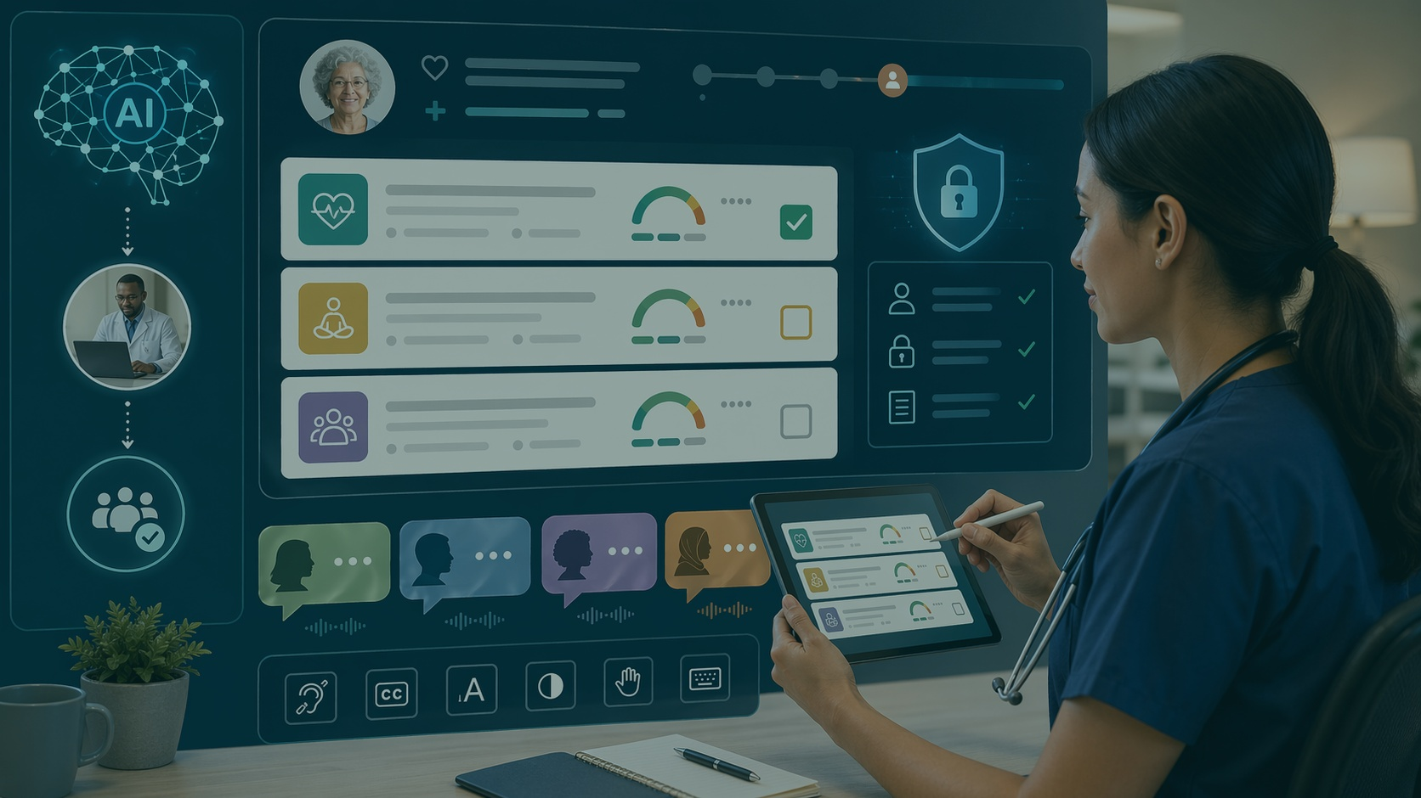
Responsible AI is a product feature
Handoff NYC is designed for public-interest technology: equity, transparency, accessibility, and human oversight.
Privacy first
Use only synthetic demo documents
Human review
Low-confidence items are flagged
Transparency
Show what came from the document
Accessibility
Translation, audio, simple UI
Not a doctor. Not a diagnosis. A safer way to understand the instructions already given.
AI Innovation Challenge • 7

Slide 8
Handoff NYC
Technical architecture for a 2-day build
Keep the stack lean; cache a successful demo output as backup.
React / Next.js
Frontend
API Routes
Backend
AI Model
Extraction + Translate
TTS
Audio Briefing
CarePlan
JSON Schema
Storage
Mongo/Supabase/JSON
Recommended demo stack: Next.js + API routes + Gemini/OpenAI + ElevenLabs/browser TTS + simple storage.
AI Innovation Challenge • 8

Slide 9
Handoff NYC
Three-person execution plan
Clear ownership keeps the scope realistic and deliverables on time.
PSS
RH
IP
Pirtom Shil Supta
Rahat Hossain
Israel Pina
UI Designer
Backend Developer
Frontend Designer
Visual system, dashboard layout, safety states, slides, website visuals
AI extraction, JSON schema, translation, audio API, GitHub README
Upload flow, care plan dashboard, language switcher, audio playback
Unknown fields: EMPLIDs and campus details can stay TBD until the final team form is completed.
AI Innovation Challenge • 9

Slide 10
Handoff NYC
Hackathon deliverables map
Build the product and the submission package in parallel.
Fri AM
Fri PM
Fri Night
Sat AM
Sat PM
Finalize MVP
Create repo + doc
Upload + extraction
Submit started links
Translation + UI polish
Demo data
Audio + safety flags
Bug fixes
Record video
Submit by 5 PM
Submission package: Product Design Doc • Website • Google Slides • GitHub • <5 minute video • BeMyApp signoff
AI Innovation Challenge • 10

Slide 11
How we prove impact
Judges need to see both technical success and public-good value.
Extraction
accuracy
Time
saved
Language
access
Safety
coverage
Compare AI output to expected sample answer
Upload-to-care-plan in under 2 minutes
Support 2–3 languages in demo
Low-confidence fields are flagged
Social impact goal: help caregivers understand what to do, what to watch for, and what to verify.
AI Innovation Challenge • 11

Slide 12
Handoff NYC
Turning confusing medical paperwork into care that families can understand.
AI for Health & Public Good • Software Track
Pirtom Shil Supta • Rahat Hossain • Israel Pina

