Slide 1
Ahamed Thanveer Nishad
Final Project
3/21/2024 Annual Review

Slide 2
PROJECT TITLE
Quantum steganography
3/21/2024 Annual Review

Slide 3


AGENDA
1.Introduction to Steganography: Concealing messages within innocuous carriers for covert communication. 2.Basics of Quantum Computing: Understanding quantum mechanics and computation principles. 3. Quantum Steganography Fundamentals: Leveraging quantum principles for secure information concealment. 4.Techniques and Algorithms: Exploring methods like quantum watermarking for data security. 5.Summary and Conclusion: Recap of key insights and implications of quantum steganography for future information security.
3/21/2024 Annual Review

Slide 4

PROBLEM STATEMENT
To create a quantum steganography system that hides secret information within quantum states
3/21/2024 Annual Review

Slide 5

PROJECT OVERVIEW
The aim of this project is to develop a quantum steganography protocol using plaintext as seemingly innocent cover data. This cover data is encoded into a quantum circuit using the Breinstein Vazirani Algorithm. The stego data is then created by embedding a secret message into the cover data. For encoding and decoding, a symmetric encryption method is employed, utilizing XOR operation (which can be substituted with more complex hash functions if needed). To secure the communication channel, the BB84 protocol is implemented, preventing attackers from decoding the hidden message without the key.
3/21/2024 Annual Review

Slide 6

WHO ARE THE END USERS?
The end users of this quantum steganography system could be individuals or organizations seeking secure communication channels for transmitting sensitive information without detection by unauthorized parties
1. Government agencies involved in classified communications and intelligence gathering. 2. Military organizations requiring secure transmission of sensitive tactical information. 3. Financial institutions needing to safeguard financial transactions and customer data. 4. Research facilities conducting sensitive experiments and sharing confidential findings. 5. Law enforcement agencies engaged in undercover operations and surveillance activities.
3/21/2024 Annual Review

Slide 7

YOUR SOLUTION AND ITS VALUE PROPOSITION
Our quantum steganography protocol securely hides confidential information within quantum states using plaintext as cover data. It employs the Breinstein Vazirani Algorithm for encoding and XOR encryption for added security, while the BB84 protocol safeguards communication channels. Value Proposition: 1. Unmatched Security: Quantum mechanics ensure unparalleled data protection against decryption attempts. 2. Data Integrity: Secret messages are embedded without altering the cover data’s appearance or content. 3. Covert Communication: Enables discreet transmission of sensitive information. 4. Customizable Security: Adaptable encryption methods meet diverse security needs. 5. Wide Applicability: Suitable for government, military, finance, research, and law enforcement sectors requiring secure communications.
3/21/2024 Annual Review

Slide 8

THE WOW IN YOUR SOLUTION
Unprecedented Security: Quantum mechanics provide unmatched data protection against decryption attempts
Seamless Integration: Embed secret messages into cover data without altering its appearance.
Covert Communication Mastery: Ensure discreet transmission of sensitive information
Customizable Fortification: Adapt encryption methods to meet specific security needs
Universal Utility: Suitable for diverse industries requiring secure communication, setting a new standard for data confidentiality.
3/21/2024 Annual Review

Slide 9
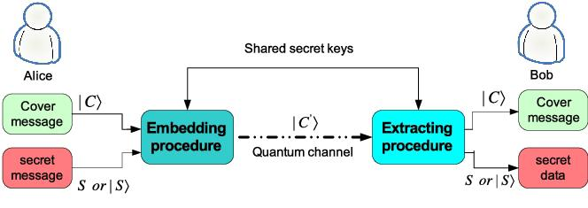
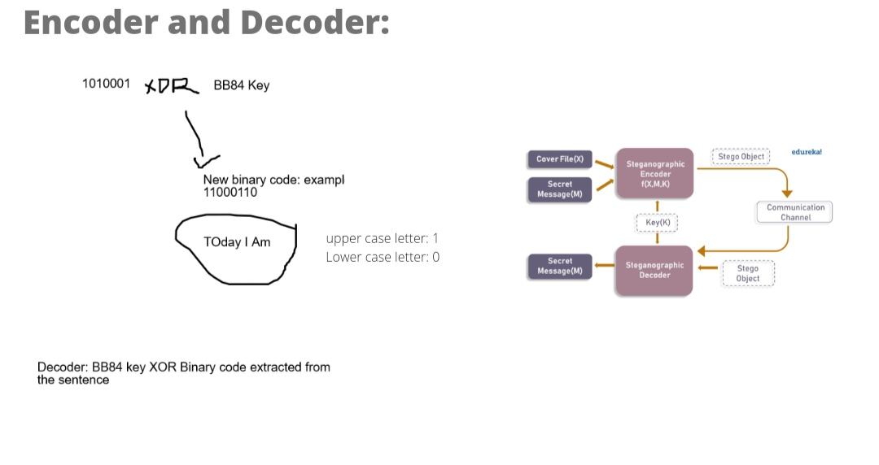
MODELLING
3/21/2024 Annual Review

Slide 10
RESULTS
In conclusion, our quantum steganography protocol stands as a cutting-edge solution for secure communication. By harnessing the power of quantum mechanics, we’ve crafted a method that shields your data from prying eyes with an invisible cloak of encryption. With this sophisticated tool at your disposal, you can transmit sensitive information covertly, safeguarding it from unauthorized access. As we continue to refine and innovate, we’re paving the way for a future where data security is stronger and more resilient than ever before.
Demo Link
3/21/2024 Annual Review

