Slide 1
Practical Session 1

Slide 2




Compartmental model building - SEIR
Write down the model diagram and accompanying ODE system for an SEIR model. Use whatever letters you wish to designate the parameters. Ignore disease induced mortality for now.
S
λ
E
γ
I
τ
R
$$\frac{dS}{dt}=−λS$$
$$\frac{dE}{dt}=λS−γE$$
$$\frac{dI}{dt}=γE −\text{t}\text{I}$$
$$\frac{dR}{dt}=\text{t}\text{I}$$

Slide 3




Compartmental model building - SEIRS
Write down the model diagram and accompanying ODE system for an SEIRS model. Use whatever letters you wish to designate the parameters. Ignore disease induced mortality for now.
S
λ
E
γ
I
τ
R
α
$$\frac{dS}{dt}=−λS+αR$$
$$\frac{dE}{dt}=λS−γE$$
$$\frac{dI}{dt}=γE −\text{t}\text{I}$$
$$\frac{dR}{dt}=\text{t}\text{I}−α\text{R}$$

Slide 4
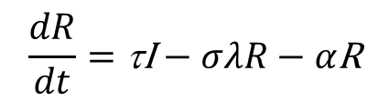
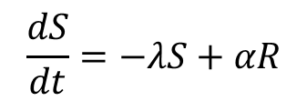

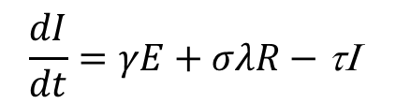
Compartmental model building - SEIR^{I}S
Now consider that after an initial infection, individual recover with only partial immunity, i.e., recovered individuals can be infected again at a lower rate compared to fully susceptible individuals. How would you include that in the model? Draw the diagram and write down the equations.
S
λ
E
γ
I
τ
R
σλ
α
$$\frac{dS}{dt}=−λS+αR$$
$$\frac{dE}{dt}=λS−γE$$
$$\frac{dI}{dt}=γE+σλR−\text{t}\text{I}$$
$$\frac{dR}{dt}=\text{t}\text{I}−σλR−α\text{R}$$

Slide 5
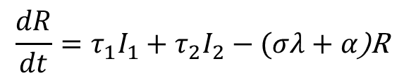
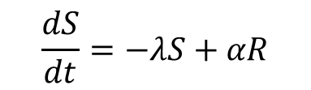
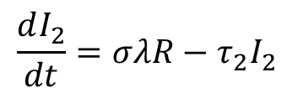
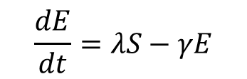

Compartmental model building - SEIR^{I}S
What if partial immunity implies that a second infection will be shorter than the first? How would you include that in the model? Draw the diagram and write down the equations.
γ
σλ
S
λ
E
I₁
τ₁
R
I₂
τ₂
α
$$\frac{dS}{dt}=−λS+αR$$
$$\frac{dE}{dt}=λS−γE$$
$$\frac{dI_{1}}{dt}=γE−τ_{1}I_{1}$$
$$\frac{dR}{dt}=τ_{1}I_{1}+τ_{2}I_{2}−(σλ+α\text{)}\text{R}$$
$$\frac{dI_{2}}{dt}=σλR−τ_{2}I_{2}$$

Slide 6

Let’s see how the dynamics change with key parameter changes
https://www.epidemix.app/

Slide 7
Run the SIR model with parameters
N = 1000
I(t=0) = 1
Beta= 0.4
Recovery from infection = 5 days
Timeline = 365 days
Download the csv files and plot them in R.

Slide 8
Import the csv files
Epidemix_import.R
This is the working directory we will be working from all week. Please store ALL files from canvas on this folder
setwd('C:/mgh - mmid’)
app<-read.csv('SIR.csv', header = T)
app
This is how you import a csv file onto R, preserving the column names (header row).
Make a (S,I) phase plot
Note that plotting a matrix or dataframe produces multiple plots simultaneously
plot(app$S, app$Is)
plot(app)
plot(app[,c(2,5,6)])
You can select which columns to look at

Slide 9

Coding mathematical models – SIR
Let’s use a similar coding template to the one you’ve seen during the R programming module. Remember this?
Step 1 - Let’s translate these differential equations into an R function.
Step 2 - Define the initial conditions of the system.
Step 3 - Assign baseline values to the parameters.
Step 4 - Define the simulation timeline.
Step 5 - Solve the model (integrate the differential equations) with the ode function from the deSolve package.

Slide 10
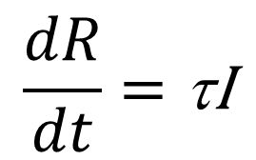
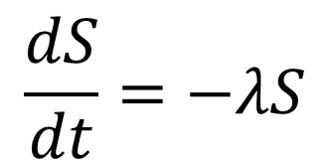
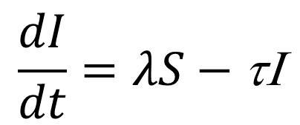
Step 1 - Let’s translate these differential equations into an R function (starting with SIR).
Epidemix_import.R
$$\frac{dS}{dt}=−λS$$
$$\frac{dI}{dt}=λS−\text{t}\text{I}$$
$$\frac{dR}{dt}=\text{t}\text{I}$$
SIR_model<-function(t, state, parameters) {
with(as.list(c(state, parameters)),{
P <- (S+I+R)
lam<-parameters['beta’]*I/P
dS <- mu*P-mu*S-lam*S
dI <- lam*S-tau*I-mu*I
dR <- tau*I-mu*R
list(c(dS, dI, dR))})
}
Note the function arguments
Using the with function allows you to use the names of variables and parameters directly
Always make sure that P is the sum of all model variables
Make sure you have the right force of infection
List the output variables at the end

Slide 11
Step 2 - Define the initial conditions of the system.
Epidemix_import.R
initP<-99
initI<-1
initR<-0
initS<-initP-initI-initR
istate <- c(S = initS, I = initI, R = initR)
You need at least one infected individual to seed infection
istate is the list of initial conditions for the ODE system
Step 3 - Assign baseline values to the parameters.
parameters <- c(
mu=(1/(50*52*7)),
beta=0.4,
tau=1/10
)
Be mindful of the time scale. All parameters need to be in the same time units.

Slide 12
Step 4 - Define the simulation timeline.
Epidemix_import.R
time_start <- 0
time_stop <- 365
deltat<- 0.1
tps <- seq(time_start , time_stop , by = deltat)
deltat determines the integration step for the numerical solver
Step 5 - Solve the model (integrate the differential equations) with the ode function from the deSolve package.
out <- deSolve::ode(y = istate, times = tps, func = SEIR_model, parms = parameters)
Explore the options available in the ode function

Slide 13
Plot the SIR model results and compare them to app’s results
Epidemix_import.R
out2 <- deSolve::ode(y = istate, times = app$X, func = SIR_model, parms = parameters)
plot(out2[,1],out2[,3])
lines(app$X,app$Is, col="red")
For the comparison to be valid, we will use the app’s timeframe (app$X). We then overlay two solutions on top of each other.
Let’s adapt the SIR code and incorporate loss of immunity.
SIRS_model<-function(t, state, parameters) {
with(as.list(c(state, parameters)),{
P <- (S+I+R)
lam<-parameters['beta’]*I/P
dS <- mu*P-mu*S-lam*S+alpha*R
dI <- lam*S-tau*I-mu*I
dR <- tau*I-mu*R-alpha*R
list(c(dS, dI, dR))})
}
We don’t need additional variables.
We just have to add a rate from R to S.

Slide 14
What parameters would you need to change to get more frequent epidemic peaks? Would increasing the transmission rate do it?
Epidemix_import.R
Add alpha to the list of parameters and give it a value
parameters['alpha']<-1/150
out <- deSolve::ode(y = istate, times = tps, func = SIRS_model, parms = parameters)
plot(out[,1],out[,3])
parameters['beta']<-parameters['beta']*5
out_high_beta <- deSolve::ode(y = istate, times = tps, func = SIRS_model, parms = parameters)
lines(out_high_beta[,1],out_high_beta[,3],col="red")
parameters['beta']<-parameters['beta']/10
out_low_beta <- deSolve::ode(y = istate, times = tps, func = SIRS_model, parms = parameters)
lines(out_low_beta[,1],out_low_beta[,3],col="blue")
parameters['beta']<-0.4
parameters['alpha']<-parameters['alpha']*5
out_high_alpha <- deSolve::ode(y = istate, times = tps, func = SIRS_model, parms = parameters)
lines(out_high_alpha[,1],out_high_alpha[,3],col="magenta")
parameters['alpha']<-parameters['alpha']/10
out_low_alpha <- deSolve::ode(y = istate, times = tps, func = SIRS_model, parms = parameters)
lines(out_low_alpha[,1],out_low_alpha[,3],col="green3")
Change beta and re-run the model
Change beta and re-run the model
Reset beta and change alpha
Change alpha again

Slide 15
Compare the HITs for the SIR and SIRS models. Which is largest? Why?
Epidemix_import.R
Change alpha back to default value
parameters['alpha']<-1/150
out_sir <- deSolve::ode(y = istate, times = tps, func = SIR_model, parms = parameters)
out_sirs <- deSolve::ode(y = istate, times = tps, func = SIRS_model, parms = parameters)
plot(out_sir[,2],out_sir[,3])
lines(out_sirs[,2],out_sirs[,3],col="red")
lines(rep(2500,4000),1:4000)
parameters['alpha']<-1/50
out_sirs2 <- deSolve::ode(y = istate, times = tps, func = SIRS_model, parms = parameters)
lines(out_sirs2[,2],out_sirs2[,3],col="green3")
Add vertical line with expected HIT
Does loss of immunity impact HIT at all?

Slide 16
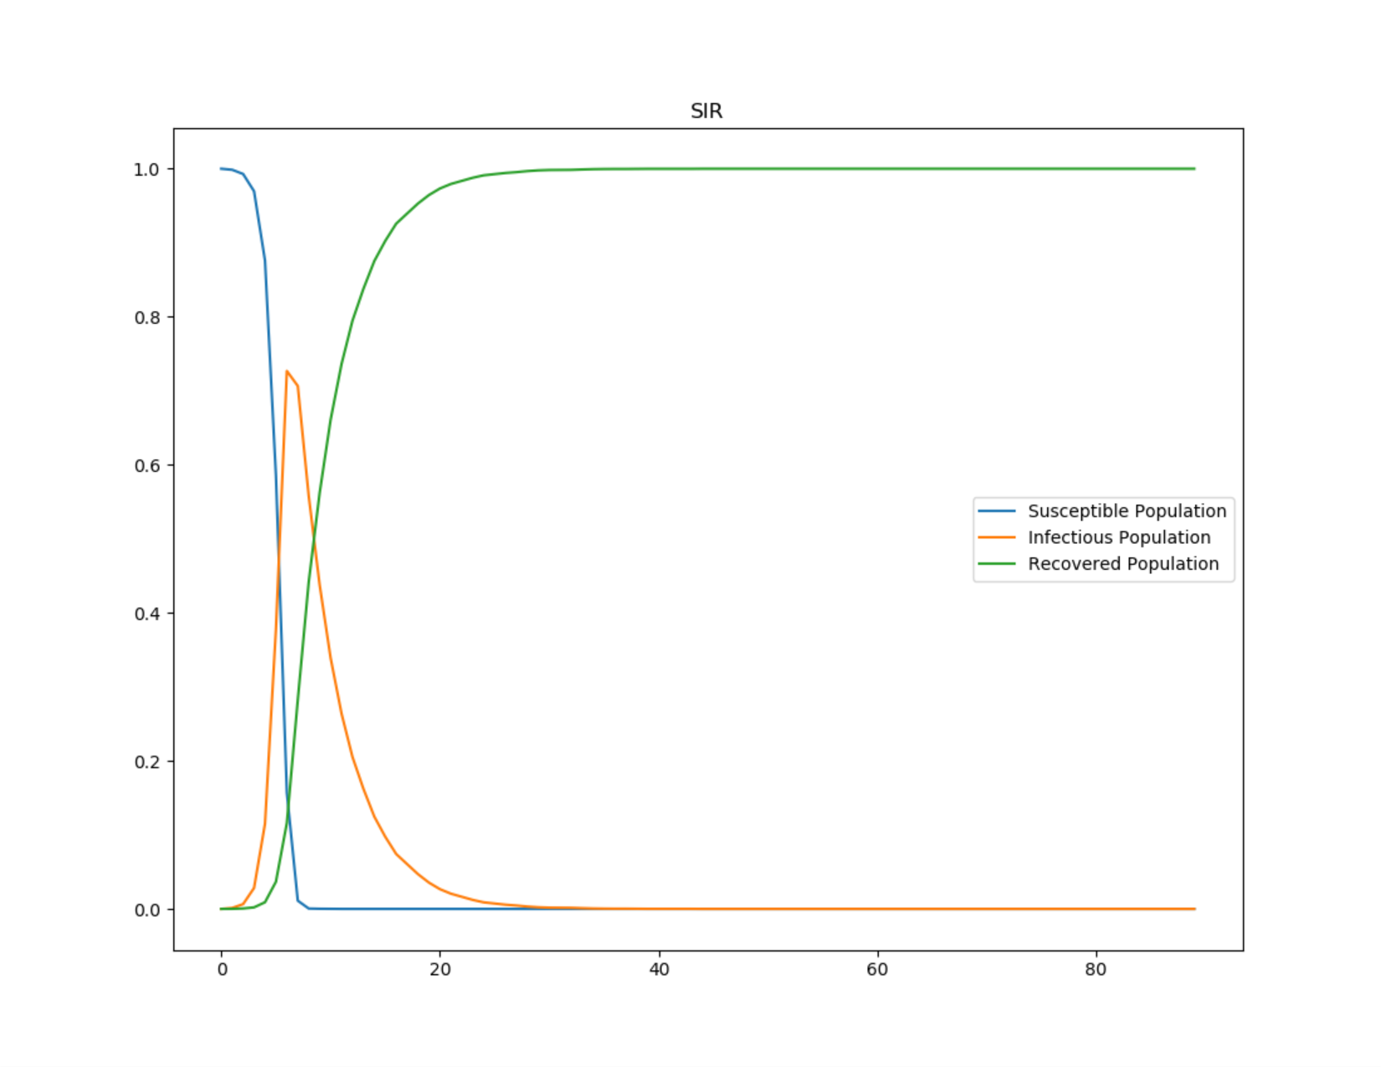
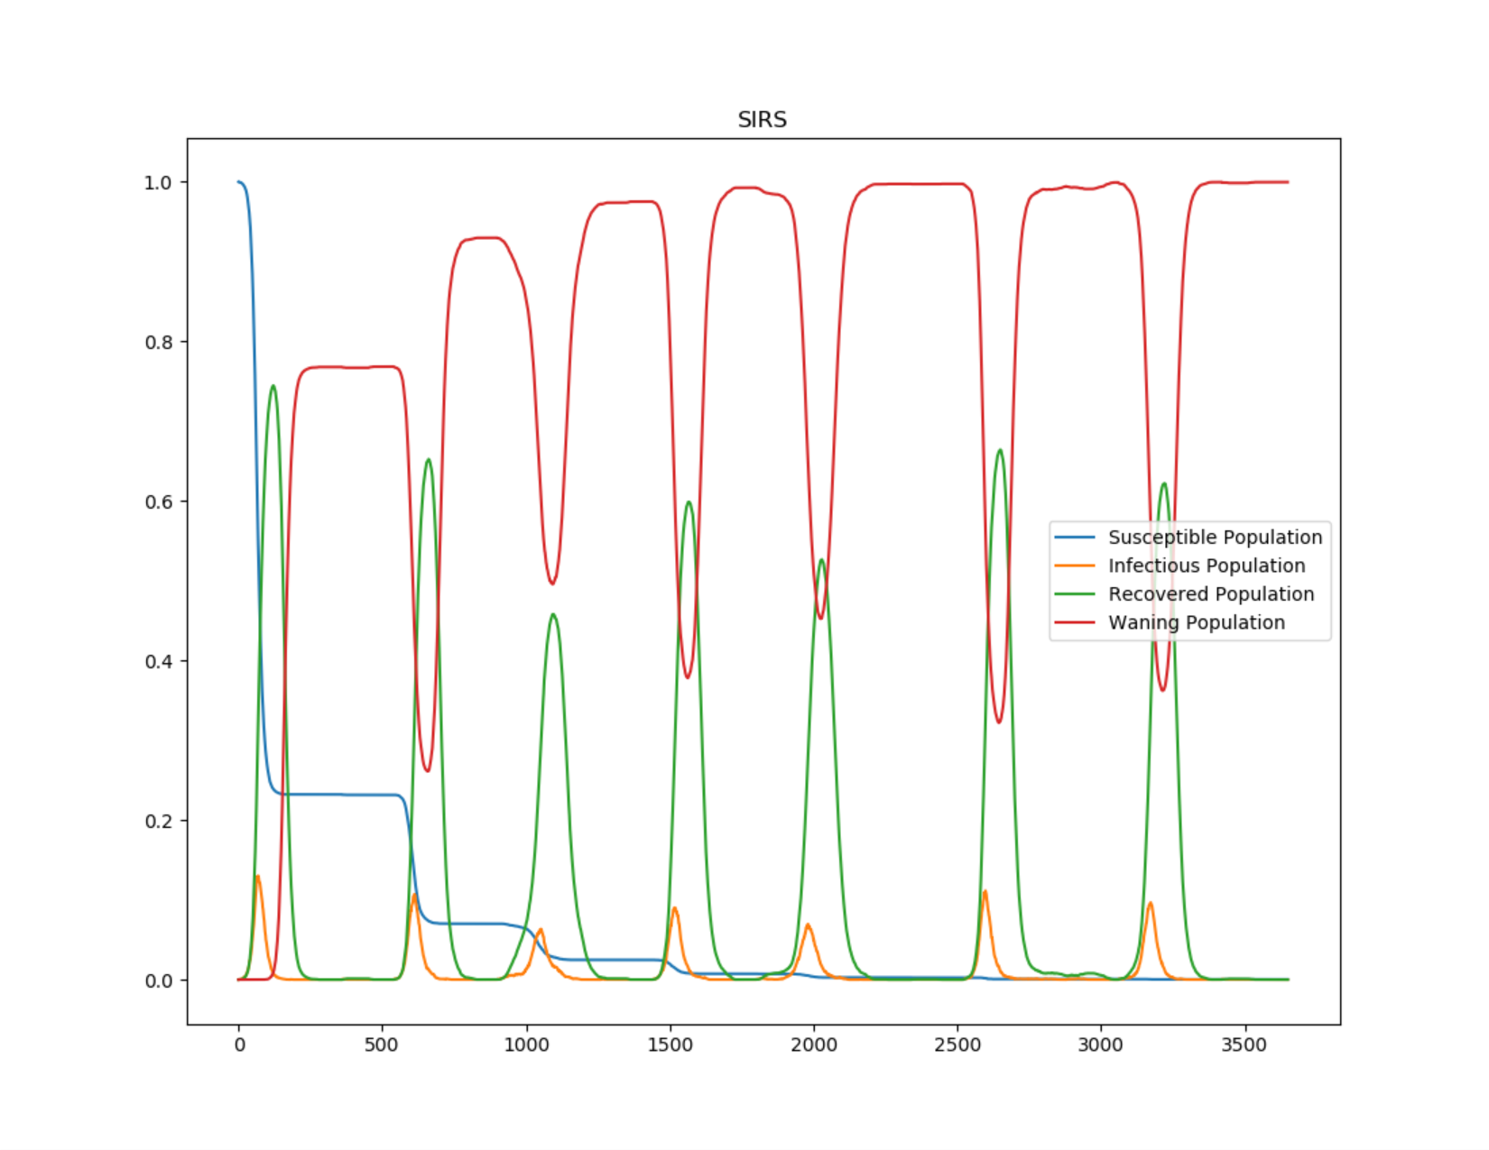
Epidemic vs Endemic
The long term dynamics of a system are determined by how susceptibility to infection is implemented (pathogen dependent)
Equilibrium reached
Equilibrium?
© Copyright 2019, Intellectual Ventures Management, LLC (IVM). All rights reserved.

Slide 17
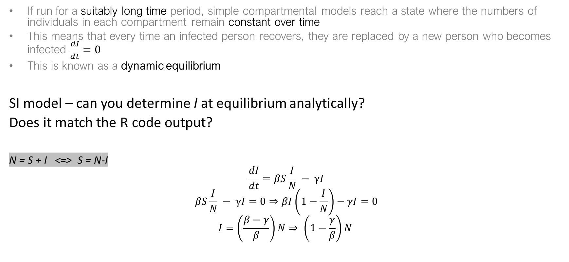
Equilibria
If run for a suitably long time period, simple compartmental models reach a state where the numbers of individuals in each compartment remain constant over time
This means that every time an infected person recovers, they are replaced by a new person who becomes infected $\frac{dI}{dt}=0$
This is known as a dynamic equilibrium
SI model – can you determine I at equilibrium analytically?
Does it match the R code output?
N = S + I <=> S = N-I
$$\frac{dI}{dt}=βS\frac{I}{N} − γI$$
$$βS\frac{I}{N} − γI=0⇒βI\left(1−\frac{I}{N}\right)−γI=0$$
$$I=\left(\frac{β−γ}{β}\right)N⇒ \left(1−\frac{γ}{β}\right)N$$

Slide 18
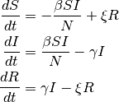
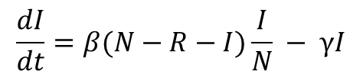
Equilibria
SIRS model
N = S + I + R
Not solvable
$$\frac{dI}{dt}=β(N−R−I)\frac{I}{N} − γI$$

