Slide 1

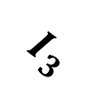



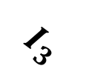
$$I_{3}$$
Low Rank Factors
r
r
+
…
$$I_{1}$$
+
$$I_{2}$$
r
$$I_{3}$$
Rank 1
Tensor
Rank 1
Tensor
…
Rank 1
Tensor
≈
+
+
$$I_{1}$$
$$I_{2}$$
Sum of ‘r’ Rank-1 Tensors

