Slide 1











$$I_{1}I_{2}$$
$$R_{}$$
$$R_{}$$
$$I_{3}I_{4}I_{5}$$
$$I_{3}I_{4}I_{5}$$
$$I_{1}I_{2}$$
$$X_{(1:2)}^{T}$$
$$∙$$
$$K_{1:2}$$
$$=$$
$$T_{(1:3)}$$

Slide 2



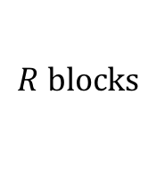






$$R blocks$$
$$R$$
$$R$$
$$I_{3}$$
$$I_{3}$$
$$I_{4}^{}I_{5}^{}$$
$$I_{4}^{}I_{5}^{}$$
$$T_{(1)}[r]$$
$$∙$$
$$K_{4:5}(:,r)$$
$$=$$
$$M^{\left(3\right)}(:,r)$$

