Slide 1
IMU

Slide 2
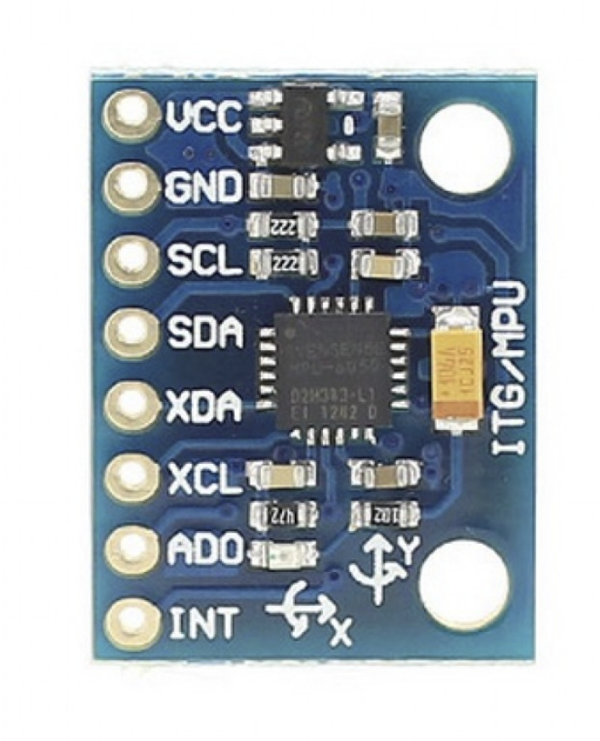
IMU-theory
Temperature Sensor
Gyroscope
Accelerometer
Digital Motion Processor(DMP)

Slide 3
IMU-theory
Temperature Sensor
Gyroscope:
Use gravity to determine how many degree it change per seconds.
Accelerometer
Digital Motion Processor(DMP)

Slide 4
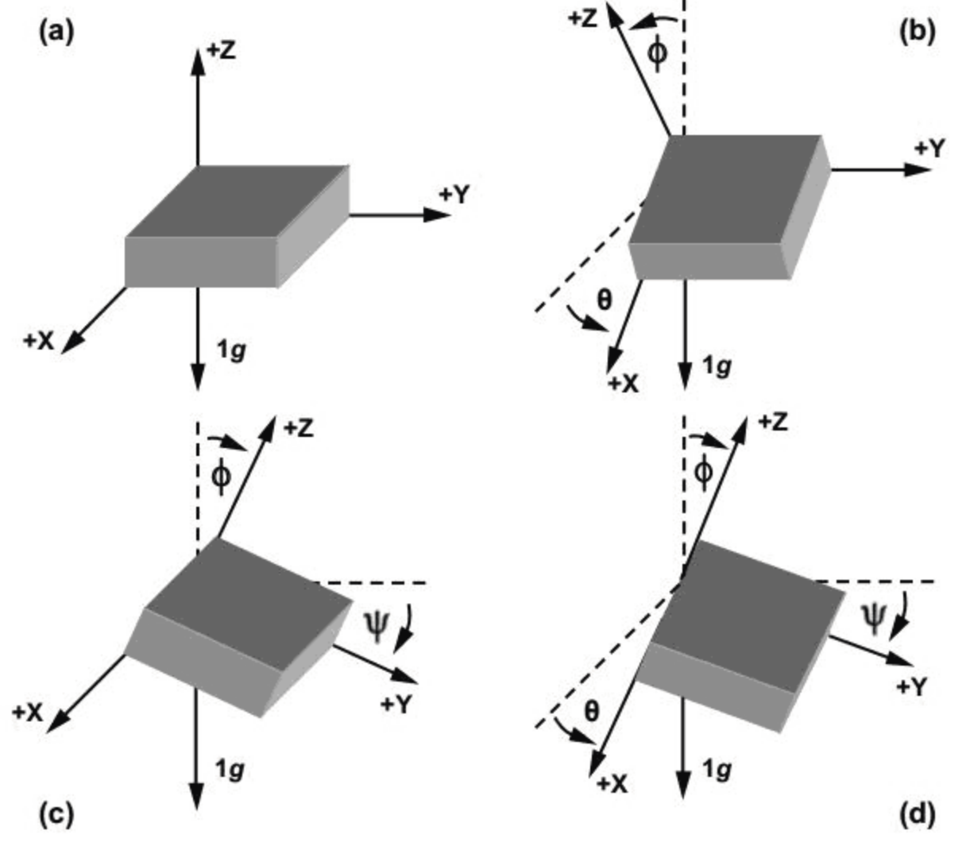
IMU-theory
Temperature Sensor
Gyroscope
Accelerometer:
It used to detect angle of tilt or inclination along the X, Y and Z axes
This displacement of moving plate (mass) unbalances the differential capacitor which results in sensor output. Output amplitude is proportional to acceleration.
Digital Motion Processor(DMP)

Slide 5
IMU-theory
Temperature Sensor
Gyroscope
Accelerometer
Digital Motion Processor(DMP):
used to compute motion processing algorithms.
It takes data from gyroscope, accelerometer and additional 3rd party sensor such as magnetometer and processes the data

Slide 6
IMU-pinout
Power
Ground
Serial Clock Line
Serial Data Line
Auxiliary Data
Auxiliary Clock
Switch I2C Address
Interrupt Pin
I2C
I2C
If you want to add second imu

Slide 7
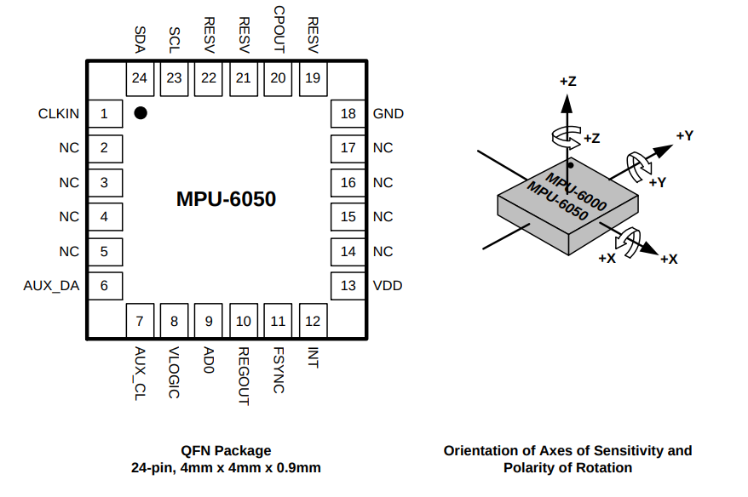
IMU-how to check X,Y,Z Axes

Slide 8
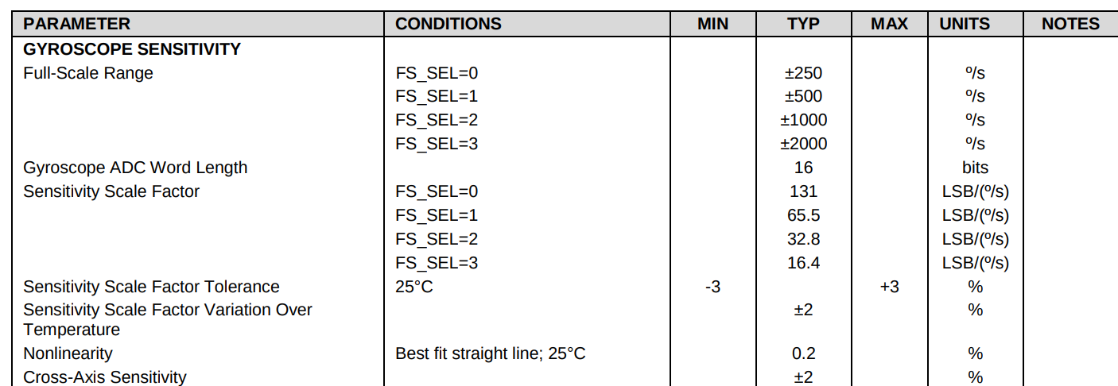
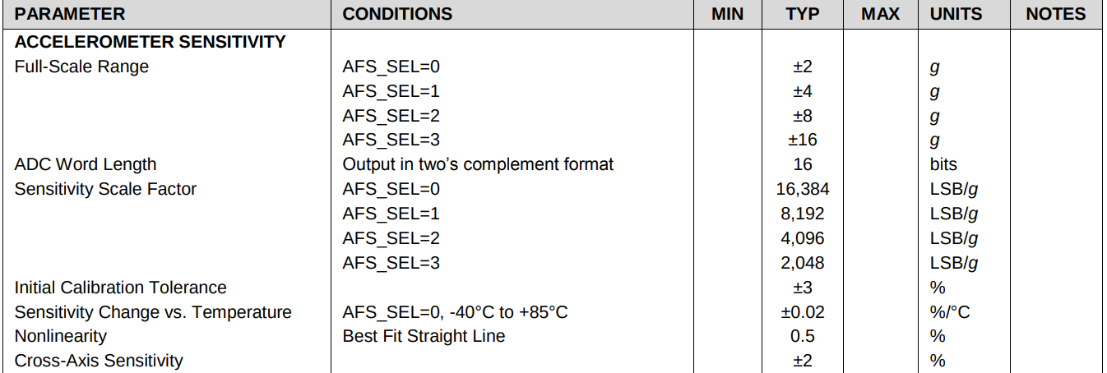
IMU-How to Calculate Gyro and Accelerometer

Slide 9
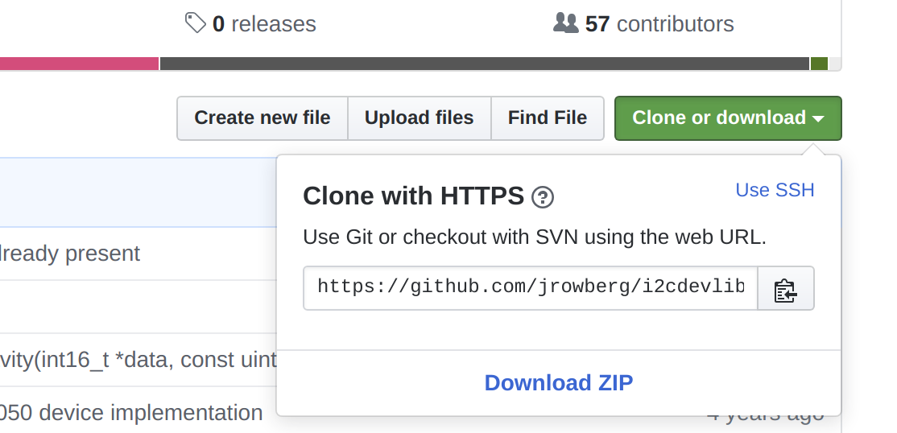
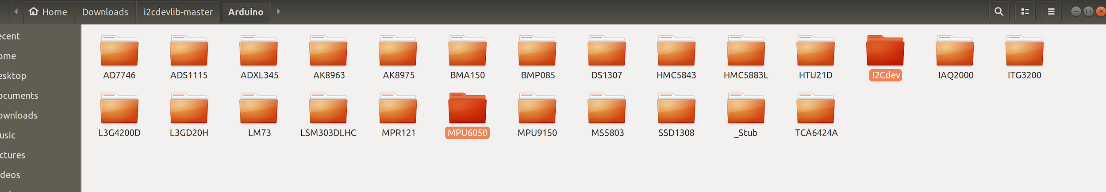
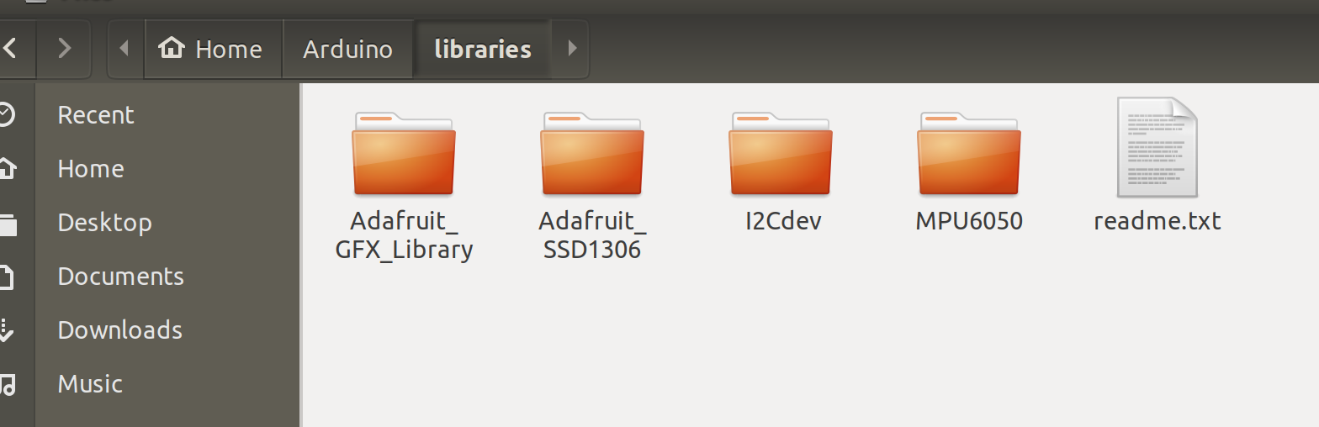
IMU-Setup
Library: https://github.com/jrowberg/i2cdevlib
Then you can find example code under “Arduino Program” -> “file” -> “Examples” -> “MPU6050” -> “MPU6050_DMP6”
Copy and past those two folders into Arduino libraries folder

